Slide 1

Neural Networks as Prediction Models
for Mutational Subtypes
Group Member: Shimin Bi, Chen Shi, Lauren Yoo, Chi Zhang, Melissa Zhao

Slide 2
CONTENTS
Motivation & Objectives
Dataset description & Preprocessing
Models
Conclusion

Slide 3
1
Motivation
&
Objection

Slide 4



Motivation
01
02
03
Personalized medicine in cancer is becoming more of a reality in recent years due to the development of targeted therapy, immunotherapy, and diagnostic pipelines that focus on a patient’s specific set of mutations prior to treatment.
With the development of personalized medicine comes the need to create reliable models that can automate the process of detecting the type of mutations involved (given a set of genes), and their potential targets.
The understanding of mutational subtypes is crucial to the detection of driver genes and successful treatment of individual cancer subtypes.

Slide 5





Objectives
01
classify genetic mutations provided by pre-existing literature
02
use machine learning algorithms to handle enormous genetic mutation data
03
building predictive models using different neural networks
04
classify mutations into subtypes relevant to their mechanisms

Slide 6
2
Dataset
description & Preprocessing

Slide 7
Dataset Description
D
nine different classes that a genetic mutation can be classified into
provide the information regarding specific genetic mutations and their respective clinical evidence used to classify them
A
Training dataset: 3054 documents ‘training_variants’ dataset: ID, Gene (where genetic mutation is located), Variation (the amino acid change for this mutations), and Class (1-9)
‘training_text’ dataset: include the text diagnosis for each ID
T
A
Validation dataset: 769 documents
Same as above

Slide 8
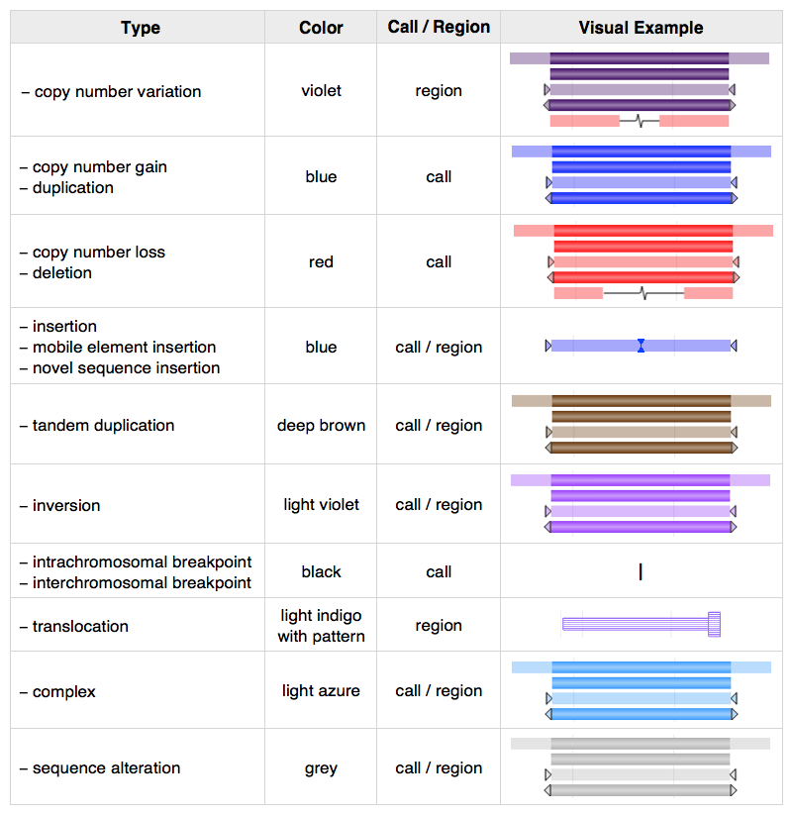
Dataset Description
9 possible mutational classes to predict
Different mutational subtypes may have different biological consequences
Driver mutations: push cells towards cancer
Passenger mutations: by-products of cancer cell development
Notes:
Now we have 9 possible mutational subtypes for cancer to predict, 9 classes can be associated with their likelihood of being driver or passenger mutations

Slide 9
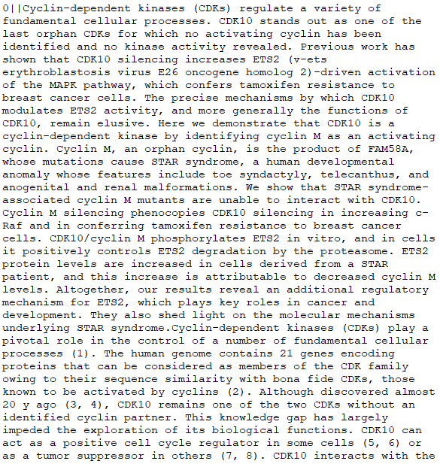
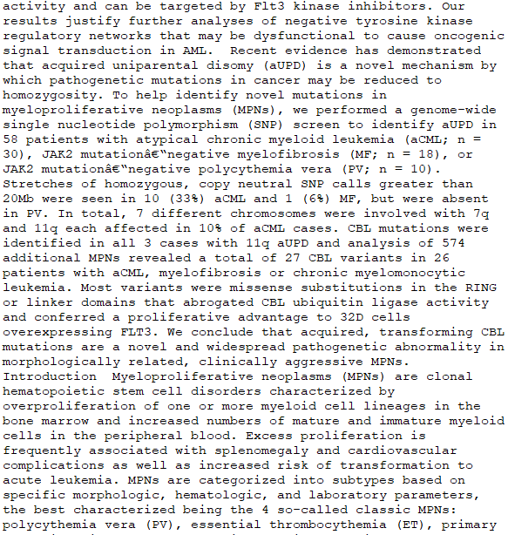
Dataset Description
Notes:
Here is our text data with a long description for each mutation.

Slide 10
Dataset Description
What makes this problem difficult is that the sequences can vary in length, be comprised of a very large vocabulary of input symbols and may require the model to learn the long-term context or dependencies between symbols in the input sequence.
Notes:
what makes this problem difficult is that the sequences can vary in length, contain a very large vocabulary of input symbols and may require the model to learn the long-term context or dependencies between symbols in the input sequence

Slide 11


Data Preprocessing
Word2Vec
Our Word2Vec
Word Embedding
Natural Language Processing model
2-layer neural network
Model similarity between words
Code words into vectors that ecode its context
Better predictions
Based on training set + unused data without outcome labels
333709 unique words, each with a vector of length 150 - pretrained weights
Extract the first 100 words from each document
Find index of each word within the similarity matrix and get its corresponding vector
Form input matrix and feed into network through an embedding layer.
Notes:
How we dealt with the text data preprocessing
Word2Vec model is a 2 layers neural layer to model the similarity between words. It has the advantage of coding words into vectors that encode its context.
To make our word2vec model. First, words in the text data are tokenized (as lists of a list), then are fed into word2vec, which translates the words into a similarity matrix encoding the unique word and its context. This created a matrix of 333709 words, each with a vector of length 150. This served as our dictionay containing info on pretrained weights.
Then we tokenized both the training dataset and validation set , extracted the first 100 words from each text data, find index of each word within our similarity matrix and get its corresponding vector. Finally, we formed our input matrix and ready to feed into the models as an embedding layer.

Slide 12
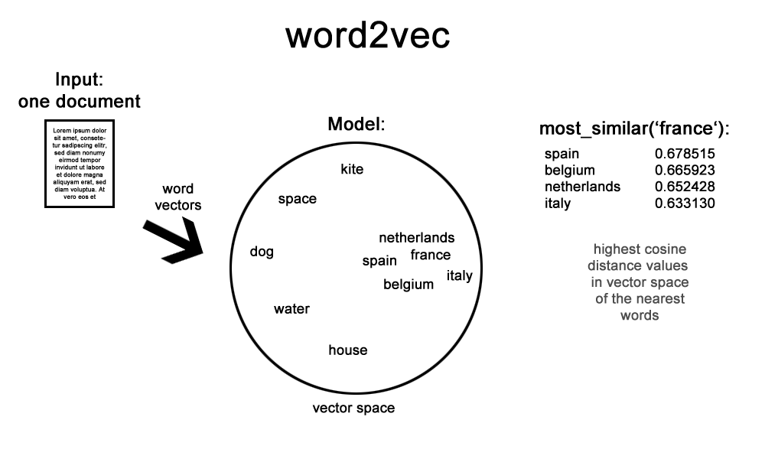
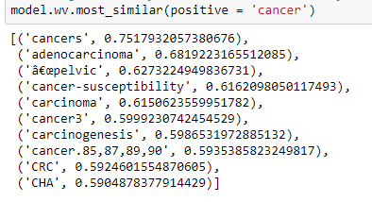
Data Preprocessing
Notes:
Brief illustration of how word2vec
Here is our text data, long description for each mutation。
We tokenize into word vectors and feed into word2vec，as we can see the words with similar meanings will be closer together, the cosine distance is used here. if we search the word ‘cancer’, we will have a list of the most relevant words with its corresponding similarity.

Slide 13
3
Models

Slide 14
Model Overview
Feedforward
01
LSTM & GRU
04
02
CNN
03
RNN

Slide 15
Findings
 | Feedforward | CNN | RNN | LSTM | GRU
Input Layer | Vectorized text data for 3045 genes, first 100 words
Hidden Layers | 2 Hidden layers, ReLu activation function, different units, different drop out layers
Validation Accuracy | 54.10% | 54.88% | 49.28% | 53.19% | 53.71%
Overfitting | High | Moderate | Moderate | Low | High
Notes:
Feedforward high 20% difference in validation accuracy
CNN 15% moderate
RNN 15% moderate
LSTM low
GRU high.more than 20%

Slide 16
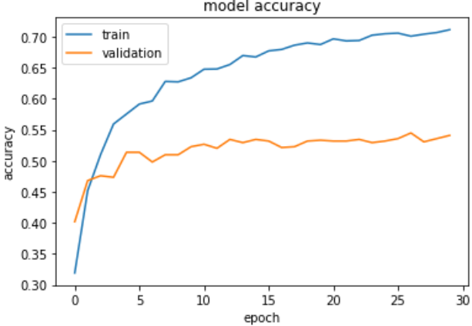
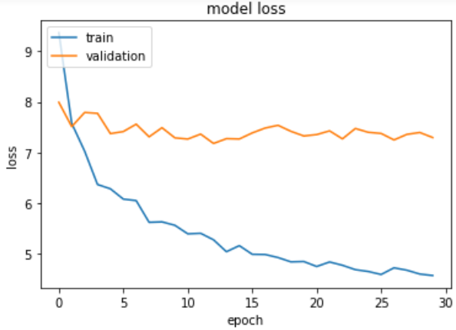
Feedforward
Description
Feedforward with 2 dense layers and 2 dropout layers
A straightforward way of modeling in neural network, computationally efficient
Parameter consideration
First 100 words of each document on gene variant, 3045 documents in total. Preprocessed with Word2Vec model.
100 dense nodes
With drop out rate of 0.5 to counter overfitting
64 dense nodes
With drop out rate of 0.2 to counter overfitting
9 classes, using softmax activation function
Accuracy/loss
Validation accuracy at epoch 30: 54.1%
Conclusion
Feedforward network shows signs of overfitting around epoch 4, despite the incorporation of dropout layers.
Accuracy stabilizes around epoch 10 for validation set. This suggests that more dropout layers may be needed, or the learning rate should be reduced.
Input data
1st Layer
2nd Layer
Output Layer

Slide 17
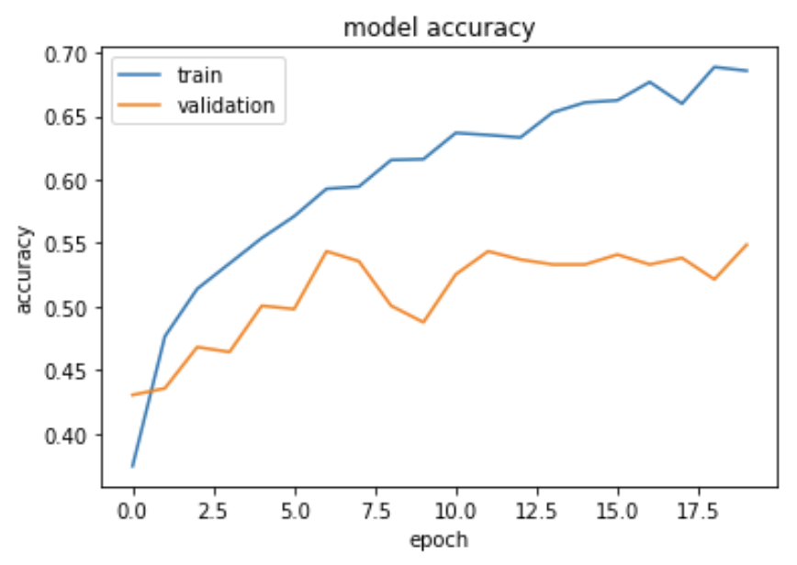
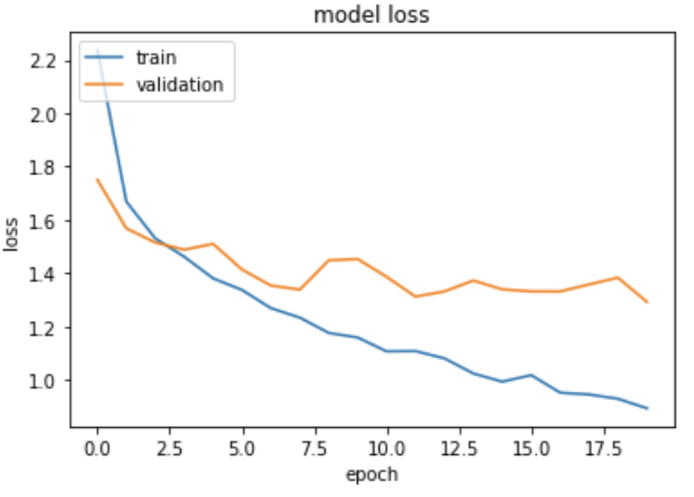
CNN
Description
One-dimensional Convolutional Neural Network
A fast, cheap alternative to recurrent network on text-data
Parameter consideration
3045 genes’ text descriptions, each limited to 100 words
32 filters of size 9x1
Applied max pooling with pool size 9
Added drop out rate of 0.5 due to overfitting
Flatten 2D data into 1D using GlobalMaxPooling
Added dropout rate of 0.2 due to overfitting
9 classes, using softmax activation function
Accuracy/loss
Validation accuracy at epoch=20: 54%
Conclusion
CNN reaches the near-optimum validation accuracy only with 7 epochs
CNN is faster, but not necessarily more reliable than other networks in text data
The accuracy is more ‘jumpy’ at each epoch
Input data
1st Layer
2nd Layer
Output Layer

Slide 18
RNN/LSTM/GRU
 | RNN | LSTM | GRU
Validation Accuracy | 49.28% | 53.19% | 53.71%
Input layer | -vectorized text data for 3045 genes descriptions -weighted by the embedding matrix (frozen) built on pretrained word2vec model
1st layer | SimpleRNN/LSTM/GRU output dimensionality = 100 , recurrent_dropout=0.2, drop_out=0.2
2nd layer | Dense layer with activation function = ‘relu’ | Dense layer with activation function = ‘relu’ Added drop out rate of 0.5 (overfitting) for LSTM | Dense layer with activation function = ‘relu’
Conclusion | RNN reaches the near-optimum validation accuracy with 25 epochs | LSTM reaches the near-optimum validation accuracy only with 10 epochs | GRU reaches the near-optimum validation accuracy only with 5 epochs
 | Work well for text data in our case, compared to baseline 1/9=11%

Slide 19
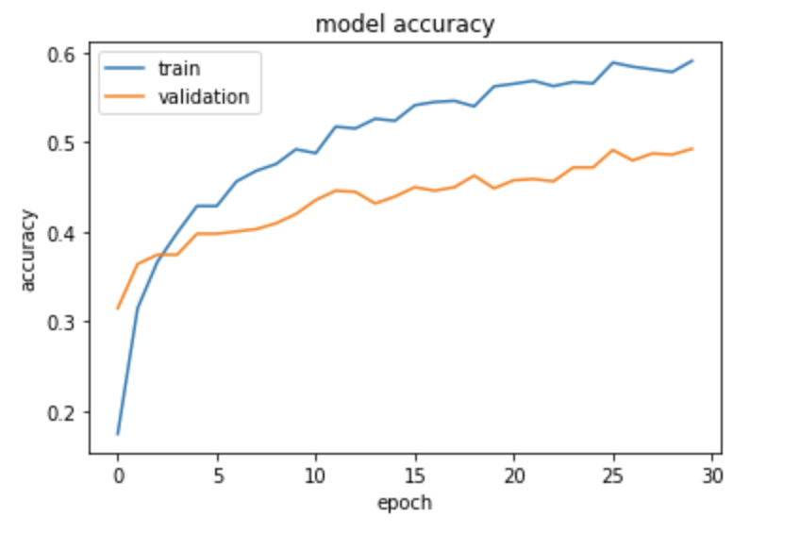
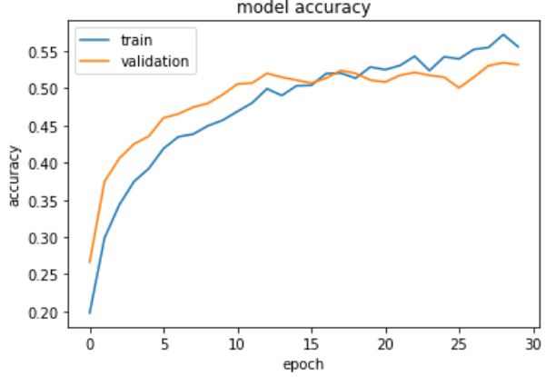
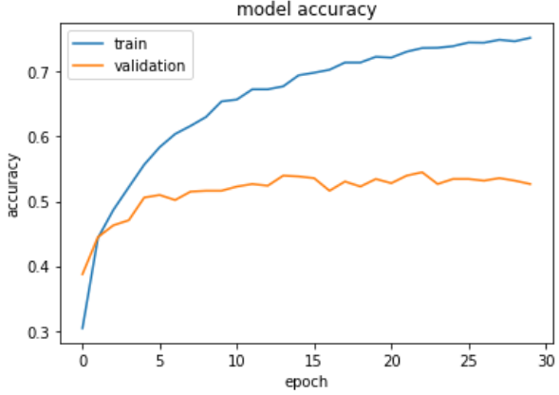
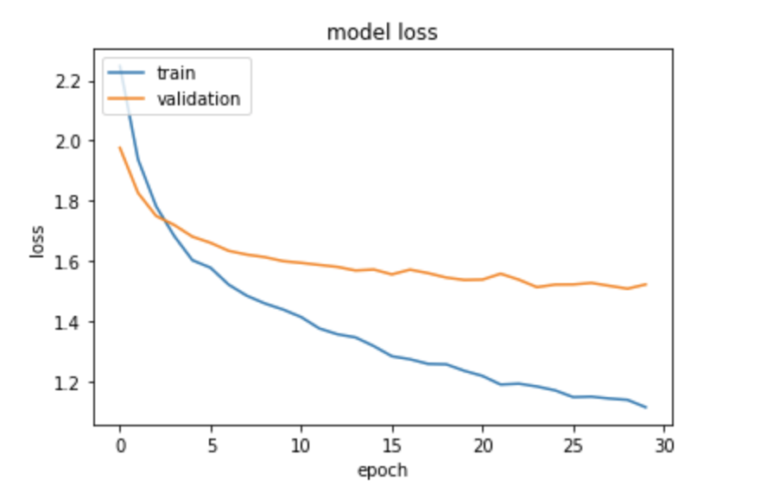
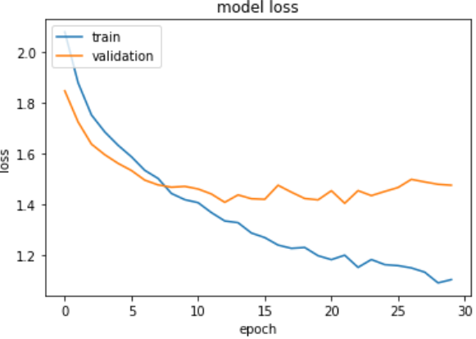
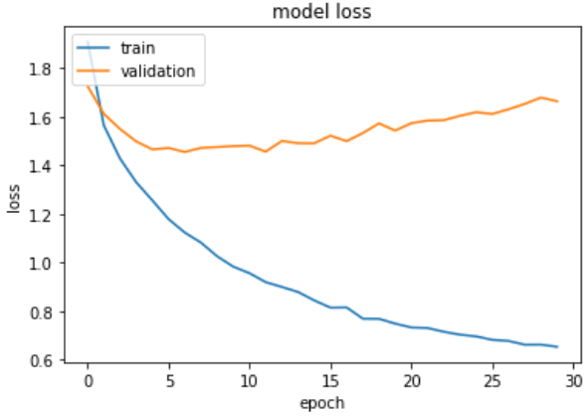
RNN/LSTM/GRU

Slide 20
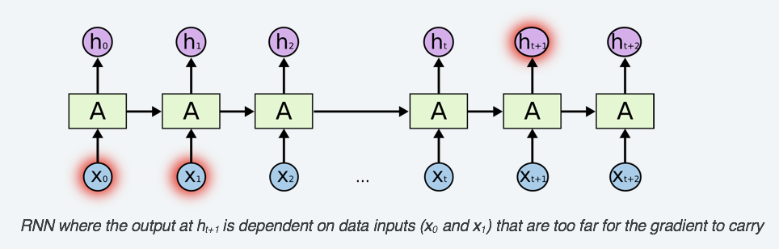
Comparison among RNN/LSTM/GRU
vanishing gradient problem occurs in simple RNN, lead to relatively bad performance. Thus, use LSTM and GRU
GRU: Combined the forget and input gates into an “update gate”, also merges cell state and hidden state
LSTM perform better on long sequences
GRUs are faster, easy to understand and modify

Slide 21
4
Conclusion

Slide 22
Conclusion
Model Chosen
CNN (accuracy=54.88%) or
LSTM (accuracy = 53.19%)
01
Model Improvement
Add more layers
Change to larger input length
Try more dropout for overfitting
02
Future Directions
we can build the model using average text length=9000
could combine CNN(speed) and RNN(time sensitivity) by using CNN to turn long sequences into shorter ones and then use RNN, maybe faster
ensembling: pool together the predictions of different good models to make a better prediction.
03

Slide 23
THANK YOU

