Slide 1

How Can Airbnb Hosts Improve their Profitability and Ratings ?
By – Jeffrey Mychalch, Luke Iorio, Prajakta Gaikwad

Slide 2
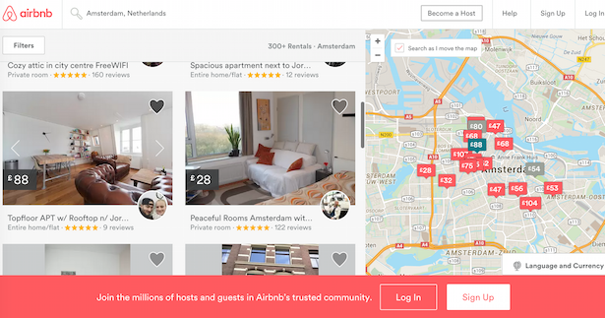
Founded in 2008, Airbnb is an American company that operates an accommodation marketplace, that allows people to list their available living spaces to be leased or rented by users looking for short-term lodging.
The company offers nearly 5 million lodging options across 81,000 cities in the world and is valued at $38 billion in 2018.
The sheer volume of listings offers hosts an opportunity in the massive global hospitality industry to earn great returns. There is growing number of people considering Airbnb investment for quick cash and high cash on cash return.
New management companies are also emerging to assist Airbnb hosts looking to improve their short-term rentals.

Slide 3
Data:
In this project, we have organized and analyzed a database of around 74,000 listings in 6 cities in the US; in an attempt to discover any trends on how host profits and user experiences vary across different aspects such as Location, Property Types and Amenities.

Slide 4
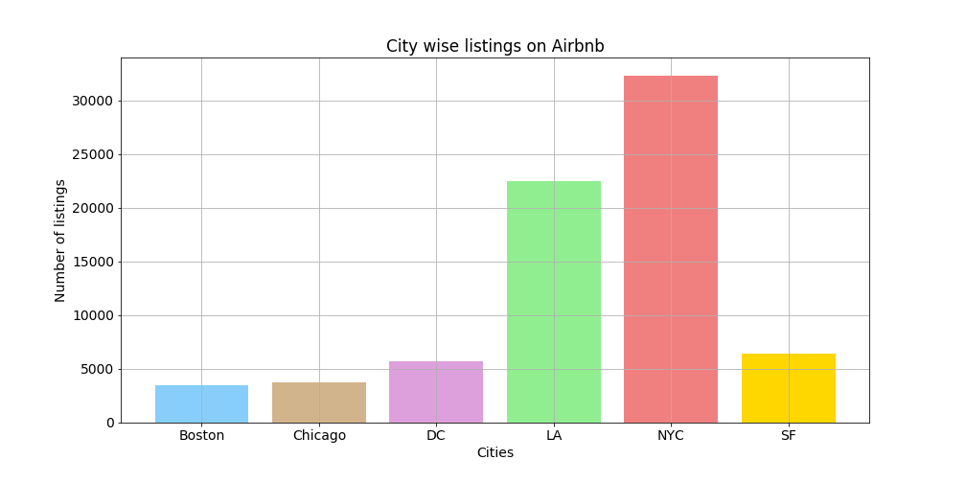
What cities have the most listings?

Slide 5
What city has the highest

Slide 6
Density of Airbnb listings is much higher in New York than it is in other cities.
With the highest number of listings and highest revenue generates (more than $ 80 Million) New York is clearly one of Airbnb’s important markets.
Airbnb hosts are more likely to make the most money in San Francisco. It has the highest average rate of around $160 per night, and average revenue generated per listing is also higher in San Francisco compared to other cities.
On an average all cities seem to have similar ratings. The location of the listing clearly has no impact on the ratings.

Slide 7
Limitations of the dataset
It is important to understand that the Airbnb rental supply isn’t static like hotel rooms, thousands of new Airbnb properties come online each day and thousands disappear only to reaper again months later. The fluidity of the short-term rental makes it incredibly complex to track. Hence, we had to make few assumptions while analyzing this data. We estimated a range of earnings based on the number of reviews on a listing and its nightly charge.
We assumed that each guest who stayed at the property also reviewed the property and stayed for one night. We also have considered only nightly rate and not cleaning fees or other additional charges

Slide 8
To get an idea of potential Airbnb earnings we looked at comparable listings in the market.

