Slide 1

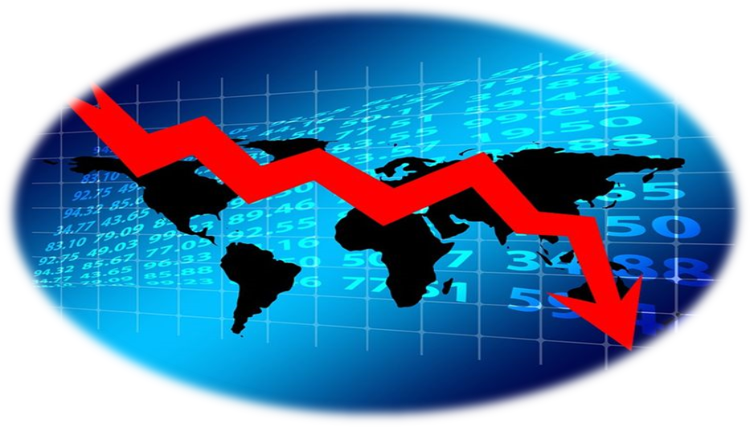
Global Interstate System

Slide 2
Global Interstate System
It is an institutional arrangement of governance that addresses regional or globalized issues that go beyond the scope of nation-state (Chase-Dunn, 1981).
Known also as a international system, and it is the main focus of the field of International Relations.
It is the whole system of human interactions. The modern world-system is structured politically as an interstate system – a system of competing and allying states.

Slide 3
Effects of Globalization on Government
Local and National government policies are based on international and global realities.
Montreal Protocol on Substances that Deplete the Ozone Layer that aims to phase out the production of numerous substance responsible for ozone depletion – August 26, 1987 by 46 country signatories.
Ozone level will return to 1980 by 2032 (Watt, 2018).

Slide 4
Effects of Globalization on Government
Positive and Negative Effect:
Attract manufacturing companies in the local communities that generate income for local businesses and create more jobs.
Displaced farmers and agricultural production will be affected due to agricultural lands will be converted to industrial zone.
Lower taxes and lower income wage as demanded by the manufacturing companies.

Slide 5
Institutions that Govern Globalization
Non-state actors – NGO’s, advocacy networks, voluntary associations and interests group
  Their strategies appeal the community and potential to organize across areas because they pushed for more just and sustainable development
  Glocalization – the term is used to describe a product or service that is developed and distributed globally but is also adjusted to accommodate the user or consumer in a local market.
  United Nations – facilitator of global governance. 192 States.
  Maintaining international peace and security, developing friendly relations among nations and promoting social progress, better living standards and human rights.

Slide 6
Institutions that Govern Globalization
  Regional Commission
    Group of officials from different countries that instruct and debate
    In charge of making certain laws declare certain rights for economic and social development
    Economic Commission for Africa, Economic Commission for Europe, Economic Commission for Latin America and the Carribbean, Economic and Social Commission for Asia and Pacific, Economic and Social Commission for Western Asia
    World Bank – International financial Institutions
      Provides loans to countries of the world for capital projects. Established during the Bretton Woods Conferences in 1944.
      International Bank for Reconstruction and Development, International Development Association, International Finance Corporation and Multilateral Investment Guarantee Agency
      These institutions mentioned provide loans to middle income countries and even private sectors in developing countries to create markets and improves local economies.
      According to the World Bank, middle-income countries (MICs) are defined as economies with a Gross National Income (GNI) per capita between $1,026 and $12,475.

Slide 7
Institutions that Govern Globalization
  International Monetary Fund – is an organization of 189 countries, working to foster and stabilize global monetary cooperation, secure financial stability, facilitate international trade, promote high employment and sustainable economic growth, and reduce poverty around the world.
  World Trade Organization - is the only international organization dealing with the global rules of trade. Its main function is to ensure that trade flows as smoothly, predictably and freely as possible.
  World Health Organization - purpose is to direct and coordinate health for its signatory nations, provide leadership and determine paths for research.

Slide 8
Institutions that Govern Globalization
  Organization for Economic Cooperation and Development - they promote policies that will improve the economic and social well-being of people around the world. The OECD provides a forum in which governments can work together to share experiences and seek solutions to common problems.
  International Labor Organization – It dedicated to promoting social justice and internationally recognized human and labor rights, pursuing its founding mission that labor peace is essential to prosperity.
  Food and Agriculture Organization of the United Nations - a specialized agency of the United Nations leading international efforts to defeat hunger. FAO's goal is to achieve food and security for all and make sure that people have regular access to enough high-quality food and lead active, healthy lives.

Slide 9
Institutions that Govern Globalization
  International Civil Organization, International Maritime Organization, International Telecommunication Union, The World Intellectual Property Organization – for regulations of international air transport; shipping and prevention of the pollution of the sea; developing standards on ICT; international intellectual property right standards.

Slide 10
Globalism vs. Internationalism
    Internationalism – political, economic, and cultural cooperation between nations.
    Emphasized diversity and celebrates multiculturalism
    Globalism – is an ideology based on the belief that flows of people, goods and information should freely across national borders.
    focused more on the economic aspects of the exchanges among countries and society.

Slide 11


