Slide 1
Business Cybersecurity Risk Analysis
TrendVault Apparel (Simulated Small Business)
Jaden Coffie

Slide 2
Business Overview
Small online clothing retailer
Uses website, payment platform, email, cloud storage
Handles customer information and online transactions

Slide 3
Key Digital Assets
E-commerce website
Customer database
Payment processor
Employee laptops
Company email
Cloud storage
Wi-Fi network

Slide 4

Major Cybersecurity Risks
Phishing
Weak passwords
Malware/ransomware
Unsecured Wi-Fi
Data breaches
Unpatched software

Slide 5
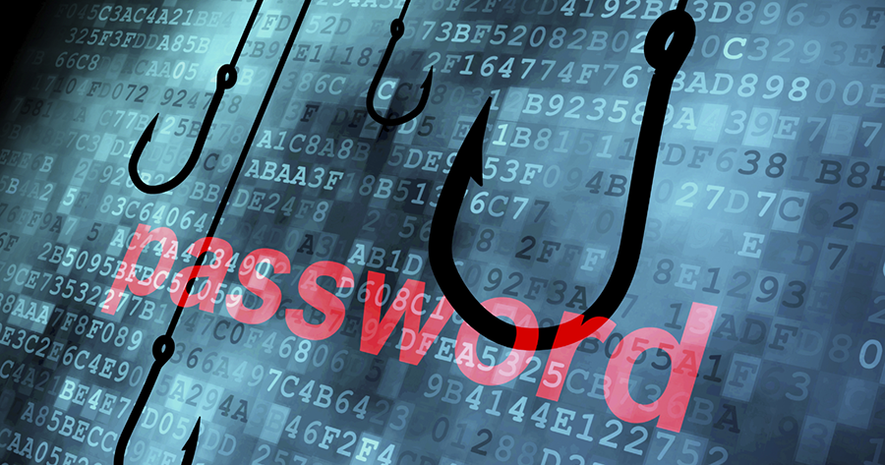
Risk Matrix
Top Risks
Phishing = Critical
Weak passwords = Critical
Malware = High
Unpatched software = High
This Photo by Unknown Author is licensed under CC BY-SA

Slide 6
Security Recommendations
MFA
Strong password policy
Phishing training
Backups
Antivirus
Software updates
Wi-Fi security

Slide 7

Business Impact / Conclusion
Reduces risk of data loss
Protects customer trust
Improves business continuity
Strengthens digital operations

