Slide 1
Constraint Reasoning
Constraint Programming
Constraint Satisfaction Problems (CSP)
…..
(C) Debasis Mitra

Slide 2
PROBLEM DEFINITION
Problem / Input:
A set of variables V {v₁, v₂, …, v_{n}}
Each variable has a domain: D₁, D₂, … D_{k}, for k≤n
all variables may have the same domain
A set of constraints C {c₁, c₂, … c_{m}}, m ≤ ^{n}Choose_{arity}
In a constraint-graph, constraints are labels on arcs;
typically binary constraints, binary graph, (arity=2)but
multi-aried is feasible;
arity=1 is ok too (domain constraint)
Constraint c_{i} connects a subset of variables’ (arity) for
SIMULTANEOUS “allowed” values
e.g., C = {(v1=blue, v2=green), (v1=green, v2=blue)}
(C) Debasis Mitra

Slide 3
Example
Constraint c_{i} connects a subset of variables’ (arity) for
“allowed” SIMULTANEOUS values
V = {v₁, v₂, v₃}
D for all v’s = { red, blue, green, yellow}
C = {{v₁-v₂, (red, green), (blue, green) – think of a table},
{ v₁-v₃, (yellow, green), (green, yellow)} }
Note: no constraint on v₂-v₃;
inherently directed
v₂ | v₁
red | blue
red | green
… | …
v₁
{green, red},
{green, blue}
{yellow, green}
{green, yellow}
v₂
v₃
CSP: is this input satisfiable? T/F
Answer: False (try it)
(C) Debasis Mitra

Slide 4
Example 2
V = {v₁, v₂, v₃}
D₁= {1, 2, 3}, D₂={1, 4}, D₃={3, 5} // Disjunctive: chose any
C = {v₁ < v₂ , v₂<v₃} // Constraints are conjunctive:
all must satisfy, simultaneously
CSP: is this input satisfiable? Output: True
A solution: (v₁, v₂, v₃)=(1, 4, 5)
All solutions? Exercise…
v₁
<
<
v₃
v₂
“Filtered” network →
note v₃=3 is not feasible, cannot appear in any solution
(C) Debasis Mitra

Slide 5
CONSTRAINT GRAPH
Typical: binary (we know about binary graph well)
Graph structure may be exploited:
Tree – easy to handle (why?)
Multi-aried constraints = “Global constraints”
e.g., “alldiff” = vars have same domains, &
each must be unique
Graph = Propositional Logic
Constraint Logic Programming: goes beyond Prop-Logic
Dual graph: Interchange nodes and arcs
Dual representation may be valuable!
Think Interior-Point algorithm for LP.
(C) Debasis Mitra

Slide 6
CONSTRAINT EXAMPLES
Map coloring: Book Ch 6 Slides 4-6 [DRAW ON BOARD]
Cryptarithmatic Example: Book Ch 6 slide 9
Other list: Ch 6 Slide 10
(C) Debasis Mitra

Slide 7
GENERATE A SOLUTION
OR FAILURE
Book Ch 6 Slides 11: Formulation as a search problem
Let's start with the straightforward, dumb approach, then fix it.
States are defined by the values assigned so far
Initial state: the empty assignment, {v₁=null, v₂=null, … }
Successor function: assign a value to an unassigned variable
that does not conflict with current assignment.
=> fail if no legal assignments (constraints not satisfiable! CSP->False)
Goal test: the current assignment is complete
1) This is the same for all CSPs! ☺
2) Every solution appears at depth d=n, for n variables
=> use depth-first search
3) b=(n - l)*d at depth l, (l goes from 0 to n-1), hence b^{n} ~ n!d ^{n} leaves!!!! ☹
4) Path is irrelevant, so, algorithm can also use complete-state formulation
(C) Debasis Mitra

Slide 8
GENERATE A SOLUTION
OR FAILURE
Book Ch 6 Slides 12-26:
Backtracking DFS
Heurstics-based improvements
Forward Checking
(C) Debasis Mitra

Slide 9
CONSTRAINT REASONING/SEARCH ISSUES
In terms of Logic: Inferencing
1. How do you answer the questions (T/F)?
2. Produce required output (one or more solutions)
3. “Filter” the variable-domains or constraints (discard impossibilities),
so that some values/constraint-elements
that will never take part in any solution
are eliminated.
Algorithms:
Backtracking
Forward Checking
Constraint Propagation, at different “levels”
(C) Debasis Mitra

Slide 10
CONSTRAINT REASONING / SEARCH ISSUES:
Constraint Propagation
How to “filter” the domains (on nodes) and constraints (on arcs),
so that, those values/constraint-elements
which will never take part in any solution
are eliminated?
Algorithms produce some type of “filtered” outputs!
Or, Failure!
Different levels of filtering defines different levels of
CONSISTENCY
(C) Debasis Mitra

Slide 11
CONSISTENCY TYPES
Simplest, Node consistency
Constraint of arity=1, Unary constraints
Domain is “constrained” within list of input constraints
Some values are explicitly prohibited,
e.g., in job-shop-scheduling:
No class may start before 8 am;
Grad classes may not start before 4pm
If a “solution” (e.g., a schedule) satisfies “Node consistency”,
then, the solution is “Node consistent”
Or, “After” filtering each variable per Node constraints,
the constraint network is “Node consistent”
A confusing issue: is the input k-consistent “before” or “after” filtering?
(C) Debasis Mitra

Slide 12
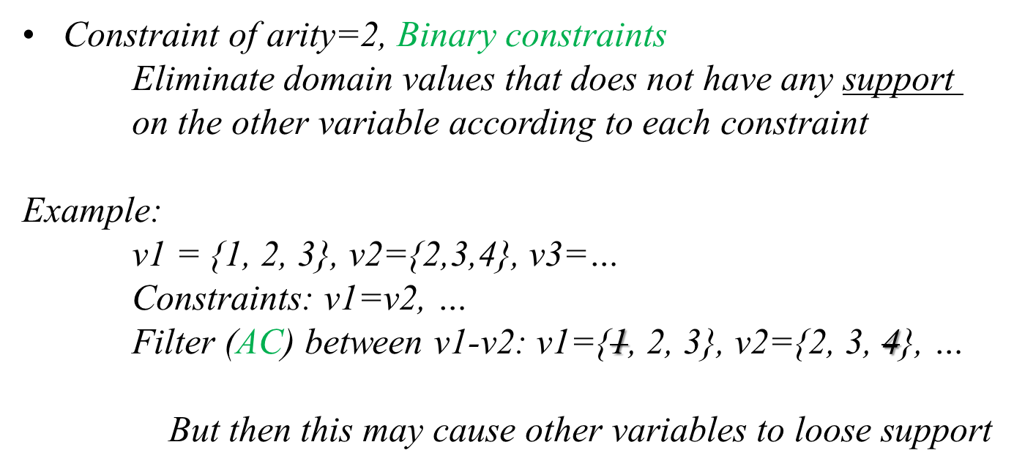
ARC CONSISTENCY (AC)
---
(C) Debasis Mitra

Slide 13
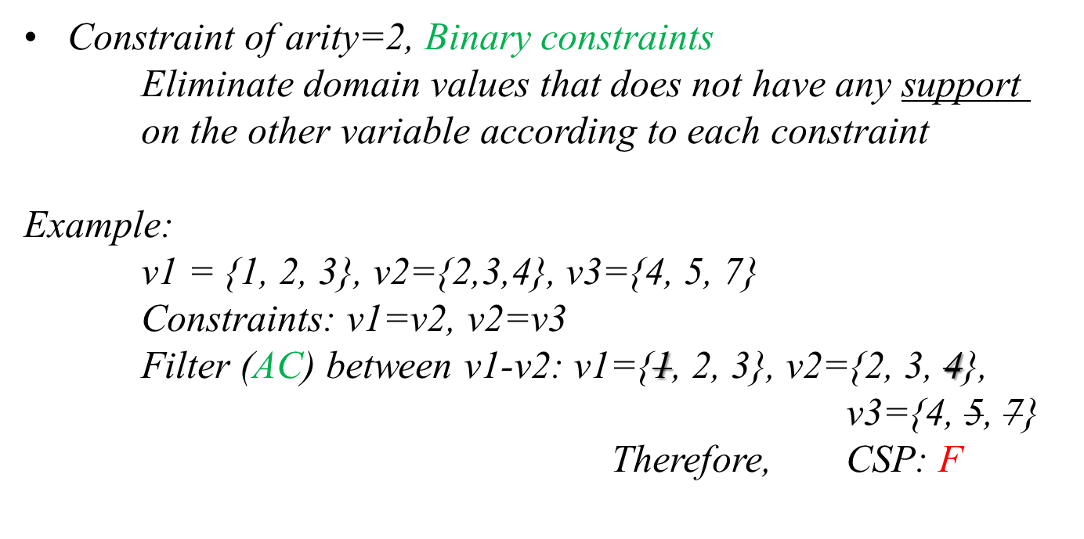
ARC CONSISTENCY (AC)
---
---
(C) Debasis Mitra

Slide 14
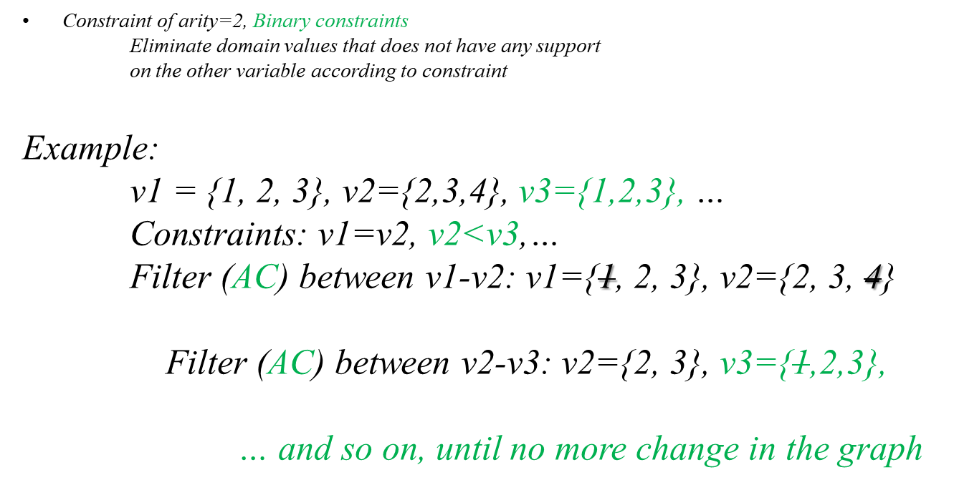
ARC CONSISTENCY (AC)
(C) Debasis Mitra

Slide 15
ARC CONSISTENCY
Constraint of arity=2, Binary constraints
Eliminate domain values that does not have any support
on the other variable according to the constraints
Domains are to be filtered, or reduced, or shrunk
Not as easy as it appears!
Need to repeat again and again:
  every value elimination needs to propagate
But how many times?
Easiest algorithm:
Keep repeating until no more variable changes
OR: a domain becomes null ➔ Inconsistent (CSP: F)
Any variable value-set changes: check its neighbors
use a Queue_of_arcs (AC-3)
(C) Debasis Mitra

Slide 16
AC-3: ARC CONSISTENCY ALGORITHM
Book Ch 6 Slides 27-31
(C) Debasis Mitra

Slide 17
ARC CONSISTENCY
Easiest algorithm:
Keep “filtering” per arc-constraints
until no more variable changes,
OR: a domain becomes null ➔ Inconsistent (CSP: F)
(on a CSP=F, if you do not do the last step → all domains will become ‘null’)
After filtering each variable per Arc constraints,
the constraint network is “Arc consistent” (AC)
AC network ≡ every variable value will have a corresponding
variable value at the other end of its constraints
Not same as “Satisfiability”:
an Arc consistent network may not actually have any solution:
2-color on Australia → AC has a sol, but not the solution
Then, what good is AC?
1) It will be faster to find a solution on an AC network!
2) But more importantly: may find inconsistency quickly P-time
(C) Debasis Mitra

Slide 18
PATH CONSISTENCY
Really, Triangle Consistency
Constraints (≡allowed value pairs) are filtered
such that each constraint will satisfy every triangle
it participates in
A theorem proves,
this is same as participating in any path it resides in
More filtering than AC
PC ≠ AC, strange!
PC-2 per Mackworth et al.
is very similar to AC-3, with triangles instead of arcs
Examples on AC, PC, etc.:
http://cs.fit.edu/~dmitra/ArtInt/TextSlides/constraints-dechter-2
(C) Debasis Mitra

Slide 19
k-CONSISTENCY
k=1: node consistency
k=2: AC
k=3: PC
k-consistency = every (k-1)-nodes value-set has extension to k-th node
k>3: does not imply (k-1)-consistency
If a network is filtered such that it is k=1, … p-consistent,
then, it is called Strongly-p consistent
Strongly k-consistent for k=n,
for n nodes network ➔ Global consistent
Minimal Network: each domain value participates in a solution
➔ a backtrack free search may be used to find a solution
(but, finding a solution/Failure may be easier than min-net!)
(C) Debasis Mitra

Slide 20
BOUND-CONSISTENCY
On Ordinal / Real domains
Constraints are over ranges, range = bound
Range gets filtered on bound propagation
“Simple” bounds = convex (single) ranges on each domain
(& constraints)
=> Bound propagation for convex bounds only, is P-class,
Global consistency (finding satisfiable value for each node by
backtrack-free search)
Non-simple bounds on input (=multiple or non-convex ranges)
=> NP-complete
B
[10-20]
A
(C) Debasis Mitra

Slide 21
CONSISTENCY
Run a path-consistency algorithm on input constraint network P:
Does P change?
  If “yes”: P was not 3-consistent
  If “no”: P was 3-consistent
k-consistency, for k=1, 2 (Arc-cons.), 3 (Path-cons.), …
  k-consistent network does not necessarily imply (k-1)
  Weak k-consistent: only k-consistent network
  Strong k-consistent: i-consistent for i=1, …k
Satisfiable: There exists a non-null solution.
  k-sat: solution exists for every k-subgraph (may be k=1, 2, … n, for n var)
  Weaker than consistency definition [WHY?]
Counter-examples: http://cs.fit.edu/~dmitra/ArtInt/TextSlides/constraints-tsang-1
(C) Debasis Mitra

Slide 22
STRUCTURE OF NETWORK
Book Slides 32-36
[slide 33 may be loaded -> mention Kadison-Singer]
Phase Transition: Book Slide 39
(C) Debasis Mitra

Slide 23
MORE ON CONSTRAINTS
Finding Solution(s): Backtracking
  Different from inferencing/propagation
  Assign value on nodes without violating constraints
  Which var v to pick next? Which value of v to pick next?
    Run-time depends on above
  Branching factor: nd, n=|V|, d=|D|
    And-Or tree: And on nodes (need all nodes values), Or on values (any value will do)
      A node empty ➔ Fail, Each value must be tried before a node fails
  Complexity = #nodes on search tree = nd*(n-1)d*(n-2)d*…=n!d^{n}
  # possible node-value assignments = d^{n} , some of them are solutions
    Think of 2^{n} Boolean-SAT problem
  Strategy, heuristics, pruning, … to improve search
(C) Debasis Mitra

Slide 24
BACKTRACKING
Var-ordering:
Min-remaining Values (MRV):
choose var with fewest remaining values
Most-constrained var (MCN): maximum degree node
  Fail-first strategy: better pruning
  Of course, out of remaining unassigned nodes
  A good tie-breaker after MRV
Value-ordering:
Least constraining value: this value allows others to satisfy easily
  Note: values are disjunctive, whereas constraints are conjunctive (MCN above)
(C) Debasis Mitra

Slide 25
IMPROVED BACKTRACKING (BT)
Interleaving:
  Backtrack search interleaved with constraint propagation
  FC is redundant if AC is run first, before running BT
  MAC (maintaining AC): BT + AC only on subgraph for the current X_{i} ,
  and all unassigned X_{j}’s
(C) Debasis Mitra

Slide 26
BACKTRACKING: Look Back
(EXCLUDE THIS SLIDE)
Ordinarily backtrack to previous var on search tree
Look-back strategies: Jump back to more relevant node
  More pruning
Backjumping (BJ):
Conflict-directed backjumping (CBJ)
  Who caused the conflict that lead to failure of current node?
Learning-based backjumping (LBJ)
  Keep track of “no-good” value assignments: actually implied constraint
  But only maximal “no-good” is useful: that cannot be extended in the network
  Use no-goods as a new constraint to filter domains (or use any other ways!)
(C) Debasis Mitra

Slide 27
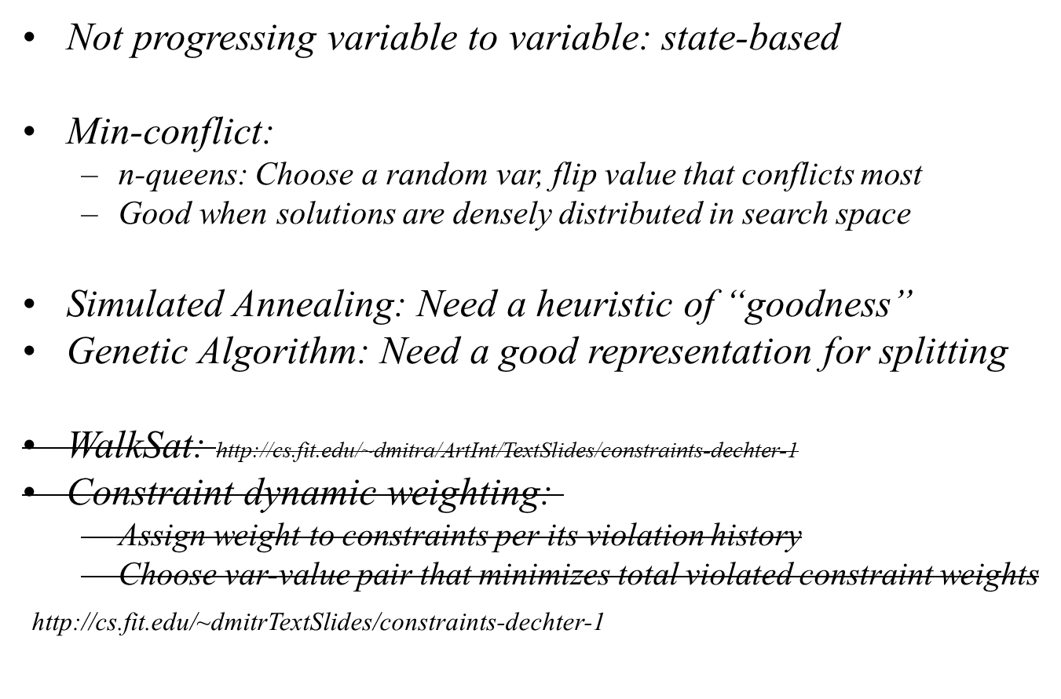
LOCAL SEARCH: CONSTRAINTS
(C) Debasis Mitra

Slide 28
MORE ON CONSTAINTS:
GRAPH STRUCTURE
Tree structure:
  Topological sort nodes, then run directed AC (DAC)
  DAC: ordered nodes filter forward/downward
  Guaranteed linear=bt-free search to assign value
  P-class problem: polynomial-time satisfiability check
  (more or less what happens for 2-SAT problem!)
Almost tree:
  Remove a node and it becomes tree (Australia-coloring, SA is such a node)
  Such nodes are called “cycle cutset”
  Needs to backtrack only on cycle-cutset
    apply heuristics/strategies on cutset to make algo even faster
  Group nodes together to super-node and convert graph to a tree
    Each group’s solutions become domain for the supernode (Fig 6.13)
    Sort of polynomial ~ d^{c} for fixed tree size c, instead of ~d^{n}
Can we use strongly connected components?
(C) Debasis Mitra

Slide 29
MORE ON CONSTAINTS
Value Symmetry:
  Solutions are agnostic to the names of colors: categorical data
  Permutations of color-names (n!) of a solution are really same solution
  Search space may be reduced by introducing symmetry-breaking constraints
Note how symmetry may be used to
exclude 15-puzzle’s unsolvable cases
We are just scratching the surface of symmetry in data!
  Think of “Big Data”
(C) Debasis Mitra

Slide 30
MORE ON CONSTAINTS
Sudoku problem as exercise?
81 variables, partial-solution, 27 all-diff constraints
AC-3 gets close for most problems
PC-2 gets harder ones
Many inferencing strategies exist
(C) Debasis Mitra

Slide 31
MORE ON CONSTAINTS
(EXCLUDE THIS SLIDE)
Tractable sub-problems
  Full problem is NP-hard: we looked for strategies, heuristics
  Look for subproblems where satisfiability may be P: Tree structure
Constraint Logic Programming
  Multi-aried
  Higher-order logic: variable bindings
  Prolog to express constraint network:
    Variables with data as domain constraints + Rules as constraints = database+relations
    Datalog, “Answer Set Programming”
Learning Constraints from Data?
  Relational learning from database: find dependencies between attributes
(C) Debasis Mitra

Slide 32
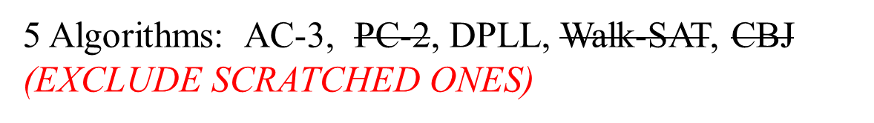
(C) Debasis Mitra

Slide 33
AC-3
function AC3(R)
Input: a binary network R = (V, D, C)
Output: an equivalent path-consistent network R’ or False
0 R’ = R // make a copy
1 a queue Q of arcs initialized with all arcs in R, Q← {(i,j) | 1≤i<j ≤ n}
2 while Q is not empty do
3 select and remove an arc (i, k) from Q
4 Temp_D_{i} = values in D_{i} that has corresponding value in D_{k} following constraint C_{ik}
5 if Temp_D_{i}== Null then return False
6 if Temp_D_{i} ≠ D_{i} then
7 replace D_{i} with Temp_ D_{i} in R’
8 Push-in(Q, {arcs (p, i), for all p ≠ i, i.e. all arcs in which i participates}
end while
9 return R’
(C) Debasis Mitra

Slide 34
PC-2 (Exclude)
function PC-2(R)
Input: a binary network R = (V, D, C)
Output: an equivalent path-consistent network R’ or False
0 R’ = R // make a copy
1 a queue Q of triangles initialized with all triangle in R, Q← {(i,j,k) | 1 ≤ i<j ≤ n, 1 ≤ k ≤ n, k ≠i, k ≠ j}
2 while Q is not empty do
3 select and remove a 3-tuple (i, j, k) from Q
4 Temp_C_{ij} = \project on ij (C_{ik} \join D_{k} \join C_{jk}) // \project and \join explained on next slide
5 C_{ij}’ ← C_{ij} \intersect Temp_C_{ij}
6 if C_{ij}’ = = Null return False
7 if C_{ij}’ has changed from C_{ij} then
8 replace C_{ij} with C_{ij}’ in R’
9 Push-in(Q, {triangles (p, j, i), for all p ≠ i, and p ≠ j, i.e. all triangles in which ij participates}
end while
10 return R’
(C) Debasis Mitra

Slide 35
(Exclude)
For those who may not have been exposed to Relational Algebra:
(C_{ik} \join D_{k} \join C_{jk}) means creating new constraints C_{ikj}
such that each triple of value has corresponding support in
C_{ij}, D_{k}, and C_{jk}
Example: C_{ij} = (<r,3>, <b,5>), D_{k} = (3, 6), C_{jk} = (<3,g>,<5,b>)
Then, C_{ijk} by above joins will be = (<r,3,g>)
\project_{ij} shrinks the constraint to variables ij pair, thus
from above C_{ijk},
\project_{ij} C_{ijk} = (<r,g>)
(C) Debasis Mitra

Slide 36
Algorithm DPLL (for Boolean satisfiability or SAT-problem)
Input: A set of clauses Φ.
Output: A truth value.
function DPLL(Φ)
if Φ is a consistent set of literals
then return True;
if Φ contains an empty clause
then return false;
for every unit clause l in Φ // unit clause, clause with one literal
Φ ← unit-propagate(l, Φ); // make the literal true in all clauses
for every literal l that occurs pure in Φ // either T or F in all clauses
Φ ← pure-literal-assign(l, Φ); // assign its value to make it T
l ← choose-literal(Φ);
return DPLL(Φ ∧ l) or DPLL(Φ ∧ not(l)); // Binary tree search
Source: Wiki
(C) Debasis Mitra

Slide 37
Exclude
GSAT and Walksat algorithms work on formulae in Boolean logic that are in, or have been converted into, conjunctive normal form.
They start by assigning a random value to each variable in the formula.
If the assignment satisfies all clauses, the algorithm terminates, returning the assignment.
Otherwise, a variable is flipped and the above is then repeated until all the clauses are satisfied.
WalkSAT and GSAT differ in the methods used to select which variable to flip.
GSAT makes the change which minimizes the number of unsatisfied clauses in the new assignment,
or with some probability picks a variable at random, somewhat like simulated annealing with fixed T.
WalkSAT first picks a clause which is unsatisfied by the current assignment, then flips a variable within that clause.
The clause is picked at random among unsatisfied clauses.
The variable is picked that will result in the fewest previously satisfied clauses becoming unsatisfied,
with some probability of picking one of the variables at random.
When picking at random,
WalkSAT is guaranteed at least a chance of one out of the number of variables in the clause of fixing
a currently incorrect assignment.
When picking a guessed “to be optimal” variable, WalkSAT has to do less calculation than GSAT because it is considering fewer possibilities.
The algorithm may restart with a new random assignment if no solution has been found for too long,
as a way of getting out of local minima of numbers of unsatisfied clauses.
Source: Wiki
(C) Debasis Mitra

