Slide 1
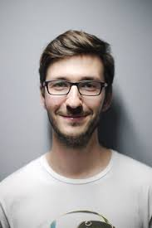
Name – “Steve”
Personal Profile
Steve is a social worker living in Darwin, Australia. Steve came to Australia as an international student to study Humanitarian and Community Studies. In his spare time he volunteers for a local charity that engages with aboriginal communities to engage community development and resilience. He plans on starting up his own business and aims to set-up his own office and employ social workers.
Personal Information
Profession – Social Worker
Location – Darwin, Australia
Age - 38
Hobbies – Current events, swimming, cricket.
Favourite TV Show - Game of Thrones
Personality – Outgoing, Logician – Has an appetite for knowledge
Internet usage
Internet experience – Studying, professional & social
Primary Uses – Mostly used in a professional capacity at work. Also uses in spare time to catch up on social media
Favourite Sites – Facebook, Netflix
Hours online per week - 25
Computer – HP Laptop
Current qualifications
Batchelor of Humanitarian and Community Studies
Literacy
IT Skills/knowledge – Basic, knowledge of MS office, internet etc.
User Goals To get information tailored to him, based on location and his preferred preferences To start his own business for social care. To utilize a system that allows his staff to work away from the office by using smart technology | Business Objectives Create an office that allows him to manage his charity start-up. Frustrations Sometimes too much choice – Difficult to identify the right product/information Technical talk – Difficult to understand, prefers simplified information that is easy to digest.

