Slide 1
My Car Concierge
The Premium Automotive Service Marketplace

Slide 2
The Problem
• Finding reliable automotive service providers is frustrating and time-consuming
• No transparency in pricing - customers often feel overcharged
• Payment disputes between customers and service providers
• Service providers struggle to find quality customers
• No centralized platform for premium automotive services
• Vehicle owners lack tools to communicate their needs effectively

Slide 3
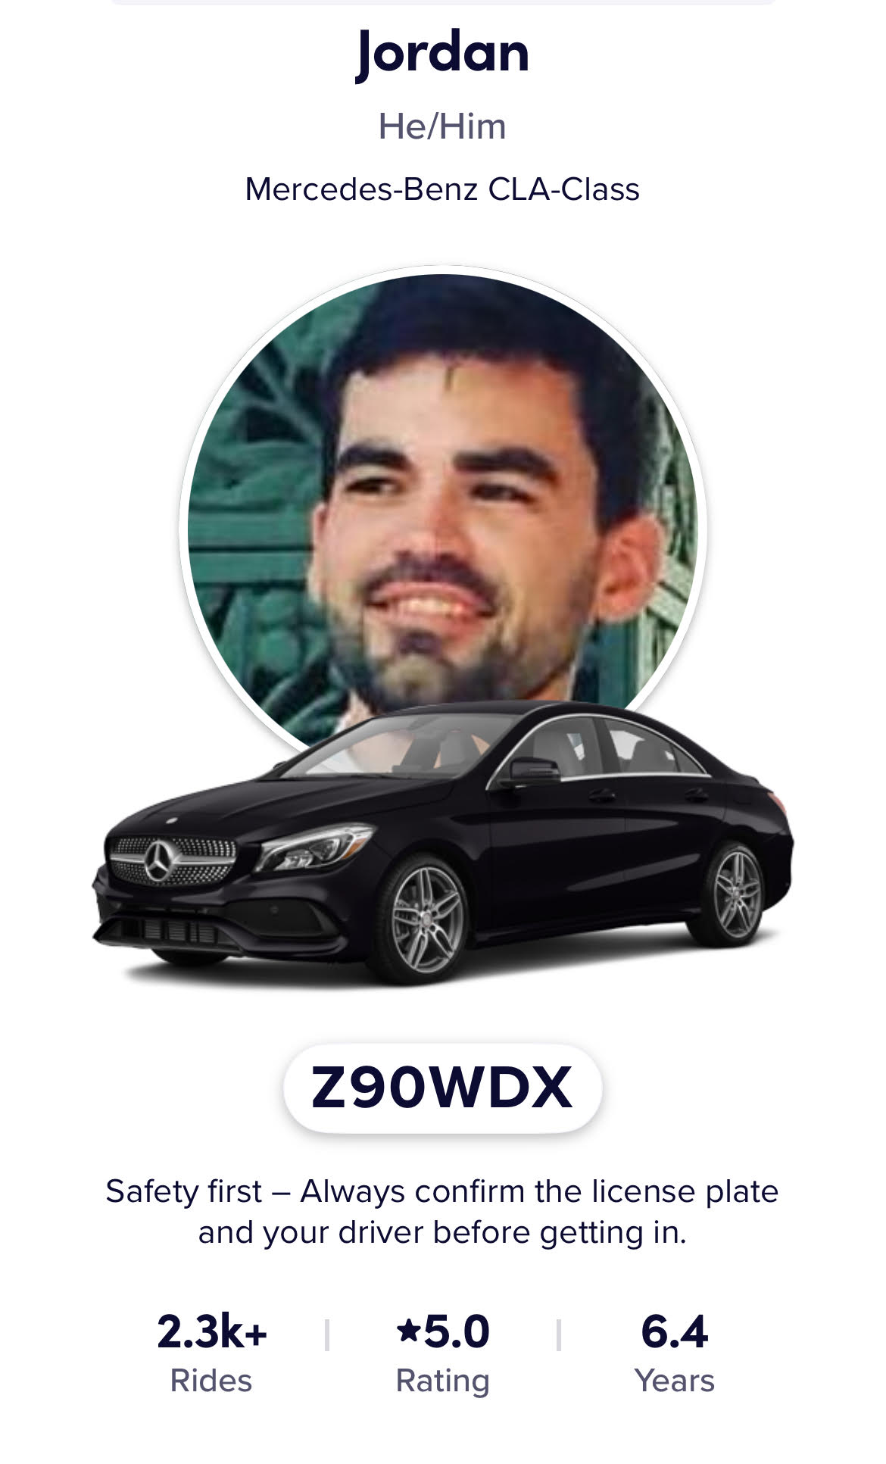
Why I Built This
"After 2,300+ rideshare trips over 6 years, I saw the same problem over and over..."
Passengers constantly asked me for mechanic recommendations. They were frustrated with:
• Wasting hours waiting at repair shops
• Surprise bills and hidden fees
• Not knowing if they could trust the mechanic
• No easy way to compare prices
As a driver who depended on my vehicle for income, I understood the stakes. I built My Car Concierge to solve this problem - for passengers, for drivers, for everyone.

Slide 4
Our Solution
• Premium marketplace connecting vehicle owners with vetted service providers
• Competitive bidding system ensures fair, competitive, pricing
• Escrow payment protection for both parties
• AI-powered vehicle diagnostic assistant
• Comprehensive service categories from maintenance to custom work
• Walk-in POS system for brick-and-mortar shops
• Multi-platform: Web, iOS, Android, Desktop apps

Slide 5
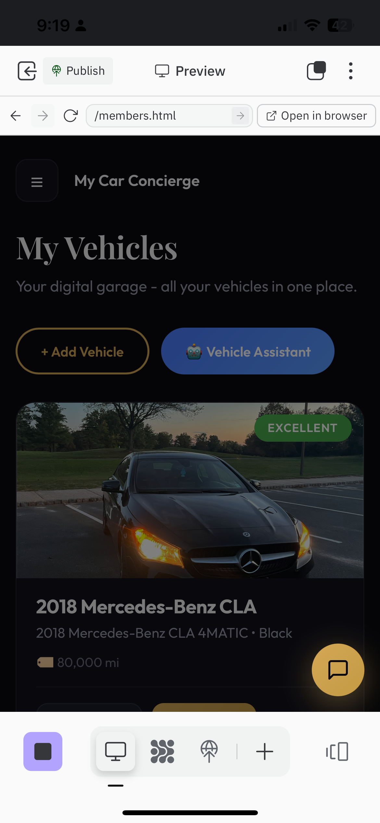
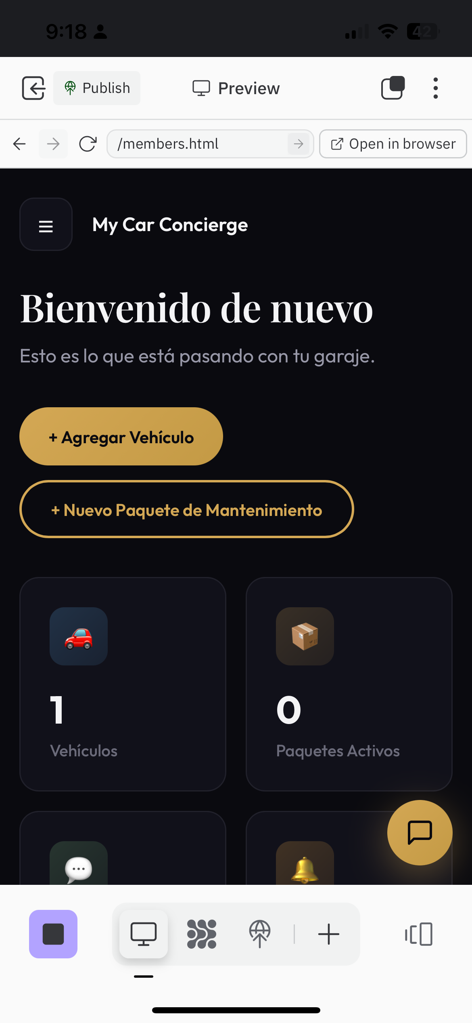
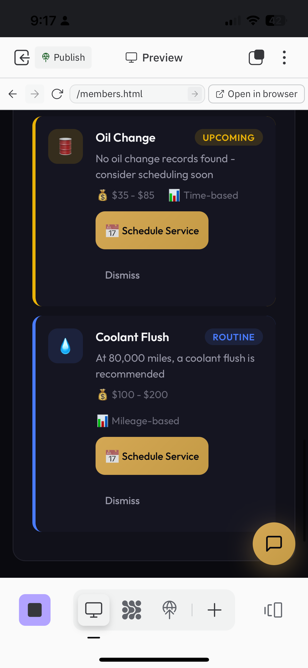
Product: Member Experience
Digital garage, AI assistant, smart reminders, and emergency services
Digital Garage
Maintenance Reminders
Emergency SOS

Slide 6
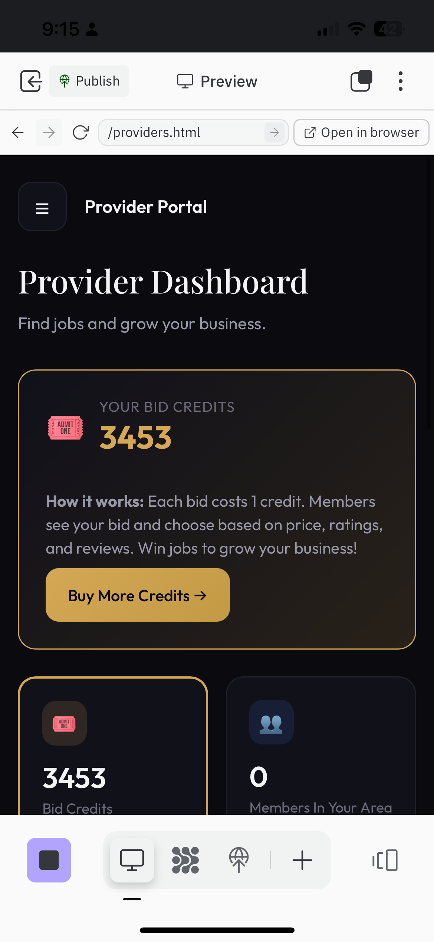
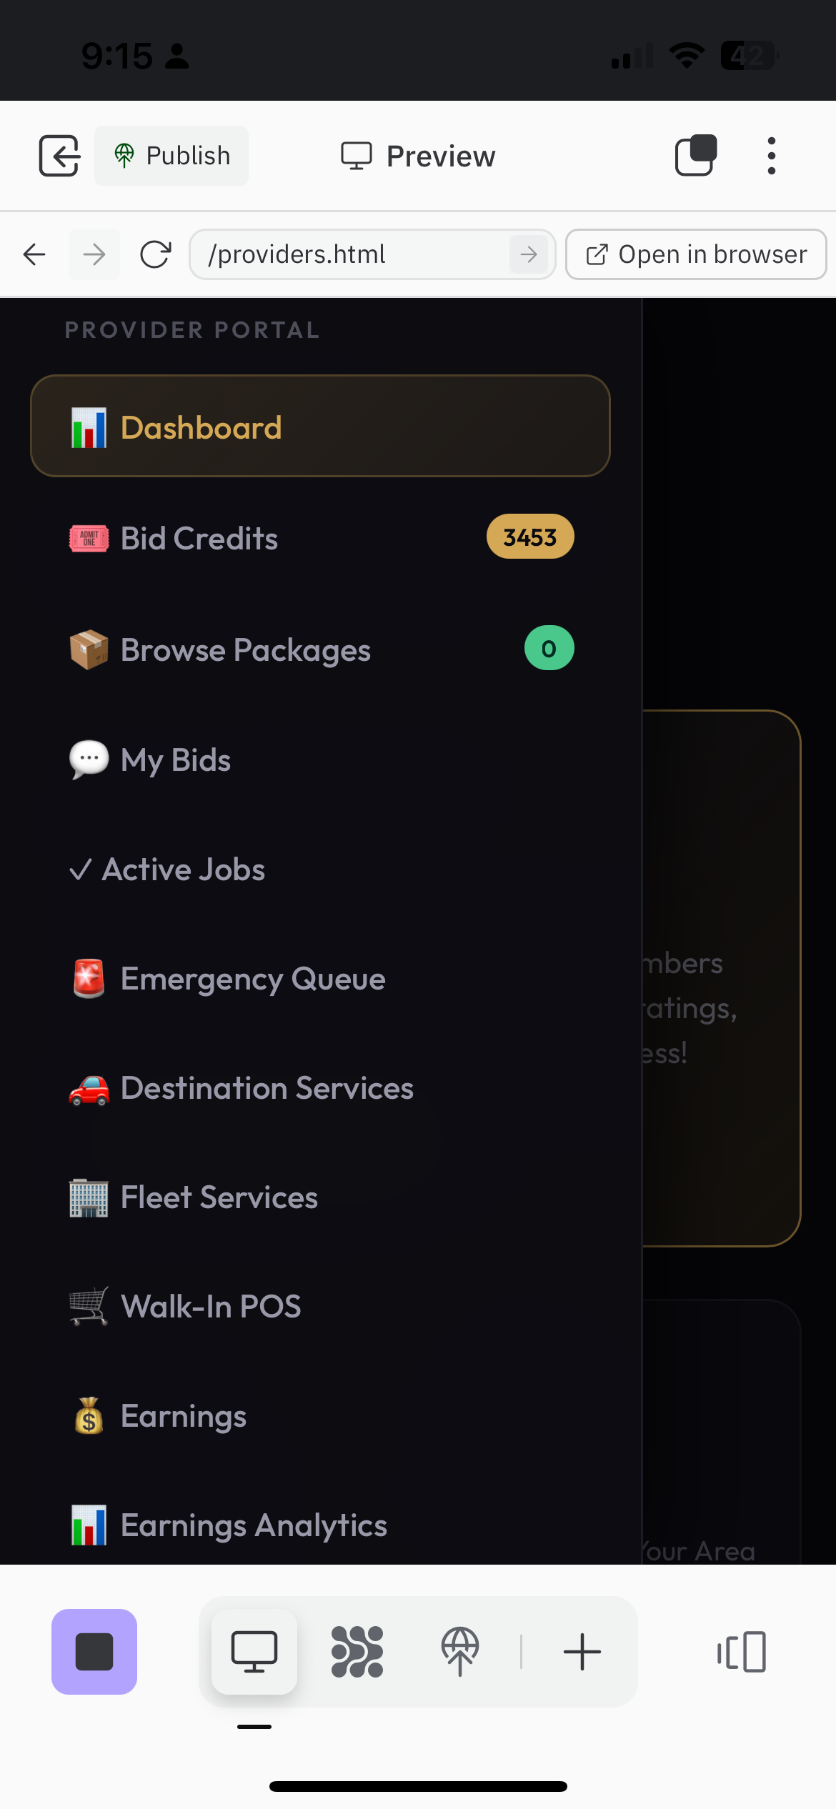
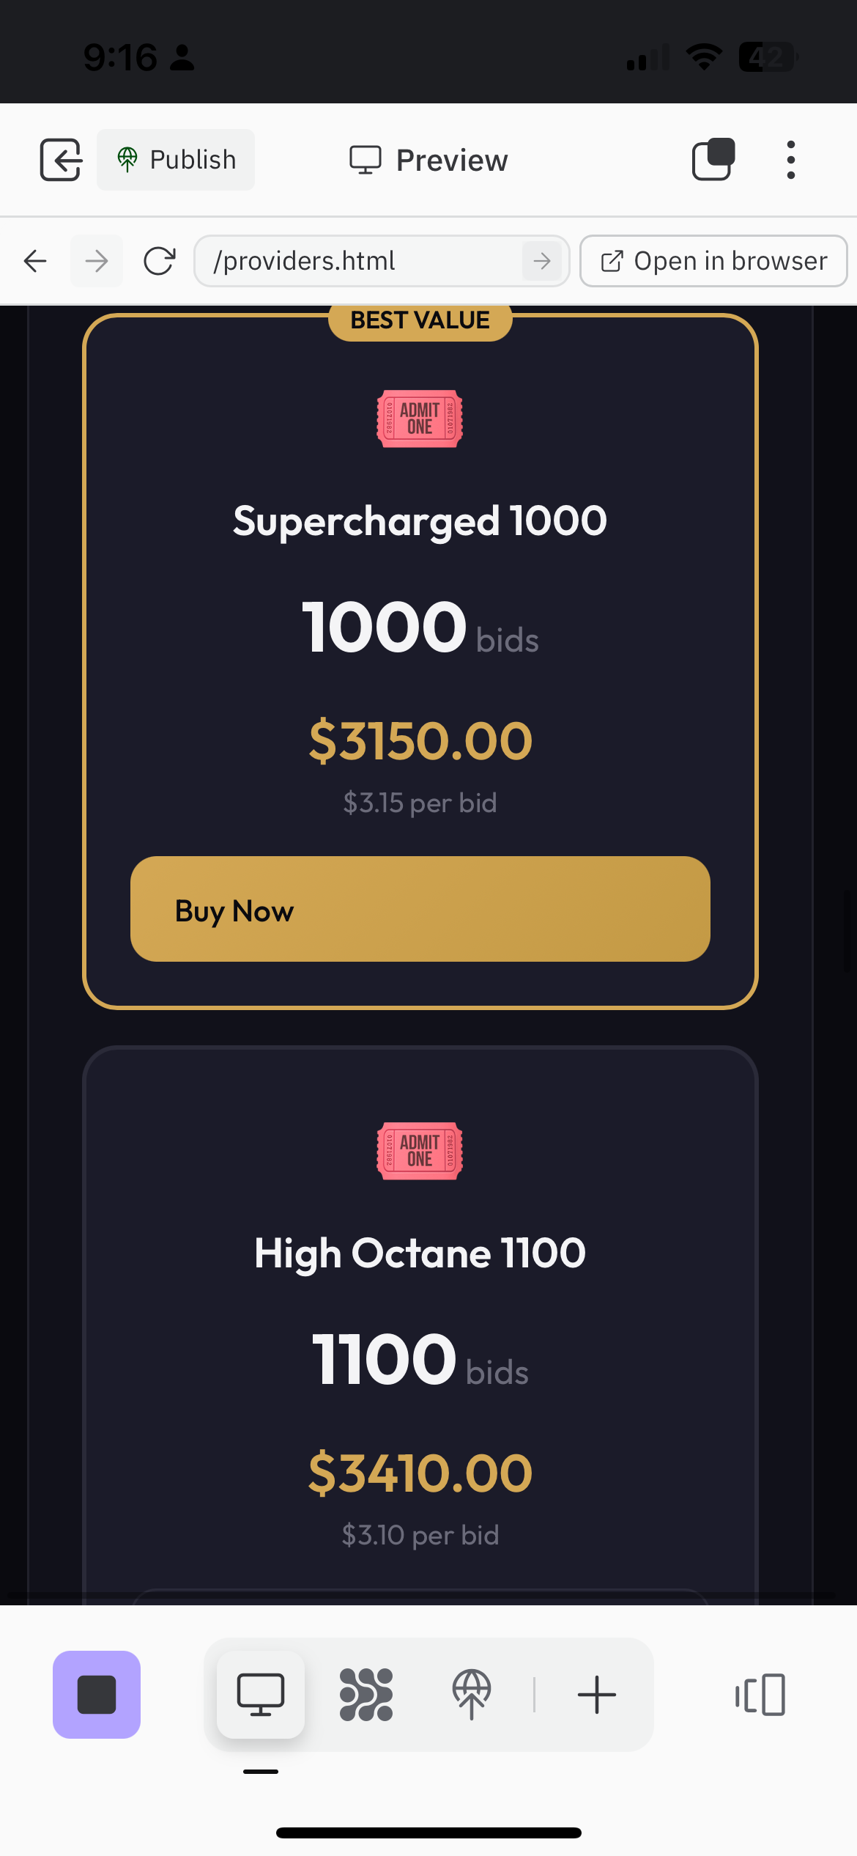
Product: Provider Experience
Dashboard, bid credits, Walk-In POS, and earnings tracking
Provider Dashboard
Full Menu
Walk-In POS

Slide 7
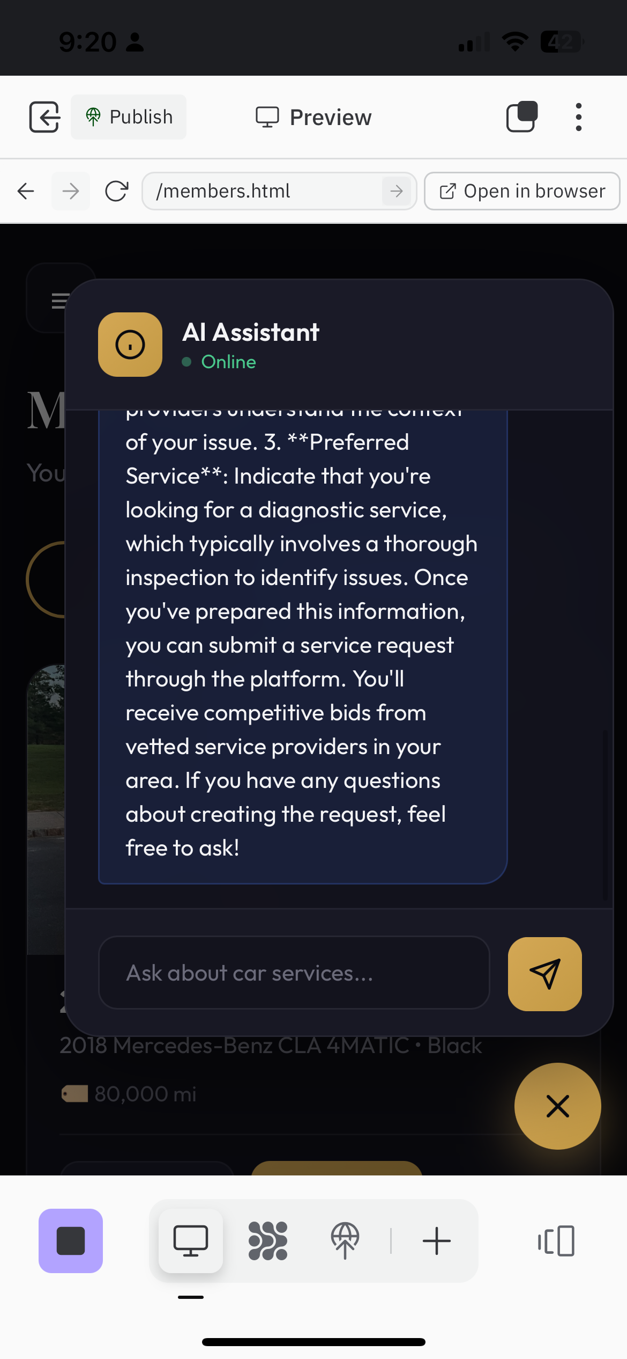
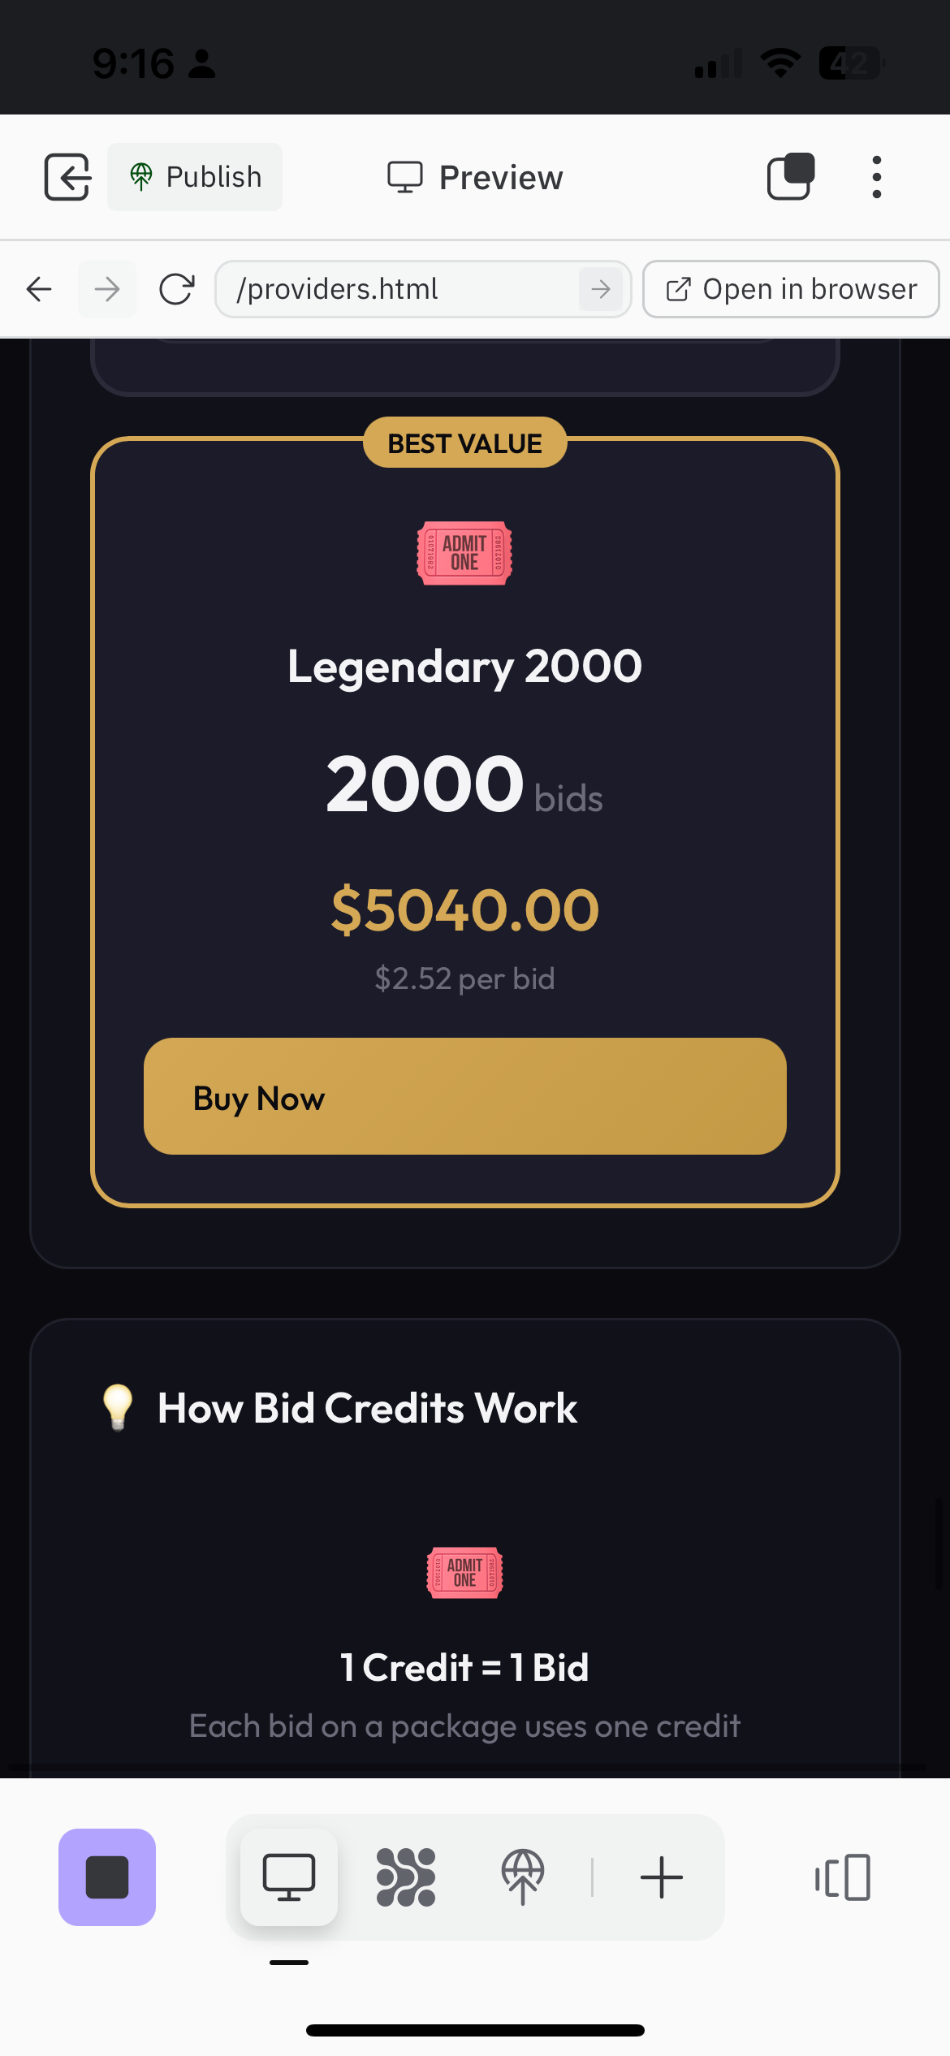
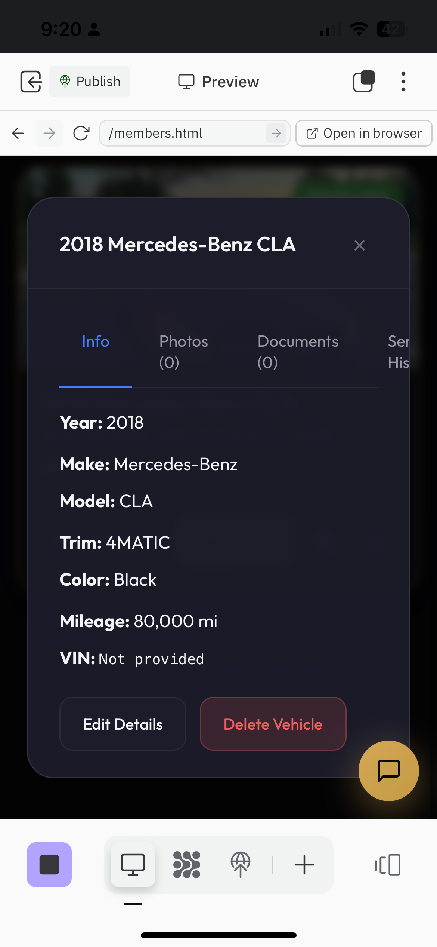
Product: AI & Monetization
Vehicle assistant chatbot and tiered bid credit packages
AI Vehicle Assistant
Bid Credit Packages
Vehicle Details

Slide 8
Market Opportunity
$300B+
7.5%
19+
US Auto Service
Market Size
Industry-Low
Platform Fee
Service
Categories

Slide 9
For Vehicle Owners (Members)
✓ Virtual garage to manage all vehicles
✓ Post service requests and receive competitive bids
✓ AI Vehicle Assistant for issue diagnosis
✓ Cost estimates before visiting a shop
✓ Photo/video/audio upload for better communication
✓ Real-time GPS tracking during vehicle transport
✓ Escrow payment protection
✓ Rating and review system
✓ Maintenance reminders
✓ Service history tracking
✓ Multi-language support (6 languages)
✓ Household sharing for family vehicles

Slide 10
For Service Providers
✓ Keep 92.5% of every job (industry-low 7.5% fee)
✓ Guaranteed payment through escrow
✓ Access to quality, vetted customers
✓ Walk-In POS system for shop customers
✓ Team management with background checks via Checkr
✓ Documented and advertised driver certification for vehicle transport
✓ Real-time job updates and communication
✓ Performance scoring and badges
✓ Referral program for earning commissions
✓ Fleet account access
✓ Bid credit system
✓ Mobile-friendly interface

Slide 11
Comprehensive Service Categories
✓ Maintenance & Repair
✓ Detailing & Cleaning
✓ Cosmetic & Body Work
✓ Performance Upgrades
✓ Window Tinting
✓ Wraps & Graphics
✓ Wheels & Tires
✓ Interior Customization
✓ EV & Hybrid Services
✓ Classic & Vintage Cars
✓ Premium Protection (PPF, Ceramic)
✓ Motorcycle Services
✓ RV & Camper Services
✓ Boat & Marine Services
✓ Fleet & Commercial
✓ Destination Services (transport)

Slide 12
AI-Powered Features
• Vehicle Diagnostic Assistant - Describe issues in plain language
• Custom Work Helper - Articulate cosmetic and modification requests
• Photo, video, and audio clip analysis
• Realistic cost estimates for parts and labor
• Severity assessment with safety warnings
• One-click service request creation from AI assessment
• AI chatbot for platform guidance and automotive advice
• Smart service recommendations based on vehicle history

Slide 13
Technology Stack
• Progressive Web App (PWA) - Install on any device
• Native iOS and Android apps via Capacitor
• Desktop apps for Windows, Mac, Linux via Electron
• Supabase backend (PostgreSQL, Auth, Storage)
• Stripe integration for secure payments
• Real-time messaging and notifications
• Background check integration (Checkr)
• SMS verification (Twilio)
• OpenAI integration for AI features

Slide 14
Revenue Model
7.5%
$200-$5,000
50%
Transaction Fee
on Completed Jobs
Bid Credit
Packages
Referral
Commission Share

Slide 15
Quality & Trust Features
✓ Provider verification and vetting process
✓ Background check integration (Checkr)
✓ Driver certification for vehicle transport
✓ Escrow payment protection
✓ Rating and review system
✓ CAR (Corrective Action Response) system
✓ Automatic provider suspension below 3-star rating
✓ Pre/post service evidence capture
✓ Liability checklists
✓ Dispute resolution process
✓ Terms of Service acceptance
✓ Multi-point inspection support

Slide 16
Founding Partner Program
• Early adopters get Founding Member/Provider status
• Exclusive badges and recognition
• Revenue sharing through referral program
• Stripe Connect integration for automated payouts
• 50% commission on referred provider bid purchases
• Priority support and feature access
• Founding Partners (both roles) get special designation

Slide 17
The Founder
Jordan Zanetis
Founder & CEO
FOUNDER-MARKET FIT
• 6.4 years as a rideshare driver
• 2,300+ rides completed, 5.0★ rating
• Deep understanding of mobile service delivery
PROFESSIONAL BACKGROUND
• Quality Manager - Food manufacturing
• BRC & SQF audit experience
• Compliance systems & process optimization
• Digital transformation initiatives
TECHNICAL
• Self-taught full-stack development
• Built entire MCC platform solo
• React, Supabase, Capacitor, iOS deployment

Slide 18
Growth Roadmap
• Phase 1: Launch core marketplace features ✓
• Phase 2: Walk-In POS for brick-and-mortar integration ✓
• Phase 3: AI diagnostic and cost estimation tools ✓
• Phase 4: Fleet management and enterprise features
• Phase 5: Parts marketplace integration
• Phase 6: Insurance and financing partnerships
• Phase 7: International expansion

Slide 19
Thank You
Let's revolutionize automotive service together
mycarconcierge.co

