Slide 1



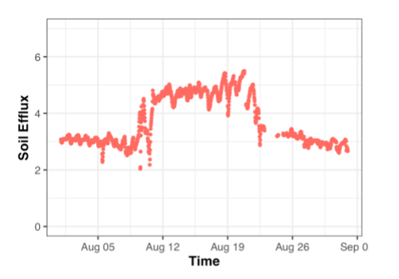
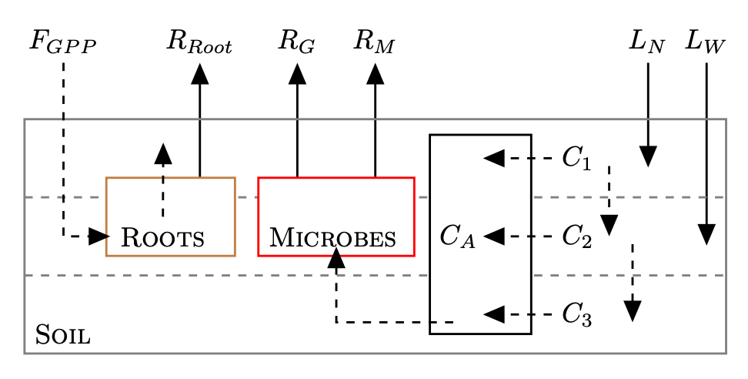
Collaborative Research: MSA: RUI: Development and validation of a continuous soil respiration product at core terrestrial NEON sites John M. Zobitz, Department of Mathematics, Statistics, & Computer Science, Augsburg University, Minneapolis, MN Naupaka Zimmerman, Department of Biology, University of San Francisco, San Francisco, CA
Overview
The NSF-funded National Ecological Observatory Network (NEON) infrastructure includes soil sensor arrays that record all the necessary components for calculating continuous soil CO₂ flux, but this derived product was de-scoped in the lead up to the observatory entering operations. We propose to fill this data gap by developing and field-validating a freely available R package to calculate soil CO₂ flux at any core terrestrial NEON site, validate our results through direct measurements and benchmarking them aganist existing soil respiration databases, and apply the soil flux data product in modeling and data assimilation to parameterize soil biogeochemical models at a focal NEON site. In the final year of this project, we will recruit five faculty from Primarily Undergraduate Institutions (PUIs) to engage in a mentoring cohort. Participating faculty will be provided with an array of soil sensors and be trained in their deployment, contribute to validation efforts for the soil respiration product, and pilot a series of macrosystems biology modules utilizing NEON data for inclusion in undergraduate biology courses.
What
Develop and validate a continuous soil CO₂ efflux product at NEON Core Terrestrial sites using the flux-gradient method.
Corroborate soil CO₂ effluxes and parameterize biogeochemical models.
Increase the participation of PUI faculty and students engaging with NEON data and macrosystems science.
Increase faculty capacity for conducting culturally sustaining research training of undergraduates
How
Engage in professional development in intercultural development practice and culturally sustaining research practices.
Deploy temporary instrumentation at NEON sites to validate fluxes. Develop and distribute an R package that will compute the flux gradient method.
Benchmark fluxes against the Soil Respiration Database. Apply data assimilation techniques to a biogeochemical model
Support instrumentation grants for PUI faculty in exchange for developing curriculum modules.
NSF Acknowledgement (grant #)
Interested in using aspects of the curriculum or contributing? Contact us: John Zobitz, zobitz@augsburg.edu, @profzobitz, Naupaka Zimmerman CONTACT INFO

