Slide 1




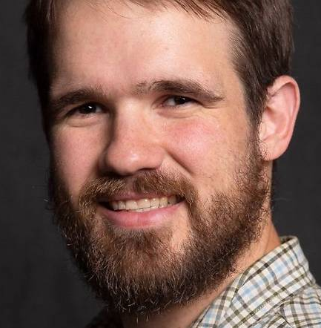
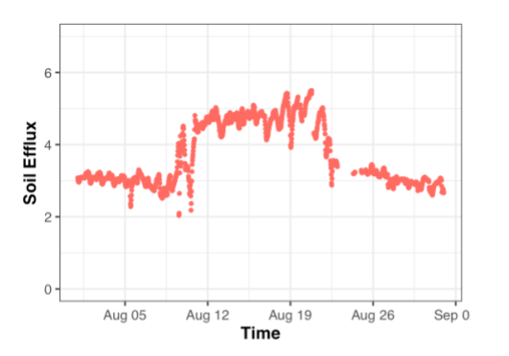
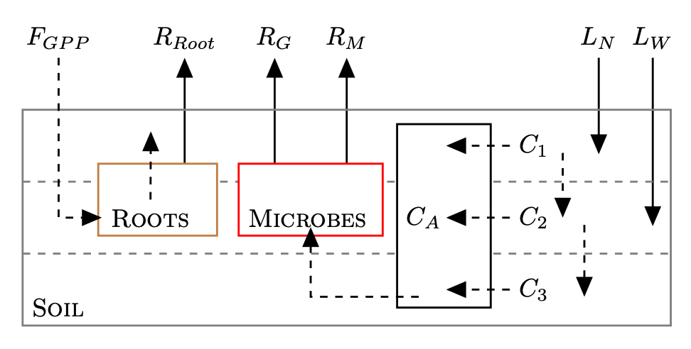
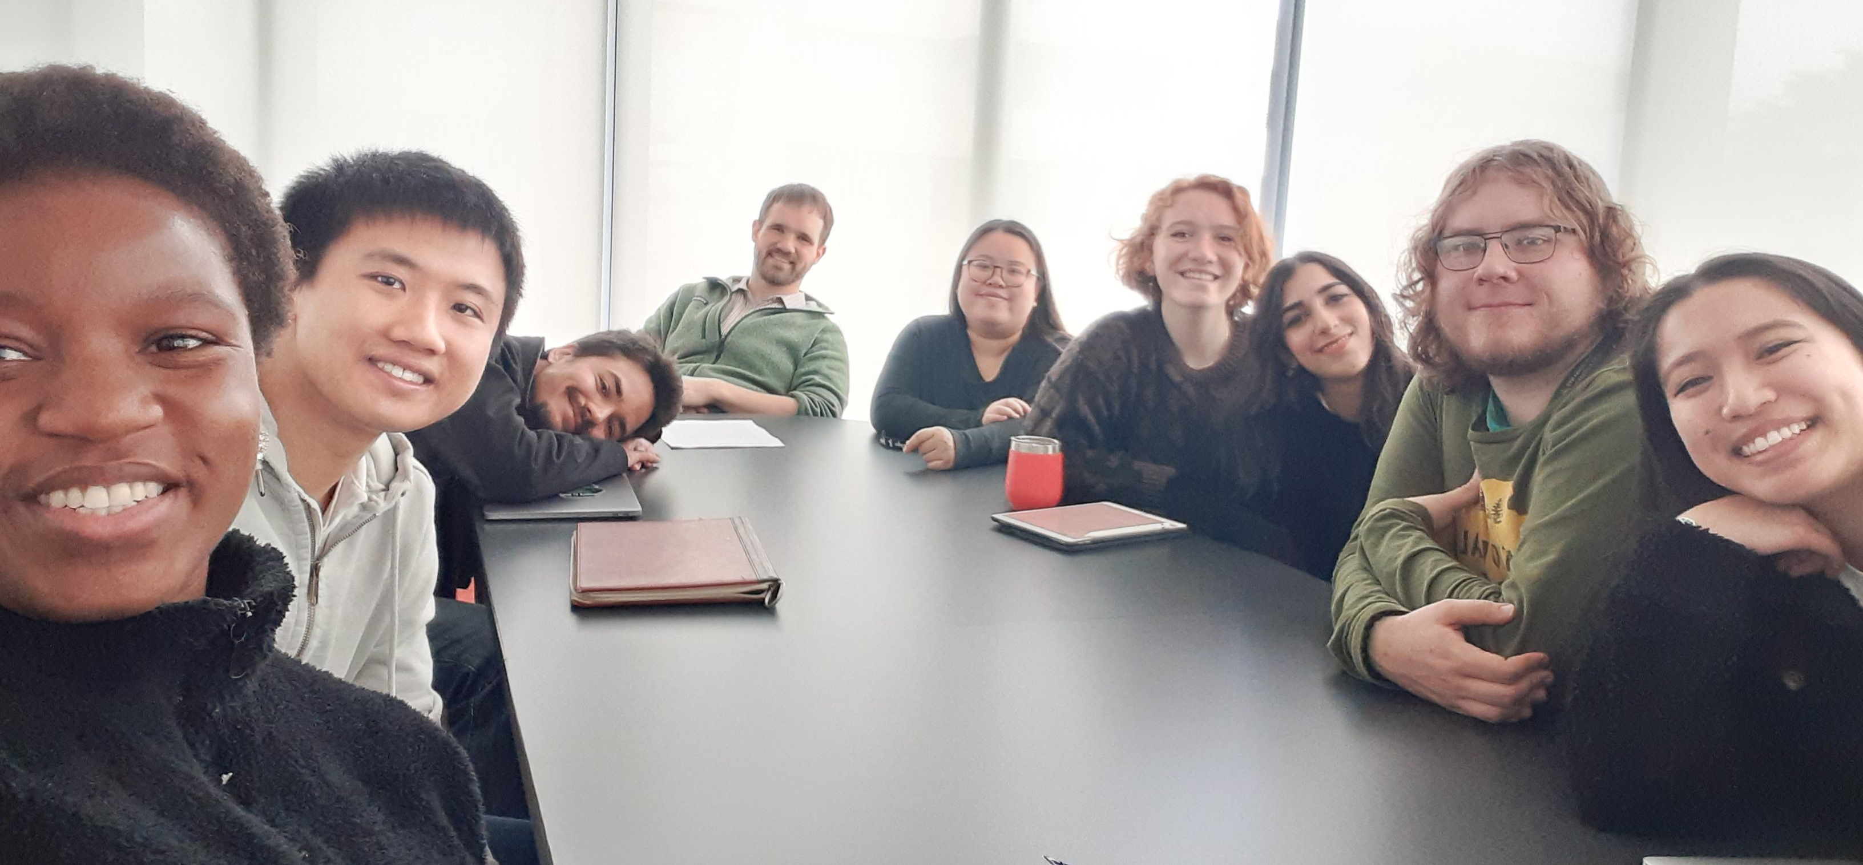

Collaborative Research: MSA: RUI: Development and validation of a continuous soil respiration product at core terrestrial NEON sites NSF# 2017829
“The Z Team”
John M. Zobitz
Dept. of Mathematics, Statistics, & Computer Science Augsburg University, Minneapolis, MN
Zobitz@Augsburg.edu @ProfZobitz
We will develop and validate models for soil CO₂ flux from NEON sites
We will lead PUI faculty in a mentoring cohort to build research capacity and teaching materials
Naupaka Zimmerman
Department of Biology
University of San Francisco, San Francisco, CA nzimmerman@ufsca.edu @naupakaz
Overview
Develop and validate a continuous soil CO₂ efflux product at core terrestrial sites
Corroborate soil CO₂ effluxes and parameterize biogeochemical models
Increase the participation of PUI faculty and students engaging with NEON and macrosystems science
Increase faculty capacity for conducting culturally sustaining research training of undergraduates
What
Deploy temporary instrumentation at NEON sites to validate fluxes, develop open-source R package
Support instrumentation grants to PUI faculty in exchange for developing curriculum modules
Conduct professional development in intercultural development theory and practice
Benchmark fluxes against the Soil Respiration Database with data assimilation
How

