Slide 1
Projects in 2019-2021
A new unit test application
A sophisticated data parser

Slide 2
Demonstration
Unit test the data parser

Slide 3
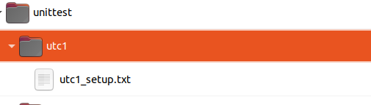
Add subfolder to parser project

Slide 4
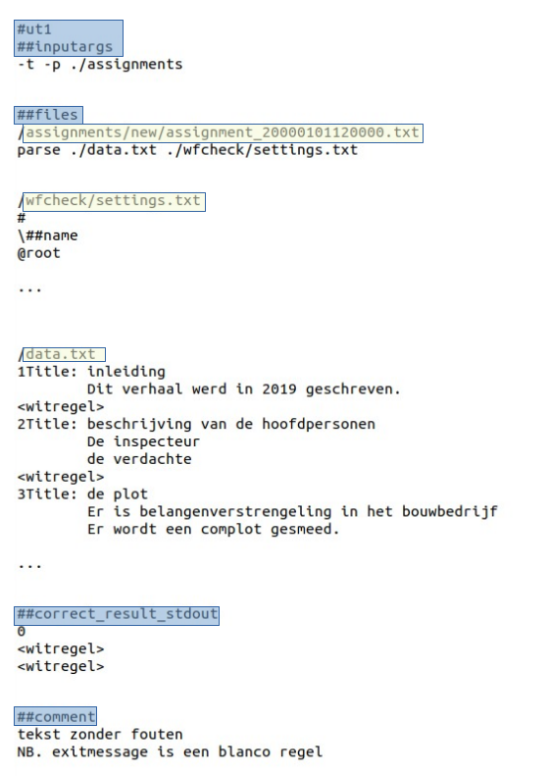
Write unittest 1
Define:
startup arguments
settingsfile
sample data
expected outcome

Slide 5
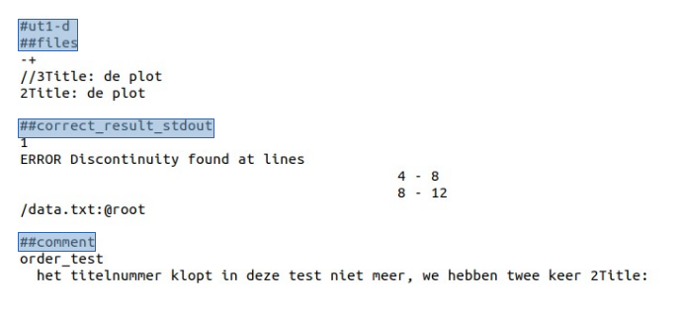
Write unittest variant
Small change in original unittest
=>
New unittest !

Slide 6
Creating variants is too easy!

Slide 7
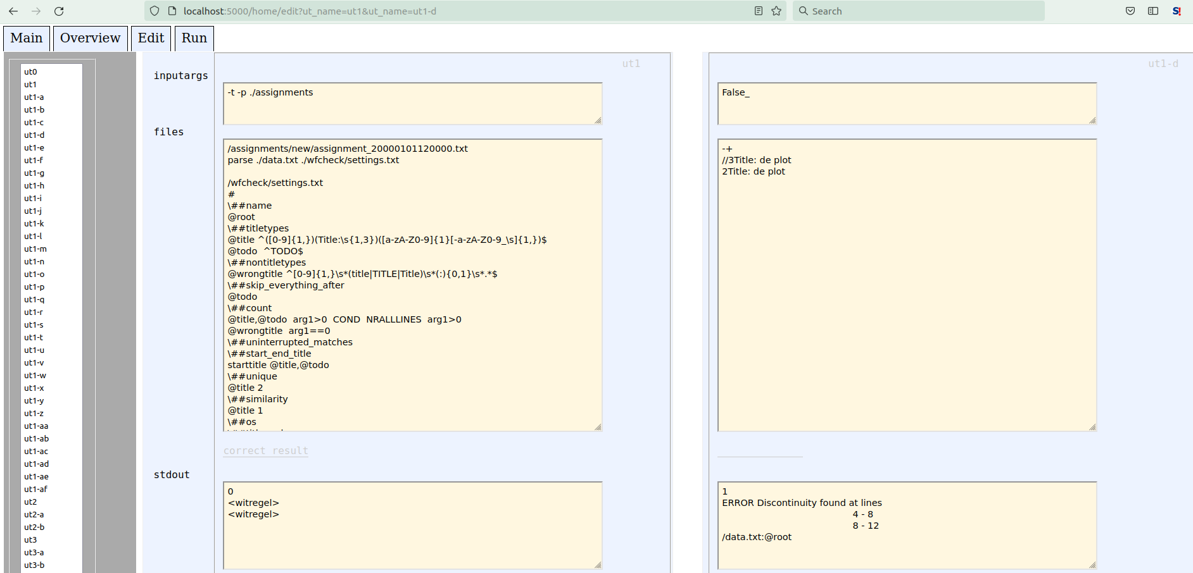
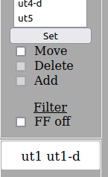
The Flask edit tool makes life even more easy

Slide 8
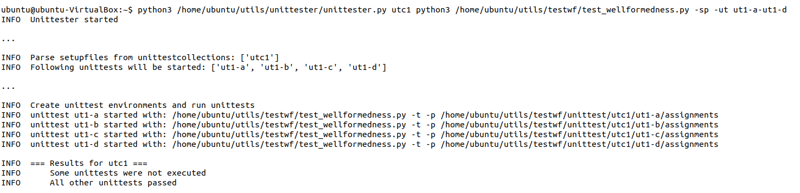
Time to unittest!

Slide 9
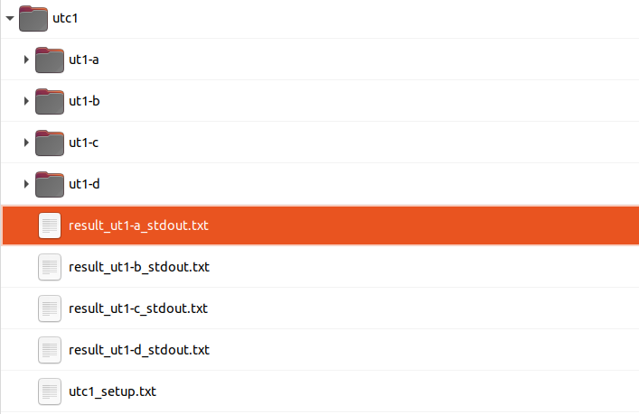
What happened?
(1) test environments were build:

Slide 10
(2) For each environment =>
Start the parser
Capture the output
Compare with expected result

Slide 11
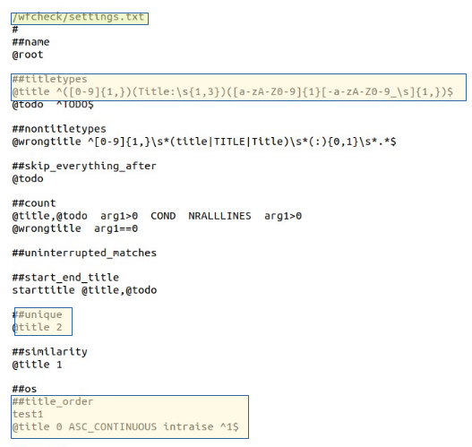
Finally: How the parser works
1. Identify titlelines in data with a regular expression
2. Perform tests:
unique test Are all titles unique?
title order test Check chapter numbers: incorrect: 1, 2, 2, 4, …

Slide 12
Parser latest version
Lots of new tests
Data can also be converted and exported

