Slide 1
Projects in 2019-2021
A new unit test application
A sophisticated data parser

Slide 2
Demonstration
Unit test the data parser

Slide 3
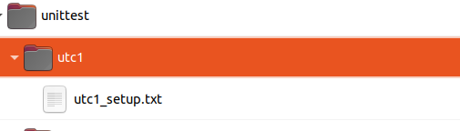
Add subfolder to parser project

Slide 4
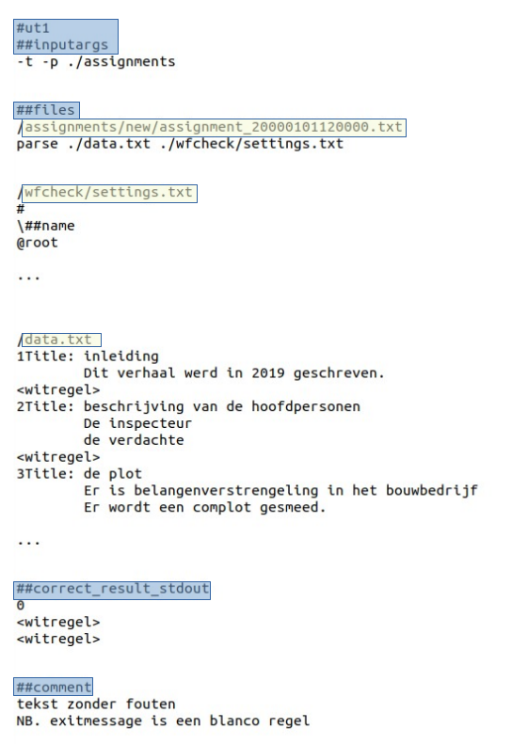
Write unittest 1
Define:
startup arguments
settingsfile
sample data
expected outcome

Slide 5
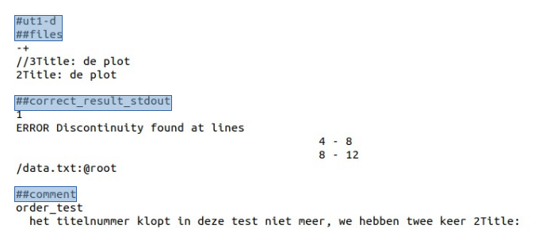
Write a unittest variant
Small change in original unittest
=>
New unittest !

Slide 6
Creating variants is too easy!

Slide 7
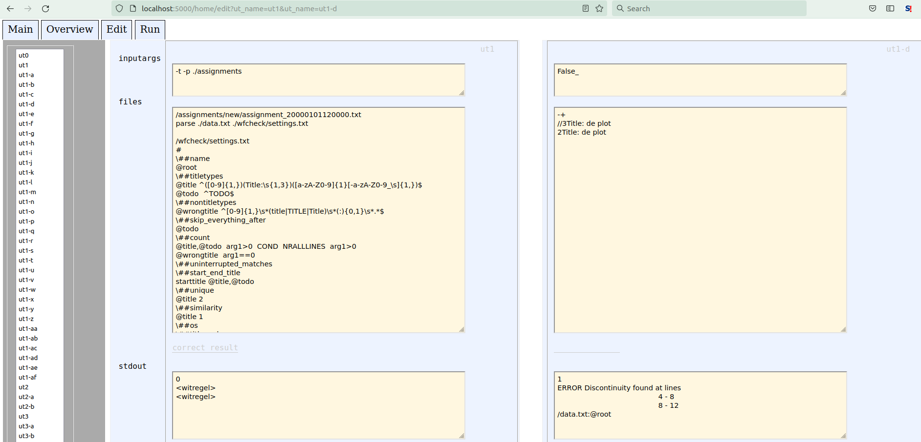
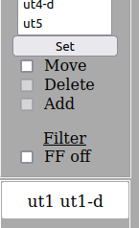
An edit tool makes life even more easy

Slide 8
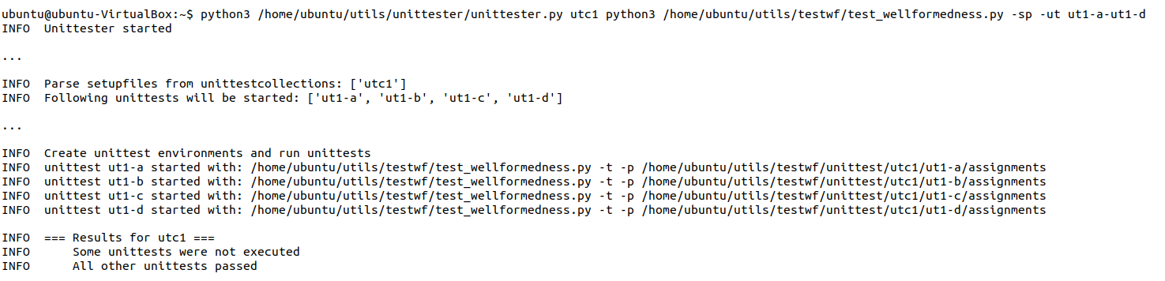
Time to unittest!

Slide 9
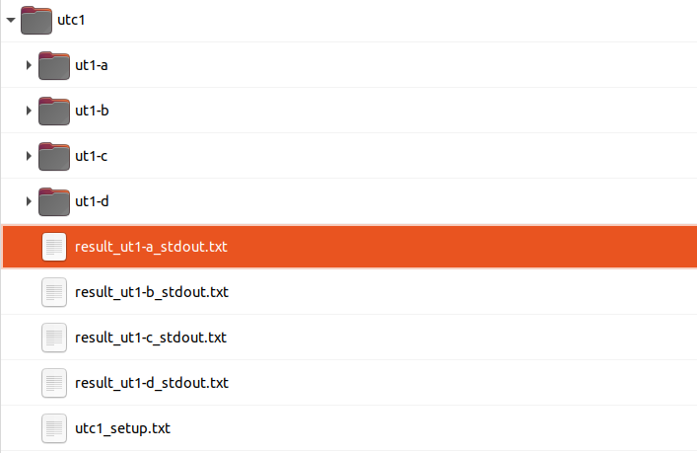
What happened?
(1) test environments were build:

Slide 10
What happened?
(2) For each environment =>
Start the parser
Capture the output
Compare with expected result

Slide 11
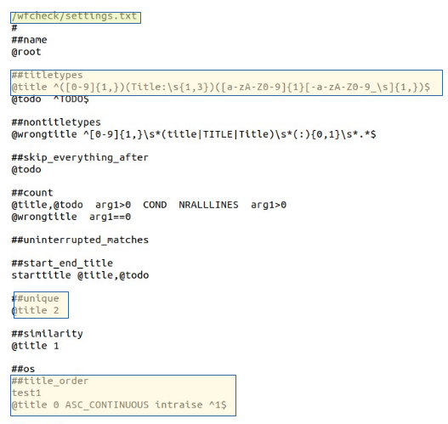
Finally: How the parser works
Identify titlelines with a regular expression
Perform tests:
unique test
Are all titles unique?
title order test
Check chapter numbers
incorrect: 1, 2, 2, 4, ...

