Slide 1
I wrote two test applications in the period 2019 – 2021
1. A unit test application
2. A data parser

Slide 2
I wrote two versions of the data parser:
1) The basic version parses data and performs consistency checks on the data.
2) The extended version also supports conversions on the data.

Slide 3
In the following example the unit test application is used to test the data parser.

Slide 4
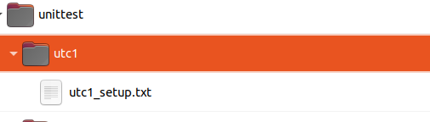
Unit tests are being defined in setup files. They can be found in a unittest folder, which is a required sub directory in the project folder of the application we want to test.
We group unit tests in unit test collections.
Here we see a setup file for unit test collection 1.

Slide 5
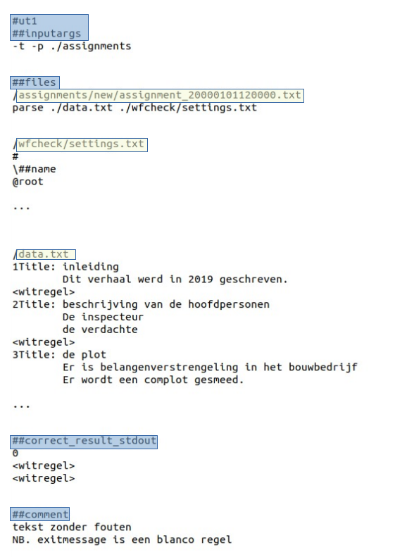
Here we see (a shortened version of) the definition of unit test 1 in the setup file.
We make clear with which arguments the parser should be started.
As the parser also needs a settings file and a data file, we also define which files need to be created.
Under correct_result_stdout we write the expected outcome in the terminal, in this case an exit code 0.

Slide 6
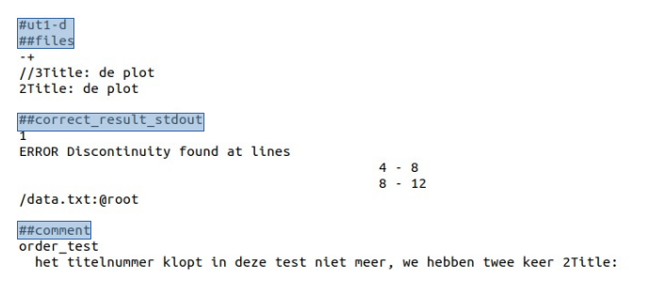
Here we define a variant on unit test 1.
This can be done very easily as the unit test application supports inheritance: a unique feature of this application!
We see that a specific (title)line in the previously defined file data.txt is being replaced with another (title)line.
We expect an error in the terminal this time and therefor set a new value for correct_result_stdout.
As the value for inputargs remains unchanged, we do not have to be concerned about it, as it is being inherited from unit test 1.

Slide 7
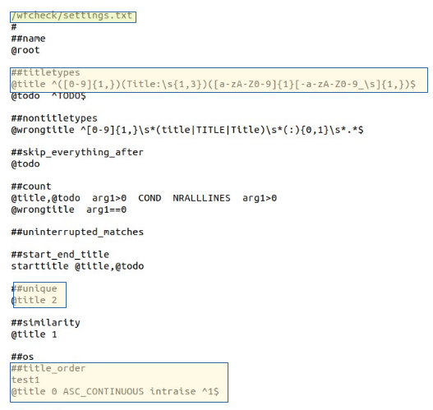
The parser identifies the titlelines in data.txt
with an in the settingsfile defined regular expression.
This allows the parser to group data. Quite complex groupings are possible, but is not demonstrated here.
The settingsfile tells the parser also how to test the data.
The unique test for example (see highlight), tests if every titleline in the collection of titlelines is unique.
The title order test (see highlight) tests the ordering of titlelines. It demands that the chapter numbers of the titlelines is an uninterrupted sequence.
This ordering for example, is incorrect:
1, 2, 2, 4, 5

Slide 8
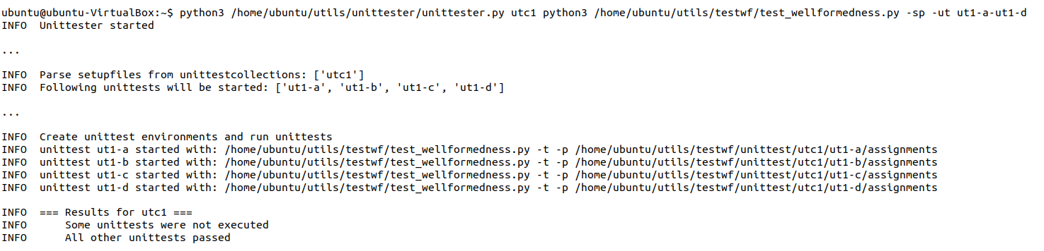
We now start the unit test application to test the parser:
Only a selection of the unit tests defined in unit test collection 1 is executed, and we see that all unit tests pass.

Slide 9
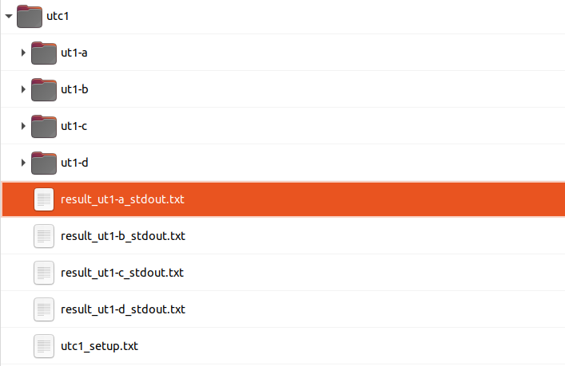
What happened?
For each unit test a working environment was made in the unit test folder.

Slide 10
In each environment the parser is being started with specific arguments that were defined in the corresponding unit test.
The output of the parser to the terminal (stdout) is captured, and compared with the expected result.

Slide 11
With this unit test application we can write a lot of unit tests in quite a short time!
In particular, if we use the Flask input tool, a very handy tool to edit setup files.

Slide 12
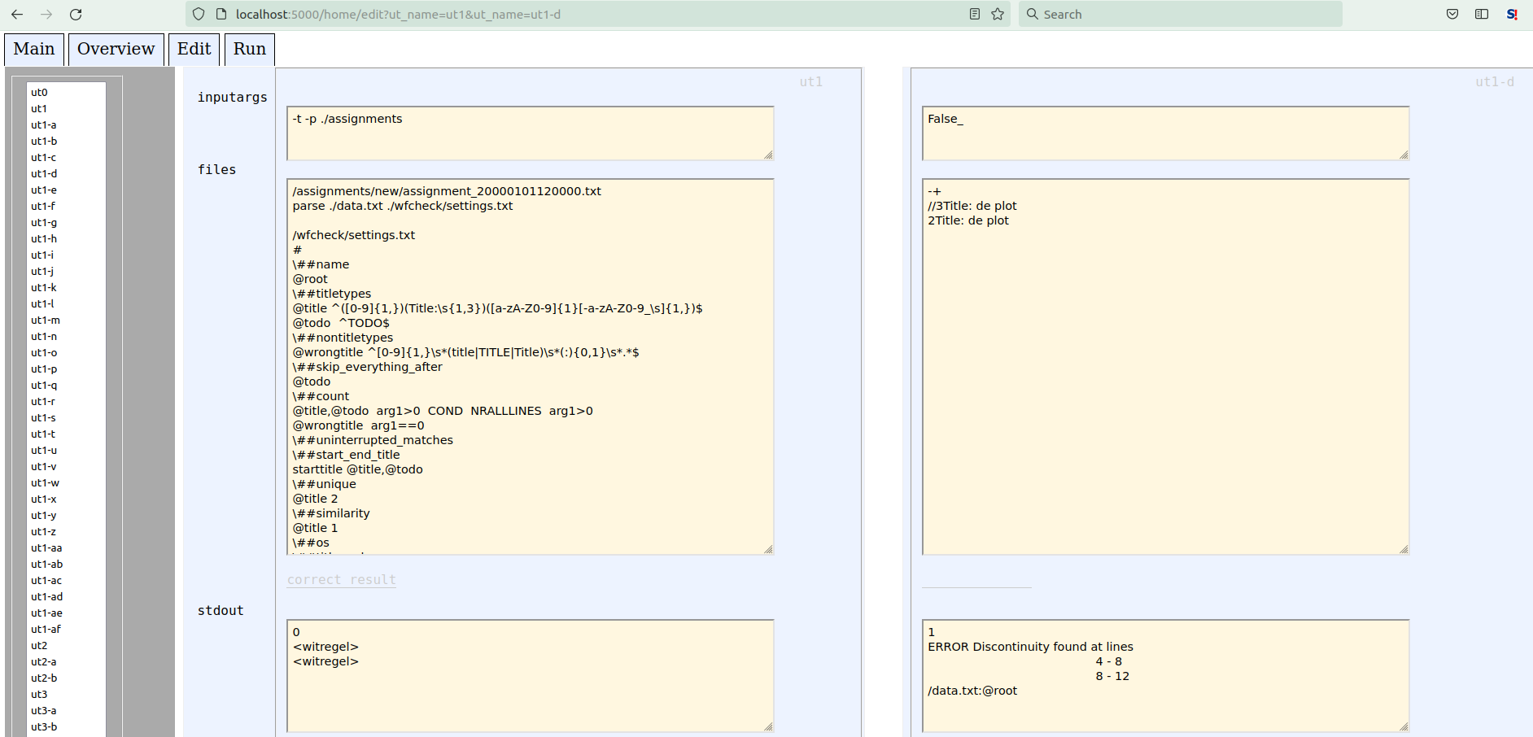
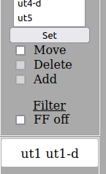
In this example, in the left part of the screen ut1 is shown, and in the right part unit test variant ut1-d
The input tool uses the API of the unit test application to read information from and write information to the setup file we are editing.

