Slide 1

Building a Restaurant Recommendation System with Foursquare
Jeremy Nathan

Slide 2
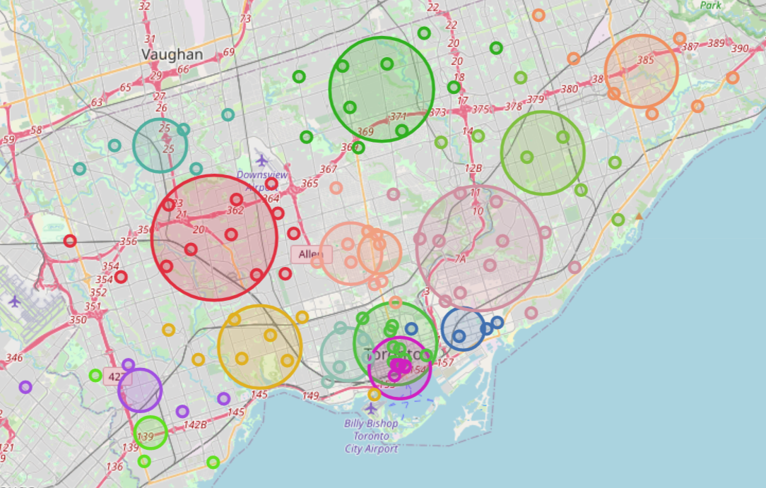
Motivation
Given an input restaurant, produce a list of recommended restaurants based on their similarity to the input restaurant’s attributes
Requirements: Fast, scalable, logical
Initially will focus on a subset of restaurants in Toronto

Slide 3
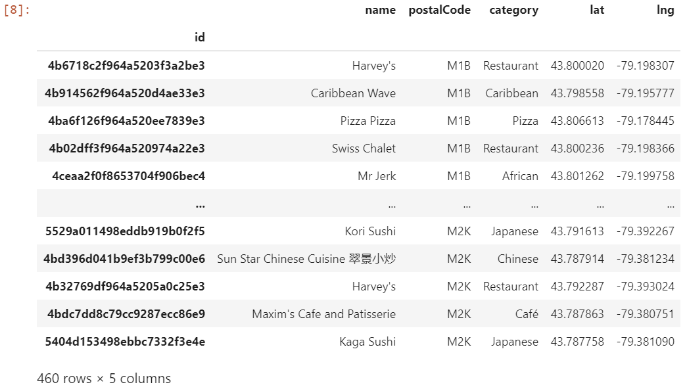
Data
Obtained from Foursquare API
2 Endpoints used: Explore, Venue Likes
Focused on restaurants in Scarborough, Toronto for prototype
Preprocessing: dropping duplicates, fast-food restaurants
~460 restaurant sample size

Slide 4
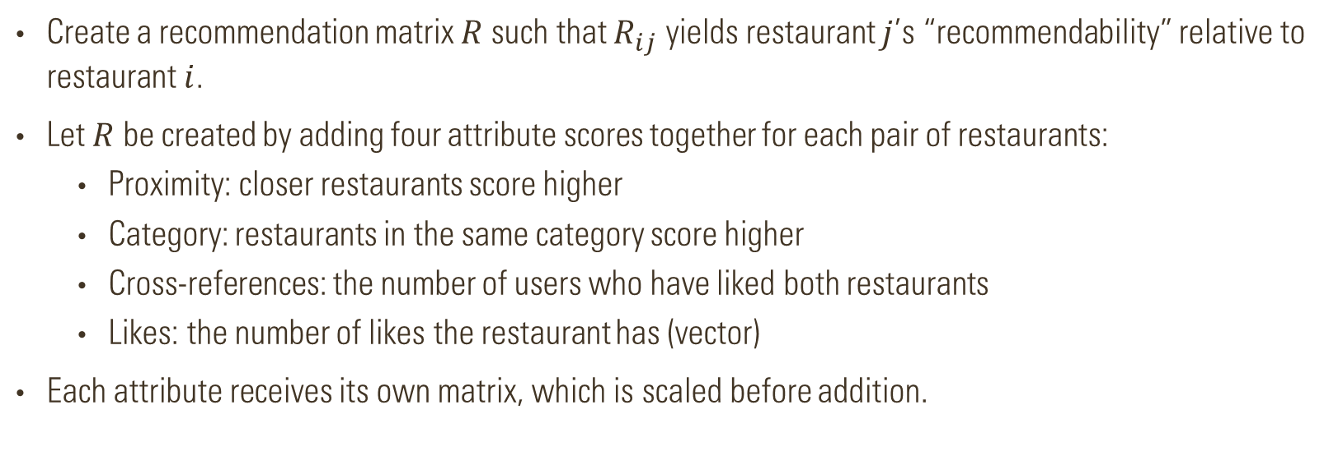
Methodology
Create a recommendation matrix $R$ such that $R_{ij}$ yields restaurant $j$’s “recommendability” relative to restaurant $i$.
Let $R$ be created by adding four attribute scores together for each pair of restaurants:
Proximity: closer restaurants score higher
Category: restaurants in the same category score higher
Cross-references: the number of users who have liked both restaurants
Likes: the number of likes the restaurant has (vector)
Each attribute receives its own matrix, which is scaled before addition.

Slide 5
Scaling
Before attribute matrices can be added, they must be scaled to same range
Four different scaling combinations tested
Row-wise min-max scaling selected
Min-max scaling guarantees that values will fall between 0 and 1, and that shape of distribution is preserved
Scaling of entire row ensures that each row ranges from 0 to 1, as opposed to a subset
Summary of Scaling Methods Examined |  | Scaling Type
 |  | Min-Max | Standardization
Subarray Selection | Row-wise | Selected | Rejected
 | Triangular | Rejected | Rejected

Slide 6
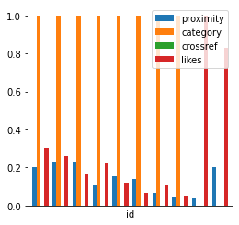
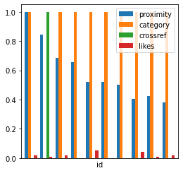
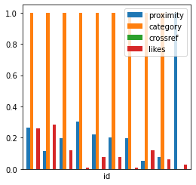
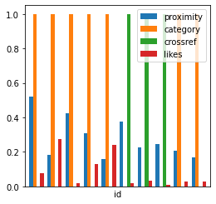
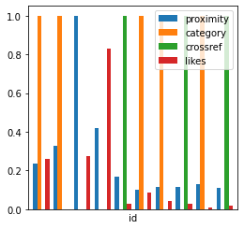
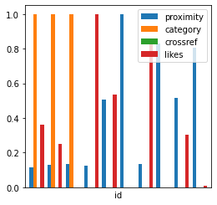
Results
Each factor shown to influence recommendation matrix
Across 6 trial restaurants, restaurants that scored highly in one or more of each attribute are well represented

Slide 7
conclusion
Solution is fast
Pre-computed recommendation matrix ensures instantaneous lookups
Solution is scalable
Matrix operations can be applied to whatever sample size of restaurants provided
Solution provides logical results
Each attribute has an equal opportunity to influence the final recommendation matrix

Slide 8
Thank you for reviewing!

