Slide 2
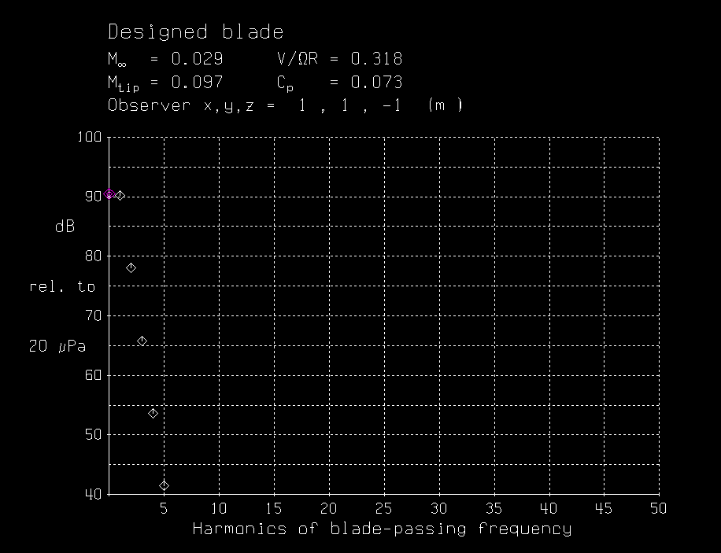
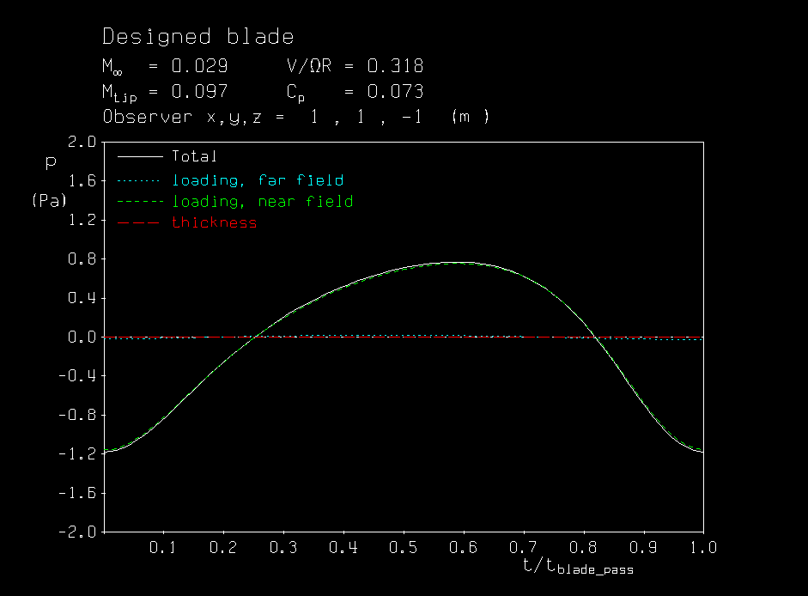
The individual dB value for each component is defined relative to 20 microPascals:
Acoustic Pressure Signature
Decibel Spectrum

Slide 3
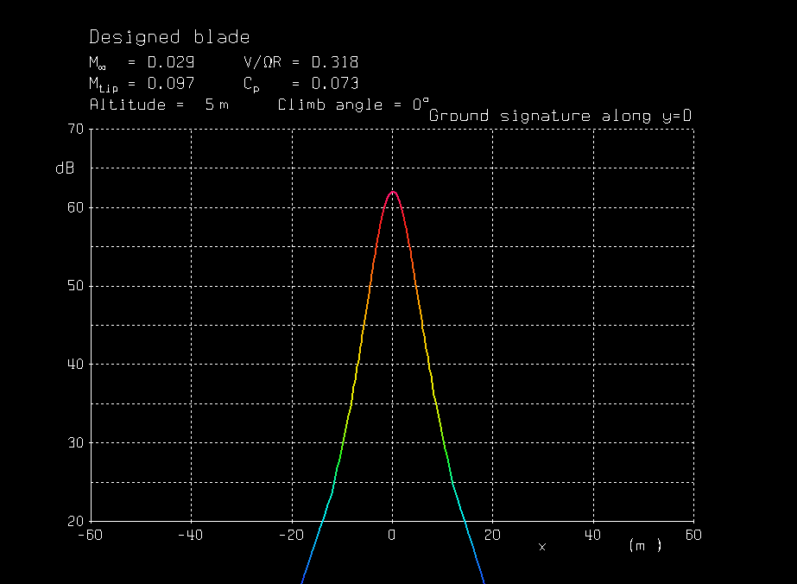
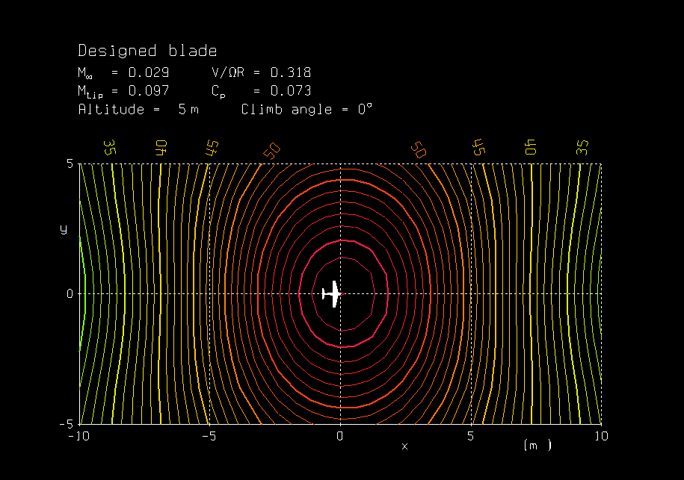
The individual dB value for each component is defined relative to 20 microPascals:
Ground Plane db Footprint
Decibel footprint contours on ground plane

