Slide 1
DevSecOps What Why and How?

Slide 2
Agenda
What is DevSecOps?
Why do we need DevSecOps?
How do we do DevSecOps?
Integrate Security in DevOps Pipeline
Tools of Trade
Sample Implementation (On Prem and Cloud Native)
Case Studies

Slide 3
Disclaimer
I will be listing a lot of tools, It’s not an exhaustive list
I don't endorse or recommend any specific tool / vendor
Every environment is different: Test and validate before implementing any ideas

Slide 4
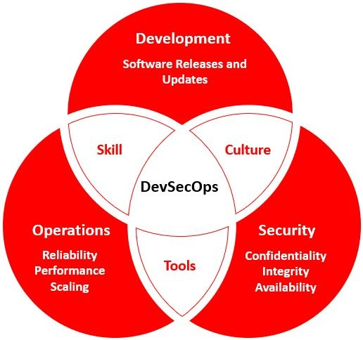
What is DevSecOps?
Effort to strive for “Secure by Default”
Integrate Security via tools
Create Security as Code culture
Promote cross skilling

Slide 5
Why do we need DevSecOps?
DevOps moves at rapid pace, traditional security just can’t keep up
DevSecOps makes it easier to manage rapid pace of development & large scale secure deployments
DevSecOps allows for much smoother scaling of process
Security as part of process is the only way to ensure safety

Slide 6
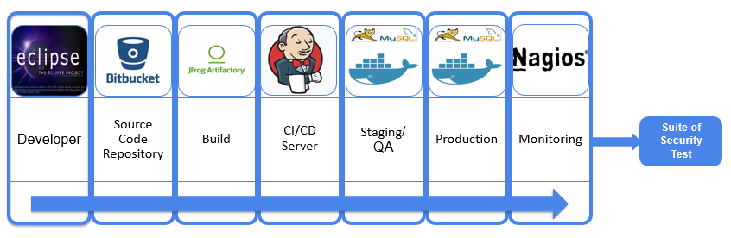
Shifting Left saves cost & time

Slide 7
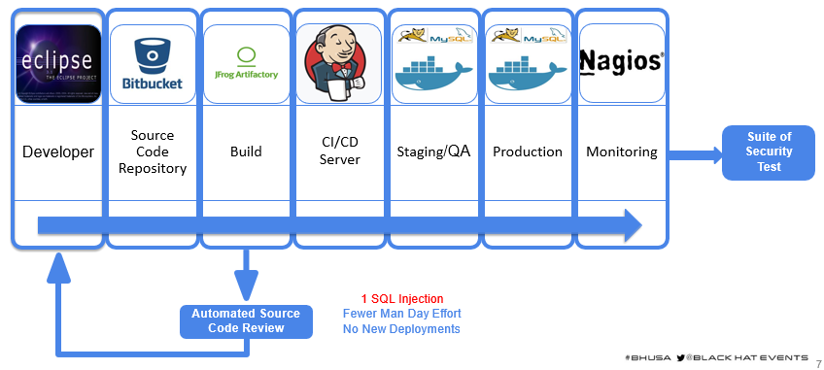

Shifting Left saves cost & time

Slide 8
How do we do DevSecOps?
DevSecOps is Automation + Cultural Changes
Integrate security tools into your DevOps Pipeline
Enable cultural changes to embrace DevSecOps

Slide 9
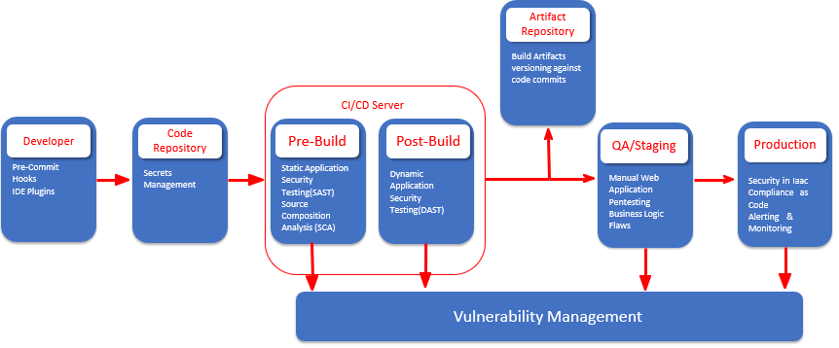
Injecting Sec in DevOps

Slide 10
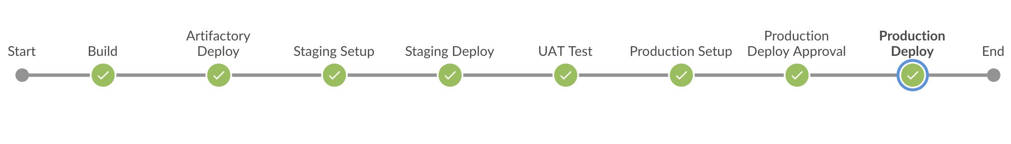
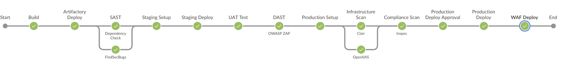
DevOps ---> DevSecOps
DevOps Pipeline
.
DevSecOps Pipeline

Slide 11
Pre-Commit Hooks
Sensitive information such as the access keys, access tokens, SSH keys etc. are often erroneously leaked due to accidental git commits
Pre-commit hooks can be installed on developer’s workstations to avoid the same
Work on pure Regex-based approach for filtering sensitive data

Slide 12
IDE Security Plugin
IDE Plugin's provide quick actionable pointer to developers
It is useful to stop silly security blunders
Work on pure Regex-based approach

Slide 13
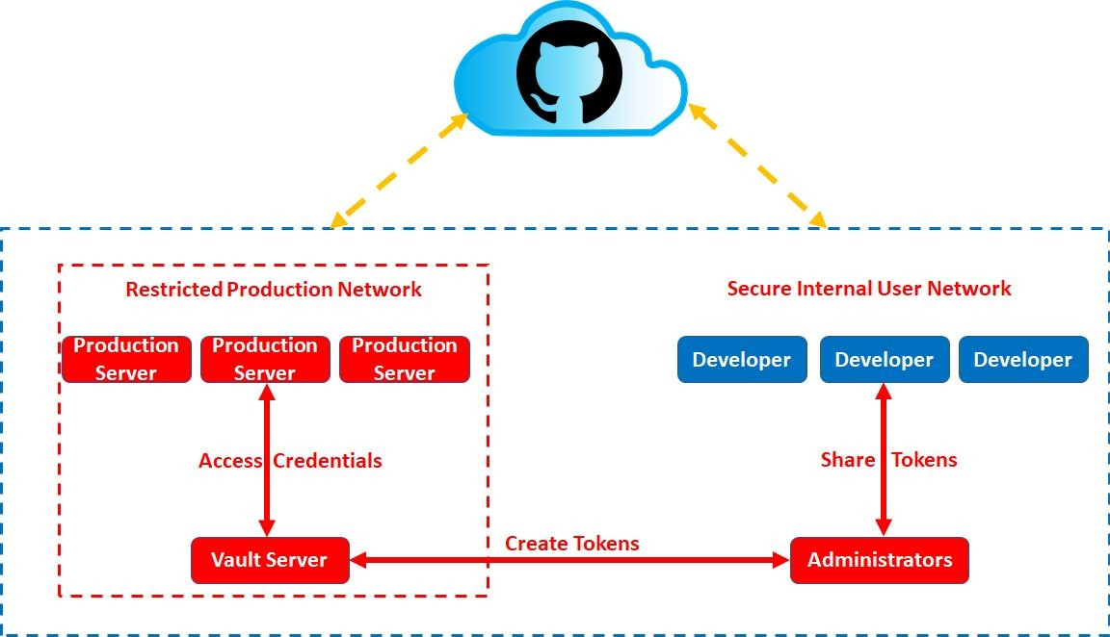
Secrets Management
Often credentials are stored in config files
Leakage can result in abuse scenario
Secrets Management allows you to tokenize the information

Slide 14
Software Composition Analysis
We don’t write software's, we build on frameworks
Biggest portion of software is now third party libraries
Major languages provide module managements
PIP, NPM, Gems, go get, perl cpan, php packager and more
Software Composition Analysis performs checks to identify vulnerable/outdated 3rd party libraries

Slide 15
Static Analysis Security Testing
White-box security testing using automated tools
Useful for weeding out low-hanging fruits like SQL Injection, Cross-Site Scripting, insecure libraries etc
Tool by default configured with generic setting, needs manual oversight for managing false-positives

Slide 16
Dynamic Analysis Security Testing
Black/Grey-box security testing using automated tools
SAST may not get full picture without application deployment
DAST will help in picking out deployment specific issues
Results from DAST and SAST can be compared to weed out false-positives
Tools may need prior set of configuration settings to give good results

Slide 17
Security in Infrastructure as Code
Infrastructure as a code allows you to document and version control the infra
It also allows you to perform audit on the infrastructure
Docker / K8s infra relies on base images
Environment is as secure as the base image
Base images need to be minimal in nature and need to be assessed to identify inherited vulnerabilities

Slide 18
Compliance as Code
Compliance could be industry standard (PCI DSS, HIPAA, SOX) or org specific
Compliance is essentially a set of rules and hence can be converted into written test cases
Having written code format this can again be version controlled

Slide 19
Vulnerability Management
All the tools discussed above result in report fatigue
Every tool has a different style of presentation
A central dashboard is required to normalize the data
Vulnerability Management System can then be integrated to bug tracking systems to allow devs to work on items

Slide 20
Alerting and Monitoring
Monitoring is needed for two end goals
Understand if our security controls are effective
What and where we need to improve
To test Security control effectiveness:
When did an attack occur
Was it blocked or not
What level of access was achieved
what data was bought in and bought out

Slide 21
Asset Monitoring
With recent advancements assets now should include anything and everything where organization data resides
With rapid development & provisioning the asset inventory can't be a static inventory
We need to monitor the assets constantly both on premise and Cloud

Slide 22
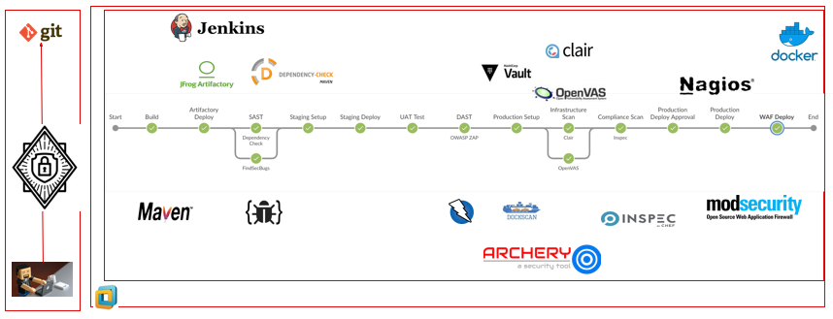
Sample Implementation - Java
A simplistic flow of DevSecOps Pipeline incorporating various stages

Slide 23
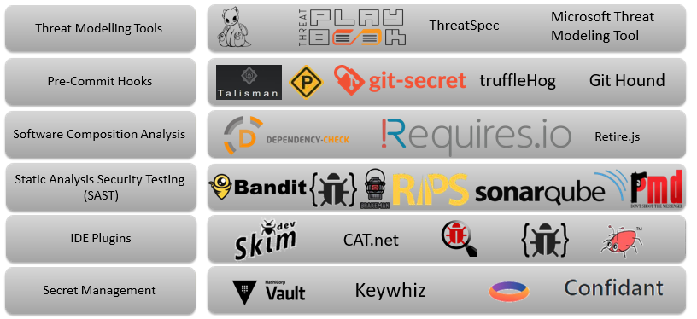
Tools of The Trade

Slide 24
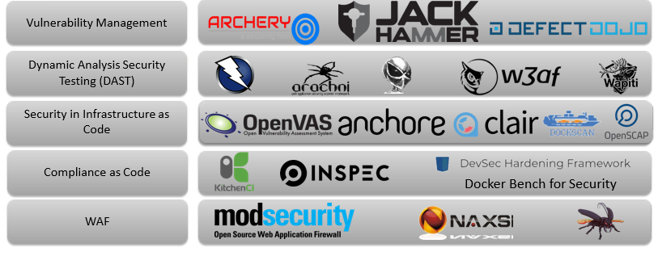
Tools of The Trade

Slide 25
To be or Not to Be in Pipeline
API / command line access
Execution start to final output should be 15 minutes max
Tools should be Containerizable / scriptable
Minimal licensing limitations (parallel scans or threads)
Output format parsable / machine readable (no to stdout, yes to json / xml)
Configurable to counter false negatives / false positives

Slide 26
Pipeline Optimization
Pipeline to be tweaked based on Milestone (Initiative/Epic/Story)
Remember initial onboarding is tedious
Ensure dataset dependent tool get frequent data refresh
Sample optimization
Only CSS Changes: no need for SCA
Only pom.xml or gradle changes: no need of SAST
If Infra as code has zero changes skip or fast track infra scan
Ensure to run full (non optimized) pipeline periodically

Slide 27
Does Programming Language Matter
Different programming languages need different tools for static analysis and software composition analysis
Some tools support multiple languages like sonarqube
Others are focused on one language

Slide 28
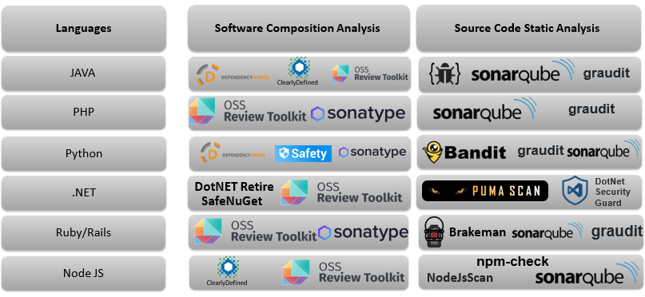
Language Specific Tools

Slide 29
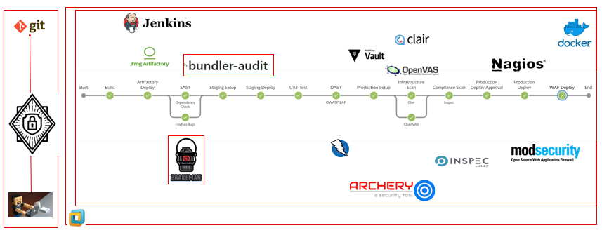
DevSecOps Lab - Ruby

Slide 30
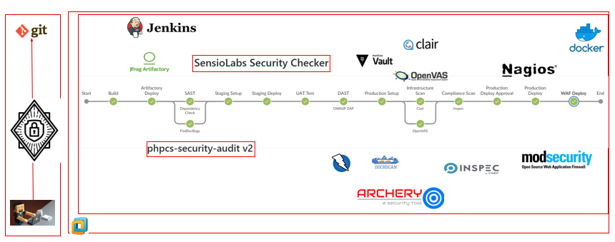
DevSecOps Lab - PHP

Slide 31
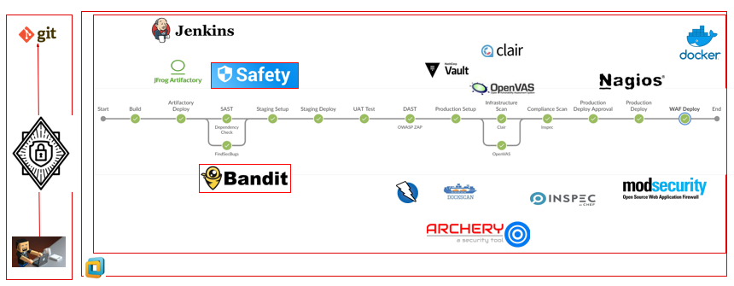
DevSecOps Lab - Python

Slide 32
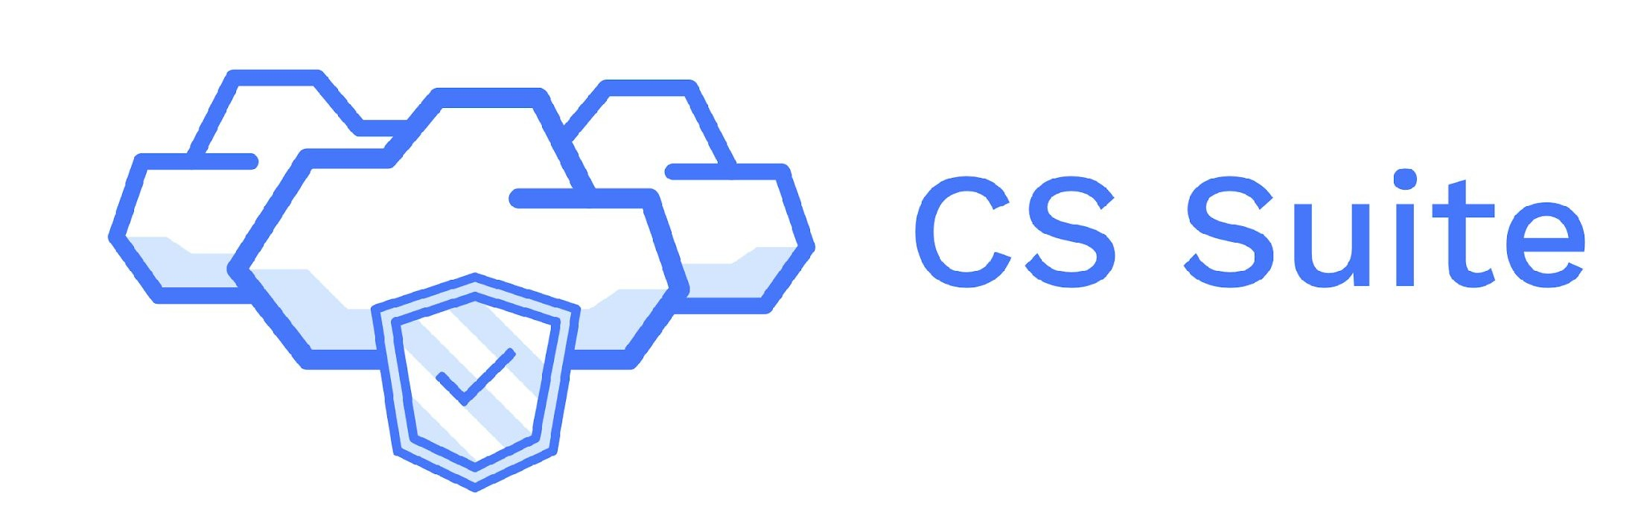

What about Cloud
The Threat Landscape changes
Identity and Access Management
Asset Inventory
Billing
Infrastructure as Code allows quick audit / linting
Focus more on:
Security groups
Permissions to resources
Rogue / shadow admins
Forgotten resources (compromises / billing)

Slide 33
Cloud Native Approach to Security
Different Service Providers Approach Security Differently
All of them provide some of the ingredient in-house
Irrespective of Cloud provider some tools will still need to be sourced
Static Code Analysis Tool
Dynamic Code Analysis Tool
Software Composition Analysis
Vulnerability Management Tool

Slide 34
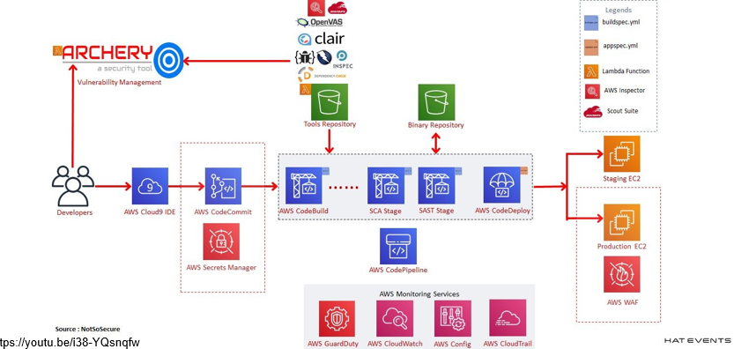
AWS Cloud Native DevSecOps

Slide 35
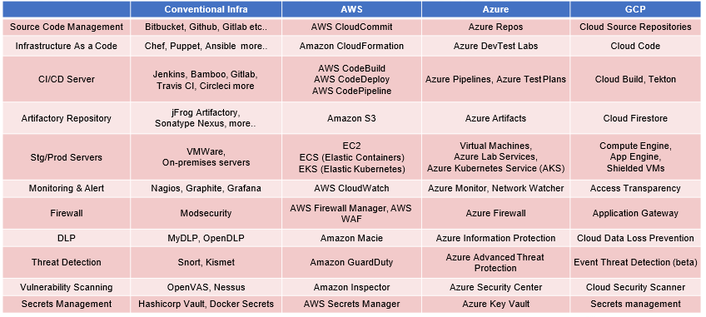
Cloud Native Dev[Sec]Ops

Slide 36
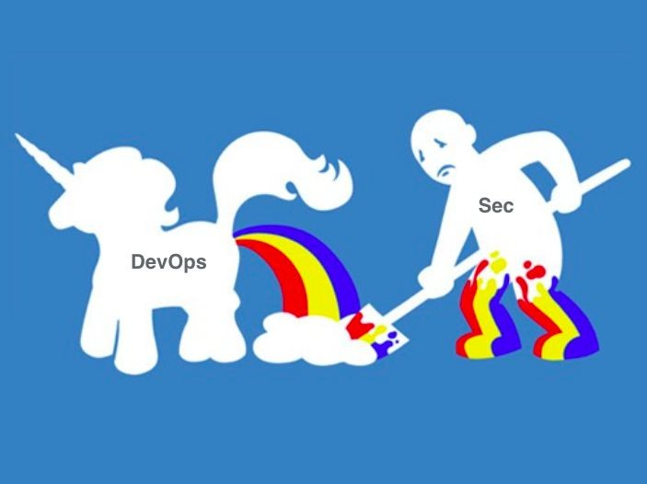

Cultural Aspect
Automation alone will not solve the problems
Encourage security mindset especially if outside sec team
Cultivate/Identify common goals for greater good
Build allies (security champions) in company
Focus on collaboration and inclusive culture
Avoid Blame Game
Security team should try to eliminate the need of dedicated security team

Slide 37
Security Champion
Bridge between Dev, Sec and Ops teams
Single Person per team
Everyone provided with similar cross skilling opportunities
Incentivize other teams to collaborate with Sec team
Internal Bug bounties
Sponsor Interactions (Parties / get-togethers)
Sponsor cross skilling trainings for other teams

Slide 38
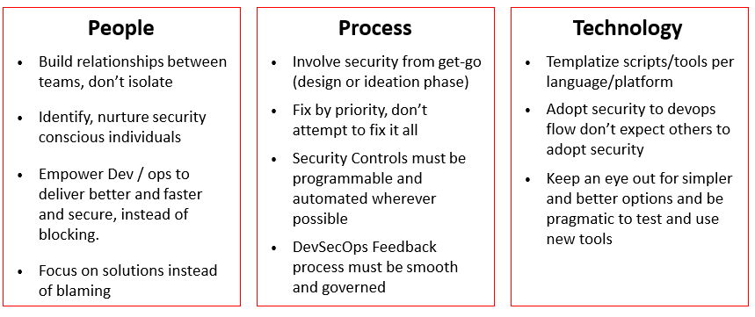
Security Enablers

Slide 39
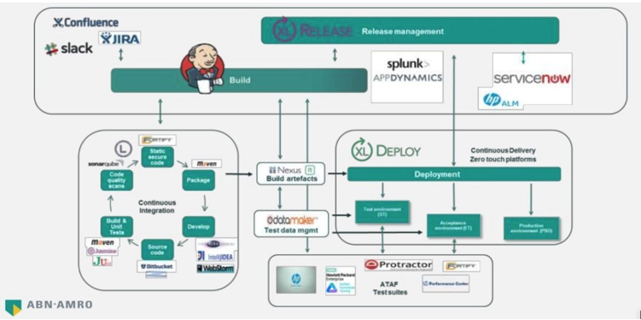
Case Studies – ABN Amro

Slide 40
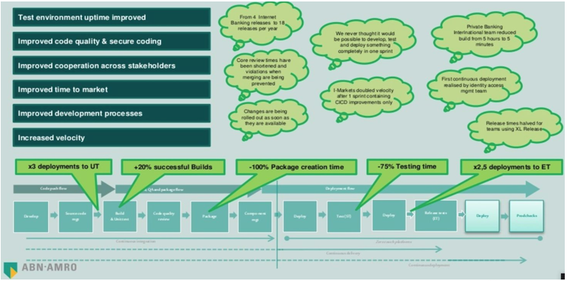
Case Studies – ABN Amro

Slide 41
Thank you

