Slide 1

Terraform

Slide 2
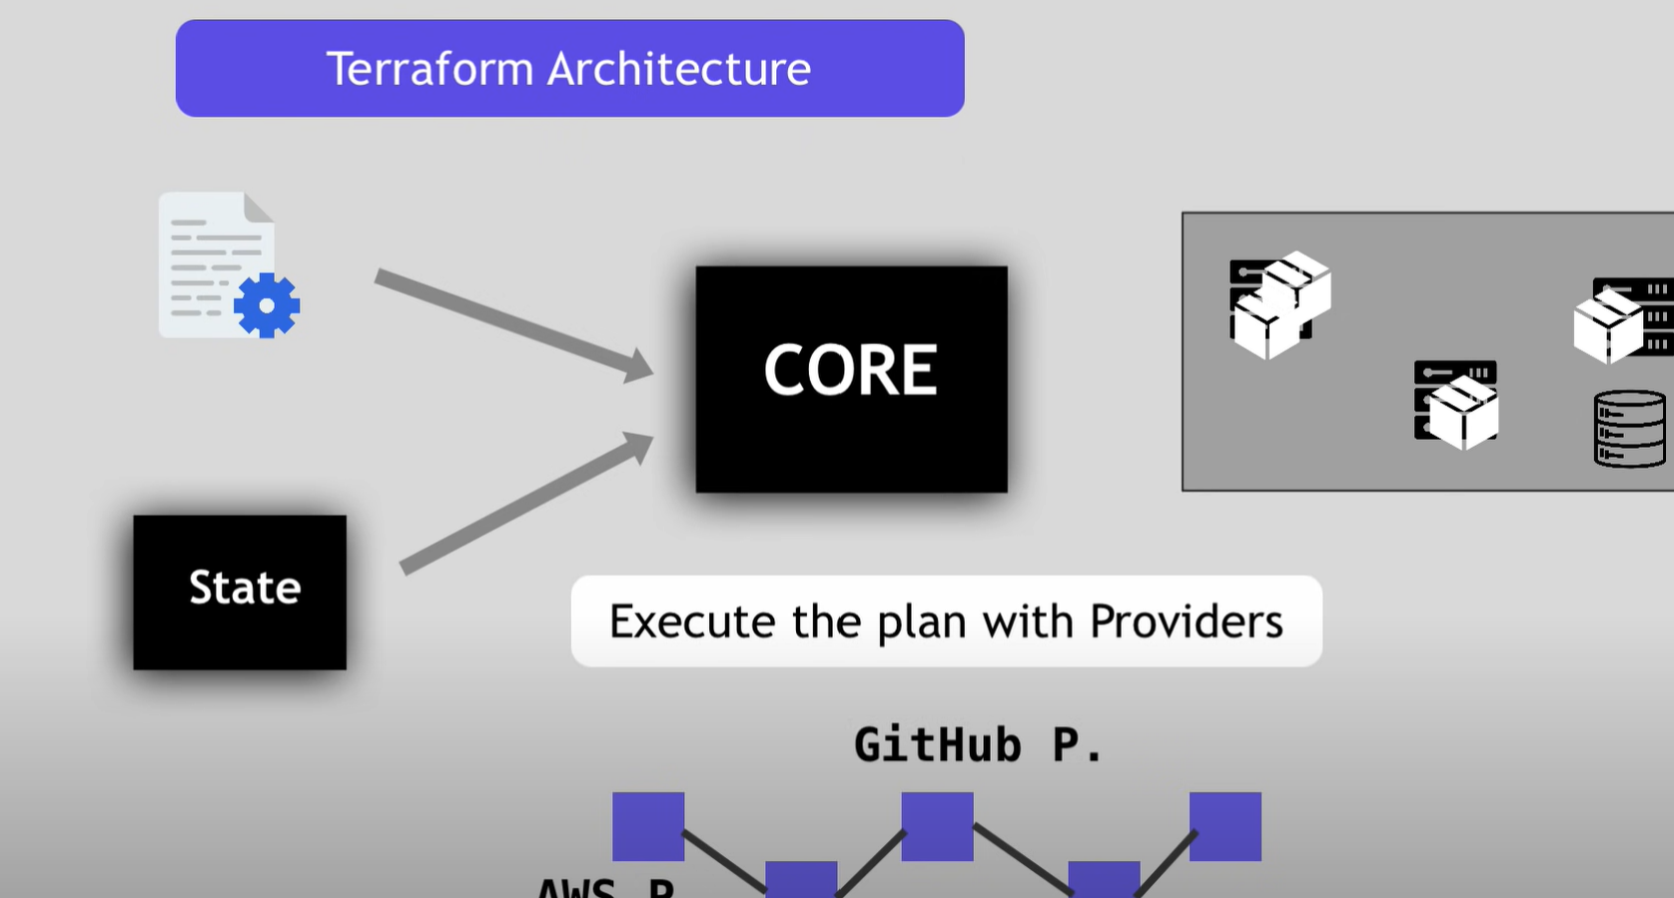

Slide 3
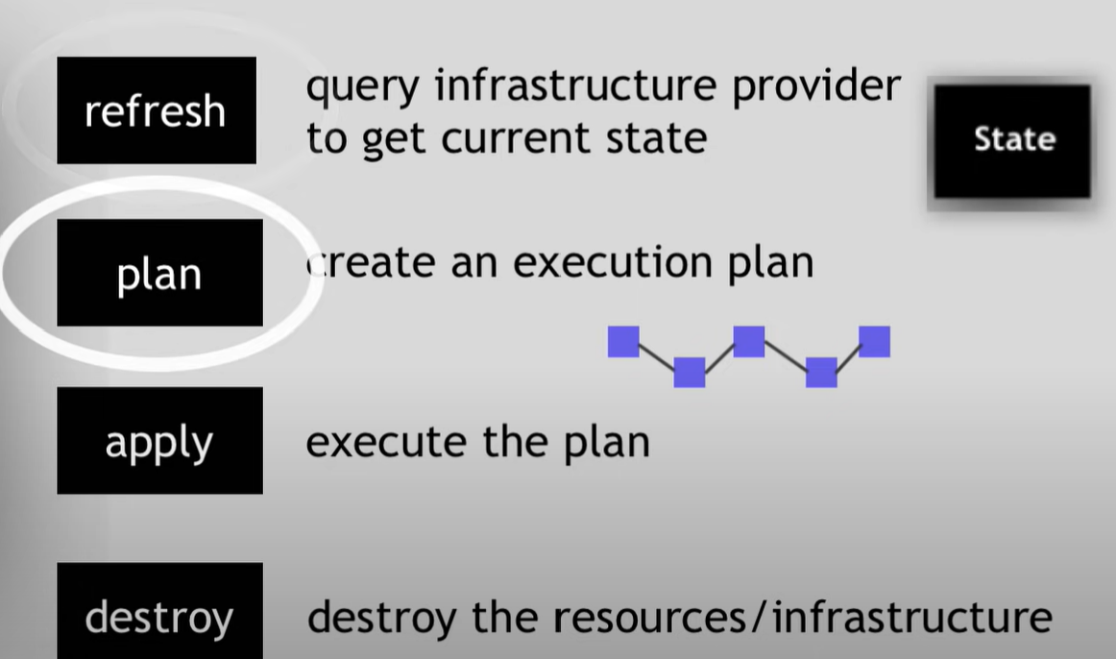
Process in the core

Slide 4
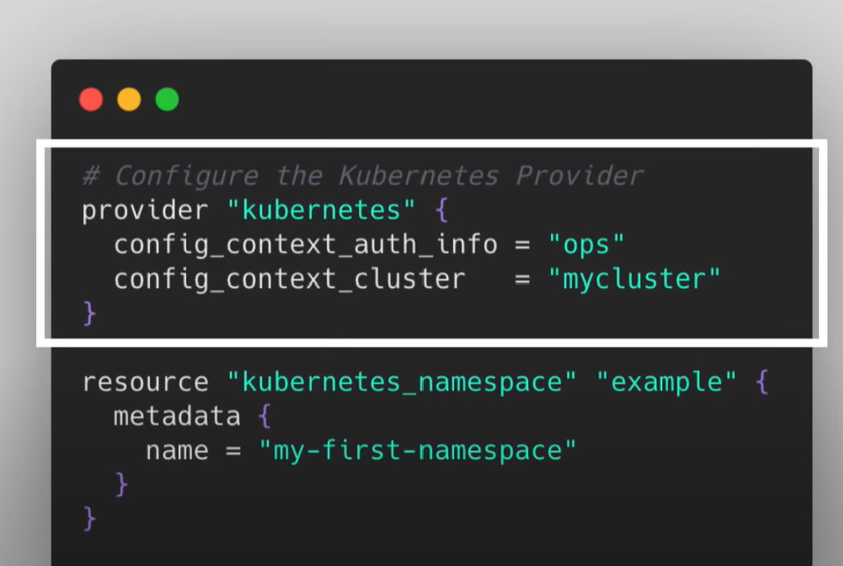
Terraform templets

Slide 5

Thank you

