Slide 1
Descoberta de Conhecimento
Dataset MORBIMORTALIDADE
Hugo Carvalho
Marcos Luís
João Almeida

Slide 2
Business Understanding

Slide 3
Introduction – Business Understanting
Health studies are some of the more complex, specially because of the envolvement of different areas. Applying essays and studies like this one, give great support to the community by helping the professionals involved in different stages such as diagnostic, treatment and general lookover of each patient situation.
In our case, we believe our work will help patients and medical staff, by studying certain patterns found in the former and the way each one deals with a specific disease: breast cancer.
Breast cancer is the 3rd most common type of cancer among all individuals, and the most common type among women. Fortunately the survival rate of this type of cancer as increased during the last 40 years, and it currently stands at a rate of 93% chance of survival over a period of five years.
Cancer is a disease that causes abnormal cell growth in a certain body tissue that has the potential to spread to other body parts.

Slide 4
Business Understanding
Our dataset deals with the numerous information found in 176 cases of breast cancer. It provides information about the personal history of each patient, information about the treatmente each one received and the postoperative complications that may have arised.
Objetive:
Predict the number of days of hospitalization associated with each surgery
Tools:
WEKA
R
Linear Regression

Slide 5
Data Understanding

Slide 6
Data Understanding
Dataset Description:
176 Entries;
23 Attributes.
4 groups: Personal history, Surgery, Post-operative and Complications

Slide 7
Dataset Attributes
Nome
Idade
Tabaco
Diabetes
Imunoss
Hipocoag
Qrx NA
Dias
Antibiot.
Hipocoag.
Personal history
Post-operative
Data Cx
Cx/Ambulatório
Bem./Malig.
Diagnóstico
Lateralidade
Intervenção Mama
Intervenção Axila
Outras Intervenções
Data dx
Dias após-op
Complicação
Tratamento
Dias Tx.
Surgery
Complications

Slide 8
Dataset Attributes
Personal history | Surgery | Post-operative | Complication
Attribute | Type | Range of Values
Nome | String | -
Idade | Int | -
Tabaco | Boolean | Sim/Não
Diabetes | Boolean | Sim/Não
Imunoss | Boolean | Sim/Não
Hipocoag | Boolean | Sim/Não
Qtx Na | Boolean | Sim/Não
Attribute | Type | Range of Values
Data Cx | String | -
Cx/Ambul. | Boolean | Cx/Ambul.
Ben/Malig | Boolean | Ben/Malig
Diagnóstico | String | -
Lateralidade | Boolean | D/E
Int. Mama | String | -
Int. Axila | String | -
Outras Int. | String | -
Attribute | Type | Range of Values
Dias | Inteiro | -
Antibiot. | Boolean | Sim/Não
Hipocoag | Boolean | Sim/Não
Attribute | Type | Range of Values
Data Dx | Data | -
Dias após-op | Int | [0,26]
Complic. | String | -
Tratamento | String | -
Dias Tx.

Slide 9
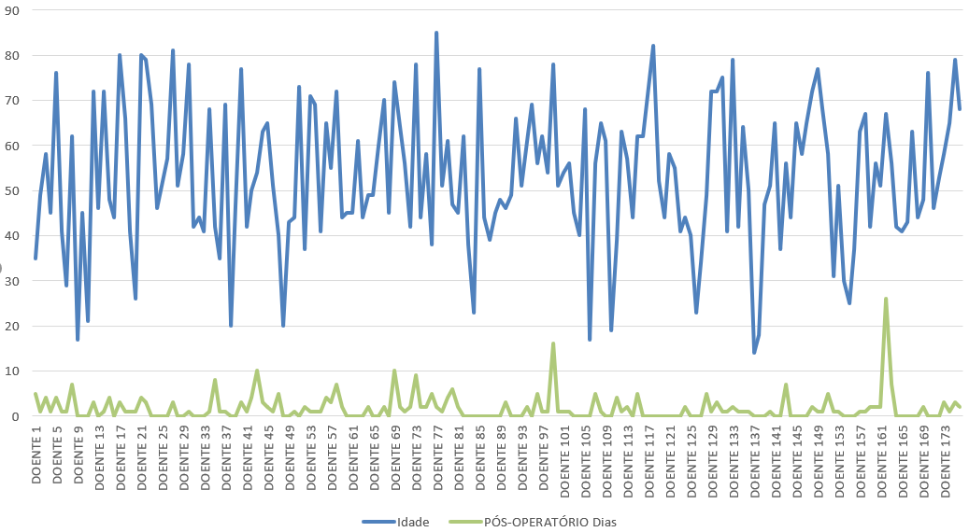

Slide 10
Data Quality
Duplication
There no duplicate data in dataset
Missing Values
Missing Attributes
For example, "tx days" has no records
Attribute redundancy
Same value with different names

Slide 11
Descoberta de Conhecimento
Dataset MORBIMORTALIDADE
Hugo Carvalho
Marcos Luís
João Almeida

