Slide 1
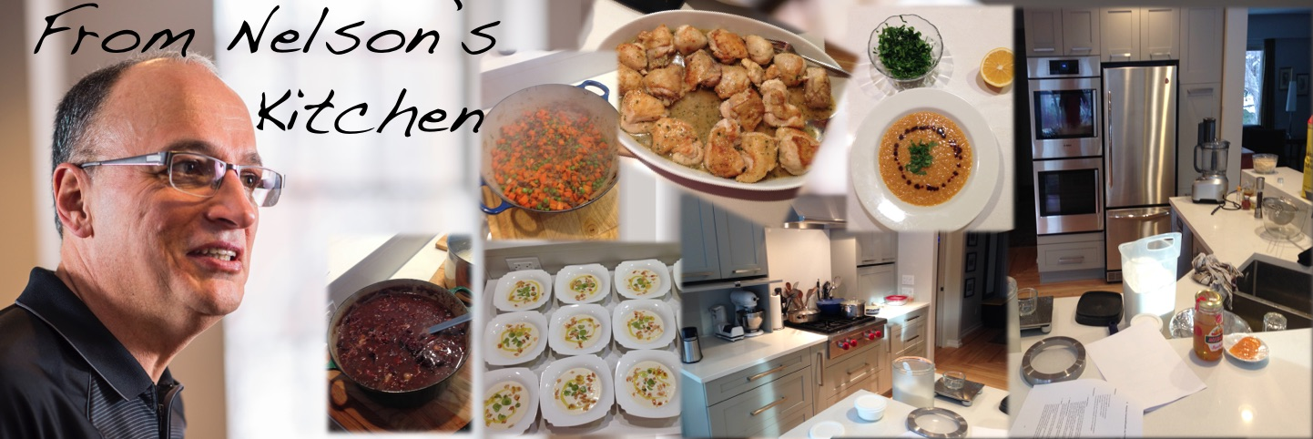
www.fromnelsonskitchen.site

