Slide 1
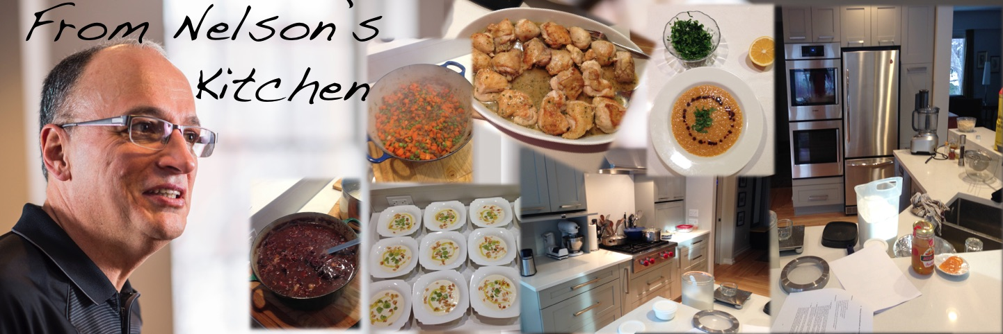
http://webdocs.cs.ualberta.ca/
~amaral/FromNelsonsKitchen/
http://webdocs.cs.ualberta.ca/
~amaral/FromNelsonsKitchen/
http://webdocs.cs.ualberta.ca/
~amaral/FromNelsonsKitchen/
http://webdocs.cs.ualberta.ca/
~amaral/FromNelsonsKitchen/
http://webdocs.cs.ualberta.ca/
~amaral/FromNelsonsKitchen/
http://webdocs.cs.ualberta.ca/
~amaral/FromNelsonsKitchen/
http://webdocs.cs.ualberta.ca/
~amaral/FromNelsonsKitchen/
http://webdocs.cs.ualberta.ca/
~amaral/FromNelsonsKitchen/
http://webdocs.cs.ualberta.ca/
~amaral/FromNelsonsKitchen/
http://webdocs.cs.ualberta.ca/
~amaral/FromNelsonsKitchen/

