Slide 1
The Use of Traces for Inlining in Java Programs
Borys J. Bradel
Tarek S. Abdelrahman
Edward S. Rogers Sr.Department of Electrical and Computer Engineering
University of Toronto
Toronto, Ontario, Canada

Slide 2
Introduction
Feedback-directed systems provide information to a compiler regarding program behaviour
Examples:
  Jikes RVM [AFG+00]
  Open Runtime Platform [Mic03]
Source Code
Compiler
Program
Feedback

Slide 3
Work Overview
Explore whether traces are useful in offline feedback directed systems
Create trace collection system for Jikes
Use traces to guide Jikes’s built in optimizing compiler
  Help with a single optimization, inlining
  Improves execution time

Slide 4
Outline
Background
Implementation
Results
Related work
Conclusion

Slide 5
Trace Definition
A trace is a frequently executed sequence of unique basic blocks or instructions
B0
a=0
i=0
goto B2
Trace 1
public static int foo() {
int a=0;
for (int i=0;i<5;i++)
a++;
return a;
}
B1
a+=i
i++
B2
if (i<5) goto B1
B3
return a

Slide 6
Traces and Optimization
Traces may offer a better opportunity for optimization:
  Enable inter-procedural analysis
  Reduce the amount of instructions optimized
  Simplify the control flow graph, allowing for more optimization

Slide 7
Multiple Methods
Inter-procedural analysis without an additional framework
Increase possibility of optimization
  B1,A1,B2 can be simplified to two instructions
    a+=(5+i)
    i++
B0
B1
call g(i)
Trace 1
A1
t=5+i
return t
B2
t=returned value
a+=t
i++
B3
B4

Slide 8
Fewer Instructions
Fewer instructions to optimize
May allow for extra optimization
  If know that B3 is executed then know that t=5
B0
Trace 1
B1
B2: t=f(...)
B3: t=5
B4
B5
B6
B6

Slide 9
Trace Exits
Traces usually contain many basic blocks
Traces may not execute completely
  Unlike basic blocks
B0
Trace 1
B1
B2
B3
B4
B5
B6
B6

Slide 10
Trace Collection System
Monitor program execution
Record traces
Start traces at frequently occurring events
  Backward branches
  Trace exits
  Returns
Stop at backward branches and trace starts
Captures frequently executed loops and functions
B0
a=0
i=0
goto B2
Trace 1
B1
a+=i
i++
B2
if (i<5) goto B1
B3
return a

Slide 11
Jikes
Baseline
Compiler
Program
Optimizing
Compiler
Adaptive
System

Slide 12
Jikes and our TCS
Baseline
Compiler
Program
Optimizing
Compiler
Inform TCS
Adaptive
System
TCS
Trace
Information

Slide 13
Jikes – Second Phase
Baseline
Compiler
Program
Optimizing
Compiler
Adaptive
System
Trace
Information

Slide 14
Inlining and Traces
Traces are executed frequently
Therefore invocations on traces should be inlined
  Reduce invocation overhead
  Allow for more opportunities for optimization
May lead to large code expansion
a:call b()
b: …
method a()
…
invoke b()
…
method b()
…

Slide 15
Code Expansion Control
There are ways to control inline expansion
Inline sequences [HG03,BB04]
Selectively inlining:
  What if compile method a()?
  What if compile method b()?
a:call b()
b:call c()
c:…

Slide 16
Code Expansion Control
Compile method a()
  Inline methods b() and c()
Compile method b()
  No inlining
method a()
…
invoke b()
…
method b()
…
invoke c()
…
method c()
…
method b()
…
invoke c()
…
method c()
…

Slide 17
Results
Provide inline information to Jikes based on previous executions
Compare our approach to two others:
  Inline information provided by the Adaptive system of Jikes
  A greedy algorithm based on work by Arnold et al. [Arn00]
Evaluate two approaches: Just in Time and Ahead of Time
Measure overhead of system

Slide 18
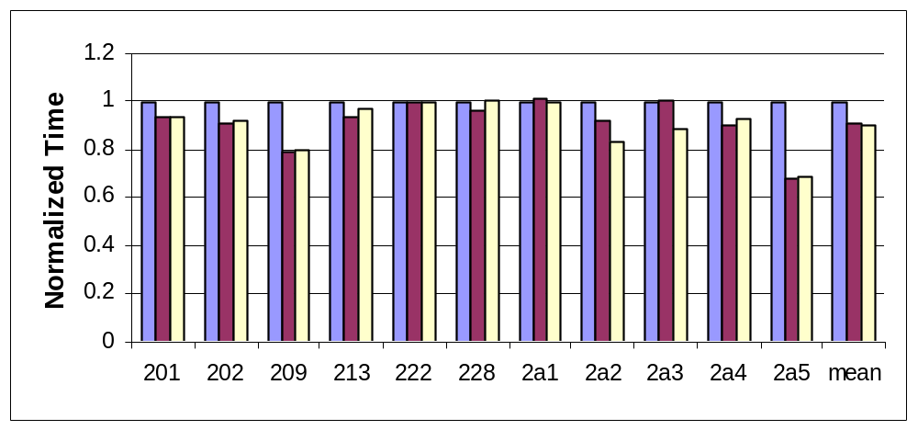
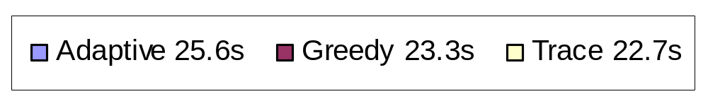
JIT Inlining – Execution Time

Slide 19
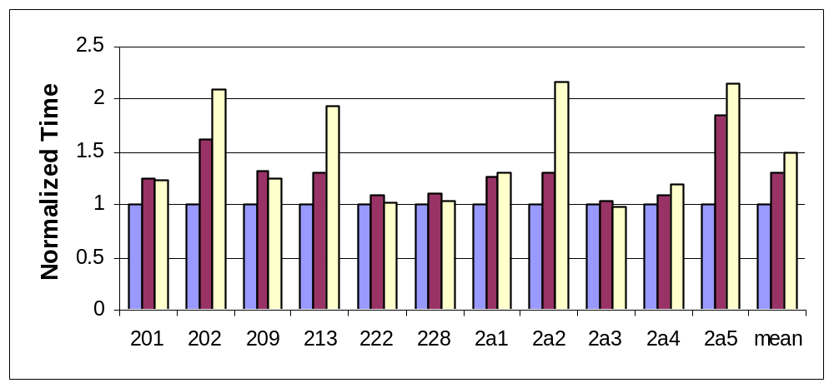
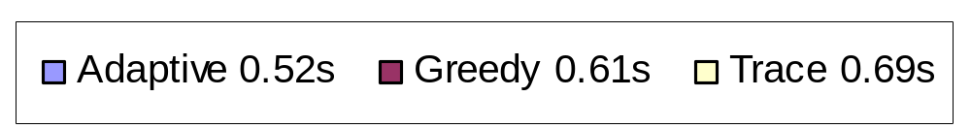
JIT Inlining – Compilation Time

Slide 20
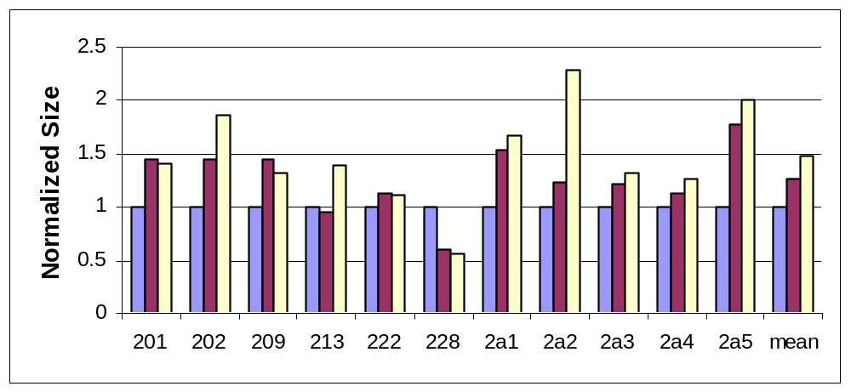
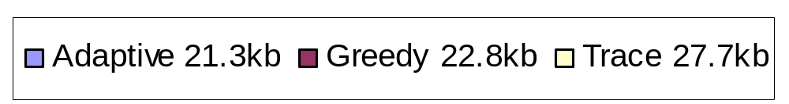
JIT Inlining – Code Expansion

Slide 21
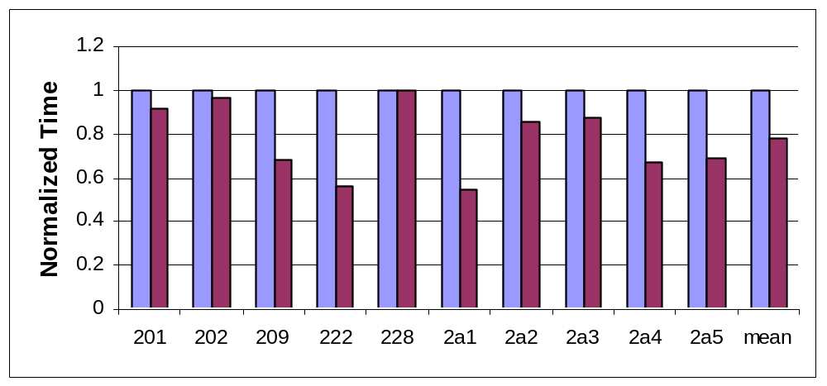

AOT Inlining – Execution Time

Slide 22
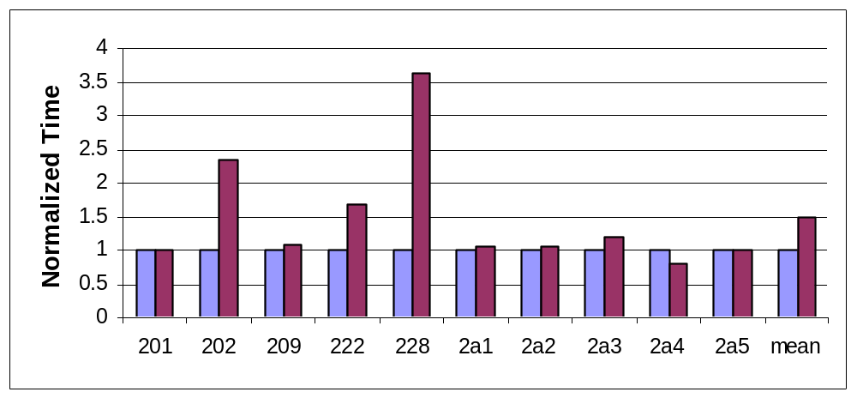

AOT Inlining – Compilation Time

Slide 23
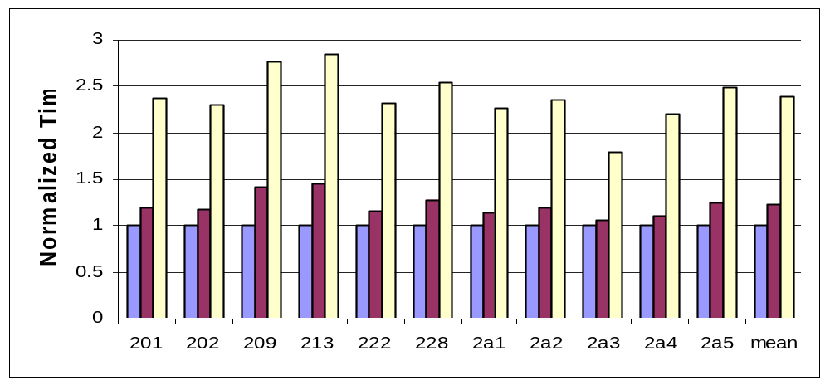
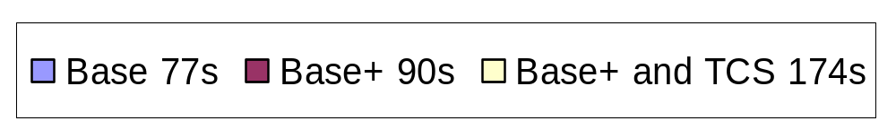
Overhead

Slide 24
Related Work
Arnold et al. [Arn00]
  Feedback-directed inlining in Java
  Collected edge counts at method invocations
  Used a greedy algorithm to select inlines that maximize invocations relative to code expansion
Dynamo [BDB99]
  Trace collection system
  PA-RISC architecture
  Assembly Instructions
  Compiled traces

Slide 25
Conclusions
Traces are beneficial for inlining:
  Decreased execution time compared to one approach
  Decrease competitive with another approach
  Increases compilation time and code size
A potential avenue of future research

Slide 26
Future Work
Different trace collection strategies
Trace based compilation and execution
Reduction of code size
Application of traces to other optimizations
Usage of an online feedback directed system

Slide 27
References
[MSD00] Matthew Arnold, Stephen Fink, David Grove, Michael Hind, and Peter F. Sweeney. Adaptive optimization in the Jalapeno JVM. ACM SIGPLAN Notices, 35(10):47-65, 2000.
[Mic03] Michael Cierniak et al. The open runtime platform: A flexible high-performance managed runtime environment. Intel Technology Journal, February 2003.
[HG03] Kim Hazelwood and David Grove. Adaptive online context-sensitive inlining. International Symposium on Code Generation and Optimization, p 253-264, 2003.
[BB04] Bradel, B.J.: The use of traces in optimization. Master’s thesis, University of Toronto (2004).
[Arn00] Matthew Arnold et al: A comparative study of static and profile-based heuristics for inlining. SIGPLAN Workshop on Dynamic and Adaptive Compilation and Optimization. (2000) 52-64.
[BDB99] Vasanth Bala, Evelyn Duesterwald, and Sanjeev Banerjia. Transparent dynamic optimization: The design and implementation of dynamo. HP Laboratories Technical Report HPL1999 –78, 1999.

Slide 28
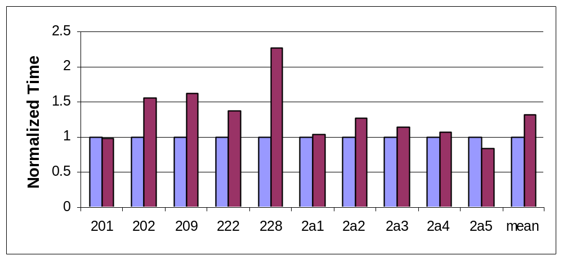

AOT – Compilation Time (Wall Time)

