Slide 1
Experiments with auto-parallelizing SPEC2000FP benchmarks
Guansong Zhang
CASCON 2004

Slide 2
Authors
Guansong Zhang, Priya Unnikrishnan, James Ren
Compiler Development Team
IBM Toronto Lab, Canada
{guansong,priyau,jamesren}@ca.ibm.com
(most slides from Priya’s LCPC2004 presentation)
October 6, 2004

Slide 3
Overview
Introduction and motivation
Structure of our auto-parallelizer
Performance results
Limitations and future work

Slide 4
Auto parallelization, again?
HPF (Fortran D)
  V 1.0 1992; V 2.0 1997
MPI
  V 1.0, 1994; V 2.0 2002
OpenMP
  V 1.0, 1997; V 2.0 2000; V 2.5 2005
Other parallel programming tools/models
  Global array (1994), HPJava(1998), UPC(2001),
Auto parallelization tools
  ParaWise (CAPtools, 2000), Other efforts: Polaris, SUIF, …

Slide 5
The most effective way in parallelization
Discover parallelism in the algorithm

Slide 6
So, why?
User expertise required
  Knowledge of parallel programming, dependence analysis
  Knowledge of the application, time and effort
Extra cycles in desktop, even laptop computing
  hyperthread
  multicore

Slide 7
SPEC, from CPU2000 to OMP
Parallel programming is difficult.
  Even for just getting it right
Parallelizable problem exist
  Amdahl's Law vs. Gustafson's Law
  10 of the14 SPEC CPU FP tests are in SPECOMPM
  9 of the 11 SPECOMPM tests are in SPECOMPL

Slide 8
Strategy
Make parallelism accessible to general users
  Shields users from low-level details
Take advantage of extra hardware
  Do not waste the cycle and the power
Our emphasis
  Use simple parallelization techniques
  Balance performance gain and compilation time

Slide 9
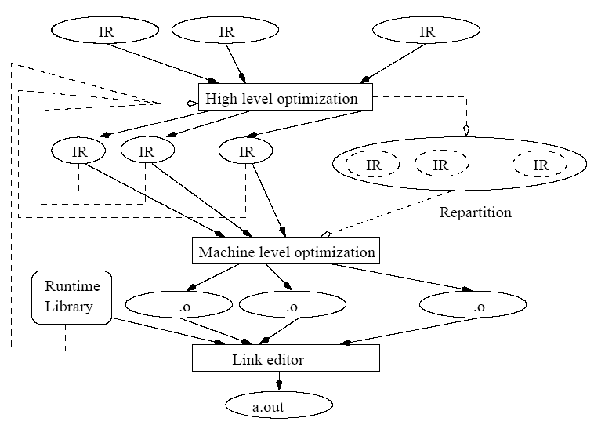
Compiler infrastructure

Slide 10
Our auto-parallelizer features
Use OpenMP compiler and runtime infrastructure
  for parallelization and parallel execution.
Essentially a Loop parallelizer,
  inserting “Parallel do” directives
Can further optimize an OpenMP programs
  general optimization specific to an OpenMP program
Depending on dependence analyzer
  core of the parallelizer, shared with other loop optimizations

Slide 11
Pre-parallelization Phase
Induction variable elimination
Scalar Privatization
Reduction finding
Loop transformations favoring parallelism

Slide 12
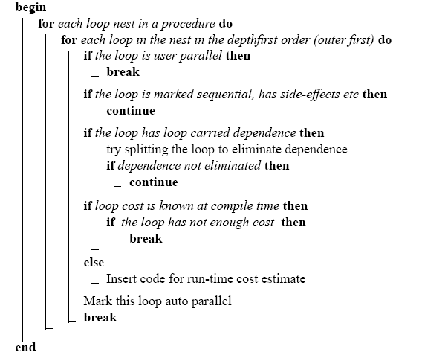
Basic loop parallelizer

Slide 13
for each loop nest in proc
for each loop in nest
user parallel
yes
sequential
yes
side-effects
yes
yes
dependence
split loop
yes
dependence
no
no
compiletime cost
yes
insufficient cost
yes
no
insert runtime cost expr
no
mark auto parallel loop

Slide 14
Loop Cost
LoopCost = ( Iterationcount * ExecTimeOfLoopBody )
Compile time cost
(LoopCost < Threshold) ← reject
Runtime loop cost expression – extremely light-weight
Runtime profiling – finer granularity filtering

Slide 15
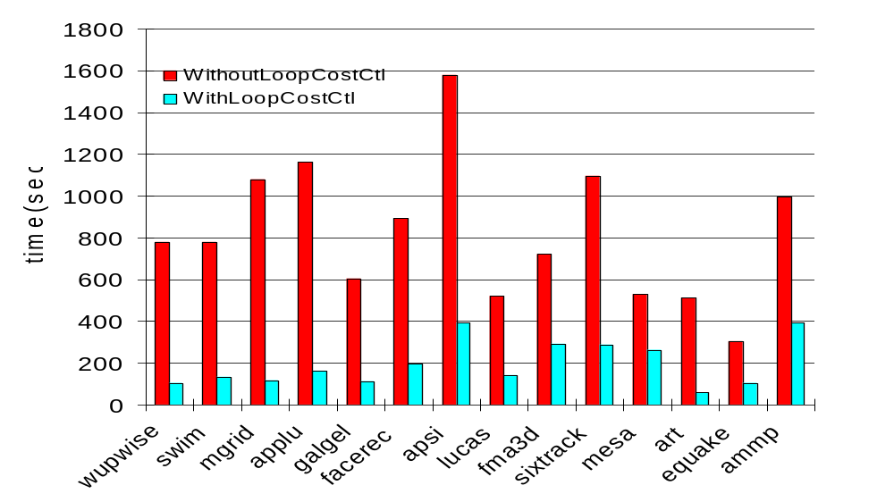
Impact of Loop cost on performance

Slide 16
Accuracy of loop cost algorithm
Benchmark | #Parallelizable HighCostLoops from PDF | #HighCostLoops selected by Parallelizer | #LowCostLoops selected by Parallelizer
swim | 5 | 5 | 0
mgrid | 7 | 7 | 0
applu | 11 | 11 | 0
galgel | 49 | 36 | 0
sixtrack | 13 | 11 | 0
fma3d | 33 | 33 | 0

Slide 17
Balance coarse-grained parallelism and locality
Loop interchange for data locality
Loop interchange to exploit parallelism
Transformations do not always work in harmony
  DO I = 1, N ← FORTRAN loop nest
  DO J = 1, N
  DO K = 1, N
  A( I, J, K) = A( I, J, K+1)
  END DO
  END DO
  END DO

Slide 18
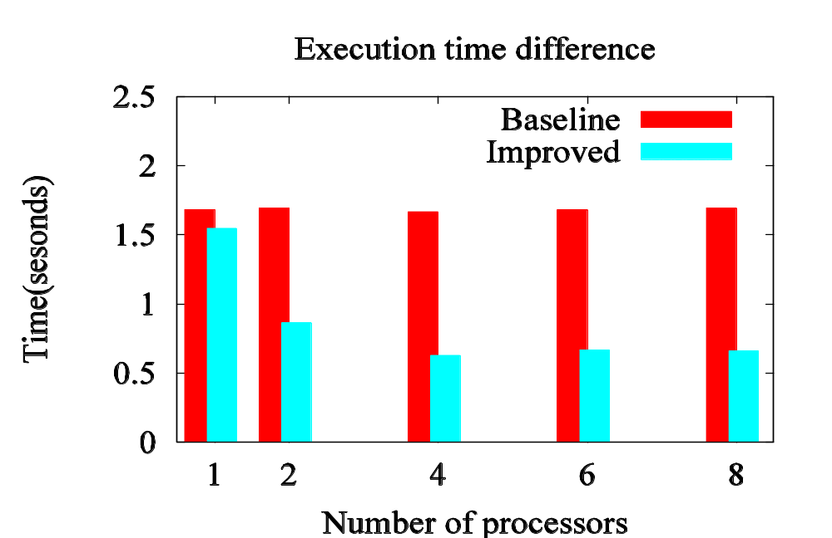
Performance: loop permutation for parallelism

Slide 19
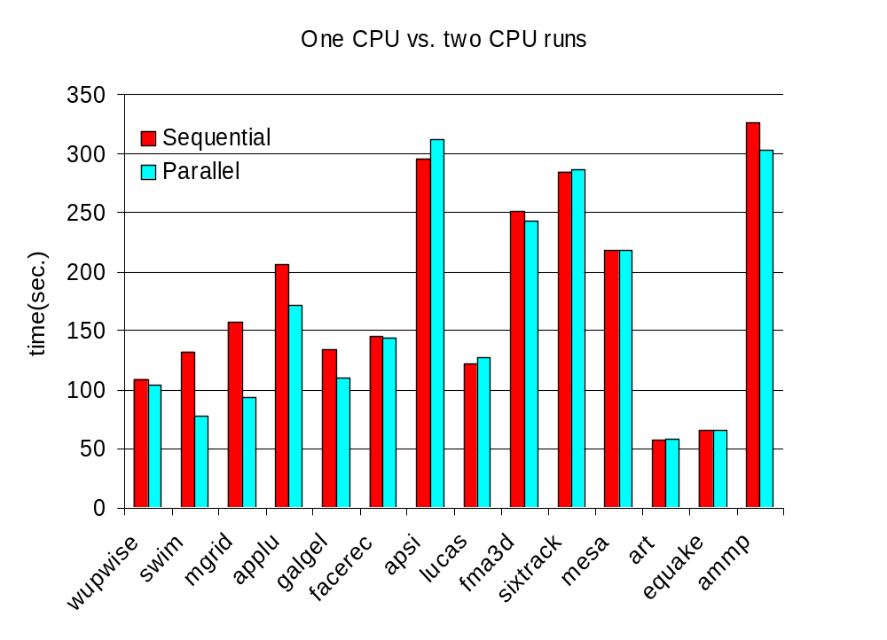
Auto-parallelization performance – 10%

Slide 20
Expose limitations
Compare SPEC2000FP and SPECOMP
SPECOMP achieves good performance and scalability
  Disparity between explicit and auto-parallelization
Expose missed opportunities
10 common benchmarks
  Compare on a loop-to-loop basis

Slide 21
Limitations
Loop body contains function calls
Array privatization
        COMPLEX*16 AUX1(12),AUX3(12)
        ....
        DO 100 JKL = 0, N2 * N3 * N4 - 1
        DO 100 I=(MOD(J+K+L,2)+1),N1,2
        IP=MOD(I,N1)+1
        CALL GAMMUL (1,0,X(1,(IP+1)/2,J,K,L),AUX1)
        CALL SU3MUL (1,1,1,I,J,K,L),'N',AUX1,AUX3)
        ....
        CONTINUE

Slide 22
Limitations … contd
Zero trip loops
      IV=0
      DO J=1, M
      DO I=1,N
      IV=IV+1
      A(IV) = 0
      ENDDO
      ENDDO
  Induction variable ‘IV=I+(J-1)*N’
  Valid if N is positive.
  Cannot parallelize outer-loop if N is zero

Slide 23
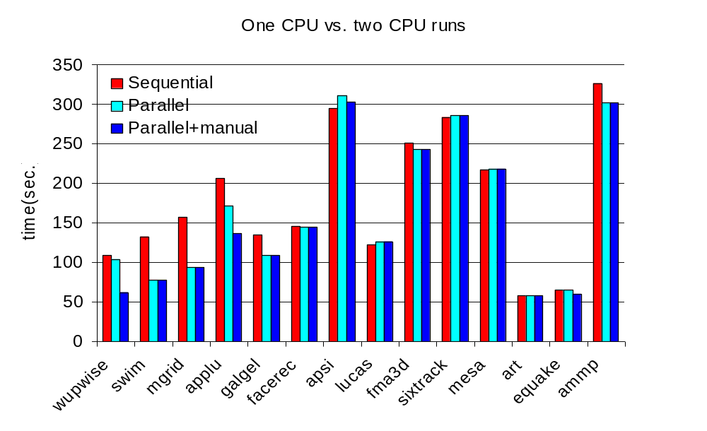
Improved auto-parallelization performance

Slide 24
System Configuration
SPEC2000 CPU FP benchmark suite
IBM XL Fortran/C/C++ commercial compiler infrastructure which implements OpenMP 2.0
Hardware : 1.1GHz POWER4 with 1-8 nodes
Compiler options: -O5 –qsmp
  Comparing to –O5 as sequential

Slide 25
Future Work
Fine tune the heuristics
  Loop cost, permutation, unroll.
Further loop parallelization
  Array dataflow analysis, array privatization
  Do across, loop with carried dependence
  Interprocedural, runtime dependence analysis
Speculative execution
  OpenMP threadprivate, sections, task queue
Keep reasonable increase in compilation time
  not to compete with auto-par tools in the near future

