Slide 1
Does Training Input Selection Matter for Feedback-Directed Optimizations?
Paul Berube
berube@cs.ualberta.ca
University of Alberta
CDP05, October 17, 2005

Slide 2
Outline
Background and motivation
Aestimo: an FDO evaluation tool
Workload Selection
Results

Slide 3
What Is FDO?
Feedback-Directed Optimization:
compile
train
compile
evaluate

Slide 4
What Is FDO?
Feedback-Directed Optimization:
compile
train
compile
evaluate
training
input
profile
eval
input

Slide 5
Performance Evaluation Space
Static optimization
Evaluation Inputs
Programs

Slide 6
Performance Evaluation Space
FDO
Evaluation Inputs
Programs
Training Inputs

Slide 7
Performance Evaluation Space
SPEC
Evaluation Inputs
Usually 1 Ref input
Programs
Training Inputs
Only 1 Train input

Slide 8
The Big Question
Does the selection of training inputs matter for feedback-directed optimization?
  Different transformation decisions?
  Different performance?

Slide 9
Aestimo
An FDO evaluation tool
Automates training and evaluating on a large number of inputs
Isolates individual transformations
  Fewer experiment variables
  Results vary by transformation
Measures:
  Differences in transformation decisions
  Performance differences

Slide 10
An Overview of Aestimo
Compile
Program
Workload
Binaries
Optimization
Logs
Execute
Analyze

Slide 11
An Overview of Aestimo
One Per Input
Compile
One Per Input
Program
Workload
Binaries
Optimization
Logs
Execute
Analyze

Slide 12
An Overview of Aestimo
Compile
Program
Workload
Binaries
Optimization
Logs
Binary X Input
5 times each
Execute
Analyze

Slide 13
An Overview of Aestimo
Compile
Program
Workload
Binaries
Optimization
Logs
Execute
Workload
Performance
Analyze

Slide 14
An Overview of Aestimo
Compile
Program
Workload
Binaries
Optimization
Logs
Execute
Workload
Performance
Transformation
Differences
Analyze

Slide 15
An Overview of Aestimo
Compile
Program
Workload
Binaries
Optimization
Logs
Execute
Workload
Performance
Transformation
Differences
Analyze
FDO vs.
Static

Slide 16
An Overview of Aestimo
Compile
Program
Workload
Binaries
Optimization
Logs
Execute
Workload
Performance
Transformation
Differences
Analyze
FDO vs.
Static
Resubstitution

Slide 17
Compilation Process
Source
Static Compile
Static
Binary
Optimization
Log

Slide 18
Compilation Process
Instr. Compile
Instrumented
Binary
Source
Training
Input
Profile
Training Run
Static Compile
FDO Compile
FDO
Binary
Static
Binary
Optimization
Log

Slide 19
Compilation Process
Instr. Compile
Instrumented
Binary
Source
Training
Input
Profile
Training Run
Static Compile
FDO Compile
FDO
Binary
Static
Binary
Optimization
Log
Optimization
Log
Static Compile
Final
Binary

Slide 20
Compilation Process
Instr. Compile
Instrumented
Binary
Source
Training
Input
Profile
Training Run
Static Compile
FDO Compile
FDO
Binary
Static
Binary
Optimization
Log
Optimization
Log
Static Compile
Final
Binary

Slide 21
Workload Selection
SPEC CINT2000 Benchmark inputs
  8 programs, 32 input
84 Additional Inputs
  Contacted benchmark authors
  Varied representative inputs
  Existing collections
  Synthetic input generator

Slide 22
Results
ORC compiler
Inlining and if conversion
Itanium and Itanium 2 processors

Slide 23
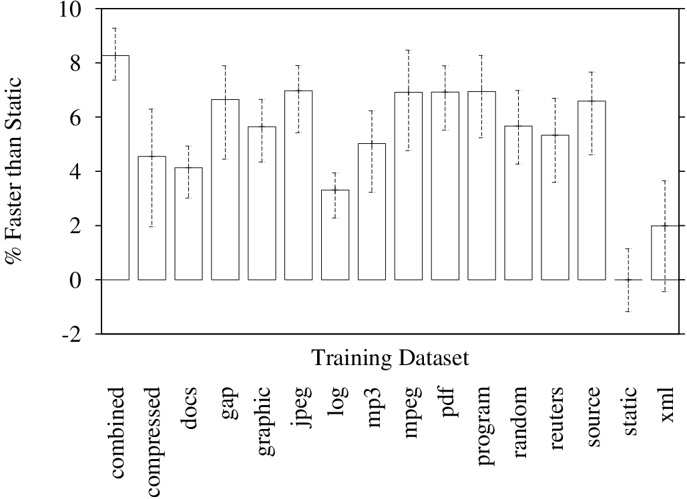
Workload Performance: bzip2
Inlining
Itanium

Slide 24
Workload Performance: bzip2
Training Input Selection Matters!
Inlining
Itanium

Slide 25
Summary of Contributions
Training input selection does impact optimization decisions and performance
Aestimo:
  Automates training and evaluating on a large number of inputs
  Isolates individual transformations
A large collection of representative inputs for SPEC CINT2000 programs

Slide 26
Thank You
Questions?

Slide 27
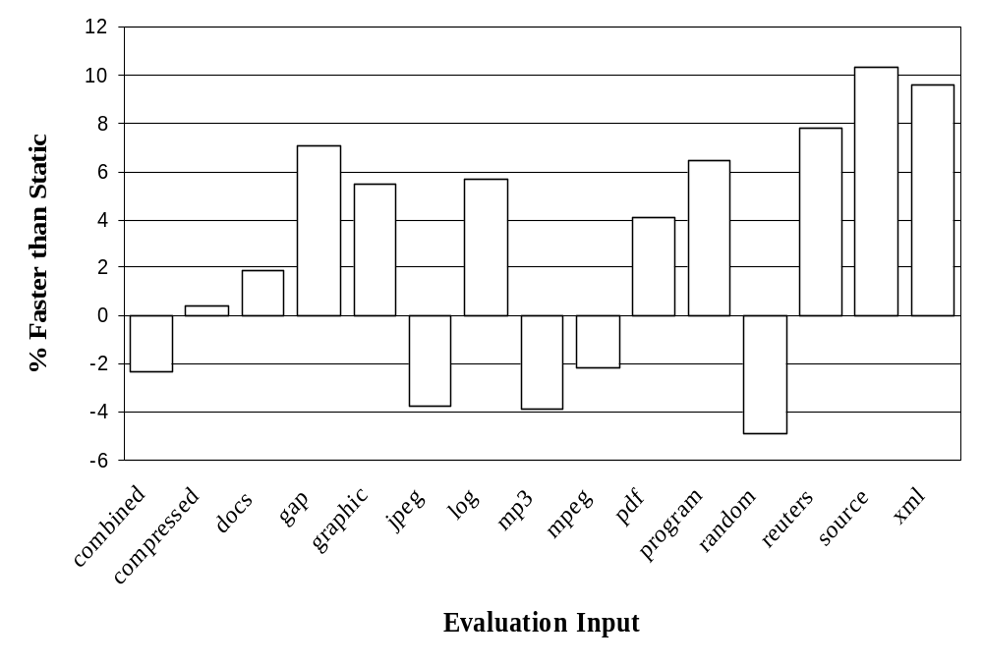
Performance: bzip2 trained on xml
Inlining
Itanium

Slide 28
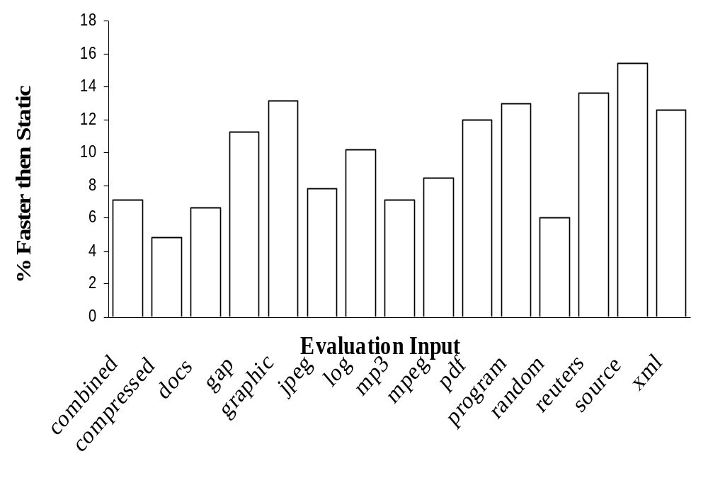
Performance: bzip2.combined
Inlining
Itanium

