Slide 1
A Framework for Safe Automatic Data Reorganization
Shimin Cui (Speaker), Yaoqing Gao, Roch Archambault, Raul Silvera
IBM Toronto Software Lab
Peng Peers Zhao, Jose Nelson Amaral
University of Alberta
* Part of the work joint with Xipeng Shen and Chen Ding (University of Rochester)

Slide 2
Contents
The memory wall problem
Data reorganization framework
  Data reshape analysis
  Data reshape planning
Performance evaluation
Summary

Slide 3
The Memory Wall Problem
Memory access latency is a “wall” to better performance
  Speed of memory continues to lag behind the speed of processors.
Memory hierarchy
  Limited cache size and bandwidth limitation
  Efficient utilization of cache is crucial for performance
Domain – applications and benchmarks with large data sets.

Slide 4
Compiler Approaches
Tolerate memory latency through buffering and pipelining data references.
  Data Prefetching
Reduce memory latency through locality optimizations.
  Code transformations - modifying the actual algorithm by reordering computations.
    Loop fusion
    Loop distribution
    Loop tiling/blocking
    Loop interchange
  Data reorganizations - Placing data in memory according to their access patterns.

Slide 5
Data Reorganization
Data reorganization is a difficult problem.
  NP problem, heuristics are needed
  Safe, automatic techniques are necessary
Data layout transformations
  Data splitting
  Fields reordering
  Data interleaving
  Data padding
  Data coalescing
  …

Slide 6
Data Reorganization Framework
Inside TPO link time optimizations
Forward Data-Flow Analysis
Data Reshape Analysis
Forward Data-Flow Analysis
Data Reshape Analysis
Forward Data-Flow Analysis
Data Reshape Analyses
Whole-Program Data Reshape Planning
Data Reshaping
Backward Data-Flow Analysis
Data Reshaping
Backward Data-Flow Analysis
Data Reshaping Transformation
Backward Data-Flow Analysis

Slide 7
Data Reshape Analyses
Safety and legality issues
  Inter-procedural alias analysis
      Pointer escape analysis
      Global pointer analysis
  Data shape analysis
Profitability issues
  Data affinity analysis

Slide 8
Inter-procedural Alias Analysis
To ensure data reshaping correctness since compiler needs to modify all the affected references when it reshapes a data object and its aliases.
Flow-insensitive alias analysis is sufficient for data reshaping [Steensgaard].
Field sensitive alias analysis is necessary to trace and distinguish the alias relationships among different fields.
char *pc;
struct A {
char *f1;
struct A *f2;
} *p1, *p2;
p1 = malloc(N * sizeof(A));
p2 = &(p1[i]);
p1[j].f1 = pc;
p1[k].f2 = &(p1[i]);
p1
&(p1[i])
p2
&(p1[j])
p1[k].f2
f1
pc
p1[j].f1
f2
Storage shape graph

Slide 9
Data Shape Analysis
Reshaping on data that has incompatible type is unsafe and is strictly avoided.
Type compatibility analysis is integrated with the interprocedural alias analysis.
  The interprocedural alias analysis keeps track of the type of each alias set.
  The types of data in an alias set must be compatible in the whole program for safe data reshaping.
Compatibility rules are enforced to check the access patterns. Two data types are compatible if
  Two intrinsic data types are compatible if their data lengths are identical.
  Two aggregated data structures are compatible if they have the same number of byte-level fields and their corresponding fields have the same offset and length.
  Two arrays have compatible types if their element types are compatible, they have the same dimensions and the strides of corresponding dimensions are also identical.
  Two pointers are of compatible types iff the data they point to have compatible types.

Slide 10
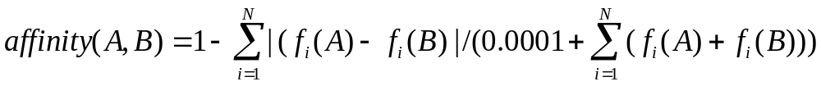
Lightweight Data Affinity Analysis
(Joint Work With Xipeng Shen and Chen Ding)
To measure how closely a group of data are accessed together in a program region.
Model affinity based on access frequency:
  An access frequency vector AFV(A) is used for each data to record all the access frequency in all the innermost loops in the program.
  Unique data is identified based on alias analysis, and AFVs of their aliases are merged.
  Two data have good affinity if their AFVs are similar:
      N - # of innermost loops, f_{i}(A) – access frequency of A in i-th loop
  Construct and partition data affinity graph to obtain all the affinity groups.

Slide 11
Data Reshaping Planning
Based on the reshape analysis and affinity analysis, a plan is made how to reshape a data.
  Array splitting
  Data outlining
  Data allocation merging
  Data interleaving
  …

Slide 12
Array Splitting
Separate cold fields from hot fields to avoid bringing rarely accessed data into the cache in order to increase cache utilization.
  A structure array is split into several contiguous arrays.
  Fields are reordered based on affinity information for large data structure.
Target to aggregate arrays that have consistent compatible access patterns.
Three approaches:
  Affinity-based splitting
  Frequency-based splitting
  Maximal data splitting

Slide 13
Array Splitting – Three Approaches
Original data structure
  hot (F0,F2, F3), affinity groups (F0, F3) (F2), (F1, F4)
F0
F1
F2
F3
F4
Original array [4]
F00
F10
F20
F30
F40
F01
F11
F21
F31
F41
F02
F12
F22
F32
F42
F03
F13
F23
F33
F43
Affinity-based splitting
F00
F30
F01
F31
F02
F32
F03
F33
F20
F21
F22
F23
F10
F40
F11
F41
F12
F42
F13
F43
Frequency-based splitting
F00
F30
F20
F01
F31
F21
F02
F32
F22
F03
F33
F23
F10
F40
F11
F41
F12
F42
F13
F43
Maximal data splitting
F00
F01
F02
F03
F30
F31
F32
F33
F20
F21
F22
F23
F10
F11
F12
F13
F40
F41
F42
F43

Slide 14

Array Splitting - Static Arrays
struct {
double x;
double y;
} a[1000];
void foo() {
for (i=0; i<N; i++) {
… = a[i].x …;
}
…
for (i=0; i<M; i++) {
… = a[i].y …;
}
}
double ax[1000];
double ay[1000];
void foo() {
for (i=0; i<N; i++) {
… = ax[i] …;
}
…
for (i=0; i<M; i++) {
… = ay[i] …;
}
}

Slide 15
Array Splitting – Single-Instantiated Dynamic Arrays
typedef struct {
double x;
double y;
} S;
S *p;
void init () {
p = malloc(sizeof(S)*N);
}
void foo() {
for (i=0; i<N; i++) {
… = p[i].x …;
}
…
for (i=0; i<N; i++) {
… = p[i].y …;
}
}
typedef struct {
double x;
double y;
} S;
void *p;
double *xbasep, *ybasep;
void init () {
p = malloc(sizeof(S)*N);
xbasep = p;
ybasep = xbasep + sizeof(double)*N;
}
void foo() {
for (i=0; i<N; i++) {
… = xbasep[i] …;
}
…
for (i=0; i<N; i++) {
… = ybasep[i] …;
}
}

Slide 16
Array Splitting – Multiple-Instantiated Dynamic Arrays
Runtime descriptor is introduced to handle the multiple instantiations.
typedef struct {
double x;
double y;
} S;
S *p, *q;
void init (N) {
p = malloc(sizeof(S)*N);
}
void bar() {
init(N1);
q = p;
init(N2);
}
void foo() {
for (i=0; i<N2; i++) {
… = p[i].x …;
}
…
for (i=0; i<N1; i++) {
… = q[i].y …;
}
}
typedef struct { typedef struct {
double x; void *basep;
double y; double *xbasep;
} S; double *ybasep;
} desc;
desc *p, *q;
void init (N) {
p = malloc(sizeof(desc) + sizeof(S)*N);
p->basep = p + sizeof(desc);
p->xbasep = p->basep;
p->ybasep = p->xbasep + sizeof(double)*N;
}
void bar() { init(N1); q = p; init(N2);}
void foo() {
for (i=0; i<N2; i++) {
… = p->xbasep[i] …;
}
…
for (i=0; i<N1; i++) {
… = q->ybasep[i] …;
}
}

Slide 17
Data Outlining
Separate cold fields from hot fields to avoid bringing rarely accessed data into the cache in order to increase cache utilization.
Target to non-array data objects whose collection of hot fields are smaller than the cache block size.
The outlined fields must be cold.
No need to worry about single/multiple object instantiations.

Slide 18
Data Outlining Approach
Original linked list element:
F0
F1
F2
F3
F4
Original linked list
F00
F10
F20
F30
F40
F01
F11
F21
F31
F41
F02
F12
F22
F32
F42
Frequency-based outlining
F00
F30
F20
C00
F01
F31
F21
C01
F02
F32
F22
C02
F10
F40
F11
F41
F12
F42

Slide 19
Data Allocation Merging
Flat multi-dimensional dynamic array into contiguous memory space to achieve better reference locality.
Target to multi-dimensional dynamic arrays with (almost) rectangular shapes. Padding is needed for non-rectangular shaped multi-dimensional dynamic arrays.
Facilitate loop locality transformation since indirect reference is replaced by array indexed reference.
Runtime descriptor is also introduced to handle the multiple object instantiation cases.

Slide 20
Data Allocation Merging Approach
Original two dimensional dynamic array **A
BasePtr
A[0]
A[0][0]
A[0][1]
A[0][2]
A[0][3]
A[1]
A[1][0]
A[1][1]
A[1][2]
A[1][3]
A[2]
A[2][0]
A[2][1]
A[2][2]
A[2][3]
A[3]
A[3][0]
A[3][1]
A[3][2]
A[3][3]
After data allocation merging *A’
BasePtr
A[0][0]
A[0][1]
A[0][2]
A[0][3]
A[1][0]
A[1][1]
A[1][2]
A[1][3]
A[2][0]
A[2][1]
A[2][2]
A[2][3]
A[3][0]
A[3][1]
A[3][2]
A[3][3]

Slide 21
Data Allocation Merging – Dynamic Arrays
float **A = (float **) malloc(N*sizeof(float *));
float **B = (float **) malloc(N*sizeof(float *));
float *C[N];
for (i = 0; i < N; i++) {
A[i] = (float *) malloc(N*sizeof(float));
B[i] = (float *) malloc(N*sizeof(float));
C[i] = (float *) malloc(N*sizeof(float));
}
for (j = 0; j < n; j++)
for (k = 0; k < n; k++)
for (i = 0; i < n; i++)
C[i][j] += A[i][k] * B[k][j];
// *(C[i]+j) += *(*(A+i)+k) * *(*(B+k)+j)
float *A = (float *) malloc(N*N*sizeof(float));
float *B = (float *) malloc(N*N*sizeof(float));
float *C = (float *) malloc(N*N*sizeof(float));
for (j = 0; j < N; j++)
for (k = 0; k < N; k++)
for (i = 0; i < N; i++)
C[i][j] += A[i][k] * B[k][j];
// *(C+i*N+j) += *(A+j*N+k) * *(B+k*N+j)

Slide 22
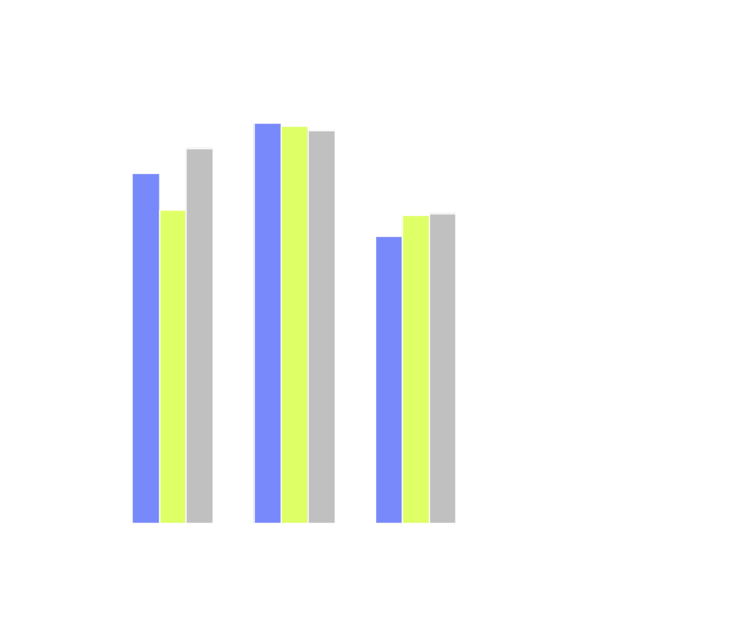
Comparison of Splitting Approaches
    Affinity-based splitting
    Frequency-based splitting
    maximal data splitting
(Measured on power4 1.1GHz, AIX5.2)

Slide 23
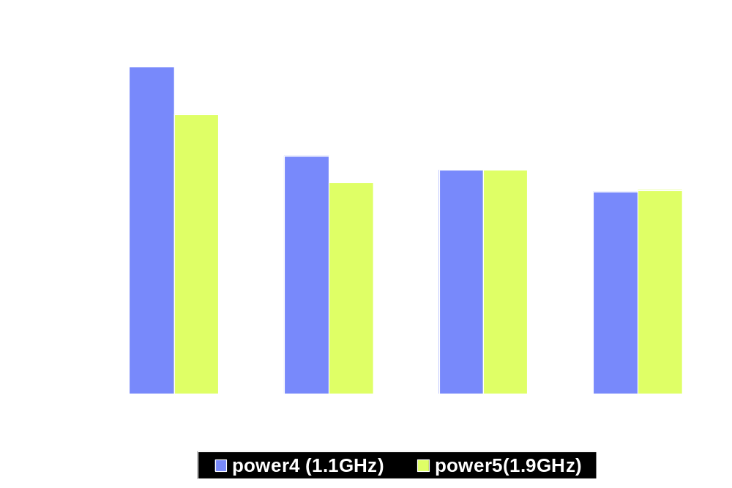
SPEC2000 Performance Improvement
With Data Reorganizations

Slide 24
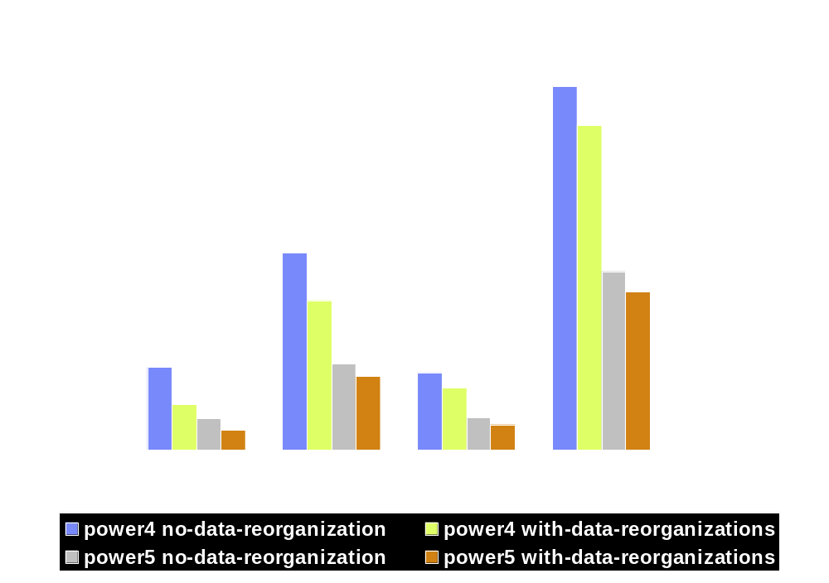
SPEC2000 Performance Improvements
With Data Reorganizations

Slide 25
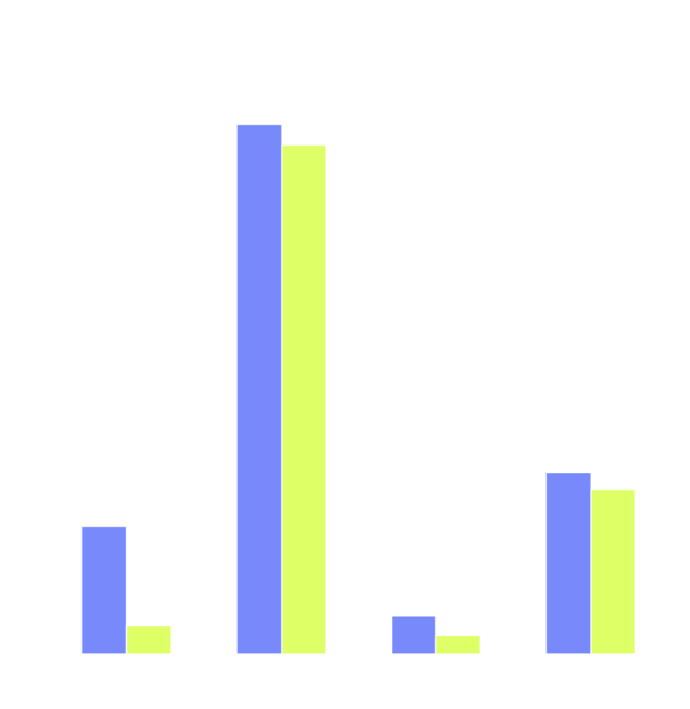
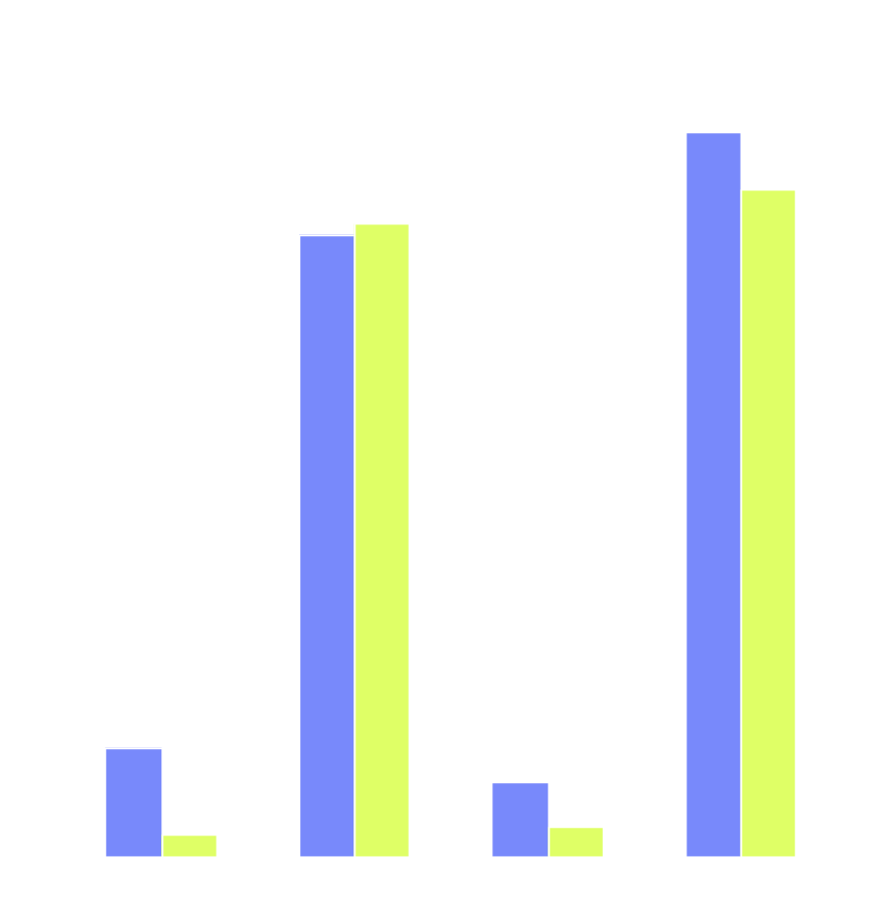
Effect of Data Reorganizations
Reduction on DL1 misses
DL1 miss rates (%)
DL1 misses (G)
    no-data-reorganization
    with-data-reorganization (Measured on power4 1.1GHz, AIX5.2)

Slide 26
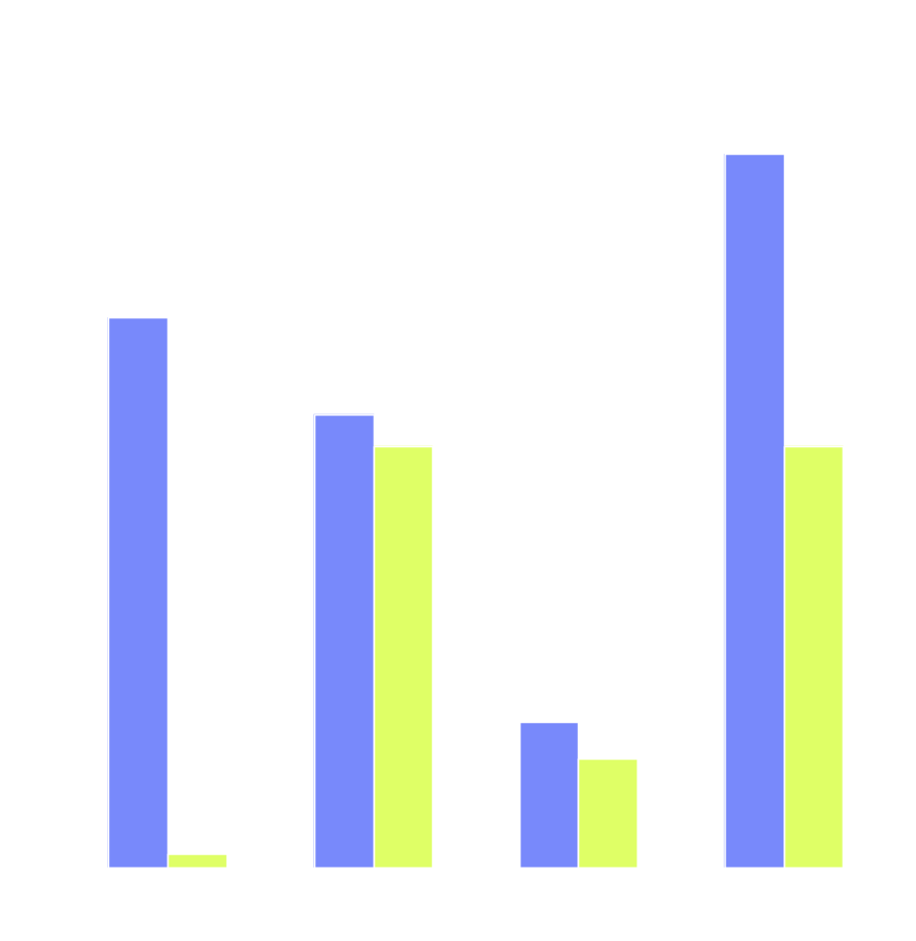
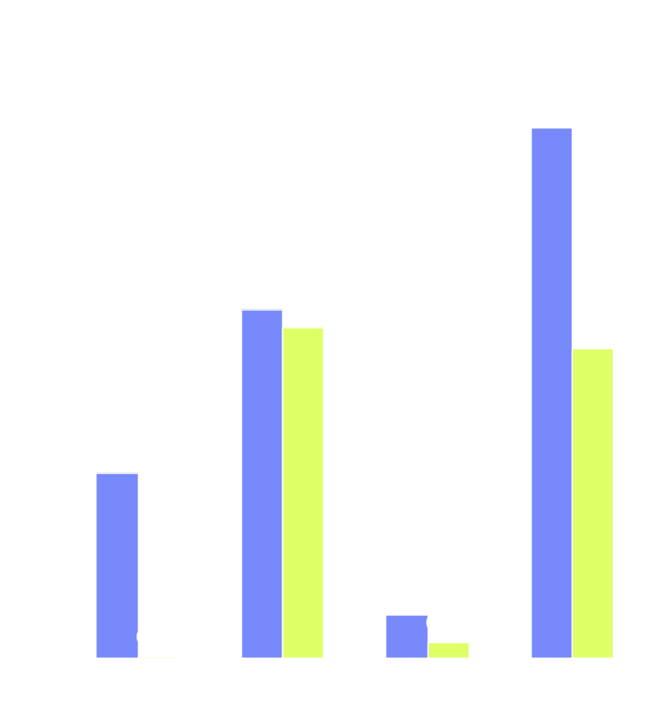
Effect of Data Reorganizations
Reduction on DL2 misses
DL2 miss rates (%)
DL2 misses (G)
    no-data-reorganization
    with-data-reorganization (Measured on power4 1.1GHz, AIX5.2)

Slide 27
Summary
A practical framework that guarantees safe automatic data reorganization.
  Implemented in IBM XL compiler
Impressive performance improvements on benchmarks and customer codes.
  Four SPEC2000 benchmarks improved significantly.
Future work
  Improve the data shape analysis to capture more complex data access pattern
  Pursue more data reorganization techniques

Slide 28
Backups

Slide 29
Data Interleaving
Group data with high affinity and put them together in memory
Reduce the number of hardware streams and also reduce the cache conflicts
Target to data in a program region with too many streams.
double a[1000];
double b[1000];
for (i=0; i<N; i++) {
… = a[i] …;
… = b[i] …;
}
struct {
double x;
double y;
} ab[1000];
for (i=0; i<N; i++) {
… = ab[i].x …;
… = ab[i].y …;
}

Slide 30
Data Padding and Alignment
Array splitting
  Inter array padding can be added between those new arrays for alignment (e.g., to ensure SIMD alignment), to avoid false sharing.
Memory allocation merging
  Intra array padding can be incorporated easily into the framework to avoid cache conflicts

