Slide 1


A Probabilistic Pointer Analysis for Speculative Optimization
Jeff DaSilva
Greg Steffan
Electrical and Computer Engineering
University of Toronto
Toronto, ON, Canada
Oct 17th, 2005

Slide 2

Pointers Impede Optimization
Many optimizations come to a halt when they encounter an ambiguous pointer
foo(int *a) {
…
while(…)
{
x = *a;
…
}
}
Loop Invariant
Code Motion
Parallelize
Pointer Analysis is Important
Notes:
Pointers are important! Programmers require them to realize data structures and to effectively design algorithms when using C and other pointer-based languages. That being said, they can make life difficult for a compiler.

Slide 3


Pointer Analysis
*a = ~
~ = *b
optimize
Pointer
Analysis
Definitely
Definitely Not
Maybe
*a = ~
~ = *b
Do pointers a and b point to the same location?
  Do this for every pair of pointers at every program point
Notes:
Pointer analysis saves the day. Pointer analysis is needed if you want to have any chance at optimizing.

Slide 4

Pointer Analysis is Difficult
Pointer analysis is a difficult problem
  scalable and overly conservative
  fails-to-scale and accurate
Ambiguous pointers will persist
  even when using the most accurate of algorithms
  output is often unavoidable
What can be done with ?
or
Maybe
Maybe

Slide 5


Lets Speculate
Compilers make conservative assumptions
  They must always preserve program correctness
“It's easier to apologize than ask for permission.”
Author: Anonymous
Implement a potentially unsafe optimization
Verify and Recover if necessary

Slide 6
Speculation applied to Pointers
int *a, x;
…
while(…)
{
x = *a;
…
}
int *a, x, tmp;
…
tmp = *a;
while(…)
{
x = tmp;
…
}
<verify, recover?>
a is probably
loop invariant
Notes:
The compiler need not be conservative in applying transformations that may violate correctness under some unlikely (but possible) conditions
This ability to avoid conservative optimization can lead to significant performance benefits

Slide 7
Data Speculative Optimizations
The EPIC Instruction set
  Explicit support for speculative load/store instructions (eg. Itanium)
Speculative compiler transformations
  Dead store elimination, redundancy elimination, copy propagation, strength reduction, register promotion
Thread-level speculation (TLS)
  Hardware support for tracking speculative parallel threads
Transactional programming
  Rollback support for aborted transactions
When to speculate? Techniques rely on profiling

Slide 8




Quantitative Output Required
Maybe
Estimate the potential benefit for speculating:
Recovery
penalty
(if unsuccessful)
Maybe
Overhead
for verify
Probability
of success
Expected
speedup
(if successful)
Speculate?
Probabilistic output needed
Maybe

Slide 9
Probabilistic Pointer Analysis (PPA)
Conventional Pointer Analysis
*a = ~
~ = *b
optimize
optimize
Definitely
Pointer
Analysis
p = 1.0
PPA
Definitely Not
p = 0.0
Maybe
0.0 < p < 1.0
*a = ~
~ = *b
Do pointers a and b point to the same location?
  Do this for every pair of pointers at every program point
With what probability p, do pointers a and b point to the same location?
  Do this for every pair of pointers at every program point

Slide 10
PPA Research Objectives
Accurate points-to probability information
  at every static pointer dereference
Scalable analysis
  Goal: The entire SPEC integer benchmark suite
Understand scalability/accuracy tradeoff
  through flexible static memory model
Improve our understanding of programs

Slide 11


Algorithm Design Choices
Fixed
  Bottom Up / Top Down Approach
  Linear transfer functions (for scalability)
  One-level context and flow sensitive
Flexible
  Edge profiling (or static prediction)
  Safe (or unsafe)
  Field sensitive (or field insensitive)
Notes:
1 – level to achieve linearity
Fscs to get probability info

Slide 12
Traditional Points-To Graph
int x, y, z, *b = &x;
void foo(int *a) {
if(…)
b = &y;
if(…)
a = &z;
else(…)
a = b;
while(…) {
x = *a;
…
}
}
= pointer
=
Definitely
= pointed at
=
Maybe
b
a
x
y
z
UND
Results are inconclusive
Notes:
For simplification purposes lets assume that when we enter foo a is always undefined and b always points to x.

Slide 13
Probabilistic Points-To Graph
int x, y, z, *b = &x;
void foo(int *a) {
if(…)
b = &y;
if(…)
a = &z;
else(…)
a = b;
while(…) {
x = *a;
…
}
}
= pointer
=
p = 1.0
0.1 taken(edge profile)
p
= pointed at
=
0.0<p< 1.0
0.2 taken(edge profile)
b
a
0.72
0.9
0.1
0.2
0.08
x
y
z
UND
Results provide more information

Slide 14

  Linear
  One -
  Level
  Interprocedural
  Probabilistic
  Pointer Analysis
LOLLIPOP
Our PPA Algorithm

Slide 15
Points-To Matrix
Location Sets
M-1 M
1
2
Area
Of
Interest
Pointer Sets
…
…
N-1
N
I
Location Sets
All matrix rows sum to 1.0

Slide 16
Points-To Matrix Example
x
y
z
UND
a
0.72 0.08 0.20
0.90 0.10
b
a
b
0.72
0.9
0.1
0.2
x
1.0
1.0
1.0
1.0
I
0.08
y
x
y
z
UND
z
UND

Slide 17
Solving for a Points-To Matrix
Points-To
Matrix In
I
Any Instruction
Points-To
Matrix Out
I

Slide 18
The Fundamental PPA Equation
Points-To
Matrix Out
Transformation
Matrix
Points-To
Matrix In
=
This can be applied to any instruction (incl. function calls)

Slide 19
Transformation Matrix
Pointer Sets
Location Sets
1 2 3 …
N-1 N
1
2
Area of Interest
Pointer Sets
…
ø
I
Location Sets
…
N-1
N
All matrix rows sum to 1.0

Slide 20
Transformation Matrix Example
S1: a = &z;
a
b
x
y
z
UND
a
1.0
b
1.0
T_{S1}
=
x
1.0
1.0
1.0
1.0
y
z
UND

Slide 21
Example - The PPA Equation
PT_{out}
=
T_{S1}
PT_{in}
S1: a = &z;
x
y
z
UND
a
0.72 0.08 0.20
0.90 0.10
1.0
1.0
b
a
b
0.72
PT_{out}
0.9
0.1
0.2
=
1.0
1.0
1.0
1.0
x
1.0
1.0
1.0
1.0
0.08
y
x
y
z
UND
z
UND

Slide 22
Example - The PPA Equation
PT_{out}
=
T_{S1}
PT_{in}
S1: a = &z;
x
y
z
UND
a
1.0
0.90 0.10
b
a
b
0.9
0.1
PT_{out}
=
x
1.0
1.0
1.0
1.0
I
y
x
y
z
UND
z
UND

Slide 23
Combining Transformation Matrices
I
PT_{out}
T_{S2}
T_{S1}
T_{S3}
PT_{in}
PT_{in}
T_{S1}
PT_{in}
=
Basic Block
S1: Instr
S2: Instr
S3: Instr
PT_{out}
T_{BB}
PT_{in}
=
I

Slide 24
Control flow - if/else
p + q = 1.0
X
Y
p
p
q
q
T_{X}
T_{Y}
=
+

Slide 25
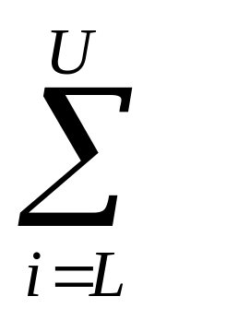
Control flow - loops
N
N
X
T_{X}
=
i
<L,U>
1
T_{Y}
Y
=
U-L+1
Both operations can be implemented efficiently
<L,U>  <min,max>

Slide 26
Safe vs. Unsafe
Pointer Assignment Instructions
Safe?
x = &y | Address-of Assignment
x = y | Copy Assignment
x = *y | Load Assignment
*x = y | Store Assignment





Slide 27
LOLLIPOP Implementation
.spd
SUIF Infrastructure
Static
Memory
Model
TF-Matrix
Collector
Points-To
Matrix
Propagator
Edge
Profile
ICFG
SMM
BU
TD
.spx
Implementation details:
Sparse matrices
Efficient matrix algorithms
Result memoization
Results
Stats
MATLAB
C Library

Slide 28
Measuring
LOLLIPOP’s
Efficiency and Accuracy

Slide 29

SPEC2000 Benchmark Data
Benchmark | LOC | Matrix Size N | PPA Analysis Time [Unsafe] | PPA Analysis Time [Safe]
Bzip2 | 4686 | 251 | 0.3 seconds
Mcf | 2429 | 354 | 0.39 seconds
Gzip | 8616 | 563 | 0.71 seconds
Crafty | 21297 | 1917 | 5.49 seconds
Vpr | 17750 | 1976 | 9.33 seconds
Twolf | 20469 | 2611 | 16.59 seconds
Parser | 11402 | 2732 | 30.72 seconds
0.3 seconds
0.61 seconds
0.77 seconds
5.51 seconds
10.34 seconds
20.64 seconds
50.04 seconds
Vortex | 67225 | 11018 | 3min 59seconds
Gap | 71766 | 25882 | 54min 56seconds
Perlbmk | 85221 | 20922 | 44min 15seconds
Gcc | 22225 | 42109 | 5hour 10 min
4min 56seconds
83min 38seconds
89min 43seconds
Still Running…
Experimental Framework: 3GHz P4 with 2GB of RAM
Scales to all of SPECint
Notes:
LOC = lines of code (no comments and no spaces)
PPA can be expensive, but it is still less expensive than data dependence profiling.
3GHz Pentium 4 CPU with 2GB of RAM

Slide 30
Comparison with Das’s GOLF
 | GOLF | LOLLIPOP
Probabilistic | No | Yes
Context Sensitive | One-level | One-level
Flow Sensitive | No | Yes
Field Sensitive | No | Turned Off
Indirect Calls | Solved | Profiled
Library Calls | Modeled All | Modeled Some
Heap Model | Callsite Alloc | Callsite Alloc
Safe | Yes | Yes
Analysis Time on GCC | < 10 seconds | > 5 hours

Slide 31
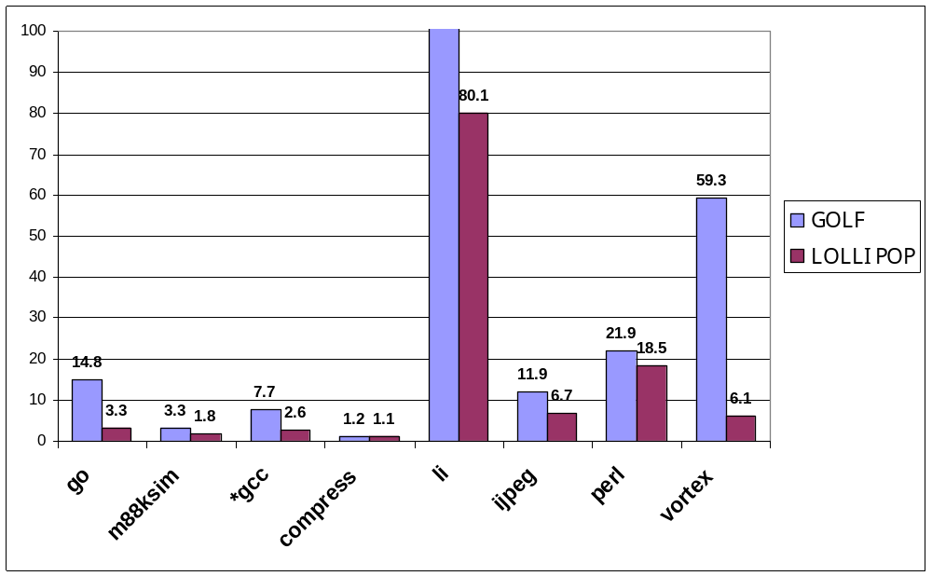
Comparison with Das’s GOLF
185.6
more accurate
Average Dereference Size
LOLLIPOP is very Accurate (even without probability information)
Notes:
GOLF is a one-level context sensitive (not flow sensitive) pointer analysis algorithm published in the 2001 Static Analysis Symposium. It can analyze large programs in seconds (spec95 gcc in less than 10 seconds). It static memory model is also slightly different (get details before cascon)

Slide 32
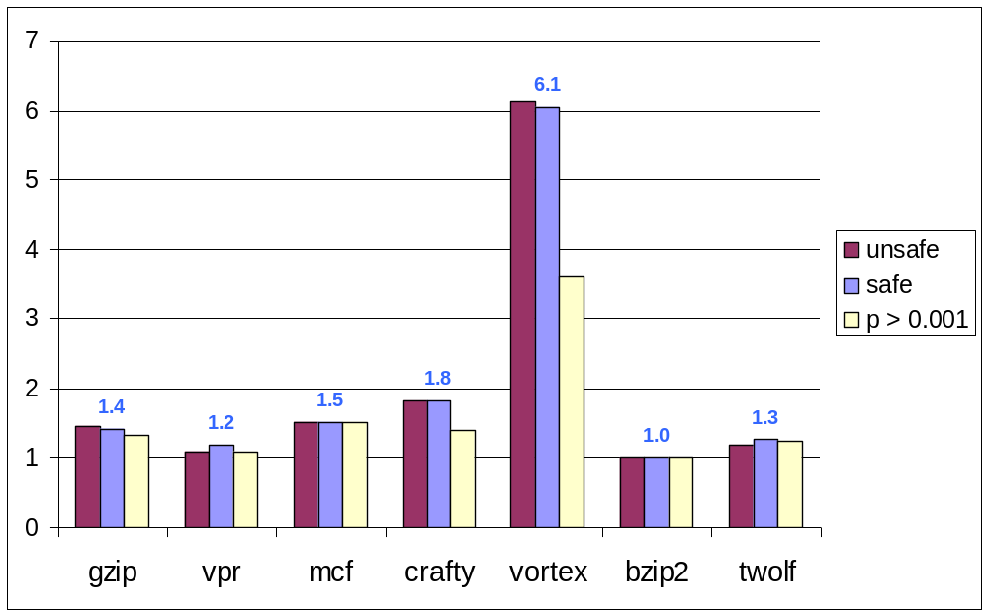
Easy SPEC2000 Benchmarks
more accurate
Average Dereference Size
A one-level Analysis is often adequate (i.e. safe=unsafe)

Slide 33
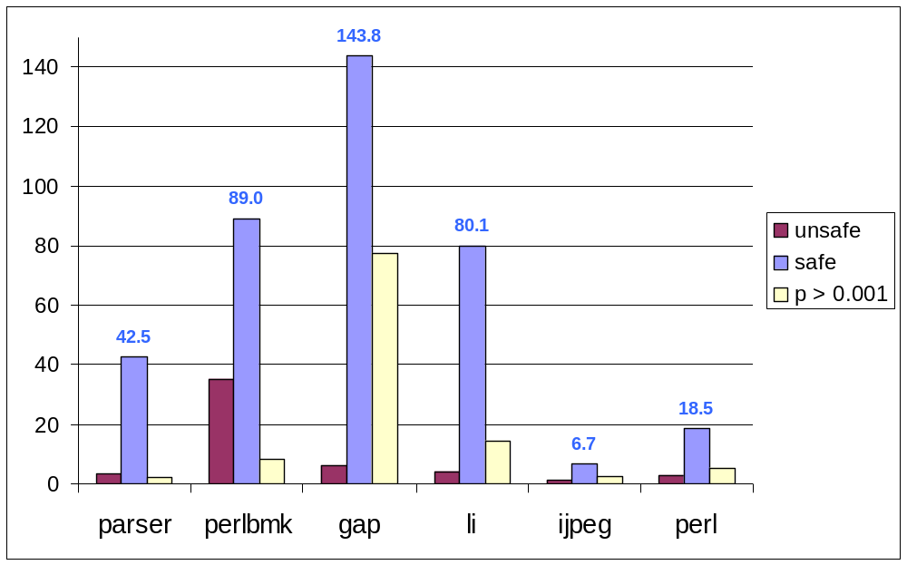
Challenging SPEC 95/2000 Benchmarks
more accurate
Average Dereference Size
Many improbable points-to relations can be pruned away

Slide 34
Metric: Average Certainty
while(…)
{
x = *a;
…
}
Max probability value = 0.72
{ (0.72, ), (0.08, ), (0.2, ) }
x
y
z
Σ
(max probability value)
Avg Certainty
=
(num of loads & stores)

Slide 35
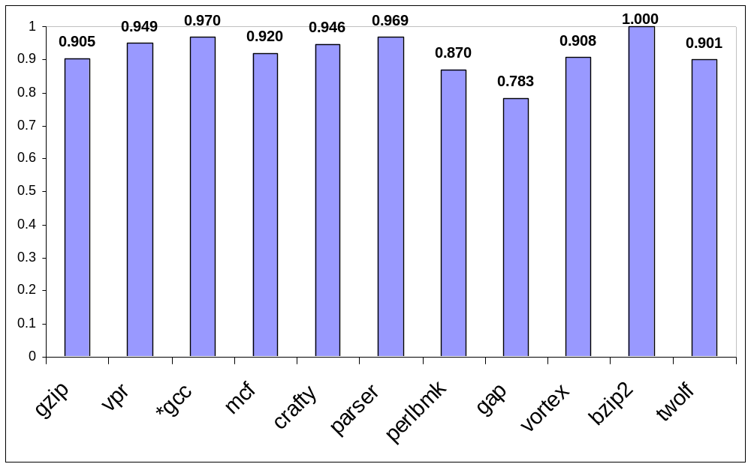
SPEC2000 Average Certainty
Probabilistic Certainty
more accurate
On average, LOLLIPOP can predict a single likely points-to relation

Slide 36
Conclusions and Future Work
LOLLIPOP
  A novel PPA algorithm
  Scales to SPECint 95/2000
  As accurate as the most precise algorithms
Future Ongoing Work
  Measure the probabilistic accuracy
  Optimize LOLLIPOP’s implementation
  Apply PPA
Provides the key puzzle piece for a speculation compiler

Slide 37
References
Manuvir Das, Ben Liblit, Manuel Fahndrich, and Jakob Rehof. Estimating the Impact of Scalable Pointer Analysis on Optimization. SAS 2001, 260-278.
Peng-Sheng Chen, Ming-Yu Hung, Yuan-Shin Hwang, Roy Dz-Ching Ju, and Jenq Kuen Lee. Compiler support for speculative multithreading architecture with probabilistic points-to analysis. PPOPP 2003, 25-36.
Jin Lin, Tong Chen, Wei-Chung Hsu, Peng-Chung Yew, Roy Dz-Ching Ju, Tin-Fook Ngai and Sun Chan, A Compiler Framework for Speculative Analysis and Optimizations. PLDI 2003, 289-299.
R.D. Ju, J. Collard, and K. Oukbir. Probabilistic Memory Disambiguation and its Application to Data Speculation. SIGARCH Comput. Archit. News 27 1999, 27-30.
Manel Fernandez and Roger Espasa. Speculative Alias Analysis for Executable Code. PACT 2002, 221-231.

Slide 38
Backup Slides

Slide 39
Metric: Average Dereference Size
while(…)
{
x = *a;
…
}
Dereference set cardinality = 3
{ (0.72, ), (0.08, ), (0.2, ) }
x
y
z
Σ
(set cardinality)
Avg Deref Size
=
(num of loads & stores)

Slide 40
SPEC2000 Benchmark Data
Benchmark | LOC | Matrix Size N | PPA Analysis Time [Unsafe] | PPA Analysis Time [Safe]
Bzip2 | 4686 | 251 | 0.3 seconds | 0.3 seconds
Mcf | 2429 | 354 | 0.39 seconds | 0.61 seconds
Gzip | 8616 | 563 | 0.71 seconds | 0.77 seconds
Crafty | 21297 | 1917 | 5.49 seconds | 5.51 seconds
Vpr | 17750 | 1976 | 9.33 seconds | 10.34 seconds
Twolf | 20469 | 2611 | 16.59 seconds | 20.64 seconds
Parser | 11402 | 2732 | 30.72 seconds | 50.04 seconds
Vortex | 67225 | 11018 | 3min 59seconds | 4min 56seconds
Gap | 71766 | 25882 | 54min 56seconds | 83min 38seconds
Perlbmk | 85221 | 20922 | 44min 15seconds | 89min 43seconds
Gcc | 22225 | 42109 | 5hour 10 min | Still Running
Notes:
LOC = lines of code (no comments and no spaces)

Slide 41

Conslusions and Future Ongoing Work
Measure the probabilistic accuracy
  Compare PPA with a runtime points-to profiler
  Evaluate analysis sensitivity to edge profiling
  Investigate the scalability/accuracy tradeoff
Optimize LOLLIPOP’s implementation
Apply PPA
  Thread level speculation (TLS) compiler
  Speculative compiler optimizations
  Helper threads
  Speculative ___________

Slide 42
Transformation Matrix Example
S2: b = a;
a
b
x
y
z
UND
a
1.0
b
1.0
T_{S2} =
x
1.0
1.0
1.0
1.0
y
z
UND

Slide 43
Transformation Matrix Example
x
S1: a = &z;
S2: b = a;
a
b
x
y
z
UND
a
1.0
1.0
b
= T_{S2}T_{S1}
=
T_{x}
x
1.0
1.0
1.0
1.0
y
z
UND

Slide 44
< 9 >
0.5
0.5

Slide 45
Shadow Variable Aliasing
Use FICI PA to
account for SVA
Unsafe SMM
Safe SMM
p
a
p
+
=
a
b
p_1
a
p_1
a
p_1
a
UND
p_1 and a are considered aliased
= pointer
= shadow ptr
= pointed at

Slide 46
Pointer Analysis
*a = ~
~ = *b
optimize
Pointer
Analysis
Definitely
Definitely Not
Maybe
*a = ~
~ = *b
Do pointers a and b point to the same location?
  Do this for every pair of pointers at every program point

Slide 47
Probabilistic Pointer Analysis (PPA)
*a = ~
~ = *b
optimize
PPA
p = 1.0
p = 0.0
0.0 < p < 1.0
*a = ~
~ = *b
With what probability p, do pointers a and b point to the same location?
  Do this for every pair of pointers at program point

