Slide 1
Dynamic Shape and Data Structure Analysis in Java
Presented by Sokhom Pheng
(Supervised by Clark Verbrugge)
McGill University
October 17th 2005

Slide 2
Outline
Introduction & Contribution
Design
Challenges
Experimental Results
Future work & Conclusion

Slide 3
Outline
Introduction & Contribution
Design
Challenges
Experimental Results
Future work & Conclusion

Slide 4
Introduction
Have you ever wondered how data structures were constructed in your programs?
Two approaches
  Static analysis
    Conservative
    Limited to simple situations
  Dynamic analysis
    More accurate
    More expensive

Slide 5
Contribution
Framework for data structure visualization
  Program understanding
  Set limits on static approaches
Provide two techniques for visualization
Provide dynamic representation of garbage data

Slide 6
Outline
Introduction & Contribution
Design
Challenges
Experimental Results
Future work & Conclusion

Slide 7
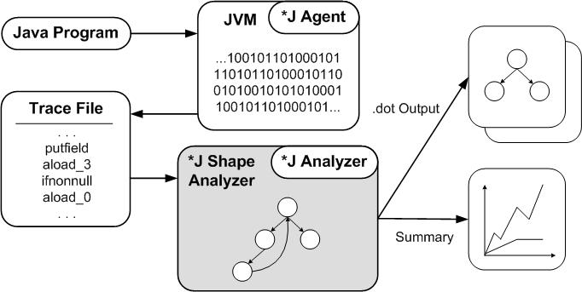
Design Overview

Slide 8
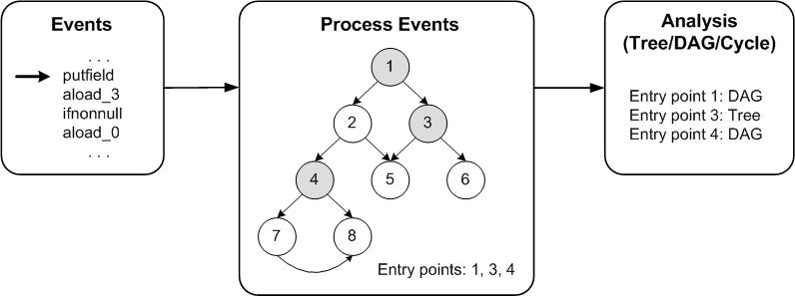
*J Shape Analyzer
Entry point 1: DAG
Entry point 3: Tree
Entry point 4: DAG
Entry point 1: DAG
Entry point 3: Tree
Entry point 4: DAG
Entry point 1: DAG
Entry point 3: Tree
Entry point 4: Tree

Slide 9
More Analysis Info
GC info
  Might be useful for GC optimization
  If visualized, can see drag effect
Aging
  Useful for general program understanding
  Useful for teaching

Slide 10
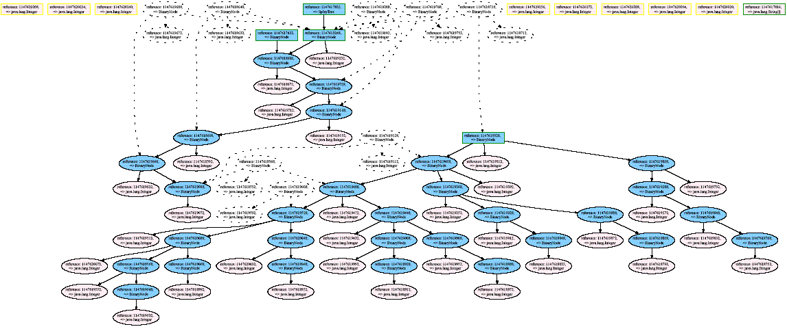
GC Info (splay tree)
application
library

Slide 11
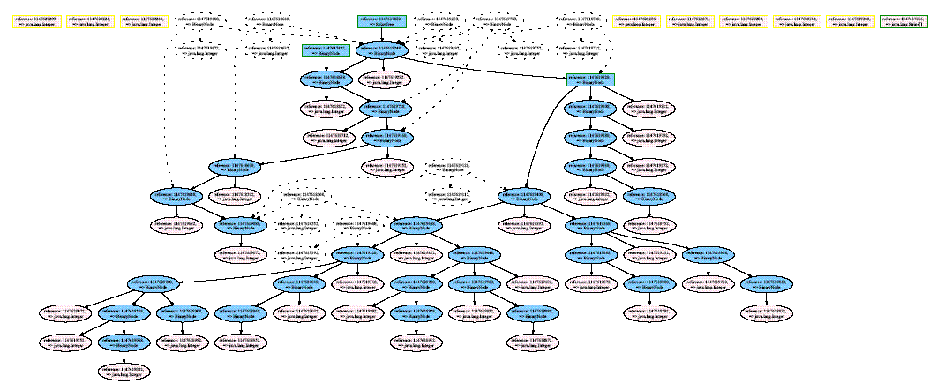
GC Info (cont’d)
application
library

Slide 12
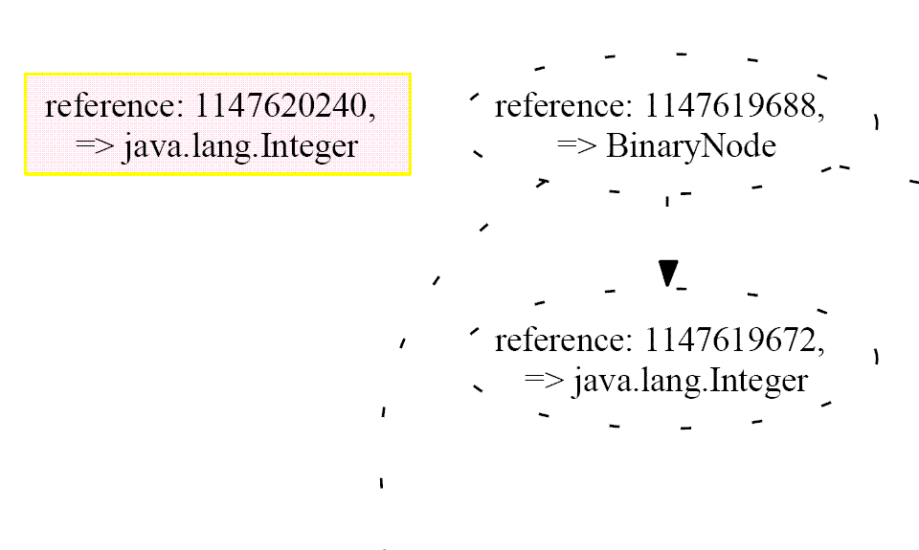
GC Info (cont’d)

Slide 13
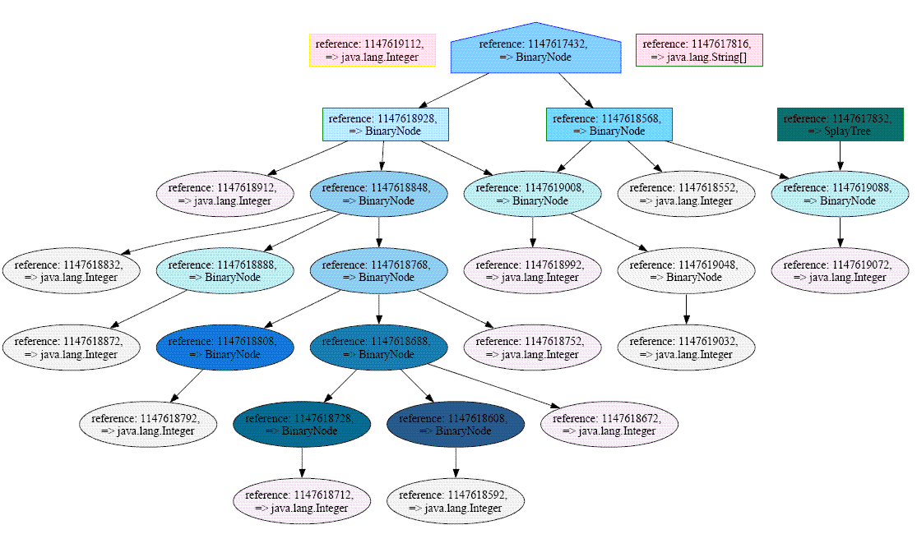
Aging (splay tree)
tree
DAG
cycle
application
library

Slide 14
Outline
Introduction & Contribution
Design
Challenges
Experimental Results
Future work & Conclusion

Slide 15
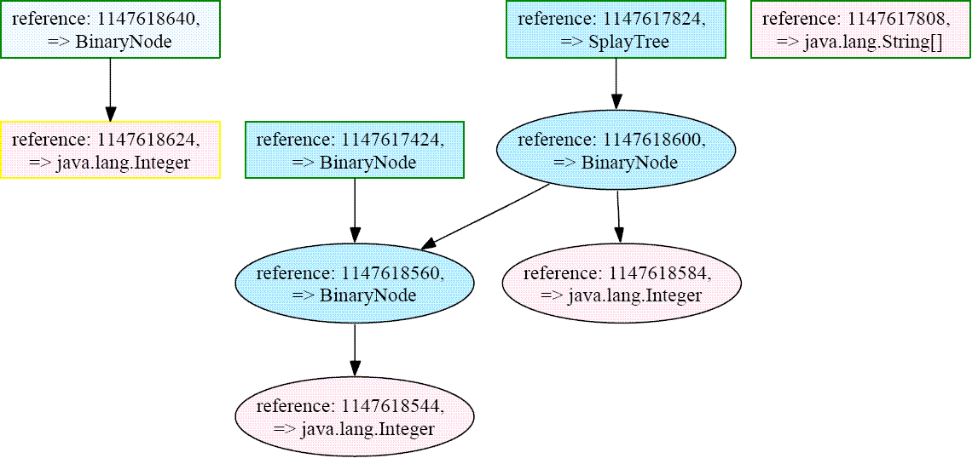
Challenge 1: Animation Issue
This is what we want:

Slide 16
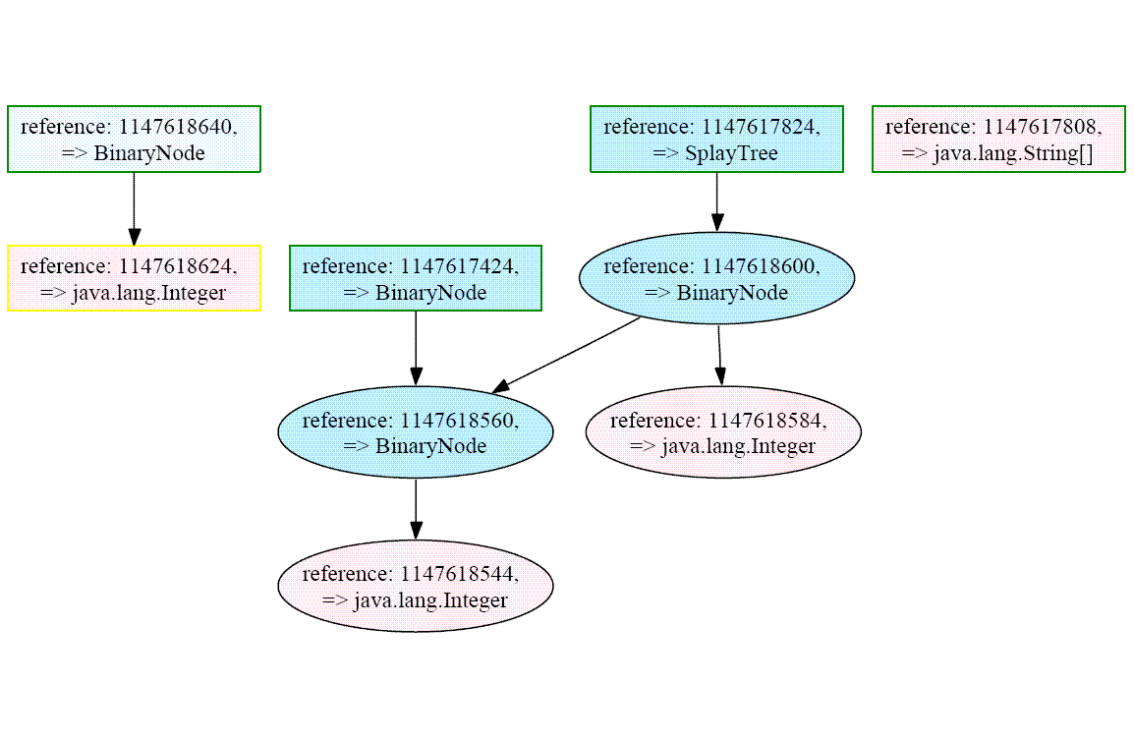
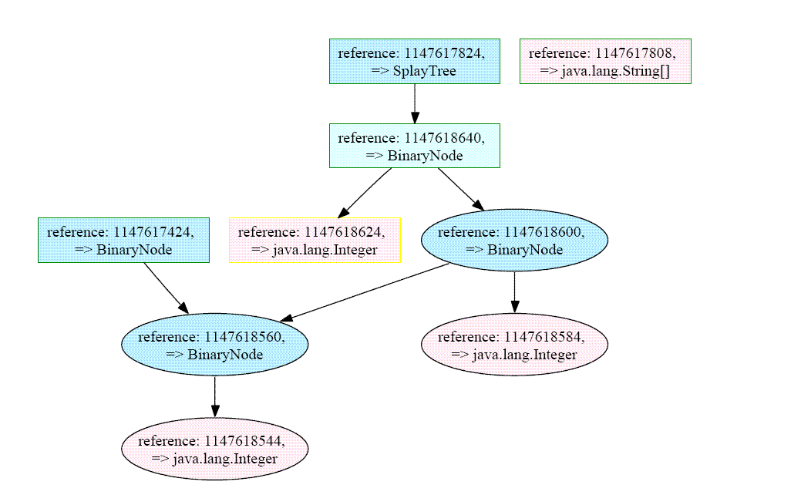
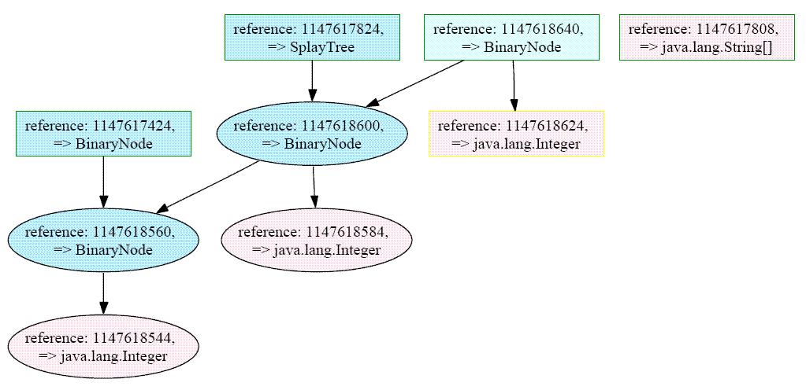
Animation Issue (cont’d)
This is what we have:

Slide 17
Tools Used
Tom Sawyer & yWorks yFiles
  Did not work properly as incremental
Graphviz Neato
  Pin down object causes problems
Graphviz Dot
  Tool we use
  Nicest and easiest to use

Slide 18
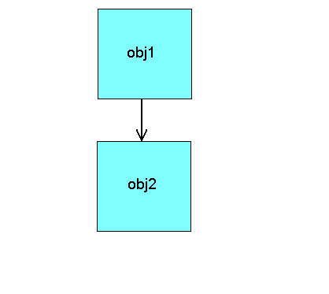
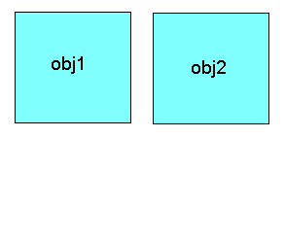
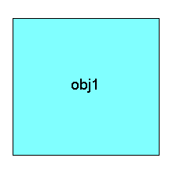
Tom Sawyer & yWorks yFiles

Slide 19
Tools Used
Tom Sawyer & yWorks yFiles
  Did not work properly as incremental
Graphviz Neato
  Pin down object causes problems
Graphviz Dot
  Tool we use
  Nicest and easiest to use

Slide 20
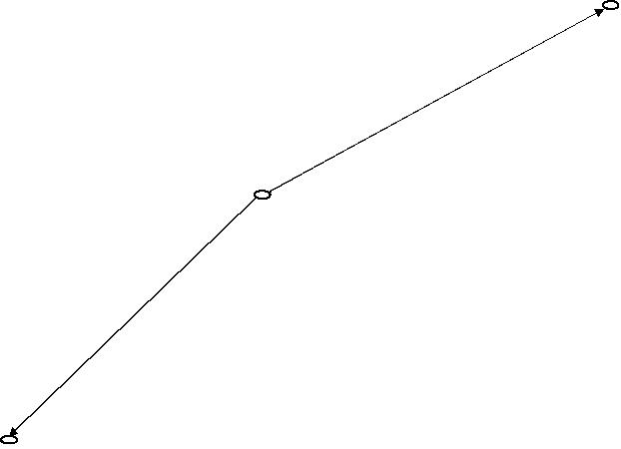
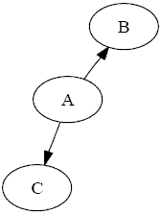
Graphviz Neato

Slide 21
Tools Used
Tom Sawyer & yWorks yFiles
  Did not work properly as incremental
Graphviz Neato
  Pin down object causes problems
Graphviz Dot
  Tool we use
  Nicest and easiest to use

Slide 22
Challenge 2: Data Size
Visualization limitation
  Too many objects to draw
    BiSort: > 120,000 objects
  Too many snapshots generated
    Jess: > 48,000,000 snapshots
Computational cost
  Analysis

Slide 23
Data Size Potential Solutions
Problem with number of snapshots and cost
  Analyze data structure after a certain number of modifications instead
Problem with number of objects
  Numerical summary

Slide 24
Outline
Introduction & Contribution
Design
Challenges
Experimental Results
Future work & Conclusion

Slide 25
Benchmarks
Tiny
  Splay tree, red-black tree
Small
  JOlden suite
Large
  SPECjvm98 suite

Slide 26
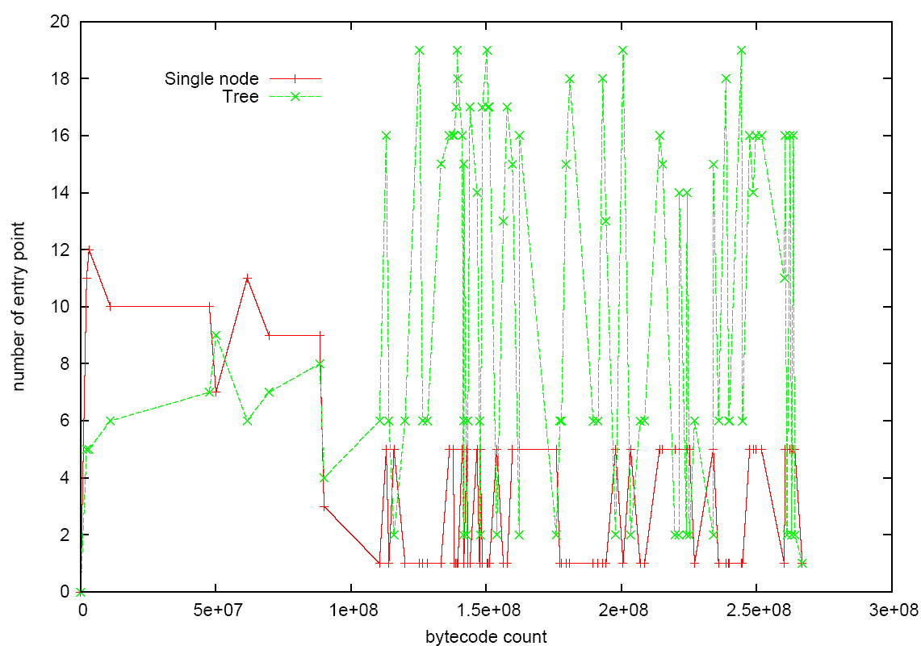
JOlden - BiSort

Slide 27
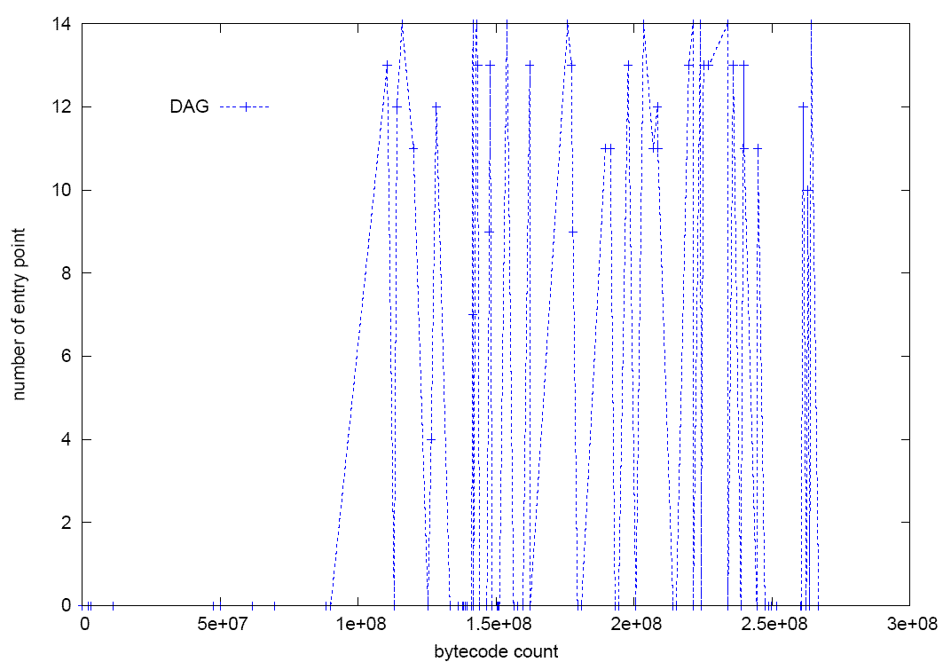
BiSort (cont’d)

Slide 28
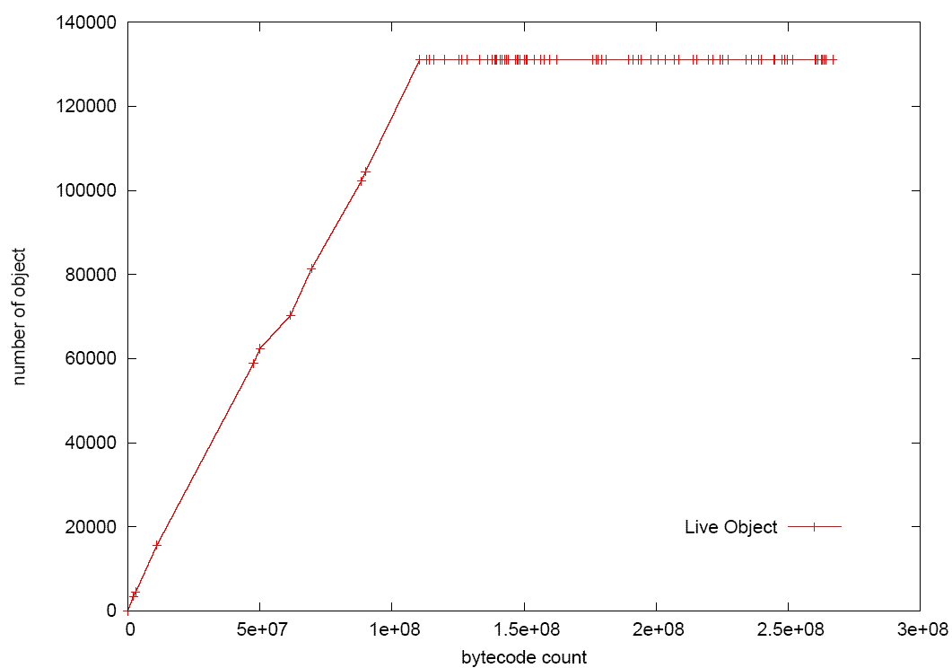
BiSort GC Info

Slide 29
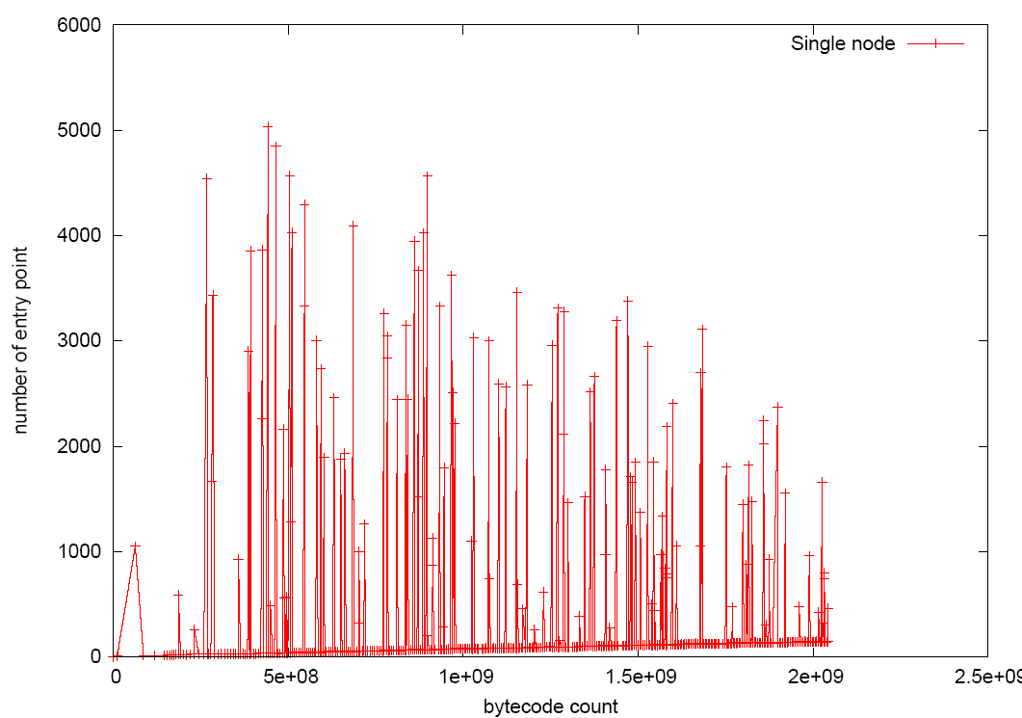
SPECjvm98 - Jess

Slide 30
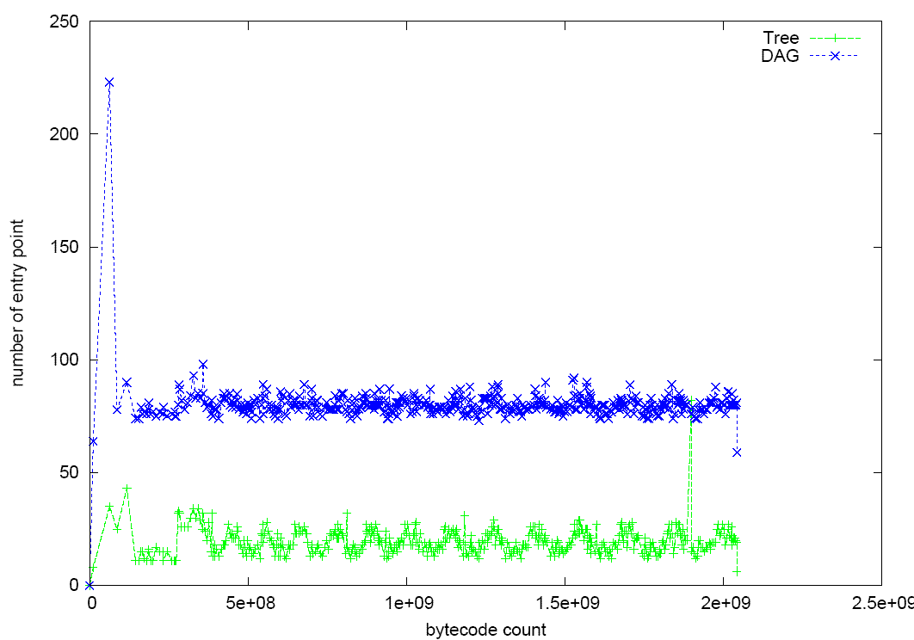
Jess (cont’d)

Slide 31
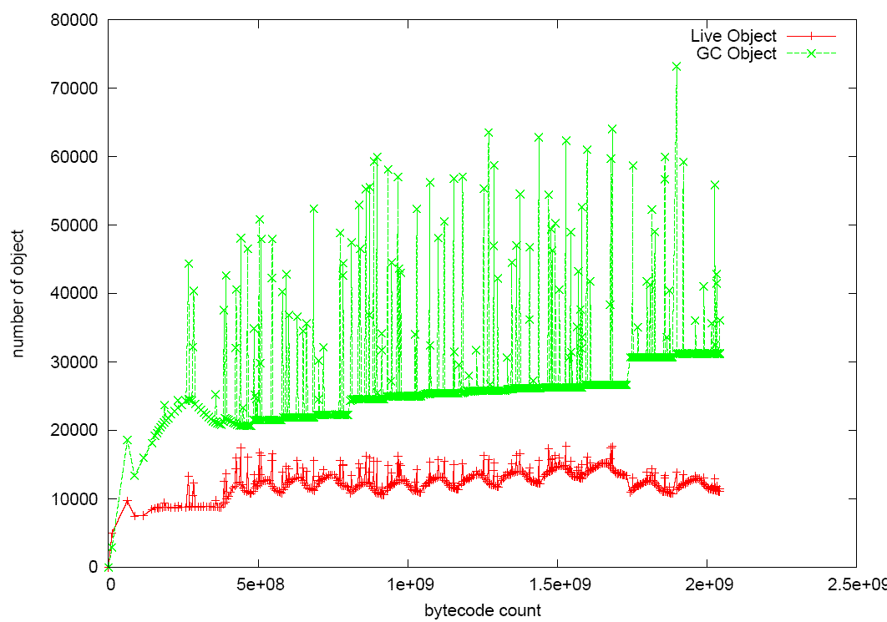
Jess GC info

Slide 32
Outline
Introduction & Contribution
Design
Challenges
Experimental Results
Future work & Conclusion

Slide 33
Future Work
Map to static code location
Visual improvement
  Improve animation quality
  Collapsing nodes to look at bigger graphs
More analyses, i.e. summary graphs

Slide 34
Related Work
Shape Analysis
  With Annotation
    Hummel et al.: program annotation
    Fradet et Le Métayer: language annotation
  Without annotation
    Ghiya and Hendren: tree/DAG/cycle
    Wilhelm et al.: shape graph
    Navarro et al.: reference-shape graph

Slide 35
Related Work (cont’d)
Dynamic Analysis
  Online
    MIT Program Analysis Group:
    The Daikon invariant detector
    The Dynamo Project (Indiana University)
  Offline
    Dufour: *J, a tool for dynamic analysis of Java programs

Slide 36
Conclusion
Design
Challenges
  Visualization & tools
  Amount of data
Experimental Results
  JOlden
  SPECjvm98

Slide 37
References
J. Bogda and A. Singh. Can Shape Analysis work at run-time? In Proceedings of the 1st Java Virtual Machine Research and Technology Symposium, April 23-24, 2001.
B. Dufour, K. Driesen, L. Hendren, and C. Verbrugge. Dynamic metrics for java. OOPSLA ’03, pages 149-168.
P. Fradet and D. L. Métayer. Shape types. POPL ’97.
R. Ghiya and L. Hendren. Is it a tree, a dag, or a cyclic graph? A shape analysis for heap-directed pointers in c. POPL ’96.
B. Hackett and R. Rugina. Region-based shape analysis with tracked locations. POPL ’05.
A. Navarro, F. Corbera, R. Asenjo, A. Tineo, O. Plata, and E. Zapata. A new dependence test based on shape analysis for pointer-based codes. LCPC ’04
R. Wilhelm, S. Sagiv, and T. W. Reps. Shape analysis. In Computational Complexity, pages 1-17, 2000.

Slide 38
Questions?

Slide 39
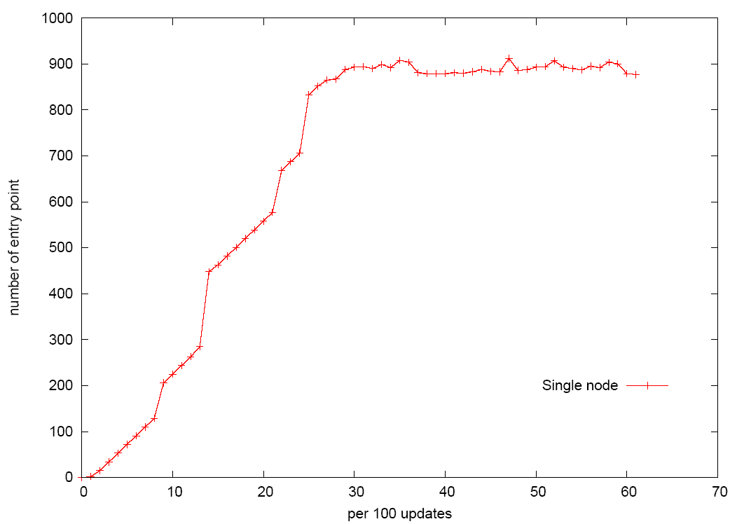
SPECjvm98 - MpegAudio

Slide 40
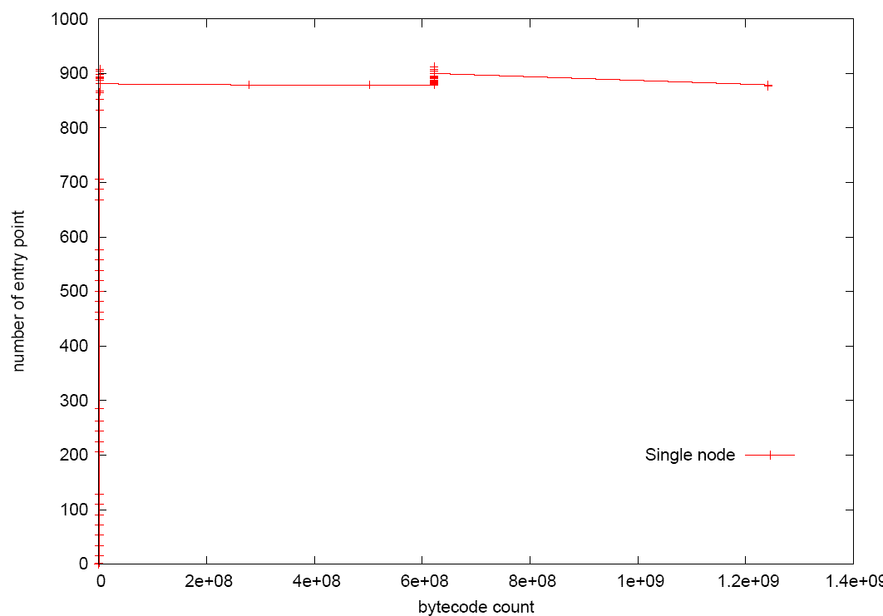
MpegAudio (cont’d)

Slide 41
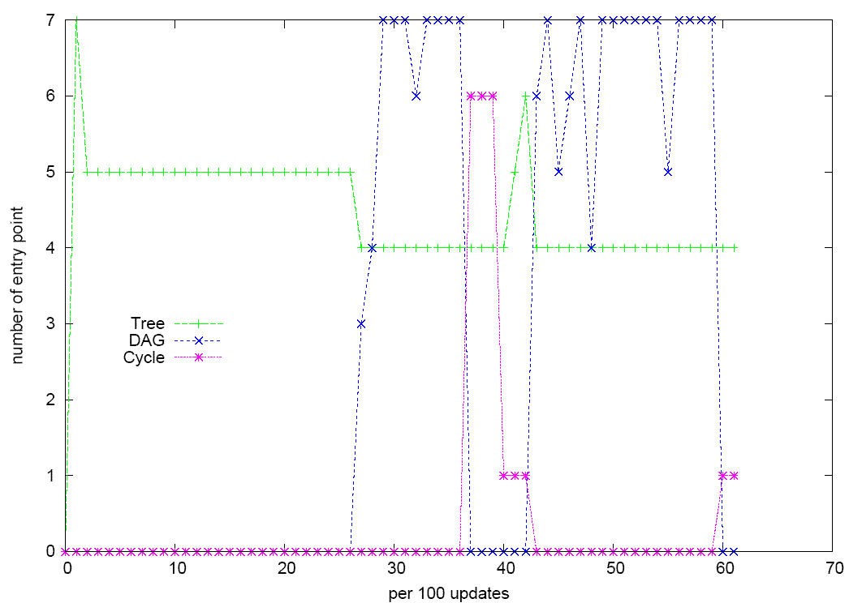
MpegAudio (cont’d)

Slide 42
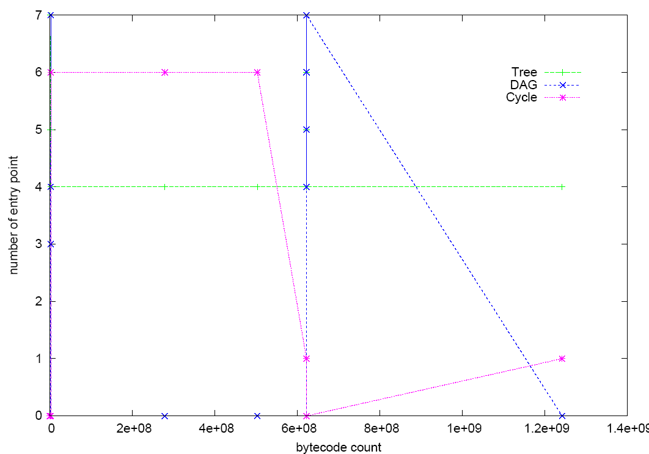
MpegAudio (cont’d)

Slide 43
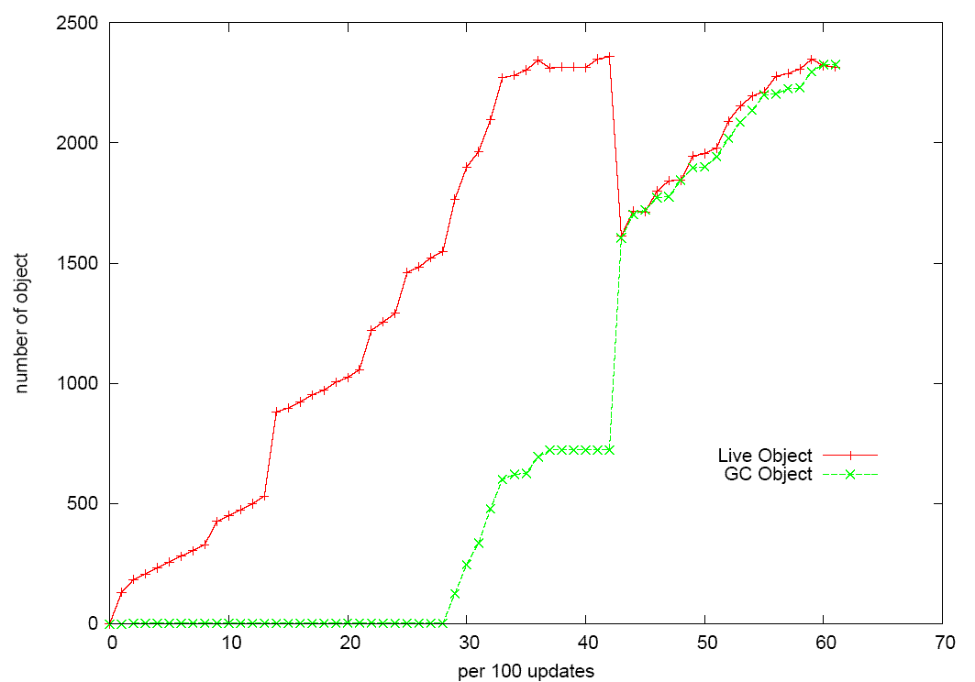
MpegAudio GC Info

Slide 44
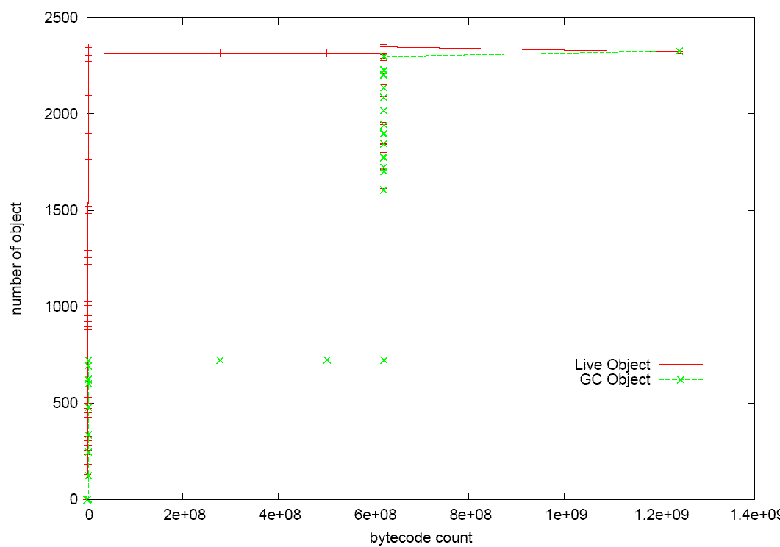
MpegAudio GC Info (cont’d)

