Slide 1
Reducing Compilation Overhead in J9/TR
Marius Pirvu, Derek Inglis, Vijay Sundaresan

Slide 2
Agenda
Adaptive compilation in the TR JIT
Class Load Phase
Asynchronous compilation
Limiting the negative effect of very long compilations
Ongoing work
  Improvements to async compilation
  AOT

Slide 3
Adaptive Compilation in TR JIT
Methods start out being interpreted
After N invocations methods get compiled at ‘warm’ level
Sampling thread used to identify hot methods
Methods may get recompiled at ‘hot’ or ‘scorching’ levels
Transition to ‘scorching’ goes through a temporary profiling step
interpreted
warm
hot
profiling
scorching

Slide 4
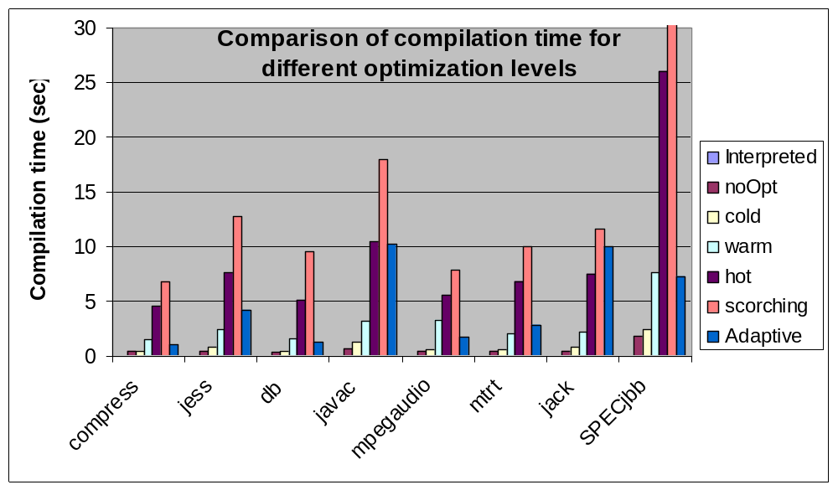
Performance
Notes:
All methods were compiled at the first invocation, at a fixed optimization level as specified in the legend of the chart

Slide 5
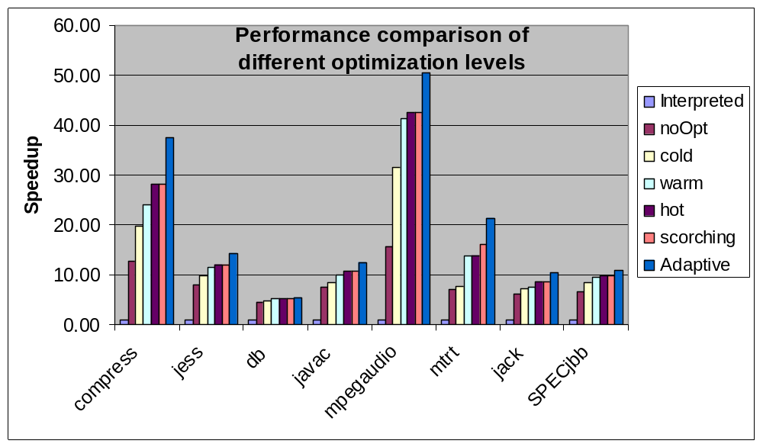
Performance
Notes:
All methods were compiled at the first invocation, at a fixed optimization level as specified in the legend of the chart (except for adaptive).
Adaptive == default configuration of our JIT

Slide 6
How About Applications Without Hotspots
WebSphere AppServer startup
  Very flat profile
 | No Adaptive Compilation | With Adaptive Compilation
Methods compiled | Warm=36700 | Warm=2750, hot=11
Time spent compiling | 115 sec | 17.3 sec
Startup-time | 161 sec | 21.5 sec
Notes:
Some applications (in particular J2EE applications) don’t have clear hotspots. In these cases the adaptive compilation provides limited usefulness.
The solution is to either compile all methods at high optimization levels or none at all.
In the table above the “No Adaptive Compilation” scenario compiles all methods on their first invocation.

Slide 7
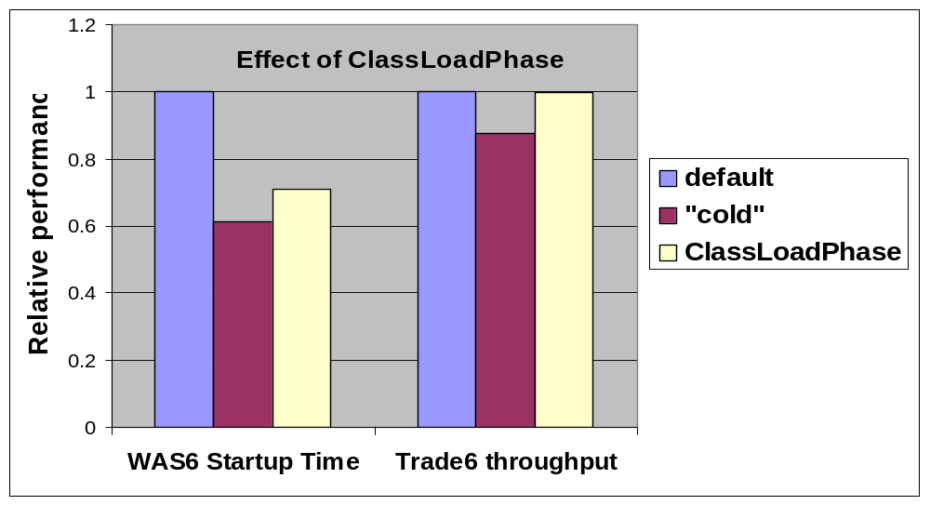
Class-Load-Phase
Intuition: Methods compiled during startup phase may not be important during application run phase
Detect phases when class loading is intense
Reduce optimization level to “cold” during such phases
Notes:
Adaptive compilation used in all experiments.
Default uses warm as first compilation level
“cold” uses cold as first compilation level
ClassLoadPhases switches between warm and cold as needed

Slide 8
Asynchronous Compilation
Synchronous compilation
  Application thread places compilation request and blocks waiting for the compilation to finish
Asynchronous compilation
  Application thread does not wait for the compilation result
JIT compilations performed on a separate compilation thread
Notes:
Currently we have only one compilation thread

Slide 9
Asynchronous Compilation
Implementation
  Synchronous compilation still needed in some cases (e.g. pre-existence)
  Synchronous and asynchronous compilation must coexist
  Queue of compilation requests
Advantages
  Takes advantage of available processors on SMP machines by increased parallelism
  Allows performance improvements in uniprocessors by changing compilation thread priority
  Allows reordering of compilation requests

Slide 10
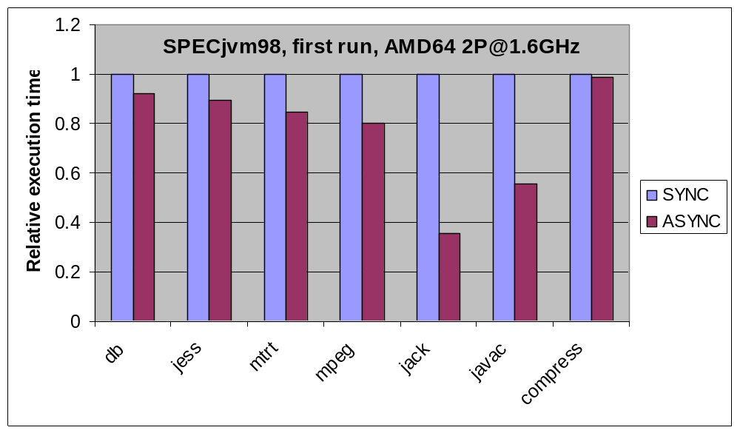
Performance Results – Short Running Apps.
Asynchronous compilation on SMP reduces execution time of short benchmarks

Slide 11
Limiting Negative Effect of Long Compilations
Compilations may impede GC operation
  GC requires exclusive VM access
  Cannot allow class unloading while compilation in progress ➔ Compilations require VM access
Solution
  Compilation thread periodically releases and reacquires VM access allowing GC to cut-in
  Upon re-acquiring VM access, check if GC unloaded any classes
  If classes were unloaded, abort current compilation and retry

Slide 12
Ongoing Improvements to Asynchronous Compilation
Idea
  Use thread priorities to smooth out the effects of compilation - effectively interleave compilation with execution
Implementation
  Don’t use more than X% CPU for compilation
  Use the queue of methods as a buffer
    accumulate work during periods of heavy utilization
    solve the backlog when CPU is lightly used or idle (due to IO for instance)
  Prioritize compilation requests in the queue

Slide 13
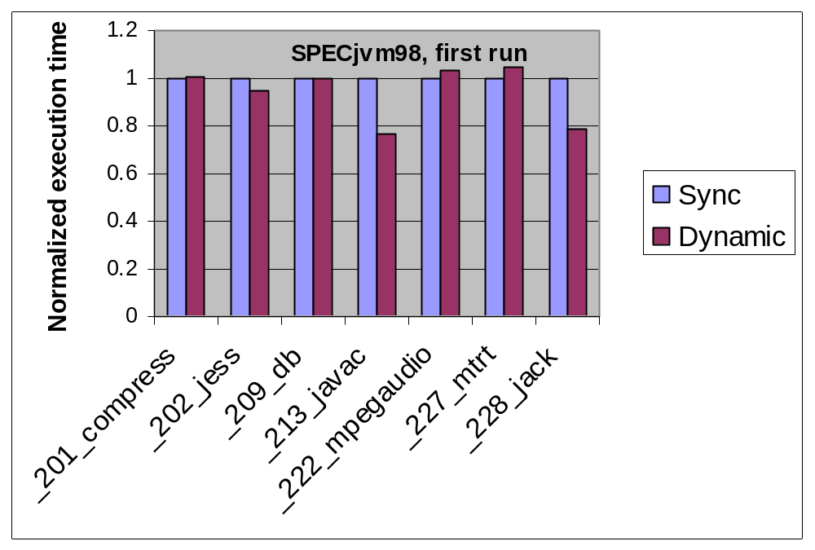
Performance - Uniprocessors
Notes:
Notes:
Results correspond to the first run of the given application (SPECjvm98 rules allow us to run an application repeatedly and report the best score)
On uniprocessors the performance of asynchronous compilation is the same as the performance of synchronous compilation because in our case the compilation thread has the highest priority.
“Dynamic” refers to asynchronous compilation with dynamic compilation thread priority.
The results are spectacular if the short version of the applications is used (-s10 instead of –s100)

Slide 14
Ahead Of Time (AOT) Compilation
Using the JIT as a static compiler
Fully compliant code
Used by J2ME customers to decrease footprint by eliminating the JIT
Will be used by the Real Time offering to eliminate the possibility of nondeterministic behaviour introduced by the JIT
Experimenting with combining AOT and JIT compilation to improve startup times
Notes:
AOT in J2ME can be used to reduce the footprint size of the jit compiler to 0

Slide 15
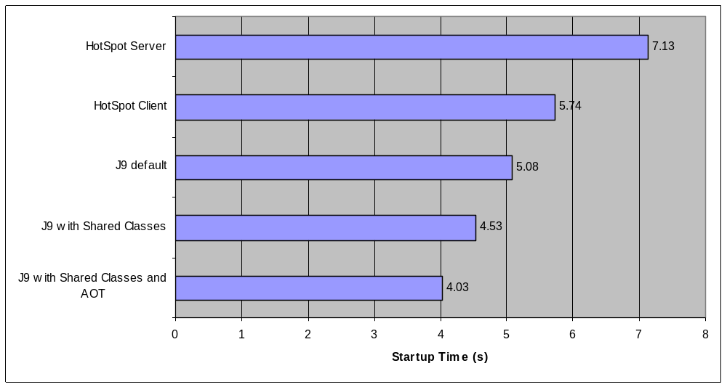
Eclipse 3.0.1 Startup Times
Hardware: 1P@1.2GHz Pentium3 M, Windows32 Options:-Xmx512m -Xms512m for all tests

Slide 16
?

