Slide 1
Inlining Java Native Calls at Runtime
(CASCON 2005 – 4th Workshop on Compiler Driven Performance)
Levon Stepanian, Angela Demke Brown
Computer Systems Group
Department of Computer Science, University of Toronto
Allan Kielstra, Gita Koblents, Kevin Stoodley
IBM Toronto Software Lab

Slide 2
In a nutshell
Runtime native function inlining into Java
  Optimizing transformations on inlined JNI calls
  Opaque and binary-compatible while boosting performance
Java Code
Native Function Call
Native Code
Notes:
-inlines compiled native code into compiled Java code at runtime

Slide 3
In a nutshell
Runtime native function inlining into Java
  Optimizing transformations on inlined JNI calls
  Opaque and binary-compatible while boosting performance
Java Code
Native Code
inlined
Notes:
-inlines native functions called by java applications

Slide 4
In a nutshell
Runtime native function inlining into Java
  Optimizing transformations on inlined JNI calls
  Opaque and binary-compatible while boosting performance
Java Code
Native Code
inlined
+
optimized
Notes:
-also performs optimizations on inlined code, specifically optimizing transformations on inlined JNI function calls
-increases performance of Java apps while maintaining JNI characteristics

Slide 5
Motivation
The JNI
  Java’s interoperability API
  Callouts and callbacks
  Opaque
  Binary-compatible
Java App
JVM + JIT
JNI
Callout
Callback
Native (Host) Environment
Native App/Lib
Notes:
-interoperability at the function level
-callouts and callbacks
-opaque and binary-compatible

Slide 6
Motivation
The JNI
  Pervasive
    Legacy codes
    Performance-critical, architecture-dependent
    Features unavailable in Java (files, sockets etc.)
Notes:
-investigations show that Java applications use JNI in a number of ways
-legacy – large existing set, avoid having to rewrite
-performance-critical Java apps – highspeed I/O quick access to drivers, numerical routines fast access to low-level unmanaged memory
-some features unavailable in Java – performance monitoring (hw counters and timers)
-main motivation comes from:
-recorded overheads associated with the JNI
-inability for a JIT to perform aggressive optimizations on code containing native calls
-I know describe in more detail the two main sources of JNI overheads

Slide 7
Motivation
Callouts run to 2 to 3x slower than Java calls
Callback overheads are an order of magnitude larger
  JVM handshaking requirements for threads leaving and re-entering JVM context
  i.e. stack switching, reference collection, exception handling
JIT compiler can’t predict side-effects of native function call
Notes:
-CLEAR THE FIGURE
-first source of overheads are those from performing callouts
-in addition to traditional function call/return overheads, there are Java to native specific call overheads

Slide 8
Our Solution
JIT compiler based optimization that inlines native code into Java
JIT compiler transforms inlined JNI function calls to constants, cheaper operations
Inlined code exposed to JIT compiler optimizations
Notes:
More specifically, our solution is
-a JIT compiler based optimization that inlines native functions at runtime and optimizes inlined JNI function calls
-it not only eliminates the native function call and return overheads
-but it optimizes the more expensive inlined JNI function calls by transforming them to JIT compile-time constants and cheaper but semantically equivalent operations
-desirable side effect:
-eliminates pessimistic JIT compiler assumptions
-exposes inlined code to the JIT compiler’s optimization arsenal

Slide 9
Infrastructure
IBM TR JIT Compiler + IBM J9 VM
Native IL to JIT IL conversion mechanism
  Exploit Native IL stored in native libraries
  W-Code to TR-IL at runtime
Machine
code
TR JIT
+
Static
compiler IL
Notes:
-have implemented a prototype version of our strategy in the IBM TR JIT java compiler
-accompanies the IBM J9 virtual machine
-we also depend on an intermediate language conversion mechanism that transforms native IL to JIT compiler IL
-we exploit W-Code stored alon, a mature, stack-based IL generated by IBM front ends for a large set of native languages
-TR IL is the JIT compiler’s IL, a tree-based linked list representation

Slide 10
Outline
Background Information ✓
Method
Results
Future Work
Notes:
-So far I’ve provided you with the background, motivation and infrastructure we’ve used for our work
-also described the cost of performing callouts and callbacks
-I now continue to discuss our actual implementation.

Slide 11
Sample Java Class
class SetFieldXToFive{
public int x;
public native foo();
static{
System.loadLibrary(…);
}
}
Notes:
-describe the Firetruck class

Slide 12
Sample Java Class
class SetFieldXToFive{
public int x;
public native foo();
static{
System.loadLibrary(…);
}
}

Slide 13
Sample Native Code
GOAL: obj.x = 5
JNIEXPORT void JNICALL Java_SetFieldXToFive_foo
(JNIEnv * env, jobject obj){
jclass cls = (*env)->GetObjectClass(env,obj);
jfieldID fid =
(*env)->GetFieldID(env,cls,“x","I");
if (fid == NULL)
return;
(*env)->SetIntField(env,obj,fid,5);
}
Notes:
-want to implement native code that of a Firetruck object’s field to 5
-requires three callbacks
-handle to the class of the passed object
-handle to the field being set
-the JNI function that sets the value
-can imagine 5 materialized from a calculation or a return value of a called function

Slide 14
Sample Native Code
GOAL: obj.x = 5
JNIEXPORT void JNICALL Java_SetFieldXToFive_foo
(JNIEnv * env, jobject obj){
jclass cls = (*env)->GetObjectClass(env,obj);
jfieldID fid =
(*env)->GetFieldID(env,cls,“x","I");
if (fid == NULL)
return;
(*env)->SetIntField(env,obj,fid,5);
}
SetFieldXToFive
Notes:
-want to implement native code that of a Firetruck object’s field to 5
-requires three callbacks
-handle to the class of the passed object
-handle to the field being set
-the JNI function that sets the value
-can imagine 5 materialized from a calculation or a return value of a called function

Slide 15
Sample Native Code
GOAL: obj.x = 5
JNIEXPORT void JNICALL Java_SetFieldXToFive_foo
(JNIEnv * env, jobject obj){
jclass cls = (*env)->GetObjectClass(env,obj);
jfieldID fid =
(*env)->GetFieldID(env,cls,“x","I");
if (fid == NULL)
return;
(*env)->SetIntField(env,obj,fid,5);
}
Notes:
-want to implement native code that of a Firetruck object’s field to 5
-handle to the class of the passed object
-handle to the field being set
-the JNI function that sets the value
-can imagine 5 materialized from a calculation or a return value of a called function

Slide 16
Sample Native Code
GOAL: obj.x = 5
JNIEXPORT void JNICALL Java_SetFieldXToFive_foo
(JNIEnv * env, jobject obj){
jclass cls = (*env)->GetObjectClass(env,obj);
jfieldID fid =
(*env)->GetFieldID(env,cls,“x","I");
if (fid == NULL)
return;
(*env)->SetIntField(env,obj,fid,5);
}
Notes:
-want to implement native code that of a Firetruck object’s field to 5
-handle to the class of the passed object
-handle to the field being set
-the JNI function that sets the value
-can imagine 5 materialized from a calculation or a return value of a called function

Slide 17
Sample Native Code
GOAL: obj.x = 5
JNIEXPORT void JNICALL Java_SetFieldXToFive_foo
(JNIEnv * env, jobject obj){
jclass cls = (*env)->GetObjectClass(env,obj);
jfieldID fid =
(*env)->GetFieldID(env,cls,“x","I");
if (fid == NULL)
return;
(*env)->SetIntField(env,obj,fid,5);
}
Notes:
-want to implement native code that of a Firetruck object’s field to 5
-handle to the class of the passed object
-handle to the field being set
-the JNI function that sets the value
-can imagine 5 materialized from a calculation or a return value of a called function

Slide 18
Native Inlining Overview
Inliner detects a native callsite
Extracts and converts Native IL to JIT IL
Identifies inlined JNI calls
Transforms inlined JNI calls
Finishes inlining

Slide 19
Method – Step 1
TR JIT
1. Inliner detects a native callsite
Inliner
Java Code
foo(){…}
(Native code)
Call to obj.foo()
Notes:
Our native inlining strategy operates as follows. When the inliner encounters the native function call to foo … (Next Slide)

Slide 20
Method – Step 2
Inliner detects a native callsite
Extracts and converts Native IL to JIT IL
Native IL
JIT IL
Notes:
-extracts the W-Code representation
-converts it to TR-IL
-mimicking operations on the W-Code stack
-preserves semantics of native code
-preserves aliasing information that the W-Code

Slide 21
Method – Step 3
JIT IL
Inliner detects a native callsite
Extracts and converts Native IL to JIT IL
Identifies inlined JNI calls
/* call to GetObjectClass */
…
/* call to GetFieldID */
…
/* call to SetFieldID */
…
Pre-constructed IL shapes
Notes:
-the next step involves iterating through the generated TR-IL and identifying JNI function calls
-not easy to to differentiate an arbitrary indirect function call from a call to a JNI function in TR-IL
-our method iterates through the inlined code, looking for sequences of IL statements that match a pre-generated set of IL
shapes that encode IL representing JNI function calls, as well as the number and types of arguments to such calls.

Slide 22
Method – Step 4
jclass cls =
(*env)->GetObjectClass(env,obj);
jfieldID fid =
(*env)->GetFieldID(env,cls,“x","I");
if (fid == NULL)
return;
(*env)->SetIntField(env,obj,fid,5);
Inliner detects a native callsite
Extracts and converts Native IL to JIT IL
Identifies inlined JNI calls
Transforms inlined JNI calls
Notes:
-after identifying inlined JNI function calls, the inliner starts optimizing them by transforming them to JIT compile-time constants or cheaper operations
-in order to decipher the concrete values and types of arguments to JNI callbacks, it performs use/def analysis on uses and definitions of arguments to callbacks
-in most cases, argument definitions can be transformed to constants, which are then tracked to their uses, resulting in other IL transformations.
With respect to the sample foo native function:
-the call to GetObjectClass can be transformed to a JIT compile-time constant because the type of the object obj is well-known
-the call to GetFieldID can also be transformed to a object field offset known at JIT compile-time.
-the call to SetIntField can be replaced with TR-IL for a putfield bytecode.

Slide 23
Method – Step 4
jclass cls =
(*env)->GetObjectClass(env,obj);
Constant: SetFieldXToFive class data structure
Inliner detects a native callsite
Extracts and converts Native IL to JIT IL
Identifies inlined JNI calls
Transforms inlined JNI calls
jfieldID fid =
(*env)->GetFieldID(env,cls,“x","I");
if (fid == NULL)
return;
Constant: Offset of field “x”
(*env)->SetIntField(env,obj,fid,5);
JIT IL: obj.x = 5

Slide 24
The Big Picture
TR JIT
Before Native Inlining & Callback Transformations
Inliner detects a native callsite
Extracts and converts Native IL to JIT IL
Identifies inlined JNI calls
Transforms inlined JNI calls
Finishes inlining
Inliner
Java Code
foo(){…}
(Native code)
Call to obj.foo()
Notes:
In the big picture, what started out as a callout to native containing three callbacks is replaced by a putfield bytecode
-as well as an implicit nullcheck

Slide 25
The Big Picture
TR JIT
After Native Inlining & Callback Transformations
Inliner detects a native callsite
Extracts and converts Native IL to JIT IL
Identifies inlined JNI calls
Transforms inlined JNI calls
Finishes inlining
Inliner
Java Code
foo(){…}
(Native code)
obj.x = 5

Slide 26
The Big Picture
TR JIT
After Native Inlining & Callback Transformations
Inliner detects a native callsite
Extracts and converts Native IL to JIT IL
Identifies inlined JNI calls
Transforms inlined JNI calls
Finishes inlining
Inliner
Java Code
obj.x = 5

Slide 27
Outline
Background Information ✓
Method ✓
Results
Future Work
Notes:
I now present our experiments and results.

Slide 28
Experimental Setup
Native function microbenchmarks
  Average of 300 million runs
1.4 GHz Power4 setup
Prototype implementation
Notes:
-each microbenchmark results is the average of having run it 300 million times
-proof of concept - couldn’t use large benchmarks

Slide 29
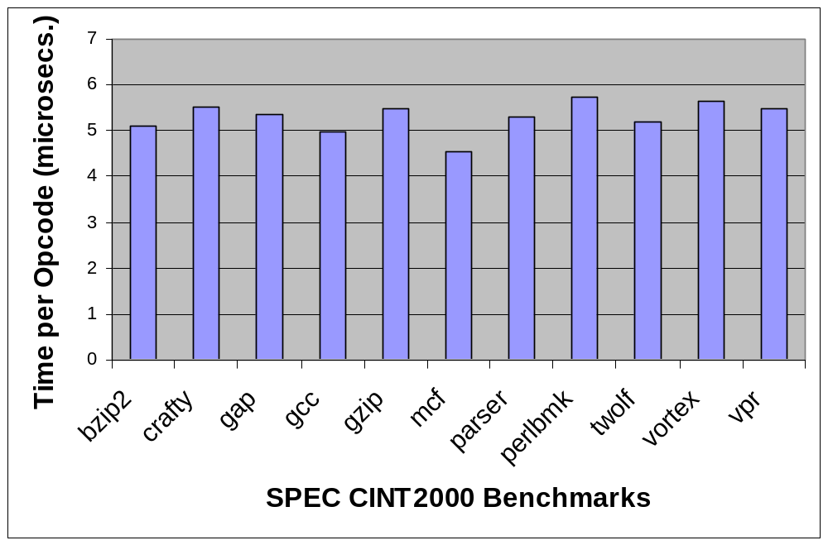
Cost of IL Conversion
5.3 microseconds per W-Code
Notes:
-first experiment to measure the cost of performing IL conversion
-converted W-Codes for the SPEC CINT2 benchmark programs
-conversion rate was fairly stable throughout benchmarks
-on average, took 5.3 microseconds per encountered W-Code
-this suggests the inliner can use a simple heuristic at runtime to estimate the total cost of converting the IL of a native function

Slide 30
Inlining Null Callouts
Null native method microbenchmarks
Varying numbers of args (0, 1, 3, 5)
  Complete removal of call/return overhead
    Gain back 2 to 3x slowdown
  confirmed our expectations
Notes:
-remove call and replace with empty method body
-divide by 0

Slide 31
Inlining Non-Null Callouts
 | Speedup (X)
Microbenchmark Test | Instance | Static
hash | 5.5 | 1.8
smaller speedups for natives performing work
instance vs. static speedup

Slide 32
Inlining & Transforming Callbacks
 | Speedup (X)
Microbenchmark Test | Instance | Static
CallVoidMethod | 12.9 | 11.8
Reclaim order of magnitude overhead

Slide 33
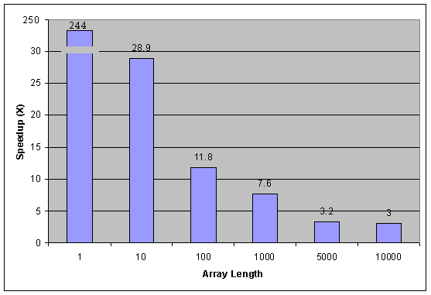
Data-Copy Speedups
Speedup (X)
Array Length
Transformed GetIntArrayRegion
Notes:
-also implemented a more realistic microbenchmark test, one that mimics the functionality of JDBC drivers
-in this microbenchmark, we copied Java declared integer array data into native code using the GetIntArrayRegion callback
-transformed the callback into a high-speed array copy routine call provided by the JIT’s runtime
-our speedups ranged from 244x for arrays of size 1, which are not uncommon, to 3x for integer array of length 10,000

Slide 34
Exposing Inlined Code To JIT Optimizations
Microbenchmark Test | Speedup (X)
GetArrayLength | 93.4
FindClass
GetMethodID
NewCharArray
GetArrayLength
Notes:
-an interesting case was a microbenchmark test we implemented that instantiated and returned the length of an array
-the first two callbacks were reduced to constants
-the latter two were transformed to their TR-IL equivalents…
-large speedup is due to the optimized object allocation strategies the JIT utilizes, that aren’t obvious to the JVM
-GetArrayLength callback is transformed into a field read in the array object’s header

Slide 35
Conclusion
Runtime native function inlining into Java code
Optimizing transformations on inlined Java Native Interface (JNI) calls
JIT optimize inlined native code
Opaque and binary-compatible while boosting performance
Future Work
  Engineering issues
  Heuristics
  Larger interoperability framework
Notes:
english

Slide 36
Fin

