Slide 1
Auto-SIMDization Challenges
Amy Wang, Peng Zhao,
IBM Toronto Laboratory
Peng Wu, Alexandre Eichenberger
IBM T.J. Watson Research Center

Slide 2
Objective:
What are the new challenges in SIMD code generation that are specific to VMX?
(due to lack of time….)
  Scalar Prologue/Epilogue Code Generation (80% of the talk)
  Loop Distribution (10% of the talk)
    Mixed-Mode SIMDization
  Future Tuning Plan (10% of the talk)

Slide 3
Background:
Hardware imposed misalignment problem
  More details in the CELL tutorial Tuesday afternoon

Slide 4
Single Instruction Multiple Data (SIMD) Computation
Process multiple “b[i]+c[i]” data per operations
16-byte boundaries
b0
b1
b2
b3
b4
b5
b6
b7
b8
b9
b10
R1
b0
b1
b2
b3
+
b0+
c0
b1+
c1
b2+
c2
b3+
c3
R3
R2
c0
c1
c2
c3
c0
c1
c2
c3
c4
c5
c6
c7
c8
c9
c10
16-byte boundaries
Notes:
what is simd
compute multiple results with a single operation
memory/register

Slide 5
Code Generation for Loops (Multiple Statements)
for (i=0; i<n; i++) {
a[i] = …;
b[i+1] = …;
c[i+3] = …;
}
Implicit loop skewing (steady-state)
a[i+4] = …
b[i+4] = …
c[i+4] = …
a0
a1
a2
b3
...
a[i]=
a4
a5
a6
a7
a96
a97
a98
a99
a
100
a
101
a
102
a
103
a0
b0
b1
b2
b3
...
b[i+1]=
b1
b4
b5
b6
b7
b96
b97
b98
b99
b
100
b
101
b
102
b
103
c0
c1
c2
b3
...
c[i+3]=
c3
c4
c5
c6
c7
c96
c97
c98
c99
c
100
c
101
c
102
c
103
loop prologue
(simdized)
loop steady state
(simdized)
loop epilogue
(simdized)

Slide 6
Code Generation for Partial Store – Vector Prologue/Epilogue
for (i=0; i<100; i++) a[i+3] = b[i+1] + c[i+2];
a0
a1
a2
a3
*
*
*
b1+
c2
b2+
c3
b3+
c4
b4+
c5
b5+
c6
...
shuffle
a0
a1
a2
b1+
c2
load a[3]
store c[3]
store c[7]
a0
a1
a2
a3
a4
a5
a6
a7
…
16-byte boundaries
Can be complicated for multi-threading and page faulting issues

Slide 7
Multi-threading issue
for (i=0; i<100; i++) a[i+3] = b[i+1] + c[i+2];
a0
a1
a2
a3
a4
a5
a6
a7
*
*
*
b1+
c2
Thread 1 performs load of a0-a3
a0
a1
a2
a3
shuffle
Thread 2 updates a0, while thread 1 is working on shuffling
a0
a1
a2
b1+
c2
WRONG!
a0
a1
a2
b1+
c2
b2+
c3
b3+
c4
b4+
c5
b5+
c6
…
16-byte boundaries

Slide 8
Solution – Scalar Prologue/Epilgue
After Late-SIMDization
20 | void ptest()
{
22 | if (!1) goto lab_4;
@CIV0 = 0;
if (!1) goto lab_26;
@ubCondTest0 = (K1 & 3) * -4 + 16;
@CIV0 = 0;
do { /* id=2 guarded */ /* ~27 */
/* region = 0 */
/* bump-normalized */
if ((unsigned) (@CIV0 * 4) >= @ubCondTest0) goto lab_30;
pout0[]0[K1 + @CIV0] = pin0[]0[K1 + @CIV0] + pin1[]0[K1 + @CIV0];
lab_30:
/* DIR LATCH */
@CIV0 = @CIV0 + 1;
} while (@CIV0 < 4); /* ~27 */
@CIV0 = 0;
lab_26:
Scalar Prologue
int K1;
void ptest() {
int i;
for (i=0;i<UB;i++) {
pout0[i+K1] = pin0[i+K1] +
pin1[i+K1];
}
}

Slide 9
if (!1) goto lab_25;
@CIV0 = 0;
do { /* id=1 guarded */ /* ~3 */
/* region = 8 */
23 | @V.pout0[]02[K1 + (@CIV0 + 4)] = @V.pin0[]01[K1 + (@CIV0 + 4)] + @V.pin1[]00[K1 + (@CIV0 + 4)];
22 | /* DIR LATCH */
@CIV0 = @CIV0 + 4;
} while (@CIV0 < 24); /* ~3 */
@mainLoopFinalCiv0 = (unsigned) @CIV0;
lab_25:
SIMD Body
if (!1) goto lab_28;
@ubCondTest1 = (unsigned) ((K1 & 3) * -4 + 16);
@CIV0 = 0;
do { /* id=3 guarded */ /* ~29 */
/* region = 0 */
/* bump-normalized */
if ((unsigned) (@CIV0 * 4) < @ubCondTest1) goto lab_31;
pout0[]0[K1 + (24 + @CIV0)] = pin0[]0[K1 + (24 + @CIV0)] + pin1[]0[K1 + (24 + @CIV0)];
lab_31:
/* DIR LATCH */
@CIV0 = @CIV0 + 1;
} while (@CIV0 < 8); /* ~29 */
@CIV0 = 32;
…
Scalar Epilogue

Slide 10
Scalar Prologue/Epilogue Problems
One loop becomes 3 loops: Scalar Prologue, SIMD Body, Scalar Epilogue
Contains an “if” stmt, per peeled stmt, inside the Scalar P/E loops
If there is one stmt that is misaligned, ‘every statement’ needs to be peeled
Scalar P/E do not benefit from SIMD computation where as Vector P/E does.

Slide 11
The million bucks questions…
When there is a need to generate scalar p/e, what is the threshold for a loop upper bound?
What is the performance difference between vector p/e versus scalar p/e?

Slide 12
Experiments
Written a gentest script with following parameters:
  ./gentest -s snum -l lnum -[c/r] ratio -n ub
  -s : number of store statements in the loop
  -l : number of loads per stmt
  -[c/r] : compile time or runtime misalignment, where 0 <= ratio <= 1 to specify the fraction of stmts that is aligned (i.e. known to aligned at quad word boundary during compile time).
  -n : upper bound of the loop (compile time constant)
Since we’re only interested in overhead introduced by p/e, load references are relatively aligned with store references. (no shifts inside body)
Use addition operation
Assume data type of float (i.e. 4 bytes)
Each generated testcase is compiled at –O3 –qhot –qenablevmx –arch=ppc970, and ran on AIX ppc970 machine (c2blade24)
Each testcase is ran 3 times with average timing recorded.
10 variants of the same parameters are generated.

Slide 13
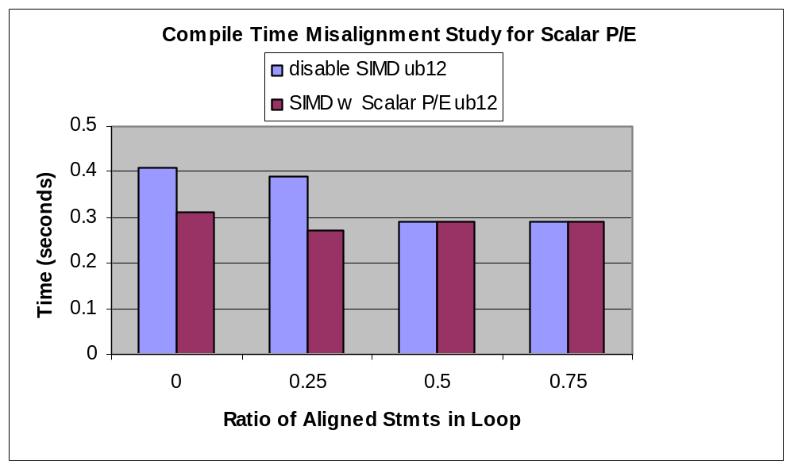
Results
With the lowest functional ub of 12 and in the presence of different degree of compile misalignment, it is always good to simdize!
Tobey is able to fully unroll the scalar p/e loops and fold away all the if conditions. (good job!)

Slide 14
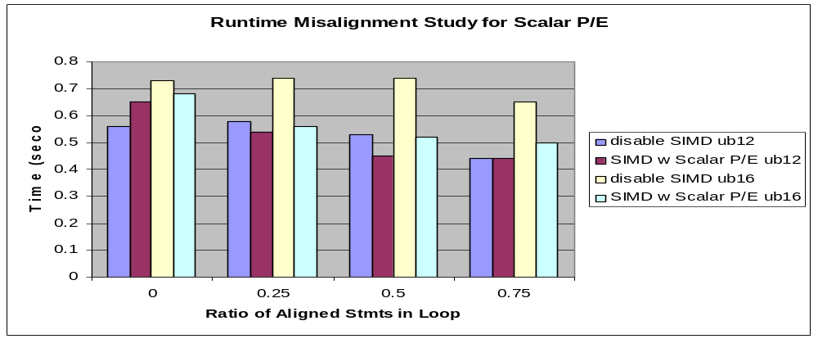
Results
When the aligned ratio is below 0.25 (i.e. misaligned ratio is greater than 0.75) at ub12, scalar p/e gives overhead too large that it is not good to simdize.
However, if we raise the ub to 16, it is always good to simdize regardless of any degree of misalignment!
Tobey is still able to fully unroll the scalar P/E loops, but can’t fold away “if”s with runtime condition.

Slide 15
Answer to the first question.
When there is a need to generate scalar p/e, what is the threshold for a loop upper bound? Compile time 12, Run time 16.

Slide 16
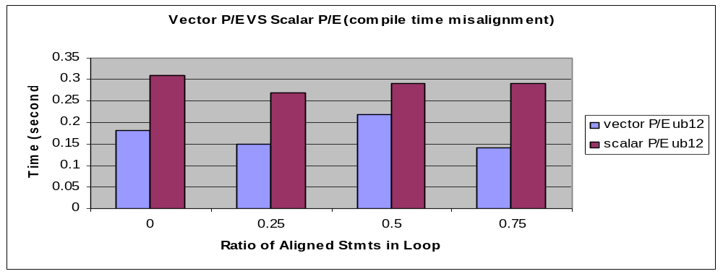
Results
In the presence of only compile misalignment, vector p/e is always better than scalar p/e
Improvement:
  Since every stmt is peeled, those that we have peeled a quad word may still be done using vector instructions

Slide 17
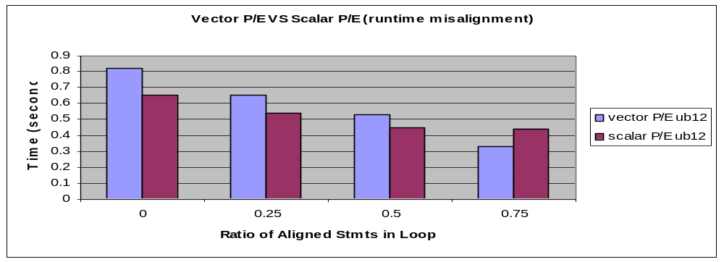
Results
In the presence of high runtime misalignment ratio, vector p/e suffers tremendous when it needs to generate select mask using a runtime variable.
It is better to do scalar p/e when misalignment ratio is greater than 0.25!

Slide 18
Answer to the second question
What is the performance difference between vector p/e versus scalar p/e?
  Vector p/e is always better when there is only compile time misalignment. When there is runtime misalignment of greater than 0.25, scalar p/e proves to be better.

Slide 19
Motivating Example
Not all computations are simdizable
  Dependence cycles
  Non-stride-one memory accesses
  Unsupported operations and data types
A simplified example from GSM.encoder, which is a speech compression application
for (i = 0; i < N; i++) {
1: d[i+1] = d[i] + (rp[i] * u[i]);
2: t[i] = u[i] + (rp[i] * d[i]);
}
Linear Recurrence
Not simdizable
Fully simdizable

Slide 20
Current Approach: Loop Distribution
Distribute the simdizable and non/partially simdizable statements into separated loops (after Loop distribution)
Simdize the loops with only simdizable statements (after SIMDization)
for (i = 0; i < N; i++) {
1: d[i+1] = d[i] + rp[i] * u[i];
}
for (i = 0; i < N; i++) {
2: t[i] = u[i] + rp[i] * d[i];
}
After Loop Distribution
After loop distribution
for (i = 0; i < N; i++) {
1: d[i+1] = d[i] + rp[i] * u[i];
}
for (i = 0; i < N; i+=4) {
2: t[i:i+3] = u[i:i+3] + rp[i:i+3] * d[i:i+3];
}
After simdization

Slide 21
Problems with Loop Distribution
Increase reuse distances of memory references
Only one unit is fully utilized for each loop
for (i = 0; i < N; i++) {
1: d[i+1] = d[i] + (rp[i] * u[i]);
2: t[i] = u[i] + (rp[i] * d[i]);
}
O(1)
Original Loop
for (i = 0; i < N; i++) {
1: d[i+1] = d[i] + (rp[i] * u[i]);
}
for (i = 0; i < N; i++) {
2: t[i] = u[i] + (rp[i] * d[i]);
}
SIMD idle
Scalar idle
O(N)
After loop distribution

Slide 22
Preliminary results
The prototyped mixed mode SIMDization has illustrated a gain of 2 times speed up for the SPEC95 FP swim. With loop distribution, the speed up is only 1.5 times.

Slide 23
Conclusion and Future tuning plan
Further improvement on scalar p/e code generation.
  Currently, finding out cases when stmt re-execution is allowed. This will allow us to fold away more if conditions
  More experiments to determine the upper bound threshold for different data types
Enable Mixed-mode SIMDization
Integration of SIMDization framework into TPO better
  e.g. predicative commoning

Slide 24
Acknowledgement
This work would not be possible without the technical contribution from the following individuals.
  Roch Archambault/Toronto/IBM
  Raul Silvera/Toronto/IBM
  Yaoqing Gao/Toronto/IBM
  Gang Ren/Watson/IBM

