Slide 1
Array privatization in IBM static compilers
-- technical report
CASCON 2005

Slide 2
Authors
Guansong Zhang, Erik Charlebois
and Roch Archambault
Compiler Development Team
IBM Toronto Lab, Canada
October 17, 2005

Slide 3
Overview
Introduction and motivation
Array data flow analysis
Array data privatization
Performance results
Future work
Possible usage

Slide 4
Expose limitations
Compare SPEC2000FP and SPECOMP
SPECOMP achieves good performance and scalability
  Compare between explicit and auto-parallelization
Expose missed opportunities
10 common benchmarks
  Compare on a loop-to-loop basis

Slide 5
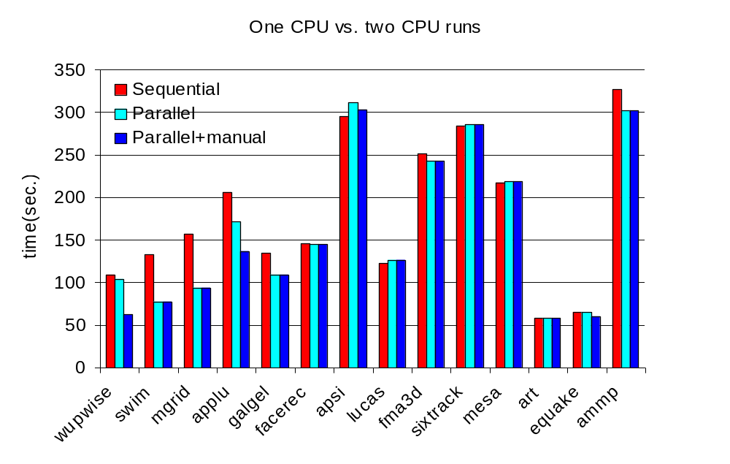
Improved auto-parallelization performance

Slide 6
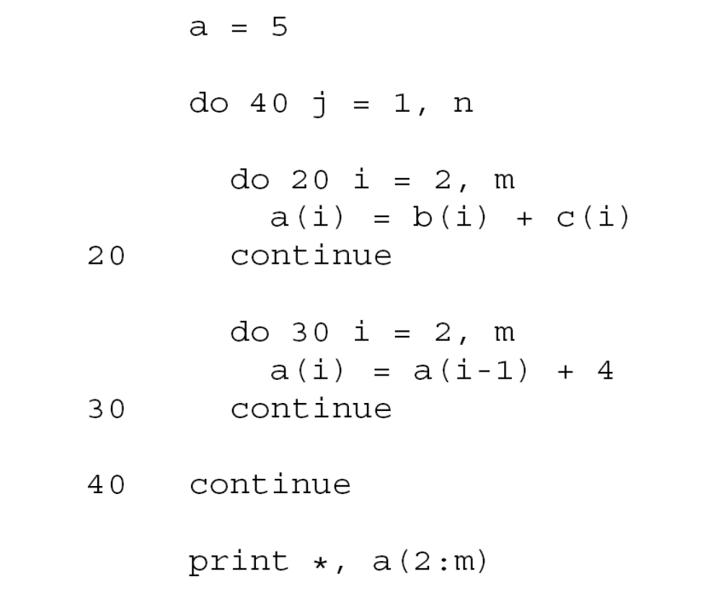
Array privatization example

Slide 7
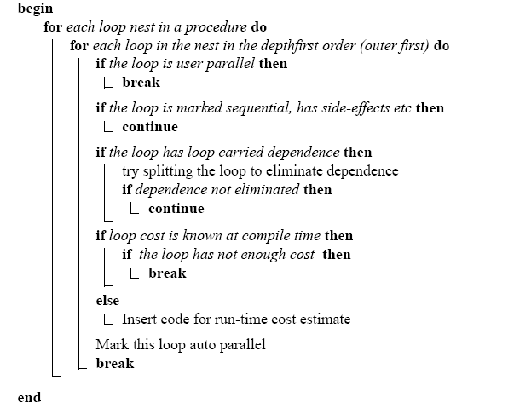
Basic loop parallelizer

Slide 8
Pre-parallelization Phase
Induction variable identification
Scalar Privatization --- only scalar !
Reduction finding
Loop transformations favoring parallelism

Slide 9
The concept of data privatization
Data is local to each loop iteration
Do I = 1, 10
  Temp = ...
  ... = … Temp …
  ... = … Temp …
  Enddo
Purpose: eliminating loop carried dependences.

Slide 10
The concept of data privatization (cont.)
Array as temp data
do J = 1, 10
do I = 1, 10
  Temp(I) = ...
  end do
  do I = 1, 10
  ... = … Temp (I) …
  enddo
  enddo

Slide 11
Array data flow and its structure
Similar to data flow
  MayDef: array elements that may be written.
  MustDef: array elements that are definitely written.
  UpExpUse: array elements that may have an upward exposed use
    a use not preceded by a definition along a path from the loop header
  LiveOnExit: array elements that are used after the loop region.
GARs: Guarded Array Regions (GARs).
  A GAR is a tuple(G,D),
    D is a bounded Regular Section Descriptor (RSD) for the accessed array section,
    G is a guard that specifies the condition under which D is accessed
Notes: many papers discussed the issue

Slide 12
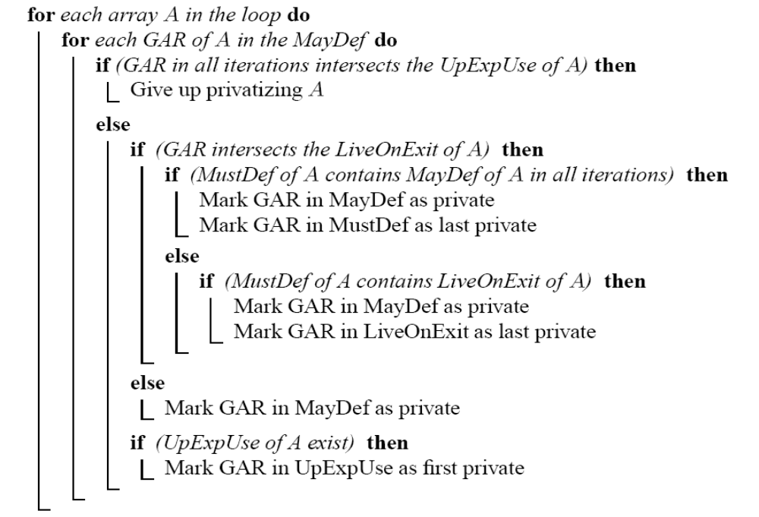
Array privatization algorithm

Slide 13
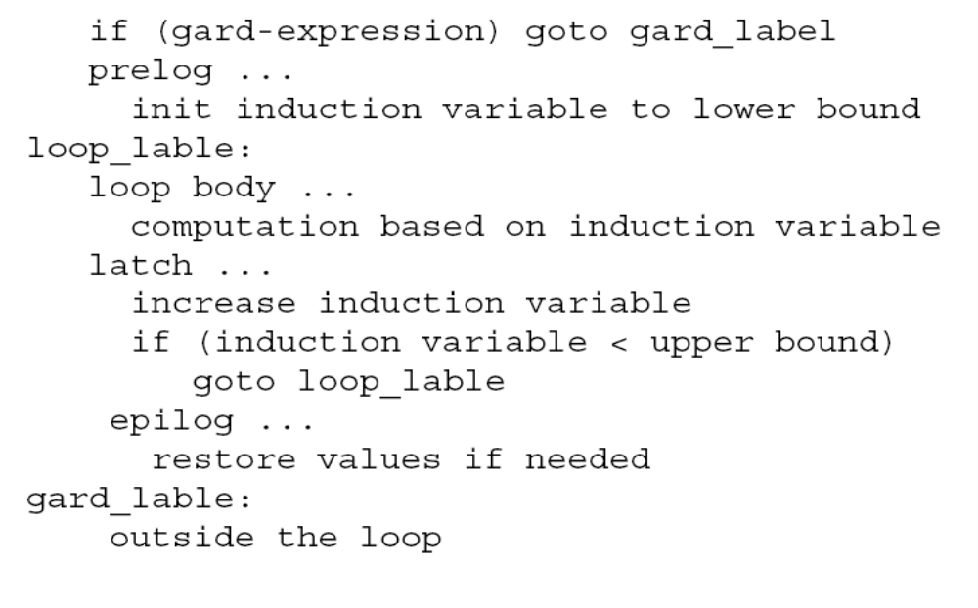
Loop normalization and array data flow
Normalized loop

Slide 14
Alias analysis and array data flow
Ideal situation: no alias at all.
  Other wise, you can not tell what is the precise intersection of the two array section involved
Alias coming from:
  Structural members, e.g. scalar replacement
  Function parameters,
    array is a shadow (not mapped data, alias to any global array)
Procedure summary may help
  Alias as fall back

Slide 15
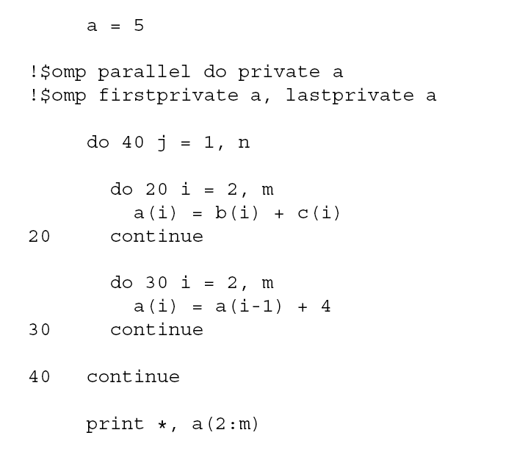
Possible parallelization results

Slide 16
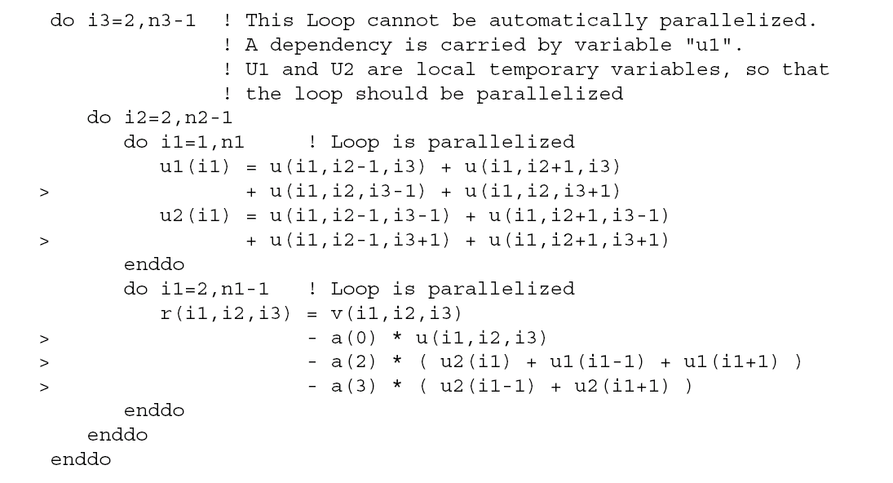
Real case

Slide 17
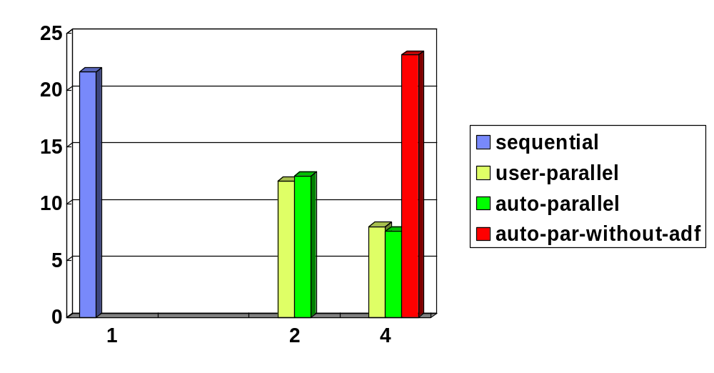
NAS MG (-O3 –qhot –q64)

Slide 18
Summary
Challenges
  Compilation time
    Work with other optimizations
      Loop unroll
    Graph complexity
      Number of branches
    Array section caculation accuracy
  Memory usage
    Managing and reusing

Slide 19
Summary (cont.)
Further improvement:
  Inter-procedural array data flow
    Procedure summary
    More accurate section information instead of using alias
  Symbolic range analysis
    Expression simplifier: lot of room to be improved
  Compilation efficiency
Possible usage
  Auto parallelization
  Array contraction
  Array coalescing

