Slide 1
Reducing Startup Costs of Java Applications with Shared Relocatable Code
Derek Inglis, Marius Lut,
Kenneth Ma and Marius Pirvu
IBM Toronto Lab

Slide 2
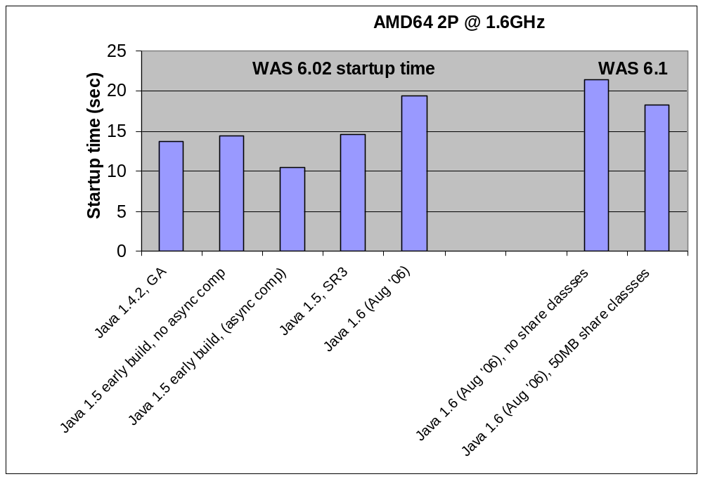
Evolution of WAS Startup Time

Slide 3
Agenda
Background
Shared Relocatable Code
Heuristics
Experiment Results
Future Work and Conclusions

Slide 4
Agenda
Background
Shared Relocatable Code
Heuristics
Experiment Results
Future Work and Conclusions

Slide 5
Shared Classes
Why shared classes?
  Memory footprint reduction
  Startup time improvement
VM a
VM b
Class Loader a1
Class Loader a1
RAM Class
RAM Class
ROM Class
Class Loader a2
Class Loader a2
RAM Class
RAM Class

Slide 6
Shared Classes
Shared Cache
  Shared memory of fixed size
  ROM Classes are stored inside the shared cache
Characteristics
  Concurrent JVM access
  All system and application classes can be stored
  Suitable for multi-JVM environment or when JVM is regularly restarted

Slide 7
Agenda
Background
Shared Relocatable Code
Heuristics
Experiment Results
Future Work and Conclusions

Slide 8
Our Solution – Shared Relocatable Code
Performance improvement by reducing compilation time
  Startup and response time
  CPU utilization
What is shared relocatable code?
  Compiled code in “relocatable” form
  Similar to code created by a static AOT compiler
  Relocations performed to fix up address values

Slide 9
Shared Relocatable Code
How does shared relocatable code work?
  Compiler generates relocatable code during execution
  Relocatable code is stored into the shared cache
  Subsequent JVM loads and relocates code from the shared cache
Share other characteristics of shared classes
  Concurrent JVM access
  Methods of all system and application classes can be stored
Reduces compilation time!

Slide 10
At a glance…
Shared Cache
Repository
Virtual
Machine
Intermediate
Code
Retrieve
Store
Compile request
Compiler
First compile?
Relocatable
code exists?
Yes
No
Class loading
phase?
No
No
Yes
Compile & Store
Retrieve
Yes
JIT
Compile
JIT Compile
Shared relocatable code
Compiled
code
Relocate

Slide 11
Agenda
Background
Shared Relocatable Code
Heuristics
Experiment Results
Future Work and Conclusions

Slide 12
Performance Desiderates
Reduce startup time
Lower CPU utilization
Maintain runtime performance (throughput)

Slide 13
Heuristics
Decisions
  When to generate shared relocatable code
  When to use relocatable code from shared cache
Heuristic
  Generate relocatable code during the “class loading phases”
  Always use relocatable code if available
    Alternative: use relocatable code, if available, during the class loading phases

Slide 14
Heuristic Refinement
Generate relocatable code only during the initial run
Use relocatable code sooner – “scount” option.
Bump priority of the relocatable code.

Slide 15
Agenda
Background
Shared Relocatable Code
Heuristics
Experiment Results
Future Work and Conclusions

Slide 16
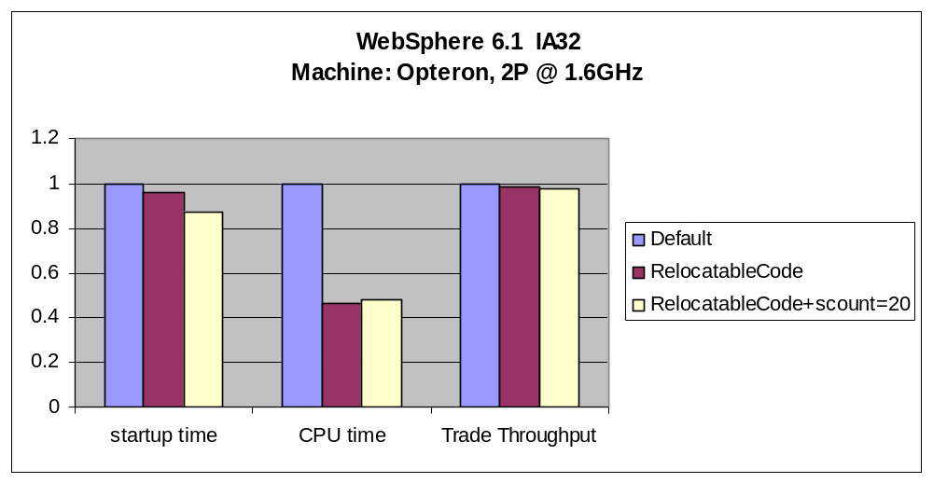
WebSphere Performance SMP

Slide 17
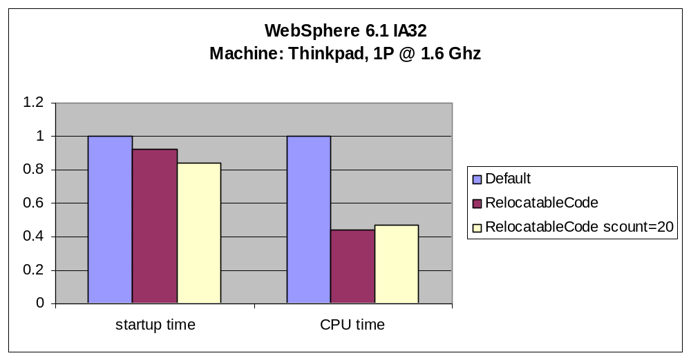
WebSphere Performance UP

Slide 18
WebSphere – Compilation level statistics
First Run
Compiled, stored in cache, and relocated 3632
Level=1 33
Level=2 5577
Level=3 62
Level=4 39
Level=5 2
Relocated methods that were recompiled = 164
Second Run
Taken from cache and relocated 3616
Level=1 543
Level=2 5320
Level=3 56
Level=4 36
Level=5 3
Relocated methods that were recompiled = 153

Slide 19
WebSphere – Shared Cache Utilization
After WebSphere startup
  ROM classes ➔ 61.7 MB
  Relocatable code ➔ 3.7 MB
After Trade run
  ROM classes ➔ 65.4 MB
  Relocatable code ➔ 4.3 MB

Slide 20
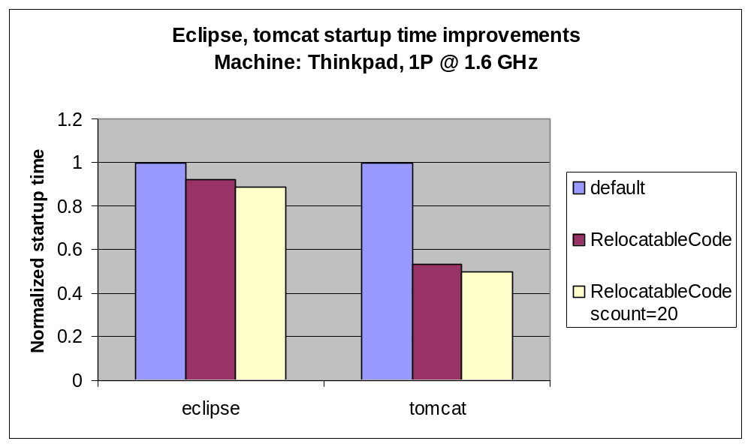
Eclipse, Tomcat Startup Performance

Slide 21
Agenda
Background
Shared Relocatable Code
Heuristics
Experiment Results
Future Work and Conclusions

Slide 22
Future Work
Improving the quality of the relocatable code
Tuning the heuristics
Heuristics about setting the ‘scount’ value
Recompile the relocatable code more aggressively to improve runtime performance

Slide 23
Conclusions
Shared Relocatable code
  Builds on top of the shared classes framework
  Generate code in relocatable form during the first run and place it in the shared cache. Reuse it during the subsequent runs.
  Reduce compilation overhead ➔ reduce startup time and CPU utilization
Good performance improvements
  startup time – 12% - 50%
  CPU utilization reduction in excess of 50%
  Runtime performance barely affected

