Slide 1
Productivity and Performance using the IBM XLUPC Compiler
  Kit Barton, Călin Caşcaval, George Almási, Philip Luk, Raymond Mak, Roch Archambault, and José Nelson Amaral
Notes:
To replace the title / subtitle with your own:
Click on the title block -> select all the text by pressing Ctrl+A -> press Delete key -> type your own text

Slide 2
Motivation
Large scale machines (such as Blue Gene and large clusters) and parallelism (such as multi-core chips) are becoming ubiquitous
Shared memory programming is accepted as an easier programming model, but MPI is still the prevalent programming paradigm
Why?
Because typically the performance of the shared memory programs lags behind and does not scale as well as the performance of MPI codes

Slide 3
Overview
Demonstrate that performance on large scale systems can be obtained without completely overwhelming the programmer by:
  Taking Unified Parallel C (UPC), a Partitioned Global Address Space (PGAS) language, that presents a shared memory programming paradigm
  Using a combination of runtime system design and compiler optimizations
  Running on Blue Gene/L, a distributed memory machine and the largest supercomputer available today

Slide 4
Outline
Brief overview of UPC features
The IBM xlupc compiler and run-time system
Compiler optimizations
Experimental results
Conclusions

Slide 5
Unified Parallel C (UPC)
Parallel extension to C
  Programmer specifies shared data
  Programmer specifies shared data distribution (block-cyclic)
  Parallel loops (upc_forall) are used to distribute loop iterations across all processors
  Synchronization primitives: barriers, fences, and locks
Data can be private, shared local and shared remote data
  Latency to access local shared data is typically lower than latency to access remote shared data
Flat threading model – all threads execute in SPMD style

Slide 6
xlupc Compiler Architecture
UPC Program
UPC source
xlupc Front-end
w-code
UPC enhanced
w-code
xlupc
TPO
Runtime
Library
TPO
w-code
w-code
TOBEY
Object code
Linker/Loader
Executable

Slide 7
xlupc Runtime System
Designed for scalability
Implementations available for
  SMP using pthreads
  Clusters using LAPI
  BlueGene/L using the BG/L message layer
Provides a unique API to the compiler for all the above implementations
Provides management of and access to shared data in a scalable manner using the Shared Variable Directory

Slide 8
Shared Variable Directory
shared [SIZE/THREADS] int A[SIZE];
. . .
Shared Local
(upc_local_alloc)
Shared Local
(upc_local_alloc)
0
0
0
1
1
1
var 1
type
var 1
type
var 1
type
var 2
local addr
var 2
local addr
var 2
local addr
var 3
local size
var 3
local size
var 3
local size
block factor
block factor
ALL
block factor
ALL
elem size
ALL
elem size
elem size
Thread 0
Thread 1
Thread THREADS-1

Slide 9
Shared Variable Directory
Thread 0
Access element i
shared [SIZE/THREADS] int A[SIZE];
. . .
Shared Local
(upc_local_alloc)
ALL
ALL
3
A_var_handle
3
Shared Local
(upc_local_alloc)
0
0
1
1
Owner = i / block_factor / THREADS
var 1
type
var 1
type
var 2
local addr
var 2
local addr
var 3
local size
var 3
var 3
local size
block factor
ALL
ALL
ALL
block factor
block factor
elem size
elem size
Thread 0
Thread 1

Slide 10
Compiler Optimizations
Parallel loop overhead removal
Memory affinity analysis and optimization
Remote update operations

Slide 11
Optimizing UPC Parallel Loops
affinity test
branch
shared [BF] int A[N];
upc_forall(i=0; i < N; i++; &A[i])
{
  A[i] = ...;
}
for (i=0; i < N; i++)
{
  if (upc_threadof(A[i]) == MYTHREAD)
    A[i] = ...;
}
for (i=MYTHREAD * BF; i < N; i+= THREADS*BF) {
  for (j=i; j < i+BF; j++) {
    A[j] = ...;
  }
}

Slide 12
Memory affinity
The UPC RTS uses the SVD to manage and access shared data,
  several levels of indirection to get to data
  impacts performance
If we can prove that the data is local, the shared memory access through SVD can be replaced with a direct memory access to the shared local section of memory of the thread
  Obtain the base address of the local portion of the array
  Compute an offset based on the index and shared data layout

Slide 13
Accessing Shared Array Elements
. . .
Shared Local
(upc_local_alloc)
#define BF SIZE/THREADS
shared [BF] int A[SIZE];
0
upc_forall (i=0; i < SIZE; i++; &A[i]) {
A[i] = MYTHREAD;
}
1
var 1
type
for (i=MYTHREAD*BF; i < SIZE; i+=THREADS*BF) {
__xlc_upc_assign_array_elt(A_h, MYTHREAD, i);
}
var 2
local addr
var 3
local size
ALL
block factor
elem size
localAddr = __x lc_upc_base_address(A_h);
for (i=MYTHREAD*BF; i < SIZE; i+=THREADS*BF) {
offset = COMPUTE_OFFSET(i);
*(localAddr+offset) = MYTHREAD;
}
Thread 0

Slide 14
Remote update optimization
Identify read-modify-write operations of the form
A[i] = A[i] OP value
Instead of issuing a get and then a put operation, we issue a remote update operation, where we send the address of A[i] and the value to the remote processor
Take advantage of existing hardware and software primitives in Blue Gene/L:
  Small hardware packet size and network guaranteed delivery
  Active message paradigm in the message layer

Slide 15
Experimental Environment
Blue Gene/L machines
    From a small 1 node-card (64 processors, 8 GB memory) up to 64 racks (128K processors, 32 TB memory)
Benchmarks:
    HPC Challenge: Random Access and EP STREAM Triad
    NAS CG
Software:
    Experimental versions of the xlupc compiler, runtime system, messaging library and control system software

Slide 16
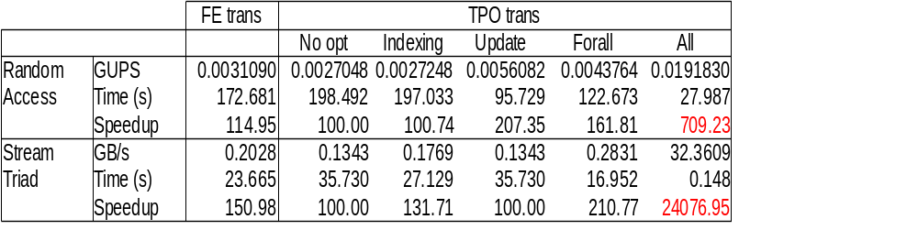
UPC Compiler Optimizations Impact
64 threads on a Blue Gene/L system

Slide 17
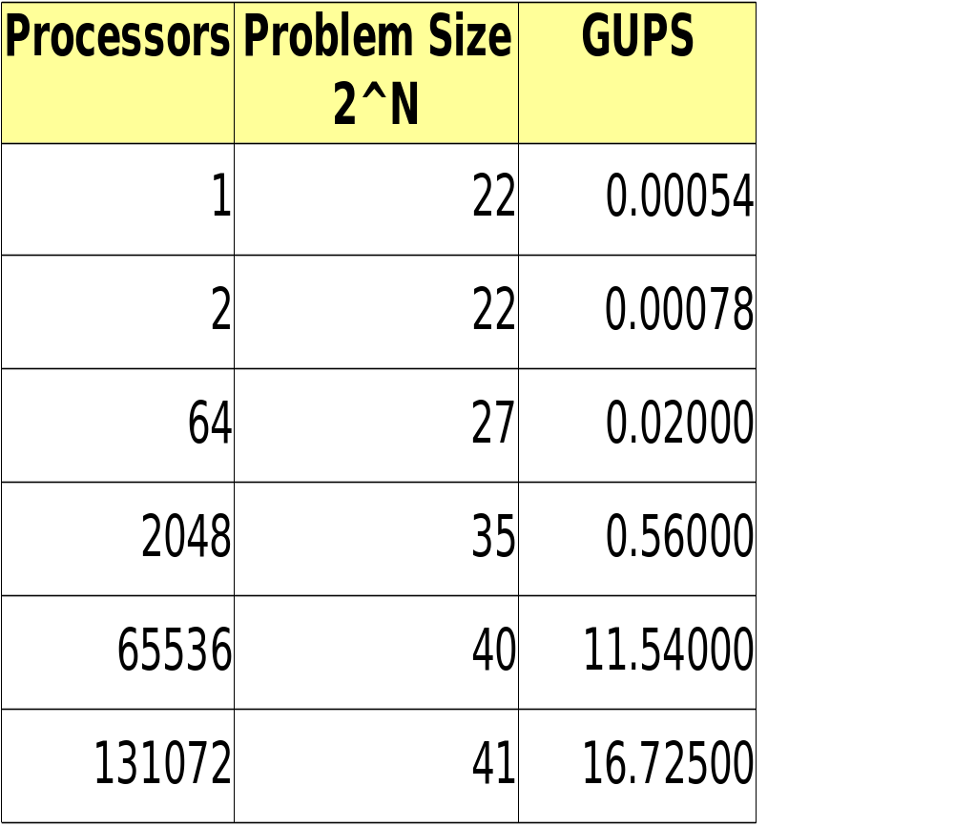
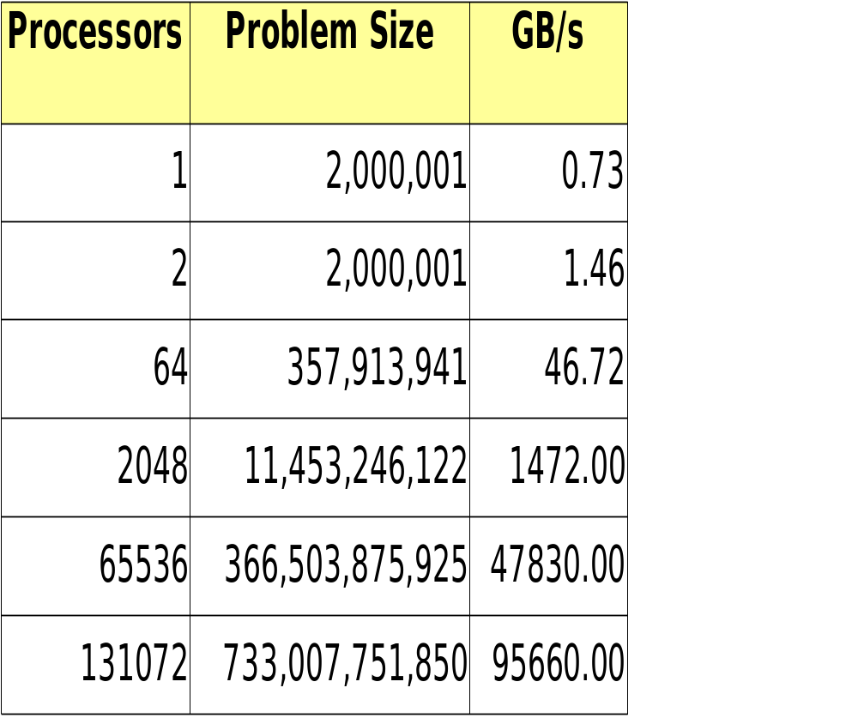
Blue Gene/L Performance Results
Random Access
EP Stream Triad
Won the HPC Challenge Productivity Award
Notes:
Base runs on BG/L w 64K MPI processes are
RA 0.0657 GUPS
EP Triad 53555

Slide 18
NAS CG Class C

Slide 19
Conclusions
We have shown that scaling programs using the shared memory programing paradigm to a large number of processors is not a myth
However, scaling to hundreds of thousands of threads is far from trivial; it requires:
  Careful design of the algorithm and data structures
  Scalable design of run-time system and system software (communication libraries)
  Support from the compiler
Lots of challenges on programming large scale machines are still waiting for compiler attention

Slide 20
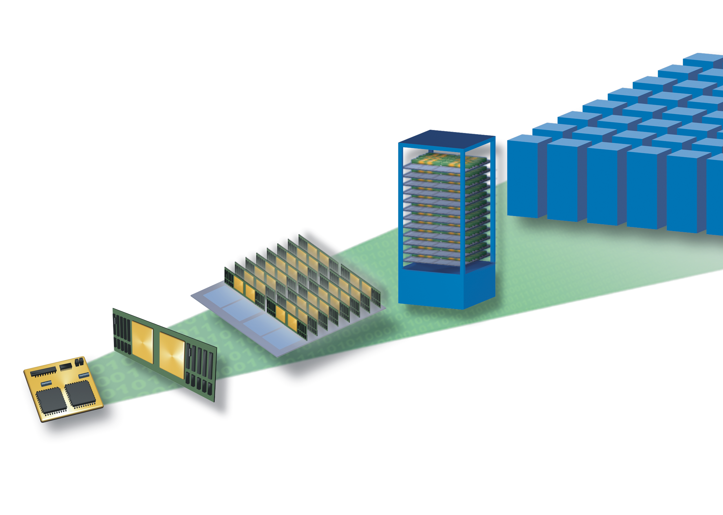
BlueGene/L system
System
(64 cabinets, 64x32x32)
Cabinet
(32 Node boards, 8x8x16)
Node Card
(32 chips, 4x4x2)
16 Compute Cards
Compute Card
(2 chips, 2x1x1)
180/360 TF/s
16 TB DDR
Chip
(2 processors)
2.9/5.7 TF/s
256 GB DDR
90/180 GF/s
8 GB DDR
5.6/11.2 GF/s
2.8/5.6 GF/s
0.5 GB DDR
4 MB

Slide 21
BlueGene/L MPI Software Architecture
MPICH2
pt2pt
datatype
topo
collectives
Abstract Device Interface
torus
tree
GI
CH3
MM
bgl
socket
Common Messaging
Library
Packet
Layer
Torus
Device
Tree
Device
GI
Device

Slide 22
Common Messaging Library
MPICH
ARMCI/GA
UPC
User apps
Common messaging API
2sided ops
1sided ops
collectives
Tree
collectives
point-to-point
Torus
collectives
point-to-point
GI
Sysdep
arch specific
initialization
IPC
vnmode
copromode
Advance
interrupts
polling
locks

Slide 23


Theoretical GUPS limit on Blue Gene/L
Pre-condition: one packet per update (naïve algorithm)
Update packets:
$\left\{\begin{aligned}\left\{\begin{aligned}\text{Packet size:}\text{75 Bytes} \\ \text{Wire speed:}4\frac{\text{cycles}}{\text{ Byte}}\end{aligned}\right\}→300\frac{\text{cycles}}{\text{packet}} \\ \text{CPU speed: 700 MHz =}1.4\frac{\text{ns}}{\text{cycle}}\end{aligned}\right\}→2.38⋅{10}^{6} \frac{\text{packets}}{\text{second}⋅\text{link}}$
16 Byte header
4 Bytes target SVD
4 Bytes offset
4 Bytes op type,kind
8 Bytes update value
Packet size: 64 Bytes
75 Bytes on wire
Cross-section bandwidth:
64 x 32 x 32 torus:
2 wires/link x 32 x 32 x 2 (torus) = 4096 links
= 9.74.10⁹ packets/s
Half of all packets travel across the cross-section;
GUPS limit = 19.5

Slide 24
Shared Variable Directory
shared [SIZE/THREADS] int A[SIZE];
. . .
0
0
0
1
1
1
var 1
type
var 1
type
var 1
type
var 2
local addr
var 2
local addr
var 2
local addr
var 3
local size
var 3
local size
var 3
local size
block factor
block factor
ALL
block factor
ALL
elem size
ALL
elem size
elem size
Thread 0
Thread 1
Thread THREADS-1

Slide 25
Accessing Shared Array Elements
. . .
#define BF SIZE/THREADS
shared [BF] int A[SIZE];
upc_forall (i=0; i < SIZE; i++; &A[i]) {
A[i] = MYTHREAD;
}
0
1
for (i=MYTHREAD*BF; i < SIZE; i+=THREADS*BF) {
__xlc_upc_assign_array_elt(A_h, MYTHREAD, i);
}
var 1
type
var 2
local addr
var 3
local size
localAddr = __x lc_upc_base_address(A_h);
for (i=MYTHREAD*BF; i < SIZE; i+=THREADS*BF) {
offset = COMPUTE_OFFSET(i);
*(localAddr+offset) = MYTHREAD;
}
ALL
block factor
elem size
Thread 0

Slide 26
Random Access
  u64Int ran = starts(NUPDATE/THREADS * MYTHREAD);
  upc_forall (i = 0; i < NUPDATE; i++; i) {
  ran = (ran << 1) ^ (((s64Int) ran < 0) ? POLY : 0);
  Table[ran & (TableSize-1)] ^= ran;
  }
Each update is a packet – performance is limited by network latency
Important compiler optimization:
    Identify update operations and translate them to one sided update in messaging library

