Slide 1
Trace-Based Automatic Parallelization in the Jikes RVM
Borys Bradel
University of Toronto

Slide 2
Introduction
Automatically parallelize programs by using traces
Target shared memory multiprocessors
Use traces
  Collect
  Package
  Execute in parallel
Modify Jikes RVM
  Initial results

Slide 3
Trace Definition
A trace is a frequently executed sequence
of unique basic blocks or instructions
a=0
i=0
goto B2
B0
Trace 1
B1
a+=i
i++
public static int foo() {
int a=0;
for (int i=0;i<n;i++)
a+=i;
return a;
}
B2
if (i<n) goto B1
B3
return a

Slide 4
Benefits
Source code not required
Granularity of parallelism can vary
Restrict control flow
Simple to identify

Slide 5
System Overview
Traces
Single-Threaded
Program
Run-Time
Compiler
Compiled
Methods
Extraction
Context Passing
Parallel Execution

Slide 6
Extraction
start
start
Trace 1
BB1
BB1’
BB2
BB3
BB2
BB3’
BB4
BB4
BB4’
end
end

Slide 7
start
prologue
Separate Method
call trace
start
prologue
Trace 1
BB1
BB1’
epilogue
BB2
BB3
epilogue
BB3’
BB2
BB4’
BB4
BB4
epilogue
epilogue
end
end

Slide 8
start
save a,b
Separate Method
call trace
start
a’=a,b’=b
BB1
c=…
BB1’
c’=…
c=c’
check exit
BB2
BB3
…=a
save c’
exit1
BB3’
…=a’
BB2
BB4’
…=b’
BB4
…=b
BB4
BB4
…=b
save c’
exit2
save c’
exit3
end
end

Slide 9
Challenges
Extract basic blocks
Create and call separate method
  Reflection
  Jikes Entrypoints
Pass context
  Efficient
  Uniform

Slide 10
Parallel Execution
Execute multiple traces in parallel
Execute the same set of traces
  Similar to data level parallelism
Execute different sets of traces
  Similar to task level parallelism
Traces need to be set up and scheduled
Our initial focus is on data level parallelism

Slide 11
Parallel Execution
Processor 1
Processor 2
sequential execution
start trace execution
parallel setup
prologue
trace
epilogue
prologue
trace
epilogue
parallel setup
prologue
trace
epilogue
prologue
trace
epilogue
…
…

Slide 12
Parallel Execution
Processor 1
Processor 2
sequential execution
start trace execution
parallel setup
prologue
trace
trace
trace
trace
trace
trace
…
epilogue
prologue
trace
trace
trace
trace
trace
trace
…
epilogue

Slide 13
Strongly Connected Component
A graph that contains traces
and edges between them
such that paths exist
between all trace pairs
…
…
…
…
…
…
…
…
…
…
…
…
…

Slide 14
Processor 1
Processor 2
parallel setup
prologue
prologue
0..49
50..99
…
…
…
…
…
…
…
…
…
…
…
…
epilogue
epilogue
epilogue
epilogue
parallel setup

Slide 15
Challenges
Identifying SCCs
Handling dependence
  Induction
  Reduction
Setting up parallel execution

Slide 16
Preliminary Results
Modified Jikes RVM 2.4.0
  Extract traces and SCCs
  Execute SCCs in parallel
Run on 2 processor Athlon 2600+ system with 512MB RAM
Java Grande Section 3 Benchmarks
Measurements
  Performance

Slide 17
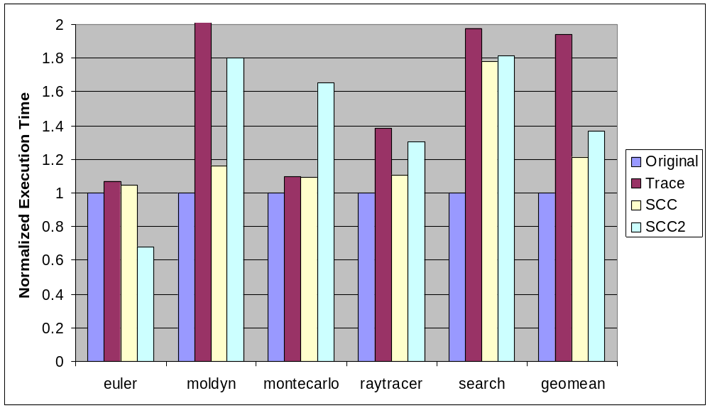
Performance
8.5

Slide 18
Related Work
Automatic Parallelization
Traces
Runtime Systems
Program and Alias Analysis

Slide 19
Remaining Challenges
Infrastructure for parallel execution of traces
Granularity
Data dependence
  Beyond induction and reduction
  Analysis vs speculation
Control dependence
Load balancing
Data locality
Online system

