Slide 1
Control Flow Virtualization for General-Purpose Computation on Graphics Hardware
Ghulam Lashari
Ondrej Lhotak
University of Waterloo

Slide 2
Outline
Motivation
Graphics Pipeline
Programming the GPU
Control Flow Virtualization
  Control Flow Elimination
  Program Restructuring
Conclusions

Slide 3
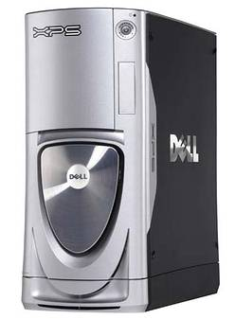
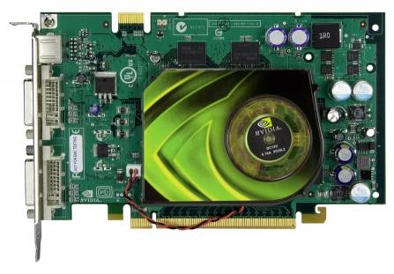
Motivation: Cheap, Commodity Hardware
Buy One
, Get One
FREE

Slide 4
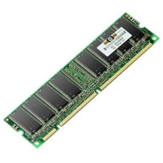


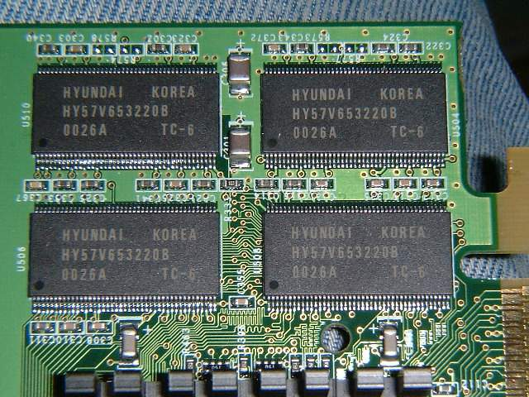
Motivation: Memory Bandwidth
8.5 GB/s
1066 MHz FSB
37.8 GB/s
XT Platinum Edition

Slide 5
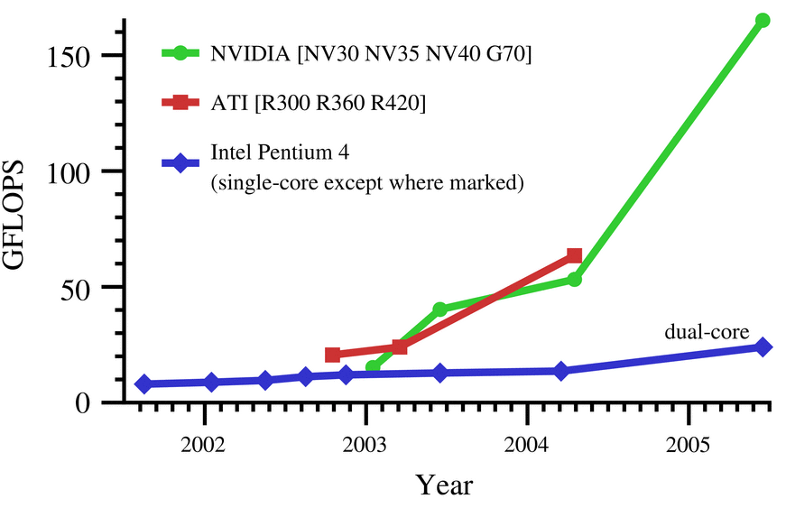
Motivation: Computational Power + Growth

Slide 6
Why Control Flow Virtualization
Even the latest GPUs cannot run this Path Tracer.
  Complicated control flow.
Goal: Virtualize Control flow to be able to run on ALL GPUs.
Next pixel
Generate eye ray
Next voxel
Next triangle
Next light source
Cast shadow ray

Slide 7
Modern Graphics Pipeline
Vertex
Processor
Rasterize
Fragment
Processor
Vertices 3D
Vertices 2D
Fragments
Pixels
Video
Memory
(Textures
Application
Render-to-Texture
CPU
GPU
Programmable
(Multiple Vertex/Fragment Processors)
Fixed- Function

Slide 8
GPU Programming for Graphics
Rasterize geometry.
Geometry Fragments
Shade each fragment in parallel; use colors from texture memory.
Store synthesized image as texture to use in next shading pass.

Slide 9
GPGPU Programming
2 3 4 5 7 9 6 4
3 2 1 .. ..
Create Stream
Array Texture
Render a Textured Quad.
1:1 mapping (Fragment:Texel)
Apply a SIMD kernel on stream.
(The output stream can be used in a
next computation pass)
2 3 4 5 7 9 6 4 3 2 1 …….
2 3 4 5 7 9 6 4
3 2 1 .. ..
2 3 4 5 7 9 6 4
3 2 1 .. ..
8
9 8 4 5 7 9 6 4
1 5 1 .. ..
8
1 2 3 4 5 6 7 8
0 7 9 .. ..

Slide 10
But, GPU Programs are restricted…
Limited instruction memory.
  65535 instructions (GeForce 6)
Fixed number of dynamic instructions.
  65535 instructions (GeForce 6)
Fixed number of inputs/outputs
  10 texture inputs (GeForce 6)
  4 outputs (GeForce 6)
Limited or No control flow
…..

Slide 11
GPU Control Flow Limits
Loop nesting depth: 4 (NVIDIA 7800 GT)
Loop iteration count: 256 (NVIDIA 7800 GT)

Slide 12
Control Flow Emulation
GPUs are SIMD machines.
Want to map SPMD computation on SIMD.
SPMD SIMD

Slide 13
Control Flow
1
2
A token flowing down the flow graph

Slide 14
Control Flow
1
2
A token flowing down the flow graph

Slide 15
Control Flow
1
2
A token flowing down the flow graph

Slide 16
Control Flow
1
2
A token flowing down the flow graph

Slide 17
Control Flow in SPMD
1
2
Stream of tokens flowing down the flow graph in parallel

Slide 18
Control Flow in SPMD
1
2
Stream of tokens flowing down the flow graph in parallel

Slide 19
Control Flow in SPMD
1
2
Stream of tokens flowing down the flow graph in parallel

Slide 20
Control Flow in SPMD
1
2
Stream of tokens flowing down the flow graph in parallel

Slide 21
Observation!
Keep track of next basic block in Token
Predicate basic block execution
1 & 2 Don’t need control flow !!

Slide 22
Predicated Basic Block Execution
1
1
1
If PC==2
2
If PC==2
2
How do we know stream elements are finished? Use Occlusion Query.

Slide 23
Predicated Basic Block Execution
1
2
2
If PC==2
2
If PC==2
2
How do we know stream elements are finished? Use Occlusion Query.

Slide 24
Predicated Basic Block Execution
1
If PC==2
2
2
3
If PC==2
2
How do we know stream elements are finished? Use Occlusion Query.

Slide 25
Predicated Basic Block Execution
1
If PC==2
2
If PC==2
2
2
2
3
3
How do we know stream elements are finished? Use Occlusion Query.

Slide 26
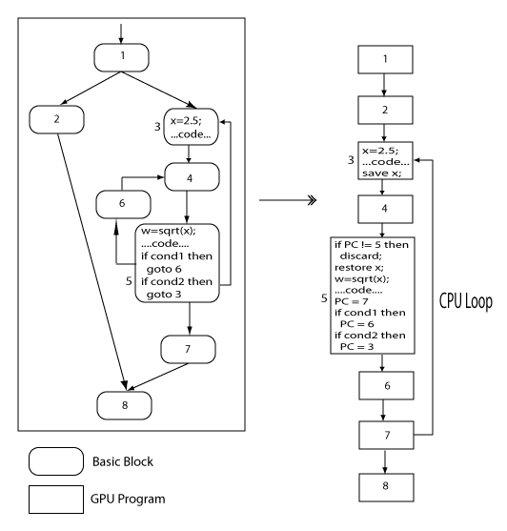
Control Flow Elimination

Slide 27
Control Flow Elimination
1 Program Many basic block kernels
1 stream element : 1 PC
Predicate Basic Blocks
Save Intermediate Results
Repeatedly run basic blocks [CPU Loop]

Slide 28
Problem !
Program Counters and Intermediate results require:
Additional texture memory.
Additional memory bandwidth to save/restore for every pass.
Additional input/output parameters.

Slide 29
Solution: Program Restructuring
Idea: Use GPU Loop (if available) to repeatedly run the basic blocks.

Slide 30
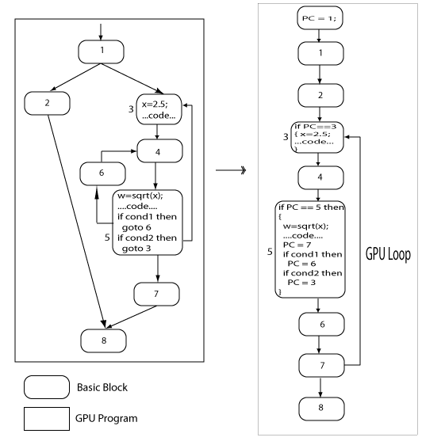
Program Restructuring

Slide 31
Loop Iteration Count Transformation
GPU Loop has iteration count limit !
icount = 0
Loop body
p
Loop body
p & not q
1
p & q
icount + +
q = icount < 256

Slide 32
Conclusion
Control Flow Elimination is useful for GPUs with no control flow.
Program Restructuring is useful for GPUs with limited control flow.
These techniques enable SPMD class of problems on GPUs.

Slide 33
Issues
GPUs cannot read and write from the same texture in one program Need two textures for PCs.
Each basic block kernel has a source texture and a destination texture for PCs stale PCs.
Solution: Use Timestamps!

