Slide 1
Optimal Instruction Scheduling for Multi-Issue Processors using Constraint Programming
Abid M. Malik and Peter van Beek
David R. Cheriton School of Computer Science
University of Waterloo

Slide 2
Introduction
Instruction scheduling is done in the back end of a compiler
Instruction scheduling is important to maximize Instruction Level Parallelism (ILP)
Instruction scheduler tries to find an instruction order that minimizes execution time
Instruction scheduler must preserve program’s semantics and honor hardware constraints
Notes:
There are different phases in compiler. Instruction scheduling is one of them. All-most, all modern processors are multi-functional, ILP is important in order to remove stall states.

Slide 3
Types of instruction scheduling
Scheduler’s scope is a sub-graph of a program’s control flow graph (CFG)
Local scheduling: single basic block
Global scheduling: multiple basic blocks:
  trace
  superblock
  hyperblock
  treegion
Notes:
Why BB is not effect?
Why Super-block is select and it was formed

Slide 4
The superblock
Single-entry multiple-exit sequence of basic blocks
Each exit node has weight, known as exit probability
Data and control dependencies and allowed code motions are represented by a Directed Acyclic Graph (DAG)

Slide 5
Example of a DAG
A
1
1
B
G
1
1
C
H
0.3
0
0
D
E
3
3
1
F
0.2
0
I
0.5

Slide 6
Cost function for instruction scheduling
Schedule length is the cost function for basic blocks
B1
w1
b1
Weighted completion time (W_{ct}) is the cost function for super-blocks
B2
B3
W_{ct} = w₁(b₁) + w₂(b₂) + w₃(b₃)
In general,
W_{ct} = ∑_{i=0}w_{i}b_{i}
w2
b2
w3
b3
n
superblock consisting of three basic-blocks B1, B2 and B3

Slide 7
Previous work
NP-Hard problem
Heuristic solutions
Optimal approaches:
  local: integer programming, enumeration and constraint programming, Heffernan and Wilken [2005]
  global: integer programming, enumeration using dynamic programming by Shobaki and Wilken [2004]

Slide 8
List scheduling
Most common method in practice
Approximate, greedy algorithm that runs fast in practice
Data-ready instructions stored in a priority list
Priorities assigned according to heuristics
If ready list is not empty, schedule top priority instruction
Else schedule a stall
Advance to next issue slot
Notes:
Give some data about the speed and improvement of optimal scheduling and the success of list scheduling
Greedy: does not backtrack, makes its best guess and goes with it
Run-Time is O(n log n)

Slide 9
Heuristics in list scheduling
Basic block :
  Critical path
Super block:
  Critical path
  Successive retirement
  Dependence height and speculative yield (DHASY)
  G*
  Speculative hedge
  Balance scheduling

Slide 10
Constraint programming (CP) methodology
We give a CP model, which is fast and optimal for almost all basic-blocks and super-blocks from the SPEC2000 benchmark
CP Model
  define constraint model: variables, domains, constraints
  add redundant constraints to reduce the search space
Solve model
  backtracking along with constraint propagation

Slide 11
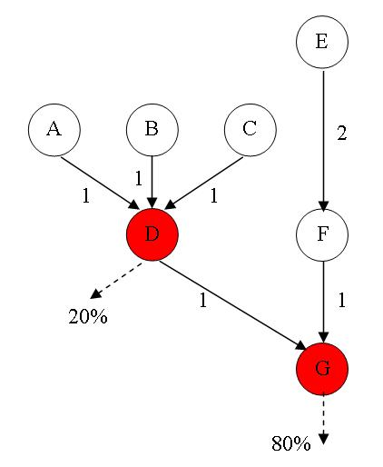
Constraint model example
variables
A, B, C, D, E, F, G
domains
{1, …, m}
basic constraints
dependency constraint:
D ≥ A + 1 G ≥ F + 1
D ≥ B + 1 G ≥ D + 1
D ≥ C + 1
F ≥ E + 2
resource constraint:
gcc( A, B, C, D, E, F, G, issue width )

Slide 12
CP model for instruction scheduling
Six main types of constraint in the CP model for basic block and super block scheduling
  latency constraint
  resource constraint
  distance constraint
  predecessor constraint
  successor constraint
  dominance constraint

Slide 13
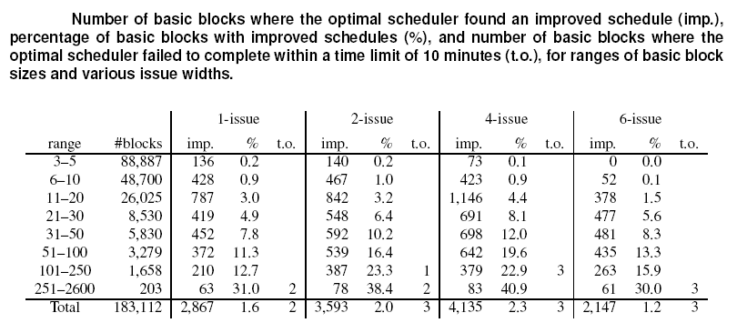
Experimental results (basic block)

Slide 14
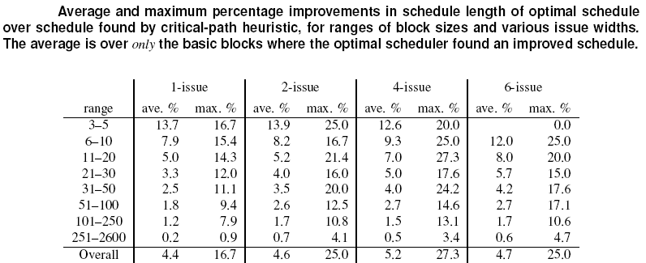
Experimental results (basic block): optimal vs. critical path

Slide 15
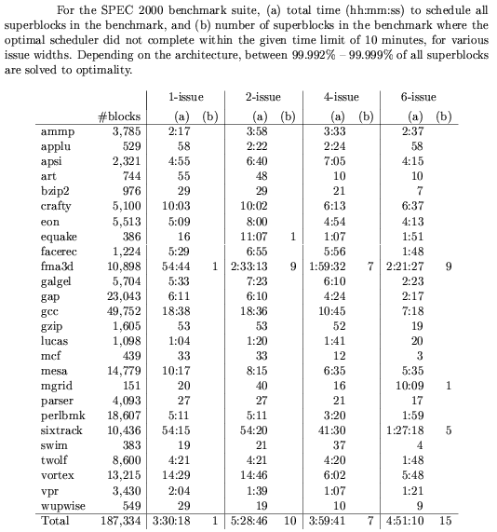
Experiment and results (super-block)

Slide 16
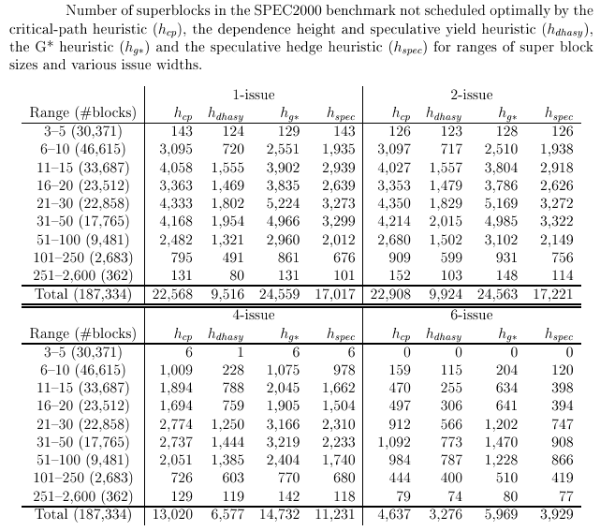
Experiments and results (super-block) : optimal scheduler vs. heuristic

Slide 17
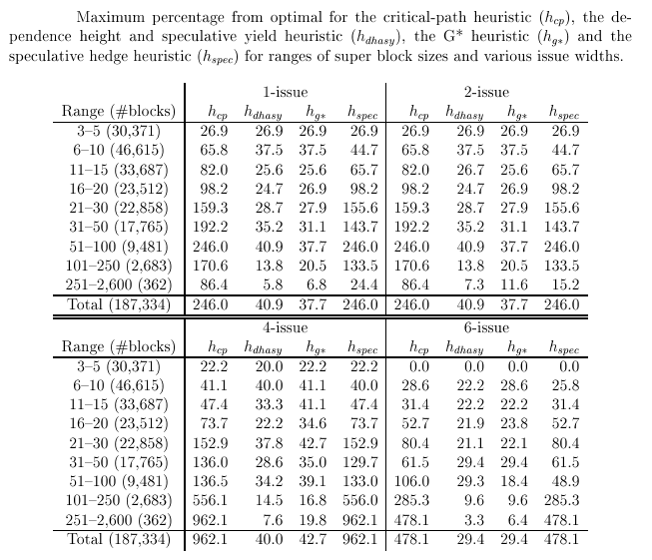
Experiment and results (super-block) : optimal scheduler vs. heuristic

Slide 18
Compare to the works by Heffernan [2005] and Shobaki [2004]
CP optimal scheduler is more robust and scales better on large problems
CP optimal scheduler able to solve more harder problems
  Test suite contains larger and more varied latencies
  Test suite contains shorter latencies
  Test suite contains larger basic blocks and super blocks

Slide 19
Conclusions
CP approach to basic block and super block instruction scheduling
  multi-issue processors
  arbitrary latencies
Optimal and fast on very large, real problems
Key was an improved constraint model

Slide 20
Future work
Using CP to find an optimal schedule for a basic block for a given register pressure without spilling
Using CP for combined instruction scheduling and register allocation problem

Slide 21
Work in progress
Optimal basic block and super block instruction scheduling for realistic architecture, Mike [2006]

Slide 22
Acknowledgement
IBM CAS Toronto Lab
Jim McInnes from IBM Toronto Lab
Tyrell Russell and Michael Chase from University of Waterloo

Slide 23
Thank You
Questions!!!

