Slide 1
Efficient Loop Versioning for Relative Alignment
Peng Wu
Rohini Nair
Alexander Eichenberger
IBM T.J.Watson Research Center
Peng Zhao
IBM Toronto Lab
Indra Mani
IBM India Lab

Slide 2
On a SIMD Unit
for (i=0; i<n; i++) a[i+3] = b[i+1] + c[i+3]
Constraint:
Memory alignment defines
data location in register
b-1
b0
b0
b1
b1
b2
b2
b3
b1
b3
b4
b5
b6
b7
b1
b0
b1
b2
b3
LOAD b[1]
16-byte
boundaries
b1
16-byte
boundaries
r1
c-1
c0
c0
c1
c1
c2
c2
c3
c2
c3
c4
c5
c6
c7
c3
c0
c1
c2
c3
LOAD c[2]
c2
r2
ADD
Problem #1:
Adding misaligned values
yield WRONG result
b0+
c0
b1+
c1
b3+
c3
b3+
c3
b1+
c1
b2+
c2
r3
STORE a[3]
Problem #2:
Vector store clobbers
neighboring values
a-1
a0
b0+
c0
a1
b1+
c1
a2
a2
a3
a2
b3+
c3
a4
a5
a6
a7
b2+
c2

Slide 3
Why Versioning for Alignment?
Memory alignment in a loop
  alignment of a memory stream refers to alignment of the 1st element of the stream
    for (i=0; i<n; i++) … = b[i+1] + c[i+2]
Runtime property can be specialized to advantageous compile-time values
  for example, to specialize all memory streams with runtime alignment are 16-byte aligned
alignment of b[i+1] stream = &b[1] mod 16 = 4
16-byte boundaries
b0
b1
b2
b3
b4
b5
b6
b7
b8
b9
b10
b1
c0
c1
c2
c3
c4
c5
c6
c7
c8
c9
c10
c3
alignment of c[i+2] stream = &c[2] mod 16 = 12

Slide 4
Runtime Alignment
Runtime alignment occurs more often than we think
  Inherent to the algorithm
  Inherent to data layout
  [Arrays of dimension 513 x 513]
  Loop from SWIM SPEC2000 (near-neighbor computation)
  DO 200 J=1,N
  DO 200 I=1,M
  UNEW(I+1,J)=UOLD(I+1,J)+T8*(Z(I+1,J+1+Z(I+1,J))*(CV(I+1,J+1)+ CV(I,J+1)+ CV(I,J)+CV(I+1,J))-TX*(H(I+1,J)-H(I,J))
  VNEW(I,J+1)=VOLD(I,J+1)-T8*(Z(I+1,J+1)+Z(I,J+1))*(CU(I+1,J+1)+ CU(I,J+1)+ CU(I,J)+CU(I+1,J))-TY*(H(I,J+1)-H(I,J))
  PNEW(I,J)=POLD(I,J)-TX*(CU(I+1,J)-CU(I,J))-TY*(CV(I,J+1)-CV(I,J))
  200 CONTINUE
  Compiler’s inability to obtain alignment information

Slide 5
How to handle misalignment?
SIMD execution of “for(i=0;i<n;i++) a[i+2] = b[i+1] + c[i+3]”
16-byte boundaries
Memory stream
b0
b1
b2
b3
b4
b5
b6
b7
b8
b9
b10
b1
Register stream
b1
b2
b3
b4
b5
b6
b7
b8
b9
b10
b11
b12
c0
c1
c2
c3
c4
c5
c6
c7
c8
c9
c10
c3
c3
c4
c5
c6
c7
c8
c9
c10
c11
c12
c13
c14
stream-shift left
stream-shift right
+
+
+
b1+
c3
b2+
c4
b3+
c5
b4+
c6
b5+
c7
b6+
c8
b7+
c9
b8+
c10
b9+
c11
b10+
c12
b11+
c13
b12+
c14
a0
a1
a2
a3
a4
a5
a6
a7
a8
a9
a10
a2
16-byte boundaries
Notes:
My goal is to walk through a simple example to illustrate what are the issues when programming for a SIMD unit like the VMC
single loop with 3 memory streams: A written into, B and C read
focusing on the first iteration, (grey boxes), ops to compute this simple add

Slide 6
A Compiler-friendly Representation
Data Reorganization Graph
  Abstract syntax tree with each load/store labeled with alignment
  Resolve alignment conflicts by adding “stream-shift” aligning operations
load b[i+1]
load c[i+3]
offset 4
offset 12
stream-shift-left-by(4)
stream-shift-left-by(12)
add
offset 0
stream-shift-right-by(8)
store a[i+2]
offset 8

Slide 7
Code Generation for Stream-Shift
Each stream-shift translates to permutation instructions for target platform
KEY INSIGHT: The number of stream-shift is an indicator of alignment handling overhead
b0
b1
b2
b3
b4
b5
b6
b7
b8
b9
b10
b11
b12
b1
...
16-byte boundaries
load b[1]
load b[5]
load b[9]
b0
b1
b2
b3
b4
b5
b6
b7
b8
b9
b10
b11
...
b1
offset 4
perm
perm
perm
stream-shift-left-by(4)
b1
b2
b3
b4
b5
b6
b7
b8
b9
b10
b11
b12
b1
offset 0
Notes:
in the steady state: only one load and one permute

Slide 8
Relative Alignment
Number of stream-shift is an indicator of alignment handling overhead
Stream-shift captures the relative alignment of two streams involved in computation
  Because it is based on the difference between the offsets of two streams
    Two misaligned accesses can have a relative alignment of 0
      for(i = lb; i<m; i++) a[i] = b[i];
    Two runtime alignment can have a compile-time relative alignment
      for(i = lb; i<m; i++) a[i] = b[i+1];
Use loop versioning to specialize runtime relative alignment
  stream-shift-left-by(…, x) is a NOP if x = 0
  If x is compile-time value, no specialization is necessary

Slide 9
An Example
for (i=0; i<n; i++) a[i] = c[i] + b[i] + b[i+1];
a) assume a, b, c are 16-byte aligned
b) assume a, b, c are pointers
0
0
4
c mod 16
b mod 16
(b+4) mod 16
load c[i]
load b[i]
load b[i+1]
load c[i]
load b[i]
load b[i+1]
CT1
RT1
RT2
RT3
add
add
add
add
1 compile-time
stream-shift
0
3 runtime
stream-shifts
a mod 16
store a[i]
store a[i]
CT1=stream-shift-left-by(…,…, 4)
RT1=stream-shift-left-by (..,…,c-a mod 16)
RT2=stream-shift-left-by (..,…,b-a mod 16)
RT3=stream-shift-left-by (..,…,b+4-a mod 16)
compile-time stream shift
CT
runtime stream shift
RT

Slide 10
Versioning for Runtime Stream-Shift
(c-a mod 16) == 0
&& (b-a mod 16) == 0
ELSE-Version
c mod 16
b mod 16
(b+4) mod 16
c mod 16
b mod 16
(b+4) mod 16
load c[i]
load b[i]
load b[i+1]
load c[i]
load b[i]
load b[i+1]
RT1
RT2
RT3
RT1
CT1
RT2
RT3
add
add
add
add
3 runtime
stream-shifts
a mod 16
3 runtime
stream-shifts
a mod 16
store a[i]
store a[i]
RT1=stream-shift-left-by (..,…,c-a mod 16)
FASTER-Version
RT2=stream-shift-left-by (..,…,b-a mod 16)
RT3=stream-shift-left-by (..,…,b+4-a mod 16)

Slide 11
The versioning algorithm
Judiciously place stream shift to satisfy alignment constraints
Collect a set of stream-shift operations with runtime shift amount
If there is no runtime stream-shift operation, no versioning is necessary
for each runtime stream-shift in the set,
  Re-evaluate the runtime stream-shift based on current versioning conditions, if it becomes compile-time update the stream-shift in the faster version, continue
  specialize runtime shift amount to be zero and AND it to versioning condition, and remove the stream-shift from the faster version
Generate the faster version guarded by versioning condition

Slide 12
Related Work
Multi-versioning for alignment
  Version for absolute alignments
Dynamic loop peeling
  Peel the loop untill all or some accesses become aligned
  Exploit certain degree of relative alignment as it requires accesses to reach the same alignment at the same iteration
Dynamic loop peeling + multi-versioning
  Dynamic peeling for one access (typically the store)
  Then multi-version the relative alignment of other accesses w.r.t peeled accesses

Slide 13
Evaluation
XL V10.1/V8 Fortran/C compiler
  Versioning for relative alignment
  Heuristics to decide when to apply versioning
  Only generate two versions per loop
  Interprocedural alignment analysis
BlueGene/L 440d dual FPU SIMD unit
  misaligned SIMD memory accesses cost thousands of cycles
  compiler generates aligned SIMD loads/stores, and reorganizes misaligned data in registers
  only compile-time stream-shift is simdizable due to lack of permute instruction
Indirectly evaluate effectiveness of versioning through SIMD performance

Slide 14
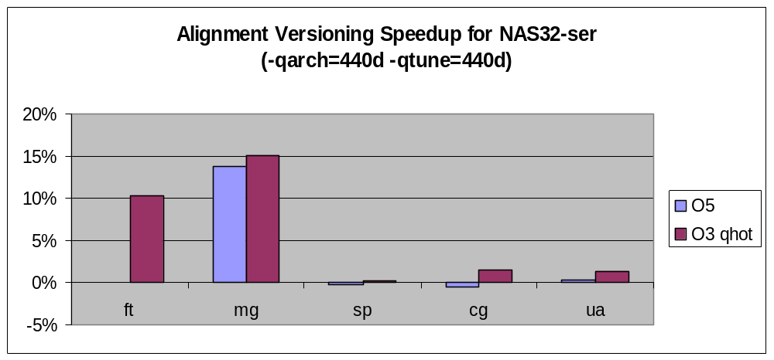
NAS32 Serial
12
23
13
14
8
11
8
3
13
8
NOTE: 1. numbers on each bar annotate # of simdizable loops being versioned for alignment
2. for missing NAS programs (lu, bt, lu-hp,ep, simdizable loops all have compile-time relative alignment

Slide 15
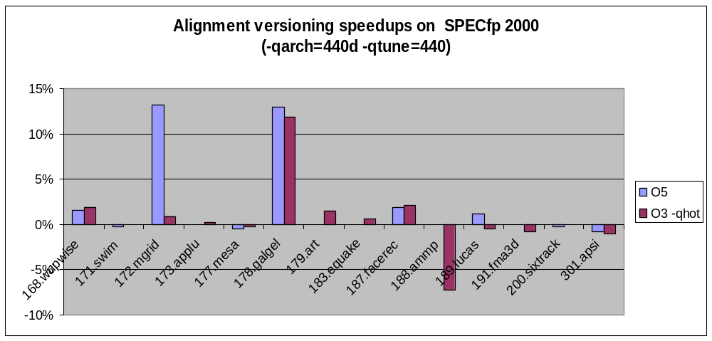
SPECfp 2000
4
165
3
13
4
0
4
NOTE: numbers on some bars annotate # of simdizable loops being versioned for alignment

Slide 16
Conclusion
Runtime alignment does happen in real codes
  Compiler’s inability to extract alignment info
  Runtime alignment inherent to the algorithm or data layout
Relative alignment better captures alignment handling overhead
Loop versioning specializes runtime relative alignment
Specialization based on relative alignment is more general because
  Two misalignment streams can be relatively aligned
  Two runtime alignment can have compile-time relative alignment

