Slide 1
Effective method for Java Lock Reservation for JVMs that implement cooperative multithreading
Nikola Grcevski
Testarossa JIT Compiler
IBM Toronto Lab
Notes:
To replace the title / subtitle with your own:
Click on the title block -> select all the text by pressing Ctrl+A -> press Delete key -> type your own text

Slide 2
Notes about the presentation
The technology was developed with cooperation with J9 JVM team in Ottawa
The following presentation contains IBM patent pending material

Slide 3
Presentation structure
Background on Java locking
Introduction to lock optimization techniques
Our approach to lock reservation
Results
Summary

Slide 4
Background on Java locking
Synchronization is built into the language
Java classes found in libraries are designed to be thread safe
Java applications tend to be multithreaded and they need synchronization

Slide 5
How much synchronization do Java programs need?
Studies have found that majority of Java programs don’t need a lot of synchronization
Because of library code use Java programs tend to pull in a lot of synchronization “automatically”
Synchronization comes with a cost
  Even without any contention

Slide 6
Compiler solutions for reducing synchronization overhead for unnecessary locks
Introduction of bi-modal locks in Java
Merging lock regions together
Lock reservation and ownership

Slide 7
Bi-modal Java locks
Use OS level mutex only when handling real contention
  Also called fat lock
Use per object field for quick way of marking an object as locked by one thread only
  Also called thin lock
  This locking mechanism isn’t free, it requires use of platform specific coherence instructions

Slide 8
Lock coarsening approach
Merge more than one locked region locking on same object
Reduces number of monitor enter and monitor exit operations
Limited to a method scope
  Interfering monitor operations and calls break it

Slide 9
Lock reservation
The basic idea is to avoid unlocking an object
  The object becomes reserved for that thread
Subsequent locks by the same thread are fast
Locking the object from another thread requires canceling the reservation

Slide 10
Why is entering reserved lock faster?
The main overhead of entering and exiting an uncontended lock are the platform specific coherence instructions required
With reservation we can replace some of the coherence instructions with a check if the lock is reserved for the locking thread
  We also need state change instructions on enter and exit to distinguish locked and reserved from reserved only

Slide 11
Lock reservation in action
Thread 1 (T1)
Thread 2 (T2)
object
monenter
Locked by T1
monexit
Reserved for T1
monenter
Locked by T1
monexit
Reserved for T1
monenter
Locked for T2
monenter – monitor enter operation to take the lock
monexit – monitor exit operation to release the lock

Slide 12
Great! So what is the problem?
Lock reservation canceling is expensive
  Requires stopping the thread that holds the reservation
What if the thread can be stopped in middle of monitor enter or monitor exit
  The monitor state is non-trivial to deduce while running monitor enter or monitor exit
Therefore, lock reservation can be costly and increase contention

Slide 13
Our approach to lock reservation
J9 JVM implements cooperative threading model
  Threads can only stop at well defined yield points
Selective reservation based on the Java code properties
Runtime detection of excessive reservation cancellation and back-out

Slide 14
Cooperative vs. preemptive threading models
Preemptive – java threads can be stopped at any point in time
Cooperative – java threads stop at well defined points (yield points)
  Yield points are inserted at method enter/exit
  Yield points are inserted in long running loops
  Yield points also in JVM runtime functions

Slide 15
Cooperative threading simplifies lock reservation
Thread cannot be stopped at monitor enter or exit code
  Cancellation is lot less complicated and intrusive
There will be locked regions without yield points (primitive locked regions)
  Entering and exiting those is faster (no state change instructions required)
Example:
synchronized (O) {
return O.f;
}

Slide 16
Selective reservation
Lock reservation will matter only in hot methods
Lock reservation will matter most if the locked region of code is short running
Using compile time analysis of the class code and recompilation we can selectively implement reservation

Slide 17
Selection algorithm
Count the number of synchronized methods in a class and compare with non-synchronized
Compute the size of the synchronized code using hotness estimate
Derive the amount of synchronization overhead
If synchronization overhead is significant or moderate, tag the class as candidate

Slide 18
Runtime detection of excessive reservation cancellation and back-out
Using timer based sampling and per class cancellation counters we can detect excessive cancellation
We can undo reservation by code patching or recompilation
Undo scope is very narrow because the reservation is selectively applied

Slide 19
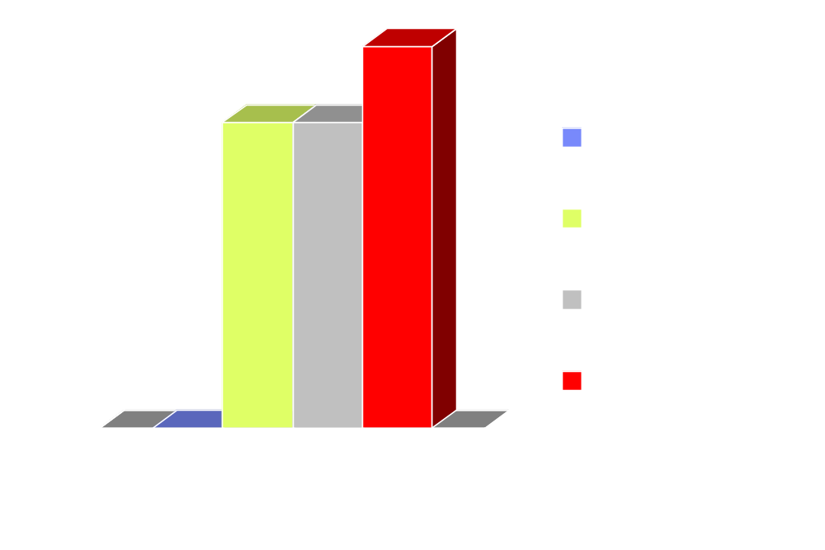
Results on SPECjvm98 db
The data was taken running on 1 socket dual-core Intel Core2 Duo
running at 2.16GHz, 2GB RAM, Windows XP Professional

Slide 20
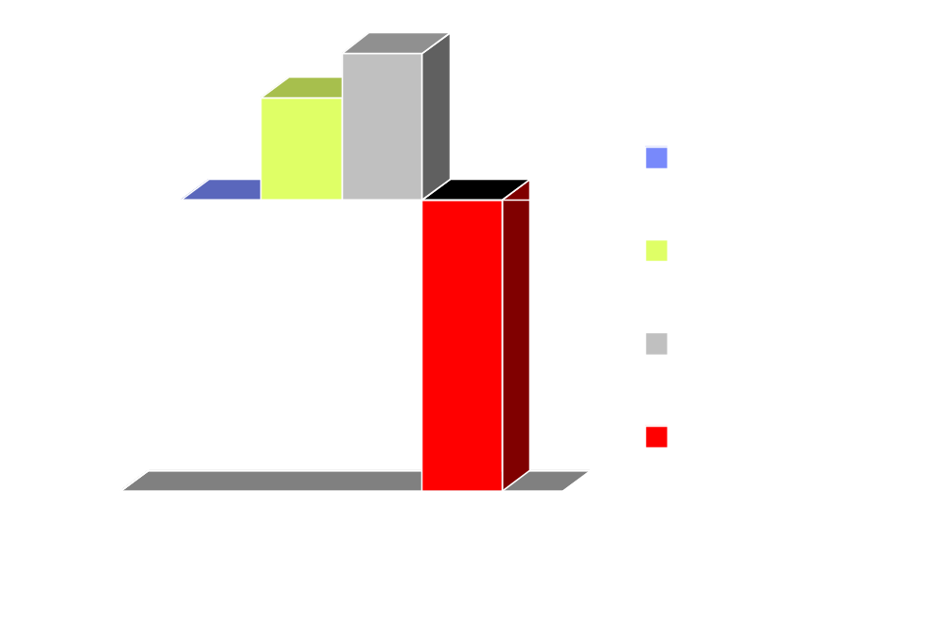
Results on SPECjbb2005
The data was taken running on 2 socket dual-core Intel Woodcrest
running at 2.6GHz, 16GB RAM, Windows 2003 64bit Server

Slide 21
Summary
Lock reservation can reduce unnecessary locking overhead
Lock reservation should be applied with caution
  Can increase contention
Cooperative threading simplifies reservation

