Slide 1
An Idiom Recognition Framework for Exploiting Complex Hardware Instructions
Pramod Ramarao, Joran Siu, Motohiro Kawahito*
IBM Toronto Lab, *IBM Tokyo Research Lab
Notes:
To replace the title / subtitle with your own:
Click on the title block -> select all the text by pressing Ctrl+A -> press Delete key -> type your own text

Slide 2
Notes about this talk
Implemented in the JIT compiler in IBM JDK for Java 6
Describes a patented methodology

Slide 3
Outline
Background
Our approach to idiom recognition
Experiments on the IBM System z platform
Summary

Slide 4
What is Idiom Recognition?
Idiom Recognition is a form of pattern matching done by optimizing compilers
Compilers can detect input code sequences in a program and replace them with complex hardware instructions
Performance of such sequences can be dramatically increased by using complex instructions

Slide 5
Complex hardware instructions
These are available today
  x86 processors have complex instructions (e.g. ‘repstos’) and have SSE, SSE4 (string and text processing)
  IBM System z processors have a coprocessor that supports character-translation
  POWER has vector instructions
Optimizing compilers can take advantage of these instructions to obtain good performance

Slide 6
Example: searching for a single delimiter
bytes:
do {
if (bytes[index] == 13) break;
index++;
} while(index < bytes.length);
T | h | i | s |  | i | s |  | a |  | t | e | s | t | . | 13
index
// Intermediate language
index = SRST(bytes, index, 13) // SRST: SEARCH STRING

Slide 7
Example: searching for a single delimiter
bytes:
do {
if (bytes[index] == 13) break;
index++;
} while(index < bytes.length);
T | h | i | s |  | i | s |  | a |  | t | e | s | t | . | 13
index
No hardware instruction
Use hardware instruction
LA R3, 12(bytes) // length
L001:
LB R0, 16(bytes,index) // array load
CHI R0, 13 // check
BRC COND, Label L002
AHI index, 1 // increment
CHI index, R3
BRC COND, Label L001
L002:
LA R2, 16(bytes, index) // start
LA R3, 12(bytes) // length
LHI R0, 13
SRST R3, R2
LR index, R3

Slide 8
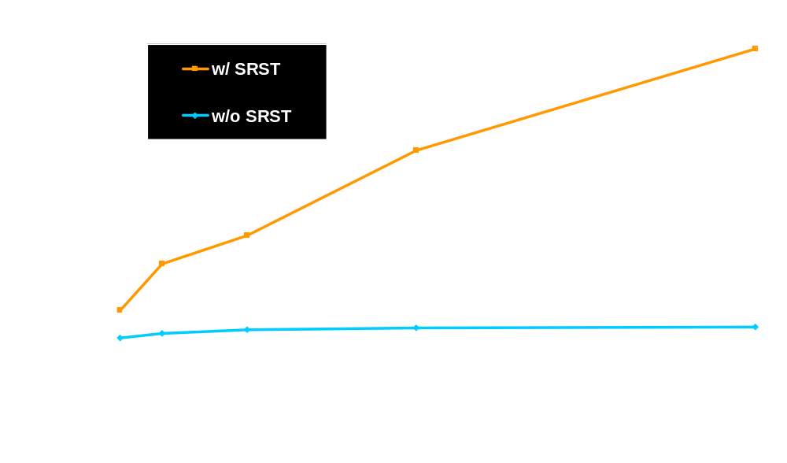
SRST instruction performance on IBM System z 990
Larger numbers are better
x7

Slide 9
Idiom Recognition
Compilers need to match the program source code to an idiom
Example: Idiom of delimiter search
op will match equality or inequality, such as “==“, “<=“, “!=“, …
C will match any constant.
do {
if (bytes[index] op C) break;
index++;
} while(index < bytes.length)
Single delimiter
Multiple delimiters
index = SRST(bytes, index, C)
index = TRT(bytes, index, Table)

Slide 10
We can use the SRST instruction for all of these examples
Program 1: (Separated code)
b = bytes[index];
do {
if (b == 13) break;
index++;
b = bytes[index];
} while(index < bytes.length);
Program 2: (Additional code)
do {
b = bytes[index];
if (b == 13) break;
index++;
} while(index < bytes.length);
temp = b; // Used after the loop
Program 3: (Different order)
do {
if (bytes[index++] == 13) break;
} while(index < bytes.length);

Slide 11
We can use the SRST instruction for all of these examples
Program 1: (Separated code)
b = bytes[index];
do {
if (b == 13) break;
index++;
b = bytes[index];
} while(index < bytes.length);
index = SRST(bytes, index, 13)
Program 2: (Additional code)
do {
b = bytes[index];
if (b == 13) break;
index++;
} while(index < bytes.length);
temp = b; // Used after the loop
index = SRST(bytes, index, 13)
b = bytes[index]
temp = b // Used after the loop
Program 3: (Different order)
do {
if (bytes[index++] == 13) break;
} while(index < bytes.length);
index = SRST(bytes, index, 13)
index++

Slide 12
Exact pattern matching cannot optimize these examples.
Program 1: (Separated code)
The case for exact matching:
b = bytes[index];
do {
if (b == 13) break;
index++;
b = bytes[index];
} while(index < bytes.length);
do {
if (bytes[index] == 13) break;
index++;
} while(index < bytes.length);
Program 2: (Additional code)
do {
b = bytes[index];
if (b == 13) break;
index++;
} while(index < bytes.length);
temp = b; // Used after the loop
Program 3: (Different order)
do {
if (bytes[index++] == 13) break;
} while(index < bytes.length);

Slide 13
Outline
Background
Our approach to idiom recognition
Experiments on the IBM System z platform
Summary

Slide 14
Our approach to Idiom Recognition
Step 1: Find potential candidates by using a topological embedding algorithm
Step 2: Attempt to transform each candidate to exactly match the idiom by applying code transformations
  Partial peeling
  Forward code motion
  Copying store nodes
Computational order is O(|V_{P}||E_{T}| + |E_{P}|)
V_{P}: Nodes of the idiom graph
E_{P}: Edges of the idiom graph
E_{T}: Edges of the target graph

Slide 15
Topological Embedding (TE)
Uses ordered label directed graphs as a representation, where order of siblings is significant
In exact matching, directed graph P matches T
        f : P → T
    f preserves label, degree and parent relationship
TE relaxes the restriction by requiring f to preserve the ancestor relationship

Slide 16
Exact Matching vs. Topological Embedding
Topological embedding matches if there is a path in the target graph corresponding to each edge in the idiom
Idiom
Target Graph
a
a
Exact
Matching
an edge to an edge
b
c
b
c
Idiom
a
a
Topological
Embedding
an edge to a path
b
Y
Z
c
b
c

Slide 17
Our approach using TE
Build a directed graph from IL using opcodes as labels
To detect commutative operations, ignore order of siblings in the graph
Use wild-card nodes to allow matching of different opcodes in a target graph
    E.g., to detect multiple IF statements
Pattern match the target graph (from IL) using TE and apply graph transformations if needed

Slide 18
Direct Conversions
Idiom
a
c
i
array load
check it with constants
increment the index

Slide 19
Direct Conversions (cont…)
Case 1: Separated Node
a
c
i
a
Idiom
a
c
i
array load
check it with constants
increment the index
Case 2: Multiple IFs
a
c1
c2
i

Slide 20
Graph transformations
Different Order
Idiom
i
a
c
a
i
c
a
c
i
array load
check it with constants
increment the index

Slide 21
Graph transformations – Partial peeling
Different Order
Idiom
i
a
c
a
c
i
array load
check it with constants
increment the index
Partial
peeling
i
a
c
i

Slide 22
Graph transformations – Forward code motion
Different Order
Idiom
a
i
c
a
c
i
array load
check it with constants
increment the index
Forward
code motion
a
c
i
i

Slide 23
Graph transformations – Copy store nodes
Additional Node
Idiom
a
S
c
i
a
c
i
array load
check it with constants
increment the index

Slide 24
Graph transformations – Copy store nodes
Additional Node
Idiom
a
S
c
i
a
c
i
array load
check it with constants
increment the index
Copy
store nodes
a
S
c
i
S

Slide 25
Graph transformations - Example
Idiom
do {
if (bytes[index] == 13)
break;
index++;
} while(index < bytes.length);
i
a
S
c
a
c
i
do {
index++;
b = bytes[index];
if (b == 13)
break;
} while(index < bytes.length);
temp = b; // Used

Slide 26
Graph transformations – Example (cont…)
i
a
S
c
i
Idiom
do {
if (bytes[index] == 13)
break;
index++;
} while(index < bytes.length);
a
c
i
Partial
peeling
do {
index++;
b = bytes[index];
if (b == 13)
break;
} while(index < bytes.length);
temp = b; // Used
index++;
do {
b = bytes[index];
if (b == 13)
break;
index++;
} while(index < bytes.length);
temp = b; // Used
Notes:
Instead of the original loop, show the transformed graph

Slide 27
Graph transformations – Example (cont…)
i
a
S
c
i
Idiom
do {
if (bytes[index] == 13)
break;
index++;
} while(index < bytes.length);
a
c
i
index++;
do {
b = bytes[index];
if (b == 13)
break;
index++;
} while(index < bytes.length);
temp = b; // Used

Slide 28
Graph transformations – Example (cont…)
i
a
S
c
i
Idiom
do {
if (bytes[index] == 13)
break;
index++;
} while(index < bytes.length);
a
c
i
Copy store nodes
S
index++;
do {
b = bytes[index];
if (b == 13)
break;
index++;
} while(index < bytes.length);
temp = b; // Used
index++;
do {
if (bytes[index] == 13)
break;
index++;
} while(index < bytes.length);
b = bytes[index];
temp = b; // Used

Slide 29
Transformation steps for example
Idiom
do {
if (bytes[index] == 13)
break;
index++;
} while(index < bytes.length);
a
c
i
do {
index++;
b = bytes[index];
if (b == 13)
break;
} while(index < bytes.length);
temp = b; // Used
index++;
do {
if (bytes[index] == 13)
break;
index++;
} while(index < bytes.length);
b = bytes[index];
temp = b; // Used
index++;
index = SRST(…)
b = bytes[index];
temp = b; // Used

Slide 30
Outline
Background
Our approach for idiom recognition
Experiments on the IBM System z platform
Summary

Slide 31
Implemented idioms
Idiom Name | Description
findbytes | Search for delimiters
arraytranslate | Conversion of character codes
memcpy | Copy memory
memset | Fill memory
memcmp | Compare memory

Slide 32
Experiments on the IBM System z platform
Environment: System z990 2084-316, 64-bit, 8 GB RAM, Linux
Three algorithm variants:
  Baseline: No matching done
  Exact Match
  Our approach: our approach in addition to exact match
Benchmarks used
  Micro-benchmarks for J2SE class files
  IBM XML Parser
  Codepage Converter primitives
Notes:
Changing baseline and rephrase the “our approach”. Try to get results with loopreduction alone system Z is mainframe

Slide 33
High-level Flow Diagram
…optimizations…
Loop Canonicalization &
Loop Versioning
Canonicalize each loop
Exact
Matching
Topological
Embedding
Find candidate loops
Idiom Recognition
Graph Transformations
Transform to match the idiom
…optimizations…
Faster Code
Notes:
Add dots to represent optimizations and add two flowcharts to represent exact matching and IR or animate

Slide 34
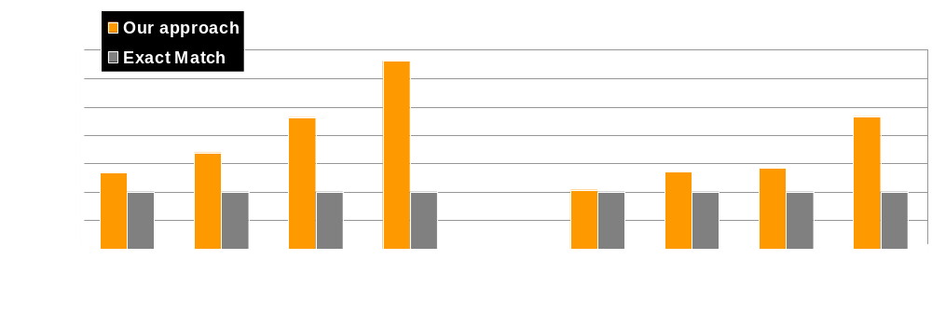
Performance improvements - Micro-Benchmarks
Larger numbers are better
(Baseline = “No match” normalized to 100%)
java/lang/String.compareTo()
java/io/BufferedReader.readLine()

Slide 35
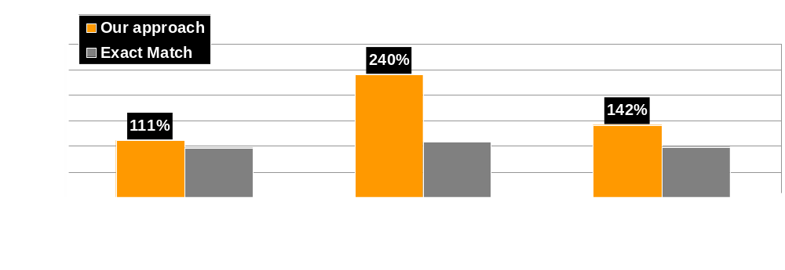
Performance improvements - IBM XML Parser
Larger numbers are better
(Baseline = “No match” normalized to 100%)

Slide 36
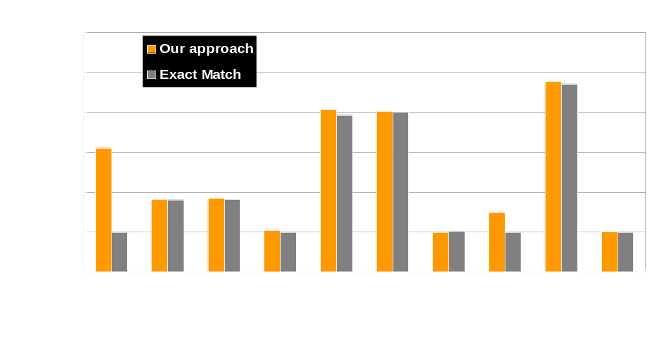
Performance improvements - Codepage Converter primitives
Larger numbers are better
(Baseline = “No match” normalized to 100%)

Slide 37
Compilation Time
Reduce compilation time
  Filters to exclude target candidates unlikely to be matched
  Applied at higher optimization levels on frequently executed methods
    Match selected idioms at lower optimization levels
Measured maximum compilation time overhead of 0.28%

Slide 38
Summary
New approach for idiom recognition
  Much more powerful than exact matching
Significant performance improvements
  Up to 240% on IBM XML parser
  Small compilation time overhead 0.28%
Future work:
  More idioms
  More graph transformations
  More architectures

Slide 39
Thank you

