Slide 1
Practical Assignment Sinking for Dynamic Compilers
Reid Copeland, Mark Stoodley, Vijay Sundaresan, Thomas Wong
IBM Toronto Lab

Slide 2
Agenda
Introduction
Practical Dataflow Analysis
Program Transformation Overview
Results and Summary

Slide 3
Introduction
Local Variable assignment is redundant if execution can follow a path where the assigned variable is dead
Goal: remove such redundant assignments
Transformation: move an assignment past the blocks to avoid redundant store

Slide 4
Optimization
Assignment sinking is a widely implemented optimization in static compiler
PRE-based algorithm is commonly used to implement the optimization
  Expensive to be used in dynamic compiler
In Testarossa JIT compiler, a practical method is devised to do assignment sinking
This presentation contains material which has Patents Pending

Slide 5
Example
BB5
x = a
BB6
BB9
BB7
BB8
BB10
BB11
z = x + y
z = x * 2
y = x / 2

Slide 6
Example
BB5
x = a
BB6
BB9
x = a
BB7
BB8
BB10
BB11
x = a
z = x + y
z = x * 2
y = x / 2

Slide 7
Motivation
Can speed up the execution if an assignment is sunk from hot or scorching to cold block
BB5
x =
Scorching
Edge
(x not live)
BB6
BB7
= x

Slide 8
Motivation
Can speed up the execution if an assignment is sunk from hot or scorching to cold block
BB5
x =
Scorching
Edge
(x not live)
BB6
BB7
x =
= x

Slide 9
Motivation
BB5
BB7
BB9
BB13
i0 = i
….
….
….
i = i0 + 1
.. = i0
…
if ()
i = i0 + 2
.. = i0
…
if ()
.. = i0
…
…
goto BB5
…
…
…
…
…
…
(use of i)

Slide 10
Motivation
BB5
BB7
BB9
BB13
i0 = i
….
….
….
i = i0 + 1
.. = i0
…
if ()
i = i0 + 2
.. = i0
…
if ()
.. = i0
…
…
goto BB5
i = i0 + 1
…
…
i = i0 + 2
…
…
(use of i)

Slide 11
Practical Dataflow Analysis
Formulate the dataflow problem in terms of partial liveness
Partial liveness analysis
  Partial liveness => redundant assignment
  Solution to partial liveness indicates which blocks have both live and dead paths
Use the solution to perform the assignment sinking transformation

Slide 12
Dataflow Variables
Liveness: a variable is live at the block on some path
Live-On-All-Path (LOAP): a variable is live at the block on all the paths which follow it
Live-On-Not-All-Path (LONAP): a variable is only partially live at the block
  Contain both live and dead successor paths

Slide 13
Dataflow Equations
Liveness
  A variable is live at the block on some paths
  Any-path backward dataflow analysis
  GEN set: set of variables used before possibly being assigned in the block
  KILL set: set of variables assigned in the block
  Liveness_out(b) =  (Liveness_in(b_{i})) ∀ b_{i}  b’s successors
  Liveness_in(b) = GEN(b)  (Liveness_out(b) – KILL(b))

Slide 14
Dataflow Equations
LOAP
  A variable is live at the block and on all the paths that follows it
  All-path backward dataflow analysis
  GEN and KILL sets: same as Liveness
  LOAP_out(b) =  (LOAP_in(b_{i})) ∀ b_{i}  b’s successors
  LOAP_in(b) = GEN(b)  (LOAP_out(b) – KILL(b))

Slide 15
Dataflow Equations
LONAP
  A variable is only partially live at the block
  Non-iterative dataflow equations in terms of LOAP and Liveness
  LONAP_out(b) = Liveness_out(b) – LOAP_out(b)
  LONAP_in(b) = Liveness_in(b) – LOAP_in(b)

Slide 16
LOAP Example
BB5
x = a
LOAP_out=0
LOAP_in=1
LOAP_in=0
BB6
BB9
LOAP_out=0
LOAP_out=1
LOAP_in=0
LOAP_in=1
LOAP_in=1
LOAP_in=1
BB7
BB8
BB10
BB11
z = x + y
z = x * 2
y = x / 2

Slide 17
LONAP Example
BB5
x = a
LOAP_out=0
LONAP_out=1
LOAP_in=1
LONAP_in=0
LOAP_in=0
LONAP_in=1
BB6
BB9
LOAP_out=0
LONAP_out=1
LOAP_out=1
LONAP_out=0
LOAP_in=0
LONAP_in=0
LOAP_in=1
LONAP_in=0
LOAP_in=1
LONAP_in=0
LOAP_in=1
LONAP_in=0
BB7
BB8
BB10
BB11
z = x + y
z = x * 2
y = x / 2

Slide 18
LONAP Example
BB5
x = a
LOAP_out=0
LONAP_out=1
LOAP_in=1
LONAP_in=0
LOAP_in=0
LONAP_in=1
BB6
BB9
x = a
LOAP_out=0
LONAP_out=1
LOAP_out=1
LONAP_out=0
LOAP_in=0
LONAP_in=0
BB11
LOAP_in=1
LONAP_in=0
LOAP_in=1
LONAP_in=0
LOAP_in=1
LONAP_in=0
BB7
BB8
BB10
x = a
y = x + 2
z = x * 2
y = x / 2

Slide 19
Design Considerations
LONAP indicates where an assignment can be beneficially sunk in terms of partial liveness
Live ranges of variables changed when the assignment is sunk
Use profile information to determine how an assignment is profitably sunk

Slide 20
Design Considerations (Cont’d)
GEN and KILL are still needed to indicate where an assignment can be legally sunk
Sinking an assignment successfully can yield opportunity for earlier assignments to be sunk
Sinking assignment along exception edges

Slide 21
Program Transformation Overview
Determine Liveness, LOAP and LONAP
Blocks are analyzed in postorder fashion to identify the potential movable assignments
Perform store placement pass to sink the potential movable assignments

Slide 22
Store Placement Algorithm
Assignment is sunk according to:
  LONAP: sink along path where it is beneficial
  GEN / KILL: sink along path where it is legal
Sunk assignments are placed in the target block or in a synthetic block which jumps to the target
Dataflow is updated along the path where the assignment is sunk
  allow earlier assignments to be sunk without additional pass

Slide 23
Store Placement Example
BB5
y = x + 1
x = a
BB6
BB9
BB11
BB7
BB8
BB10
z = x + y
z = x * 2
y = x / 2

Slide 24
Store Placement Example
KILL_cursor: maintain the kill symbols of the traversed assignments of the block
BB5
y = x + 1
x = a
KILL_cursor(x)=1
KILL(x)=0
BB6
BB9
KILL(x)=0
BB11
BB7
KILL(x)=0
KILL(x)=0
KILL(x)=0
BB8
BB10
KILL(x)=0
z = x + y
z = x * 2
y = x / 2

Slide 25
Store Placement Example
‘x’ is cleared in KILL_cursor
‘x’ is set in KILL for the placement blocks
BB5
y = x + 1
x = a
KILL_cursor(x)=0
KILL(x)=0
BB6
BB9
KILL(x)=1
x = a
BB11
BB7
KILL(x)=0
KILL(x)=1
KILL(x)=0
BB8
BB10
KILL(x)=0
x = a
z = x + y
z = x * 2
y = x / 2
Notes:
.

Slide 26
Store Placement Example
Earlier assignment to ‘y’ can now be sunk
BB5
y = x + 1
x = a
KILL_cursor(x)=0
KILL(x)=0
BB6
BB9
KILL(x)=1
x = a
BB11
BB7
KILL(x)=0
KILL(x)=1
KILL(x)=0
BB8
BB10
KILL(x)=0
y = x + 1
x = a
z = x + y
z = x * 2
y = x / 2

Slide 27
Results: Sinking Opportunities
Compile Time SPECjvm98 | No. of Method | Assignment Sunk | Assignment Placed
Compress | 45 | 164 | 213
jess | 91 | 336 | 463
db | 52 | 218 | 289
javac | 224 | 931 | 1173
mpegaudio | 84 | 266 | 351
mtrt | 60 | 207 | 333
jack | 110 | 580 | 1032
Run on x86-32 Win, 3.0GHz, 1.5G RAM

Slide 28
Results: Compile Time Overhead
Compile Time SPECjvm98 | Scorching Compile (ms) | PRE Cost / Scorching (%) | Partial Liveness Cost / Scorching (%) | Partial Liveness Cost / Overall (%)
compress | 970 | 72 | 3.7 | 1.1
jess | 2480 | 19 | 8.8 | 1.9
db | 783 | 55 | 3.7 | 0.8
javac | 500 | 20 | 2.4 | 0.0
mpegaudio | 1230 | 60 | 6.0 | 1.3
mtrt | 6853 | 45 | 41 | 1.6
jack | 3436 | 35 | 1.8 | 0.3
Run on x86-32 Win, 3.0GHz, 1.5G RAM

Slide 29
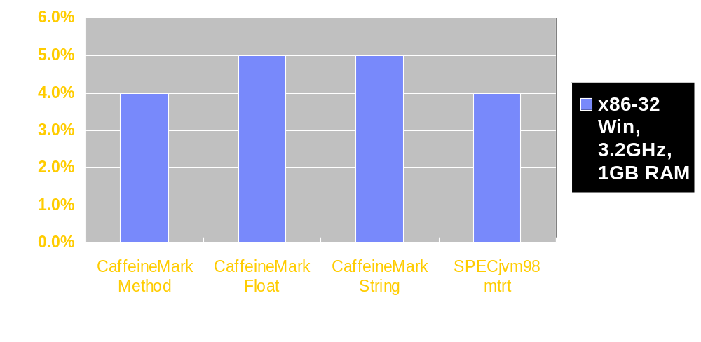
Results: x86-32 Performance

Slide 30
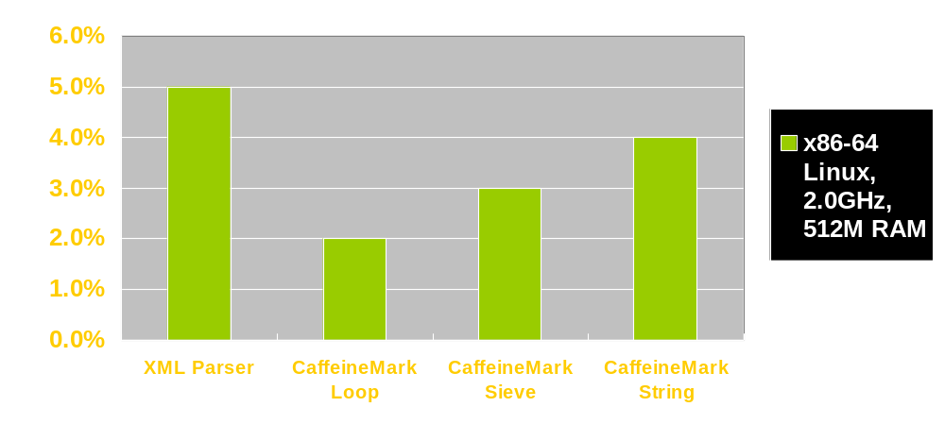
Results: x86-64 Performance

Slide 31
Summary
Practical dataflow solution to do assignment sinking is presented which is used in Testarossa JIT Compiler
Compile time overhead is negligible
Performance improvement is found in the benchmarks
Future work: need new tuning to boost up more performance

Slide 32

Questions ?

Slide 33
Thank You.

Slide 34
Backup

Slide 35
Tuning Example
BB8
x = a
z = x + y
Last use of x here

Slide 36
Tuning Example
After applying CSE and DSE
BB8
x = a
z = a + y
Last use of x here

Slide 37
Critical Edge Example
x =
= x

Slide 38
Critical Edge Example
x =
x =
= x

