Slide 1

Compiler Optimization Framework for Efficient Software Checkpointing
Chuck (Chengyan) Zhao
Dept. of Computer Science
Prof. Greg Steffan
Prof. Cristiana Amza
Dept. of Electrical and Computer Engineering
University of Toronto
Oct. 22, 2007
not filed for patent by IBM
Notes:
Might need to introduce my supervisors to the audience

Slide 2
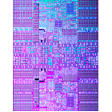
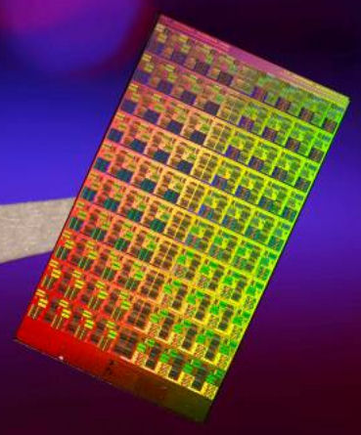
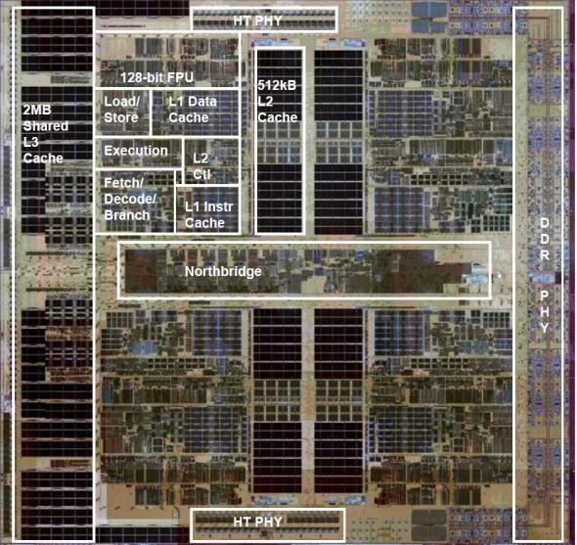
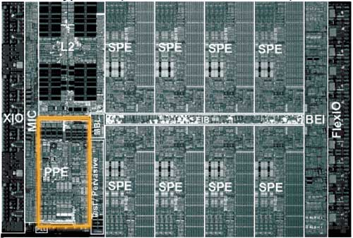

Multi-core CPUs are Everywhere
IBM
  Power 5, Power 6,…
Intel
  4-core Xeon, 80-core tera-scale, …
AMD
  4-core Barcelona,…
Sun
  UltraSparc T1,T2: 8 cores
  Rock: 16 cores,
Sony, Toshiba, IBM
  Cell: 9 cores
… …
IBM Power 6
Intel tera-scale chip
AMD 4-core Barcelona
9-core Cell
Accelerating a Single Program?
Notes:
Multi-core CPUs are now everywhere, from high-end servers, to desktop workstations to mobile laptops. All of a sudden, there are sufficient computational resources in terms of the number of available cores. In the future, we can safely predict that the number of available cores will increase exponentially. We might conservatively predict that the number of core counts will increase to a few dozens to a few hundreds in 3-5 years. Multi-core architecture ideally fits into multi-process workload as each individual process can be scheduled to a different core. However, it is not clear how this architecture can be used to help single-thread applications. In particular, help to accelerate single threaded application performance.

Slide 3

Exploiting Multicore with Optimistic Parallelism
Value Prediction
  loads
  function returns
Helper Threads
  data + instruction prefetching
Thread-Level Speculation (TLS)
Transactions and Transactional Memory (TM)
These techniques may accelerate single programs
Notes:
One of the possibilities of using such multiple cores is called Optimistic Parallelism. It is still an active research topic and can be expressed in many different forms.
Value Prediction will predict either a load or a function return value, and overlap execution using the predicted value. Helper threads can facilitate data and/or instruction prefetching to improve cache behavior while the main thread is largely unaffected, except benefiting from close-to-perfect cache behaviors. Speculative Multithreading will aggressively parallelize applications despite of uncertain dependencies, and recovers from failed speculation when the uncertain dependency turns out to be true dependency. Transactional Memory demonstrates a simplified and promising parallel programming model, where programmers partition programs into transactions and all transactions run in parallel.
In order to make any Optimistic Parallelism technique work, the following 4 items are required.

Slide 4

Optimistic Parallelism Requirements
1. Prediction
  predict value or thread independence
2. Validation
  is the prediction correct?
different, depending on technique for optimistic parallelism
3. Isolation
  separate optimistic modifications
4. Recovery
  commit or discard optimistic modifications
essentially common: checkpointing!
Checkpointing is important for Optimistic Parallelism
Notes:
What is checkpointing:
Checkpointing is a process of taking program snapshots, so that future program failures can safely recover to the save program checkpoints.

Slide 5
Checkpointing Methods
Conventional software methods
  OS/Process level (page-protection)
  object-level (object tracking)
  application: fail over, reliability
  challenge: prohibitive overhead
  advantage: need only commodity hardware
Recently proposed hardware methods
  mostly cache-line level
  advantage: fine-grain and efficient (cache-line-level)
  challenge: does not yet exist in real machines
Our goal: fine-grain on commodity hardware
Key insight: compiler can potentially enable fine-grain in software

Slide 6

Benefits of Compiler-based Checkpointing
Fine-grain
  tracking on word (byte) level
Automatic
  users do minimal work, compiler does the rest
Software-only
  work on commodity hardware
Compiler Optimization Framework
  enables optimizations to reduce overhead

Slide 7
Potential Applications
Load value prediction
Function return value prediction
Debugging support
  rewind and retry
Thread-level speculation (TLS)
Transactional memory (TM)
Enabled by lightweight checkpointing
Notes:
Mention this is just to name a few. Basically, any speculative-based application will be able to benefit from our scheme.

Slide 8
Agenda
Introduction to Checkpointing
Our Base Checkpointing Scheme
Optimizations
  Inlining
  Hoisting-based Optimizations
  Aggregation-based Optimizations
  Redundancy Elimination-based Optimizations
  Other optimizations
Challenges
Future work

Slide 9
Checkpointing Transformations
C
SUIF
C
annotated
source
base
transformations
checkpointing
optimizations
convert
back to
C
C code
xlc
gcc
SUIF frontend
POWER
x86
base checkpointing transformations
hoisting-based optimizations
aggregation-based optimizations
redundancy elimination-based optimizations
…
inlining
SUIF backend

Slide 10
Checkpointing Transformations
int a, b;
...
start_ckpt();
bkp_memory(&a, 4);
a = …;
bkp_memory(&b, 4);
b = …;
…
try_commit();
Steps
users insert checkpointing markers
  start_ckpt()
  try_commit()
compiler generates a backup call on each memory write
code sample
this talk focus on undo-log based scheme, as opposite to write-buffer scheme
Notes:
Say “this checkpointing transformation is based on undo backup scheme. There is an other scheme called write-buffer checkpointing, whose details will not be covered in this talk”
Mention that buffers are compile-time resources (not runtime), thus enable use a large number of aggressive optimizations.
Mention that start_ckpt() and try_commit() calls can be inserted by either a programmer or a compiler. Will prefer compiler to do the work as it is quite rigid.

Slide 11
Checkpointing Processing
a:
b:
main memory
0
5
…
a = 5;
b = 7;
…
0
failure
recovery
7
(&a, 0)
(&b, 0)
checkpoint buffer
main program
Notes:
Mention this is undo checkpointing scheme where the contents in main memory will be modified directly

Slide 12
Memory Backup Overhead
void bkp_memory(char * addr, int size){
// copy memory contents:
add_to_buffer(index, addr, size);
// maintain metadata:
index+=size;
}
i. function call/return overhead
ii. memory copy overhead
iii. meta data maintenance overhead
Notes:
Overhead reduction: either i, ii, iii, or any combination of the three individual items

Slide 13
Checkpointing Optimizations
optimizations | function call-return overhead | memory copy overhead | metadata maintenance overhead
hoisting-based
aggregation-based
redundancy elimination- based
inlining
✓
✓
✓
✓
✓
✓

Slide 14
Stress Test
benchmarks
bubble sort
bucket sort
heap sort
insert sort
merge sort
quick sort
selection sort
shell sort
radix sort
why integer sorting?
  simple benchmarks
  variety of access patterns
  test compiler passes
  worst-case scenario
  memory-bound, not much computation to overlap
checkpointing on global scale
  each memory write is checkpointed
checkpointing granularity
  per iteration
  no failure/recovery
Notes:
Each iteration is a checkpoint, so that we “commit” the checkpoint once when each iteration is over. In addition, there is no failure/recovery. Everything is run sequentially (no parallelism, pure overhead)

Slide 15
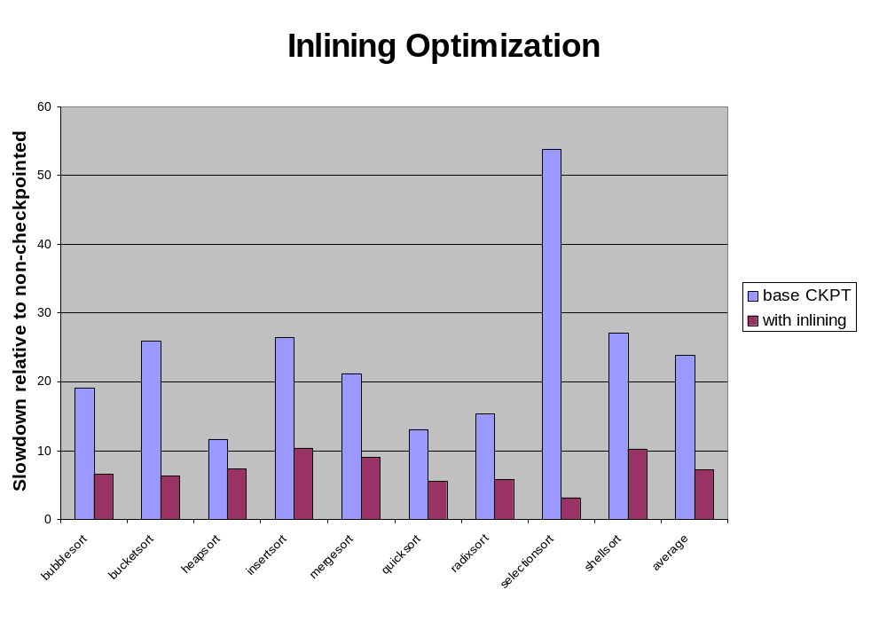
1
Average inlining improvement: 265%

Slide 16
Hoisting-based Optimizations
int i, s = 0;
…
start_ckpt();
…
bkp_memory(&s, 4);
for(i=0;i<=100;i++){ // local sum
bkp_memory(&s, 4);
s += i;
}
…
try_commit();
move backup calls on scalars into loop’s preheader
targeting overhead
  memory copy overhead
  meta data overhead
code sample
Notes:
Say:
There is a loop in the checkpointed region
There is at least 1 backup call (within the loop) whose address is fixed
We thus can hoisting the backup call into the loop’s preheader, thus avoiding copying the memory contents N times (copy it once instead)
For hoisting arrays and pointers, they are more complex cases that needs alias analysis. We are working on it, but have not yet ready to present

Slide 17
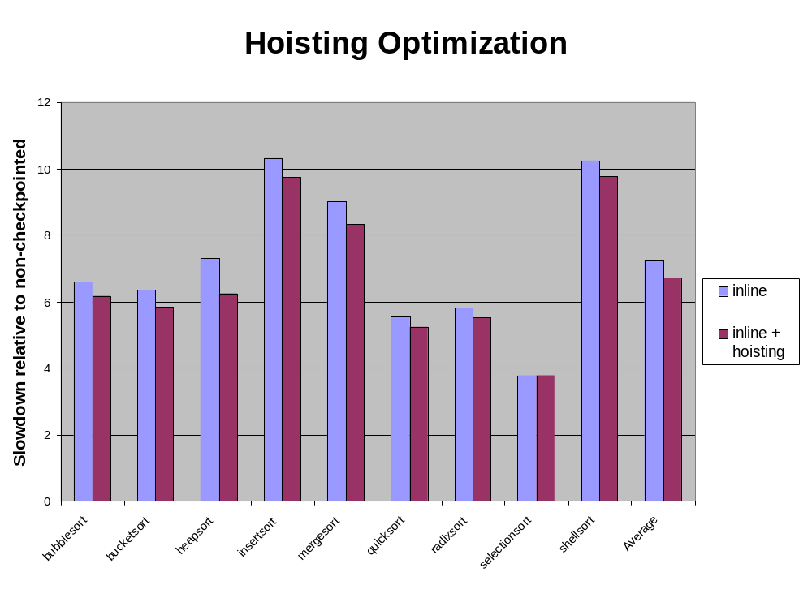
Average hoisting improvement: 7.23%

Slide 18
Aggregation-based Optimizations
int a, b, c, d; // globals
int a, c, b, d; // globals
start_ckpt();
bkp_memory(&a, 8);
bkp_memory(&a, 4);
bkp_memory(&c, 4);
a = …
bkp_memory(&c, 4);
c = …
try_commit();
group
  same-level backup function calls together
swap
  make declarations’ memory layout continuous
aggregate
  multiple backup calls covering a consecutive memory range into a single one
targeting overhead
  function call overhead
  meta data overhead
code sample
Notes:
Hoisting and group will create more opportunities for aggregation, as there will be more things to aggregate

Slide 19
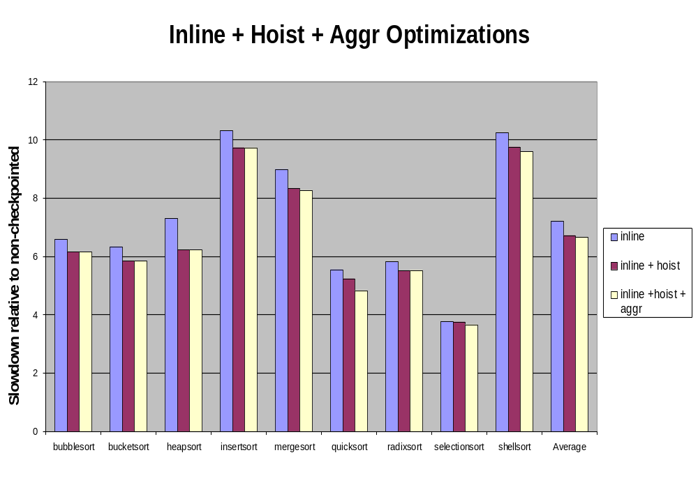
Average aggregation improvement: 1.2%

Slide 20
Completed and Work in Progress
Hoisting-based Optimizations
  scalar hoisting
  array hoisting
  pointer hoisting
Aggregation-based Optimizations
  intra-regional (simple) aggregation
  inter-regional (complex) aggregation
Redundancy Elimination-based Optimizations
  dead backup elimination
  pre-definition backup elimination
  silent backup removal
Implementation Optimizations
  inlining
  cache-aware optimization
done
✓
✓
work in progress
✓
✓
✓

Slide 21
Challenges and Future Work
Challenge: Software Overhead
Proposed Solutions
  efficient checkpointing
  compiler analyses and optimizations
Future Work
  checkpointing optimization framework
  checkpointing applications
Notes:
Mention that the challenge of software-only checkpointing is to significantly reducing the software overhead by aggressively optimizations

Slide 22
Questions and Answers
?

Slide 23
CKPT Support for Load Value Prediction
start_ckpt();
for (i;;){
prefetch(&A[i]);
p_v = predict();
… = A[i] …; // <- delinquent load
…
… = A[i] …;
}
try_commit( );
identify
  delinquent loads in a loop
checkpoint the region
value prediction transformation
  prefetch
  predict load value
  replace delinquent value with predicted value
  commit with error checking
p_v
p_v
A[i], p_v
Notes:
We use loop as its granularity level as we need as many delinquent loads as possible to amortize checkpointing overhead

Slide 24


Questions & Answers
Does your scheme support nested checkpointing?
  an open question
  no for now
  maybe in the future
How do you handle system calls, I/O functions, memory allocations, … ?
  can’t handle system call yet, unless we will have the system call’s source code to checkpoint
    suggestion: use binary instrumentation tool to do it (trace into binary code, do checkpointing on binary level)
  I/O, malloc-free:
    can’t checkpoint by default
    can be worked around
      hoist call or split checkpoint region
      provide checkpoint-aware version of I/O or memory allocator

Slide 25
Inter-regional (complex) Aggregation
int a, b, c, d, e, f,; // globals
Condition
  multiple backup calls in multiple instrumentation regions over multiple variables
Question
  how to generate a variable declaration order and backup aggregation sequence, so that checkpointing overhead will be minimized?
bkp_memory(&a, 4);
bkp_memory(&b, 4);
bkp_memory(&c, 4);
…
bkp_memory(&b, 4);
bkp_memory(&c, 4);
bkp_memory(&d, 4);
…
bkp_memory(&c, 4);
bkp_memory(&d, 4);
bkp_memory(&e, 4);
…
bkp_memory(&d, 4);
bkp_memory(&e, 4);
bkp_memory(&f, 4);
…

Slide 26
Inter-regional Aggregation Algorithm
Selectively Sorted Reference Counting (SSRC)
Count references to each distinct variable
  Consider references in loops
Sort counts
Generate an order from the sorted reference counts
  step 1
    pick a variable with the highest count
    repeat:
      pick a variable with the next highest count, and be adjacent on either side
      insert it to the side that will have minimal aggregation cost
  step 2: repeat step 1, until no available candidates left
  step 3: if there is any variable left, prepend/append in any artificial order

Slide 27
SSRC by Example
int a, b, c, d; // global vars
1. collect reference counts
2. sort counts
bkp_memory(&a, 4);
bkp_memory(&b, 4);
bkp_memory(&c, 4);
var
count
var
count
a
1
c
3
...
bkp_memory(&b, 4);
bkp_memory(&c, 4);
bkp_memory(&d, 4);
b
2
d
3
c
3
b
2
d
3
e
2
…
bkp_memory(&c, 4);
bkp_memory(&d, 4);
bkp_memory(&e, 4);
e
2
f
1
f
1
a
1
…
bkp_memory(&d, 4);
bkp_memory(&e, 4);
bkp_memory(&f, 4);
3. generate an optimal sequence

Slide 28
SSRC by Example
var
count
bkp_memory(&a, 4);
bkp_memory(&b, 4);
bkp_memory(&c, 4);
bkp_memory(&a, 12);
c
3
d
3
...
bkp_memory(&b, 4);
bkp_memory(&c, 4);
bkp_memory(&d, 4);
b
2
bkp_memory(&b, 12);
e
2
f
1
…
bkp_memory(&c, 4);
bkp_memory(&d, 4);
bkp_memory(&e, 4);
bkp_memory(&c, 12);
a
1
…
bkp_memory(&d, 4);
bkp_memory(&e, 4);
bkp_memory(&f, 4);
bkp_memory(&d, 12);
a
b
c
d
e
f

Slide 29
Optimistic Parallelism (OP)
violation
…←*q
*p←…
✗

✓
✓
Recover
Exec.
Time
…←*q
TLS
✓
exploit available optimistic parallelism
Notes:
We take a sequential program and carve it into threads. Watch for violations
We then execute the threads speculatively in parallel.
The speculative part is that we don’t know whether these threads are actually independent.
Instead, we depend on runtime support to tell us whether the threads actually were independent
whenever we have violated a data dependence we simply re-execute that thread so that it is redone with the proper value, otherwise we can commit the speculative work.
But even when speculation has failed, we can still reduce overall execution time
by exploiting the available parallelism.
If you are usually right, then it is faster to apologize when you are wrong than to always ask for permission

Slide 30
System Support for Optimistic Parallelism

Divide programs into speculative threads
  maximize parallelism
  minimize potential conflicts
Track data dependences
  determine whether speculation succeeded
Checkpointing
  buffer speculative states
  recover from failed speculation
✓
✗
3 key elements needed by every OP system
Notes:
Cross refer to Mihai’s work in our group

Slide 31
Checkpointing Backup Compiler Transformations
start_instrument();
start_ckpt(…);
for(…){
bkp_memory(&a, INT, 4);
  a = …;
  bkp_memory(&b, INT, 4);
  b = …;
  …
  }
try_commit(…);
stop_instrument();
Steps:
users mark region of interest
backup on each memory write
generate a call to start checkpoint
generate a call to try commit
remove region marking delimiters
Notes:
This is the complete Undo checkpointing compiler transformation. Moved it here just in case people get confused and asking
Mention that buffers are compile-time resources (not runtime), thus enable use a large number of aggressive optimizations

Slide 32
Checkpointing Optimizations
Inlining
Hoisting-based optimizations
Aggregation-based optimizations
Redundancy Elimination-based Optimizations
Other optimizations

