Slide 1
AOT Compilation in a Dynamic Environment for Startup Time Improvement
Kenneth Ma
Marius Pirvu
Oct. 30, 2008

Slide 2
Outline
Background
Functional Challenges
Performance Results
Performance Challenges
Future Work
Conclusions

Slide 3
Motivation
Improve startup time
  Server applications: WebSphere Application Server, WebSphere Process Server, Tomcat
  Development tools: Eclipse, Rational Application Developer, WebSphere Integration Developer
Improve response time
  Especially for GUI applications
Improve CPU utilization
  Important for zOS

Slide 4
Shared Classes in Java 6 IBM SDK
Store classes into a cache that can be shared by multiple JVMs
Reduces memory footprint
Improves startup time
Many new features including:
  Prevention of cache corruption
  Class compression
  Persistent cache
  Cache AOT code

Slide 5
How shared classes works
JVM1
Shared
Cache1
Classes
Classes on disk
JVM2
JVM3
Classes
Shared
Cache2
JVM4

Slide 6
Ahead-Of-Time (AOT) Compilation
What is AOT?
  Native compiled code generated “ahead-of-time” to be used by a subsequent execution
  Persisted into the shared cache
Why AOT?
  Improve startup time
  Reduce CPU utilization

Slide 7
How AOT works
JVM1
Shared
Cache1
Classes
Classes on disk
JVM2
AOT
Code
JVM3
Classes
Shared
Cache2
JVM4
AOT
Code

Slide 8
AOT in Java 6 IBM SDK
Cross platform support
  Supported on all IBM JSE platforms, including S390, PowerPC, and X86
  32-bit and 64-bit support
  Compressed pointer support starting in SR1
Compatibility checking
  Processor specific
  GC policy
  Compressed pointer

Slide 9
Functional Challenges
Static vs Dynamic AOT population
  Compiling select methods
  Platform neutrality
Multi-platform support
  Porting AOT functionality to all the major platforms
  64-bit support
    E.g. PPC 64-bit, load address values using sequences of instructions instead of 1 load instruction
Footprint reduction
  Reduce redundancies and pull in only relevant information
    E.g. Sharing “j2i thunks”

Slide 10
Functional Challenges
Increase possible combinations by many factors
  Checking all configurations working properly more difficult
  Test framework change
AOT runtime vs compile time
  Runtime state different from compile time
    E.g. Alignment differences

Slide 11
Performance Goals
Two main classes of applications:
  Server applications (e.g. WebSphere, tomcat)
    Goals:
      Fast restart after software reconfiguration/update
      Fast cold restart (after machine reboot)
      CPU utilization reduction (important on zOS)
      No degradation in throughput
  Desktop/client applications (e.g. eclipse, WID)
    Goals:
      GUI applications should feel responsive
      Fast restart during development cycle
      Fast cold restart after machine shutdown

Slide 12
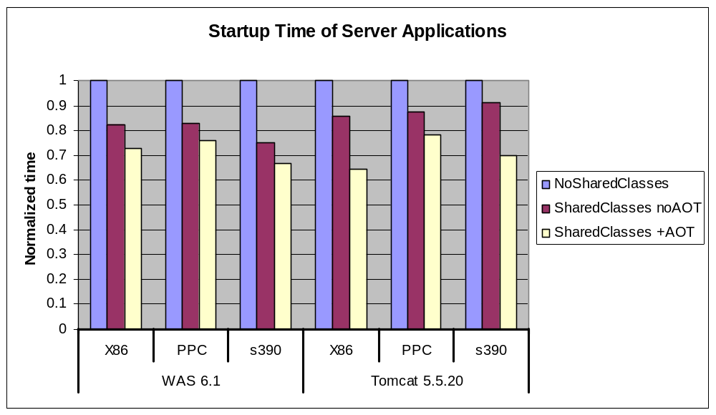
Performance of Server Applications
9-25% startup time improvement from AOT code

Slide 13
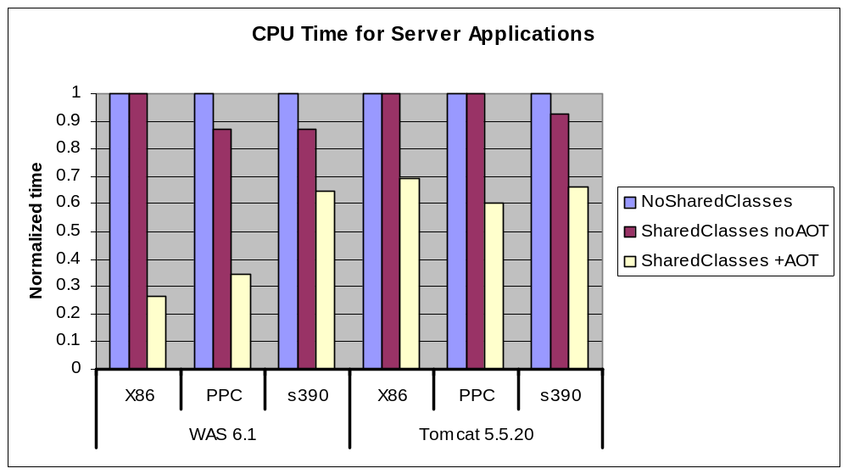
Performance of Server Applications
Notes:
On zOS, we measured CPU time spent in the Java process, while for the others, we measured the CPU time spent in the compilation thread only.

Slide 14
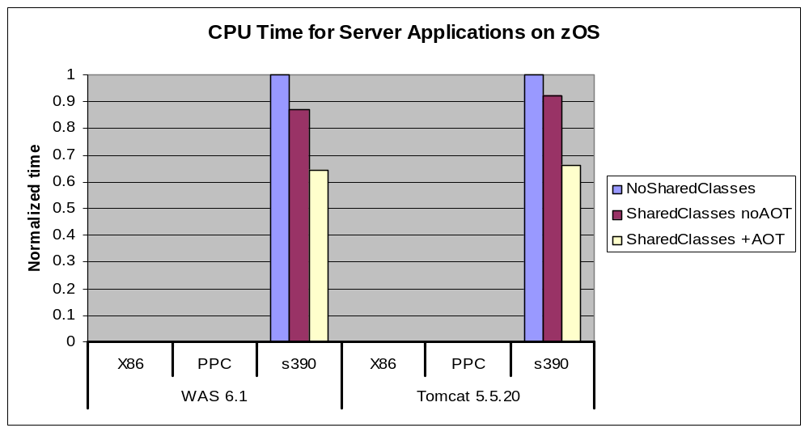
Performance of Server Applications
26-29% reduction in CPU cycles on zOS due to AOT

Slide 15
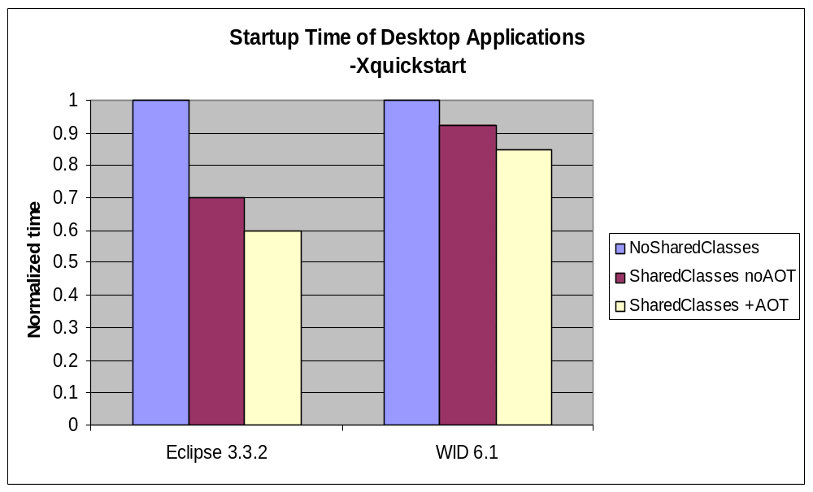
Performance of Desktop Applications
8-15% startup time improvement from AOT code

Slide 16
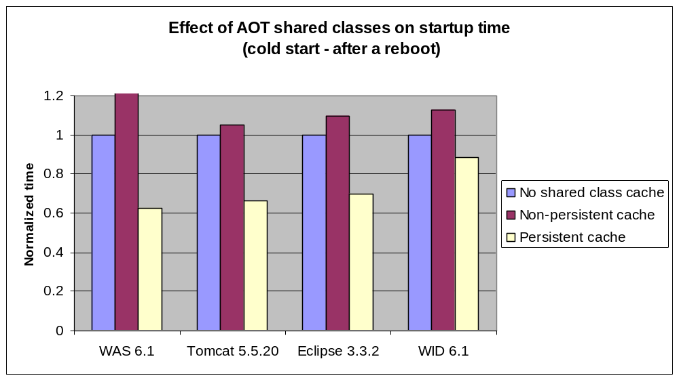
Cold Restart
Persistency ➔ 20-50% startup time improvement for cold restarts

Slide 17
Performance Challenges
Throughput/startup-time dilemma
Improve runtime performance/throughput ➔ heavily optimize code
  More optimization passes
  More complex optimizations
Shorter startup time ➔ make compiled code available as early as possible
  Compile fast → use cheap optimizations
  Compile only what matters
A real challenge to satisfy both desiderates

Slide 18
Performance Challenges
AOT code quality lower than JIT code quality
  No inlining
  Treat everything as unresolved
  Oblivious of class hierarchy
Concern: extensive use of AOT code might degrade throughput of server applications
  Questions:
    When to generate/store AOT code
    When to use/load AOT code

Slide 19
Performance Challenges
When to generate/store AOT code?
  Always
    Throughput may degrade (5-10% loss on DayTrader)
    Used for -Xquickstart
  During startup phases
    Class load phase heuristic
When to use/load AOT code?
  Always

Slide 20
Performance Challenges
Steps to avoid a potential throughput loss
  Filter methods to be AOT-ed
  First run detection
  Aggressive recompilation of AOT code (upgrade)

Slide 21
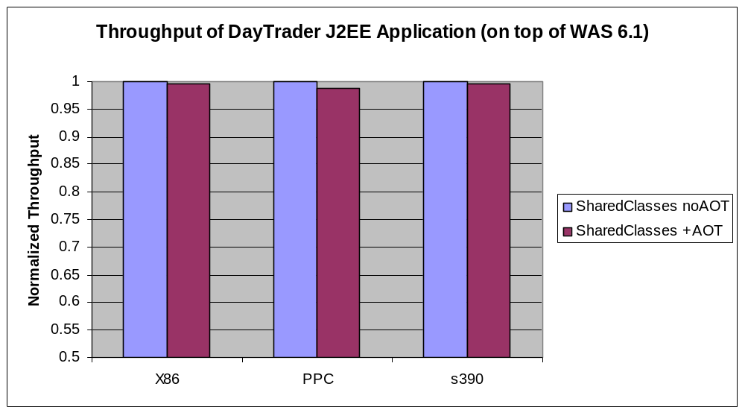
Effect of AOT Code on Throughput
Throughput loss is under 2%

Slide 22
Performance Challenges
How to minimize startup time
  Use AOT code sooner (but not too soon ☺)
  Give higher priority to relocation requests (shortest job first policy)
Minimize overhead
  Reduce the overhead to search the shared cache
  Reduce the number of shared cache searches
  Turn off interpreter profiling if JIT code not used

Slide 23
Future Work
Improve quality of AOT code
Generate AOT code more aggressively and change the mechanism of upgrading AOT compilations
Store additional information about compiled methods

Slide 24
Conclusions
AOT code technology available in Java 6 on all IBM JSE supported platforms
Many functional and performance challenges
Good startup improvements on a wide range of platforms and applications

