Slide 1

Improving 64-bit Java performance using Compressed References
Pramod Ramarao
Testarossa JIT Team
IBM Toronto Lab

Slide 2
Outline
Motivation for Compressed References
Overview
Implementation in IBM JDK for Java6
Performance results
Summary

Slide 3
Motivation for Compressed References
Migration from 32-bit to 64-bit not free
Performance penalties : additional cache, TLB misses & paging
  Especially severe on cache-constrained hardware
Increase in memory footprint compared to 32-bit
  Applications that used to fit in 32-bit address space no longer do
  Heap settings of a particular size do not work anymore
Settings for JVM are usually locked in
  Customers do not like to retune heap settings

Slide 4
Goals
Requirements for WebSphere Application Server 6.1
  On DayTrader, performance for 64-bit was to be within 5% of 32-bit
  Memory footprint was to be within 10%
In early 2007, compared to 32-bit
  64-bit SDK performance gap on Intel/AMD > 3x worse than goals
  Memory footprint gap was 3x worse than goals
Cache effects
  30% more cache misses on 64-bit
  Observation from profiles
Notes:
DayTrader is benchmark application built around the paradigm of an online stock trading system. Originally developed by IBM as the Trade Performance Benchmark Sample, DayTrader was donated to the Apache Geronimo community in 2005. The application allows users to login, view their portfolio, lookup stock quotes, and buy or sell stock shares. With the aid of a Web-based load driver such as Mercury LoadRunner, Rational Performance Tester, or Apache JMeter, the real-world workload provided by DayTrader can be used to measure and compare the performance of Java Platform, Enterprise Edition (Java EE) application servers offered by a variety of vendors. In addition to the full workload, the application also contains a set of primitives used for functional and performance testing of various Java EE components and common design patterns.

Slide 5
J9 Object Layout
Class myObj {
int myInt;
myObj myField1;
Object myField2;
}
32-bit Object (24 bytes)
64-bit Object (48 bytes – 2X)
OBJECT HEADER | int field | ref field | ref field
12 bytes
4 bytes
OBJECT HEADER + PAD | int field | Pad | ref field | ref field
24 bytes
8 bytes

Slide 6
Compressed References: Overview
Reduce object size
  Compress references (fields) to other objects
  Compress object header
Main idea is to store 32-bit offset instead of 64-bit address
Decompress at loads and Compress at stores of fields

Slide 7
J9 Object Layout (cont…)
Class myObj {
int myInt;
myObj myField1;
Object myField2;
}
32-bit Object (24 bytes)
64-bit Object (48 bytes – 2X)
64-bit Compressed References (24 bytes)
OBJECT HEADER | int field | ref field | ref field
OBJECT HEADER + PAD | int field | Pad | ref field | ref field
OBJECT HEADER | int field | ref offset | ref offset
Use 32-bit values (offsets) to represent object fields
  With scaling, between 4 GB and 32 GB can be addressed

Slide 8
Implementation
Initial Implementation
  No restriction on placement of Java heap in address space (Heap_base)
  Compression is subtract: (64-bit address – Heap_base)
  Decompression is add: (32-bit offset + Heap_base)
Significant overhead on some platforms
  Increase in path length due to add/sub
  Need to handle NULL values

Slide 9
Implementation in IBM JDK for Java6
Java heap placed in 0-4GB range of address space
  32-bit offset in object is simply the address in 0-4GB range
Compression (64-bit → 32-bit) : nop
Decompression (32-bit → 64-bit) : zero-extension
Maximum allowable heap in theory is 4GB
  In practice, the maximum heap available is lower
  ~2GB on Windows and zOS
Option to enable compression in 64-bit Java JDK
  -Xcompressedrefs

Slide 10
Example: Compressed References
Load of a reference field from an object (Decompression)
Object temp = myObj.myField2; // load of a field
  lwz gr3, [gr24+field_offset] ; load 4 bytes & zero-extend
Store into a field of an object (Compression)
myObj.myField2 = temp ; // store into field
  stw [gr24+field_offset], gr3 ; store 4 bytes

Slide 11
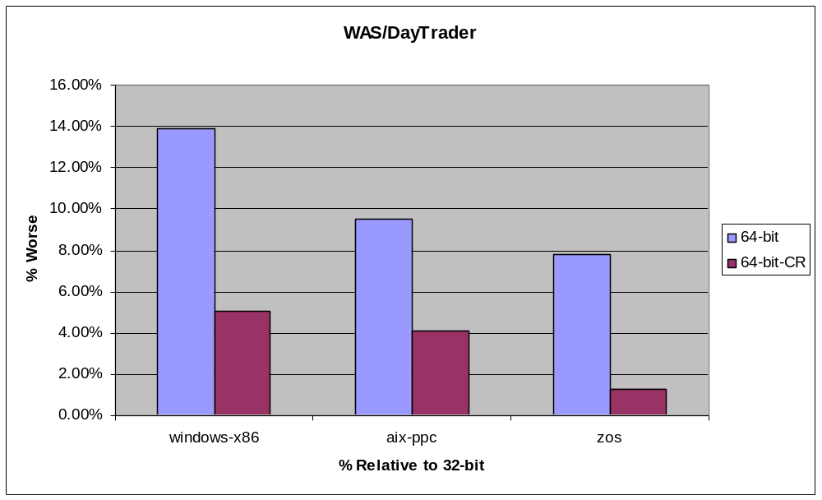
Compressed References Performance

Slide 12
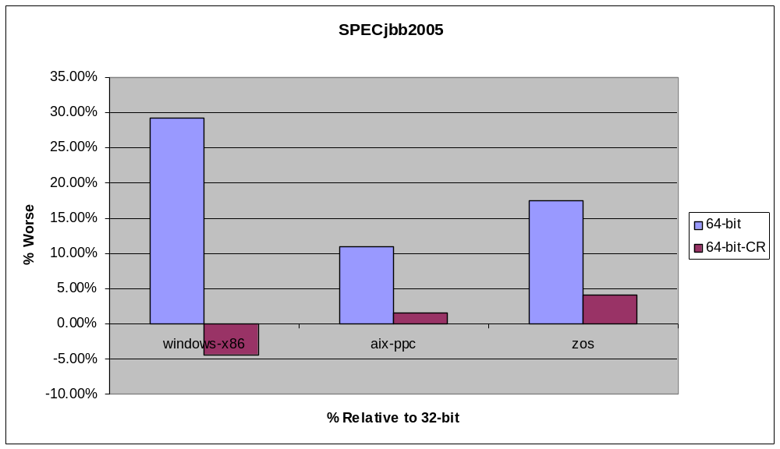
Compressed References Performance

Slide 13
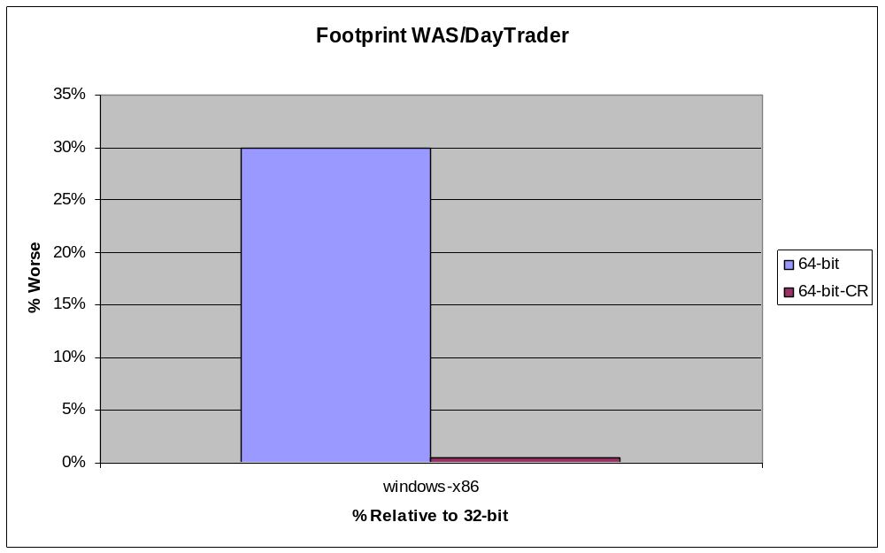
Compressed References Footprint

Slide 14
Goals (cont…)
Customer requirements of 3.5GB on Windows-x86
Previous implementation only good for applications that require small heaps (e.g. SPECjbb2005)
Need to support large heaps with minimal overhead of compression/decompression

Slide 15
Implementation in IBM JDK for Java6
Java objects in J9 are 8byte aligned (low 3 bits are 0)
  Main idea is to store 32-bit shifted offset in objects
Address range restrictions relaxed
  Java heap allocated in 0-32GB range
Compression (64-bit → 32-bit) : right shift
Decompression (32-bit → 64-bit) : left shift
Maximum allowable heap in theory is 32GB
  In practice, the maximum heap available is ~28GB

Slide 16
Example: Compressed References
Load of a reference field from an object (Decompression)
Object temp = myObj.myField2; // load of a field
  lwz gr3, [gr24+field_offset] ; load 4 bytes & zero-extend
  rldicr gr3,gr3,0x3, 0xFFFFFFFFFFFFFFF8 ; decompress by left shift (amt = 3)
Store into a field of an object (Compression)
myObj.myField2 = temp ; // store into field
  rldicl gr0, gr3, 0x3D, 0x1FFFFFFFFFFFFFFF ; compress by shift right (amt =3)
  stw [gr24+field_offset], gr0 ; store shifted value

Slide 17
Implementation characteristics
Performance Penalty is a possibility with Shifting
  Need extra instructions for performing shifts
  Less memory intensive benchmarks could be affected
  Exploit addressing modes in favor of shift instructions
    Certain platforms allow scaling
Shift amount depends on user specified heap setting (-Xmx)
  Transparent to the user
  Varies by platform, machine and user environment
  Lowest possible shift amounts chosen (for performance)
    Shift amount 1 on zSeries is less expensive than higher values
    Shift amount 1,2 & 3 have equal overhead on xSeries & pSeries

Slide 18
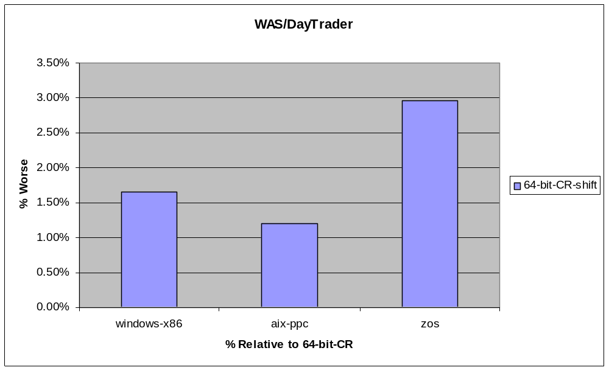
Compressed References Performance

Slide 19
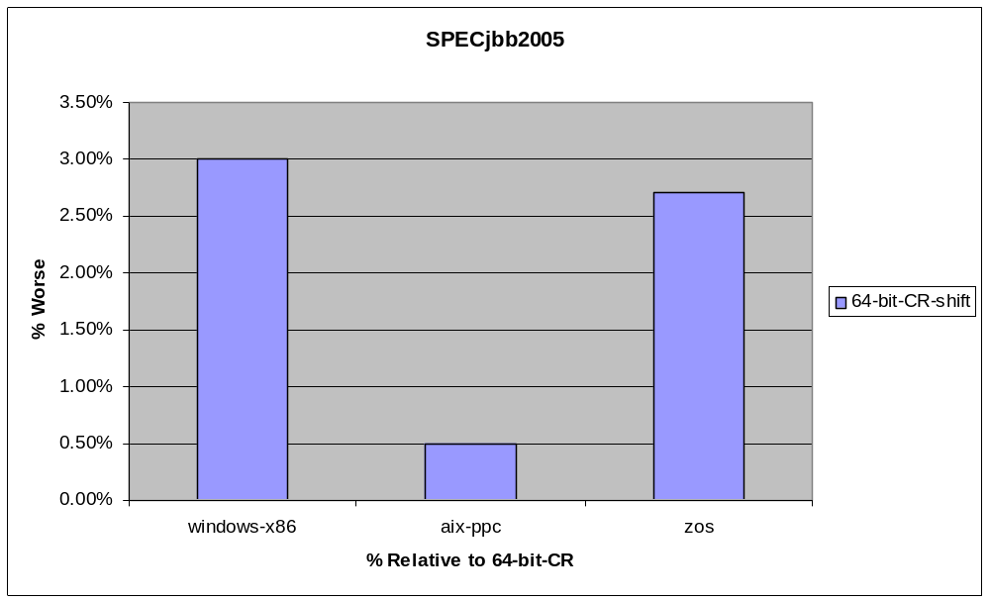
Compressed References Performance

Slide 20
Summary
Compressed References important to help customers migrating from 32-bit to 64-bit
Available in IBM Java6 JDKs starting with SR1
Significant performance improvements with compressed references
  Up to 10% improvement on DayTrader
  Up to 35% improvement on SPECjbb2005
Addressability of very large heaps, up to 32GB in compressed references mode

Slide 21
Questions?
Pramod Ramarao
pramarao@ca.ibm.com

