Slide 1

Compiler Exploitation of
Decimal Floating-Point Hardware
Ian McIntosh, Ivan Sham
IBM Toronto Lab

Slide 2
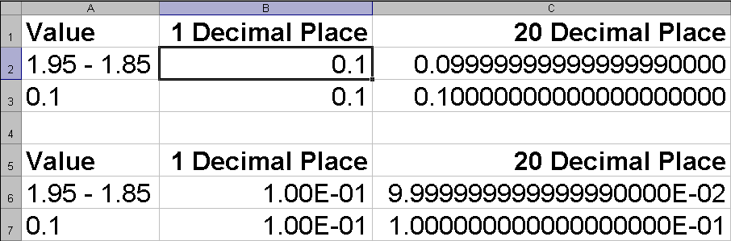
Why do we need Decimal Floating Point?
Microsoft® Office Excel 2003
Notes:
We can talk about why we need do use DFP here
Precision problem – BFP is not precise for decimal values, which can be remedied by DFP
Spreadsheets use various internal representations depending on where the value came from, causing errors

Slide 3
…Why do we need Decimal Floating Point?
public static double calculateTotal(double price, double taxRate)
{
return price * (1.00 + taxRate);
}
. . .
System.out.println("Total: $" +
calculateTotal(7.0, 0.015));
-----------------------------------------
Output -> Total: $7.1049999999999995
Notes:
We can talk about why we need do use DFP here
Precision problem – BFP is not precise for decimal values, which can be remedied by DFP
Traditionally DFP is done in software library and is computationally expensive

Slide 4
Outline
IEEE Decimal Floating Point (DFP)
C/C++ and DFP
Java and DFP

Slide 5
What is IEEE 754-2008 Decimal Floating Point?
Type Name | Size | Precision | Exponent Range
decimal32 | 32 bits 4 bytes | 7 digits single | -101 to +90
decimal64 | 64 bits 8 bytes | 16 digits double | -398 to +369
decimal128 | 128 bits 16 bytes | 34 digits quad | -6176 to +6111

Slide 6
What is Decimal Floating Point?
Values use base 10 digits
  Alternative to Binary Floating Point
Sign
Combination field
Exponent continuation
Digits continuation
Sign bit
Combination field – encodes the first two bits of the exponent and the leftmost digit (BCD)
Exponent continuation – encodes the remaining biased exponent bits
Digits continuation – encodes the remaining digits in DPD 3-digit block form
-1/10
1
01000
10010000
000000000000000001

Slide 7
Why should we use DFP?
Pervasive
  Decimal arithmetic is almost universal outside computers
More accurate for decimal numbers
  Can represent “important” numbers exactly
Programming trend
  IEEE 754, IEEE 854, IEEE 754R, IEEE 754-2008

Slide 8
Why should we use DFP?
Easier to convert to/from strings
  Great for working with databases
Performance
  More on this later

Slide 9
Why avoid using DFP?
It’s new and different
Not all languages include DFP
Limited support by other vendors
Software implementations can be slow
Incompatible formats (DPD and BID)
Current IBM hardware is in most cases
slower than binary floating point (BFP)

Slide 10
DFP at IBM
Hardware
  POWER6 and Z10
    Microcode in Z9
  One DFP functional unit
    Non-pipelined
Software
  XL C, XL C++, gcc, PL/I
  IBM® Developer Kit for Java™ 6

Slide 11
C Example – Without DFP
double calculateTotal(double price,
double taxRate)
{
return price * (1.00 + taxRate);
}
. . .
printf ("Total: $%19.16f\n",
calculateTotal(7.0, 0.015));
-------------------------------------------
Output -> Total: $7.1049999999999995
Notes:
This is the C version of the earlier Java example.

Slide 12
C Example – With DFP
_Decimal64 calculateTotal(_Decimal64 price,
_Decimal64 taxRate)
{
return price * (1.00dd + taxRate);
}
. . .
printf ("Total: $%19.16Df\n",
calculateTotal(7.0dd, 0.015dd));
-------------------------------------------
Output -> Total: $7.1050000000000000
Notes:
This is the DFP version of the previous slide, showing the correct output.

Slide 13
C / C++ DFP
C / C++ Type Name C++ Class Name | Literal Suffix | C printf / scanf Format Modifier | Library Function Suffix
_Decimal32 decimal32 | df | HD | d32
_Decimal64 decimal64 | dd | D | d64
_Decimal128 decimal128 | dl | DD | d128

Slide 14
C / C++ DFP – Approaches
C syntax | Easiest and most natural. On AIX can be compiled to either use POWER 6 DFP instructions or call decNumber library. On z/OS uses DFP instructions.
DFPAL library | Automatically adapts to either using DFP instructions or calling decNumber.
decNumber library | Very portable library.
decFloat library | Newer and often faster library.
decNumber++ library | C++ DFP class library.
Notes:
This is the DFP version of the previous slide, showing the correct output.

Slide 15
C/C++ DFP Performance – Product and Sum
In a loop: a[i] += b[i] * c[i];
 | noopt | -O2 | -O3
C syntax using decNumber library | (Baseline) | 1.26x faster than noopt | 2x faster than noopt
C syntax using DFP instructions | 27x faster than software | 1.82x faster than noopt 39x faster than software | 4.37x faster than noopt 59x faster than software
Measured by Tommy Wong, Toronto Lab
xlc for AIX version 9 on POWER 6
Notes:
-O2 POWER 6 DFP Instructions – 49x faster than baseline
-O3 POWER 6 DFP Instructions – 117x faster than baseline

Slide 16
C/C++ DFP Performance – C telco Benchmark
DFPAL* calls using decNumber | (Baseline)
decNumber calls | 1.92x faster
DFPAL* calls using DFP instructions | 2.56x faster
C syntax using DFP instructions | 4.4x faster
* DFPAL automatically adapts to either using
DFP instructions or calling decNumber.
Measured by Tommy Tse, Beaverton
xlc for AIX version 9 on POWER 6 using -O2
Notes:
No C telco measurement of C syntax using decNumber, but see previous slide for that comparison in a different context

Slide 17
Decimal Floating Point in Java
IBM Developer Kit for Java 6
64 bit DFP via BigDecimal class library
POWER 6 server or Z10 mainframe

Slide 18
BigDecimal Class Library
arbitrary-precision signed decimal numbers
  an arbitrary precision integer unscaled value
  32-bit integer scale
Supports all basic arithmetic operations
Complete control over precision and rounding behavior
Unscaled value: 9218302123431
92183021.23431
Scale: 5

Slide 19
BigDecimal and DFP
BigDecimal can represent arbitrary significance but 64-bit DFP restricted to
16 digits
BigDecimal represents 32-bit exponent,
64-bit DFP restricted to 10 bits
Set of all BigDecimal objects
Values that cannot be represented as DFP
DFP values that can
be represented values

Slide 20
BigDecimal Representation Problem
Want to:
  Use DFP representation
  Avoid software re-try
BigDecimal a = new BigDecimal("9876543210123456",
MathContext.DECIMAL64);
BigDecimal b = new BigDecimal("1234567890987654",
MathContext.DECIMAL64);
BigDecimal c = a.add(b);
Fits in 64
bit DFP
64
Precision overflow

Slide 21
Hysteresis Mechanism
Choose best representation automatically
  Base on history of operations
Use counter and threshold
  Bias towards DFP representation
    Division, string construction, unaligned addition
  Bias towards software representation
    Compare, integer constructions
BigDecimal constructors check counter

Slide 22
JIT Compiler Optimization
Detects DFP hardware support
  Replaces checks in java code with constant
  Disables hysteresis mechanism when no DFP
Inject DFP instructions
  Load operands from BigDecimal Objects
  Set rounding mode (if necessary)
  Perform DFP operation
  Reset rounding mode (if necessary)
  Check result validity
  Store result into BigDecimal Object

Slide 23
Example – Java / BigDecimal
public static BigDecimal calculateTotal(
BigDecimal price, BigDecimal taxRate)
{
return price.multiply(taxRate.add(BigDecimal.ONE));
}
. . .
System.out.println("Total: $" + calculateTotal(
new BigDecimal(“7.00”), new BigDecimal(“0.015”));
-------------------------------------------
Output -> Total: $7.1050

Slide 24
Microbenchmark results
 | HW DFP Speed up
Unaligned Addition | 5.05x
Aligned Multiplication | 3.03x
Aligned Division | 2.23x
Half Even Rounding | 1.45x
String based construction | 2.08x
zLinux on Z10 using Java 6 SR2

Slide 25
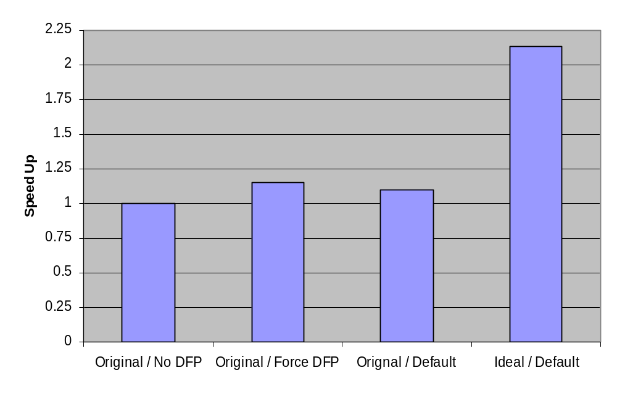
Performance Improvement - Telco
z/OS on Z10 using Java6 SR1

Slide 26
Summary
Use DFP
  Control over precision and rounding behaviour
  Accuracy for decimal numbers
  Programming trend
High performance for suitable workloads
  DFP hardware can greatly improve performance
  4x (2x) speedup was measured on C (Java) for Telco

Slide 27
Thank you!
IBM Toronto Software Lab
Ian McIntosh ianm@ca.ibm.com
Ivan Sham ivansham@ca.ibm.com

Slide 28
Resources
General Decimal Arithematic
  http://www2.hursley.ibm.com/decimal/
Decimal floating-point in Java 6: Best practices
  https://www.304.ibm.com/jct09002c/partnerworld/wps/servlet/ContentHandler/whitepaper/power/java6_sdk/best_practice

Slide 29
Java command line options
-Xdfpbd
  Disables the hysteresis mechanism
-Xnodfpbd
  Disable DFP support and hysteresis mechanism

Slide 30
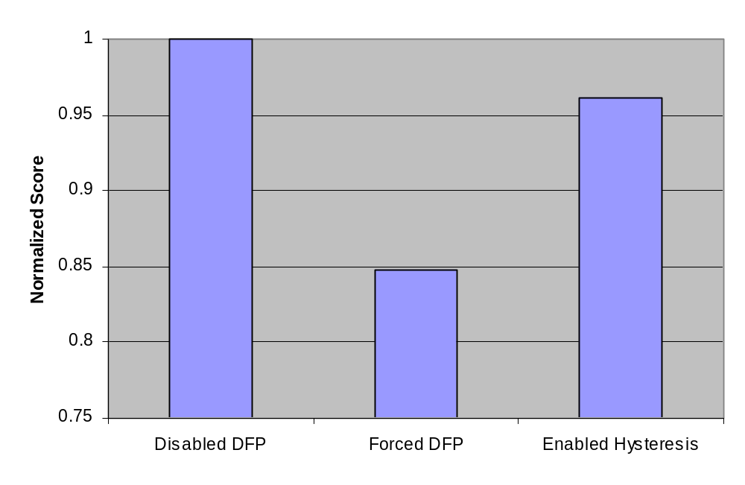
Hysteresis Mechanism Performance
Multi-threaded transaction base benchmark
  Workload does not use MathContext64
zLinux on Z10 using Java 6 SR2

Slide 31
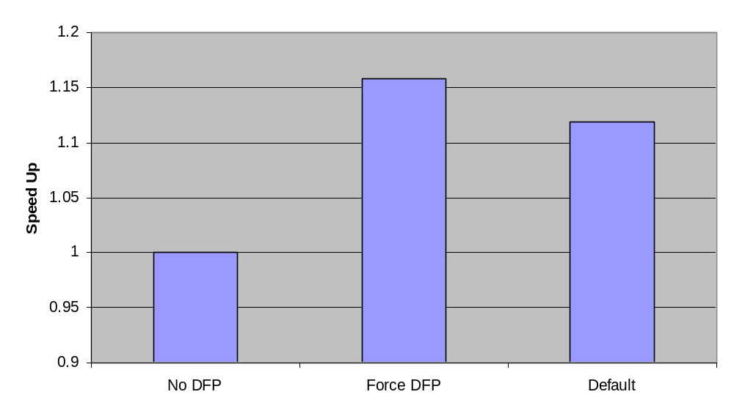
Java Telco Performance on POWER6
AIX on POWER6 using Java 6

