Slide 1
Assist Threads for Data Prefetching in IBM XL Compilers
Gennady Pekhimenko, Yaoging Gao, IBM Toronto,
Zehra Sura, Tong Chen, John K. O’Brien, IBM Watson

Slide 2
Agenda
Motivation and goals
Compiler Infrastructure for Assist Threads
  Delinquent load identification
  Code region/Loop selection
  Cloning
  Back-slicing
  Assist thread optimization: loop blocking, distance control
  Speculation handling: version control and signal handling
Performance Results
Summary
CASCON 2009, CDP09

Slide 3
Motivation and Goals
Motivation:
Significant number of cache misses in HPC workloads
Availability of multi-core and multi-threading for CMP (Chip MultiProcessors) and SMT (Simultaneous MultiThreading) exploitation
Existing prefetch techniques have limitations:
  hardware prefetch – irregular data access patterns
  software prefetch – prefetch overhead on program execution
Goals:
Deploy the available multiple SMT threads and cores to increase single thread and multiple thread performance
CASCON 2009, CDP09

Slide 4
Compiler Infrastructure for Assist Threads
Application programs
Profiling information for cache miss
Delinquent Load Identification
Version Control
Loop Selection
Distance Control
Region Cloning
Loop Blocking
Thread management
Back-slicing
Signal Handling
Basic AT Generation
AT Optimizations
XL compiler
AT Runtime
Binary with assist thread
CASCON 2009, CDP09

Slide 5
Assist Thread Generation
Delinquent load identification (common to Memory Hierarchy Optimizations)
Back-slicing for address computation and prefetch insertion
Spawn assist threads once in MT (Main Thread)
Notify AT (Assist Thread) to execute the slice function for delinquent loads
Main Thread
Assist Thread
Spawn assist thread
signal assist thread
Loop {
………
delinquent load/loads
……
}
………
while (1)
{
wait for signal;
(*func_addr)(id);
}
Slice function #id
Loop {
………
prefetch
……
}
Inter-threaded communication
CASCON 2009, CDP09

Slide 6
Example of AT Code Transformation
Original Code
// A and x are globals
y = func1();
…
i = func2();
// start of back-slice
while (i < condition) {
…
x = func3();
…
// delinquent load
func4( A[i] );
…
i += y;
}
// end of back-slice
Main Thread (MT) Code
y = func1();
…
i = func2();
// start pre-fetching in assist thread
func_addr = &slice_func_1;
signal assist thread;
// start of back-slice
while (i < condition) {
…
x = func3();
…
func4( A[i] );
…
i += y;
}
// end of back-slice
Assist Thread (AT) Slice Function
void slice_func_1(int thd_id) {
…
int y_local = y;
int i_local = I;
…
while (i_local < condition) {
// pre-fetch request
__dcbt( &A[i_local] );
i_local += y_local;
}
}
CASCON 2009, CDP09

Slide 7
Delinquent Loop Identification
Manual source change
  Can be made by user using __mem_delay() function call
Automatic identification using Performance Counters, -qpdf suboptions
  Still __mem_delay(), but inserted automatically
  Needs filtering for __mem_delay(), otherwise – too much overhead
while (i < condition) {
__mem_delay(&A[i]);
A[i] += B[i];
i += y;
}
CASCON 2009, CDP09

Slide 8
Loop Selection
Why do we need it?
  Innermost, outermost or somewhere in the middle?
  What if we have several delinquents at different levels?
  Let’s try to avoid overhead
What can we do?
  Try to keep as many delinquents together as possible
  Try to choose “hot” – enough loops, but without intermediate computation
  Predict the amount to cache accesses based on the code in the loop
CASCON 2009, CDP09

Slide 9
Back Slicing
Algorithm
  Start from the address expressions for all delinquent loads
  Backward traversal of data and control dependence edges
    Find all statements needed for address calculation
    Remove un-needed statements from slice
  Stores to global variables terminate traversal
      Localization is applied when possible
  Keep track of local live-ins to slice code
  Insert prefetch instructions in slice
CASCON 2009, CDP09

Slide 10
Controlling Progress of AT
M(ain)T(hread), A(ssist)T(hread) execute asynchronously
Prefetch may be useless, or harmful if AT-MT distance isn’t controlled
  Too close => no latency hiding
  Too far => potential cache pollution (and useless bus traffic)
Reasons for the difference in pace
  OS Scheduling of threads
  SMT thread priorities
  AT executes less code (a slice, rather than the real computation)
  AT uses non-blocking prefetch
Solutions
  Version control (coarse grain)
  Distance control (fine grain)
CASCON 2009, CDP09

Slide 11
Version Control
If AT lags, kill it when MT finishes loop
  Prevents older AT prefetching for newer version of loop
Avoid starting execution of stale AT
  Increment version number on exit from every MT loop that has an associated AT
    OS may schedule AT very late
    AT compares current version number with version number at spawn point before starting execution
Main Thread (MT)
Assist Thread (AT)
signal assist thread (…, @version ….)
Loop {
………
delinquent load/loads
……
}
@version++;
outlined_function(…, version )
if( @version != version ) goto exit;
…
Loop {
………
prefetch
……}
exit:
CASCON 2009, CDP09

Slide 12
Distance Control
Keep a reasonable iteration difference between MT, AT
Solution
  Introduce counters for MT and AT to record how many iterations have been executed
  If AT is too fast, wait
  If AT is too slow, jump ahead
Efficiency consideration in design
  All the checks are added to AT
  only increment of a counter is added to MT
    Exact synchronization isn’t required
      No locks needed
  Apply loop blocking to reduce the overhead
CASCON 2009, CDP09

Slide 13
Loop Blocking
Reduce overhead of distance control in MT
  Block loop, increment counter only in outer loop
  Number of increments decreased by blocking factor
  AT distance control is less precise
    Not that significant
// MT Blocked Loop
for (j; j < BF; j++){
for (i ; i < min (BF*j + BF, UB); i ++) {
…
a[i];
…
}
count+=BF;
}
// MT Original Loop
for (i ; i <UB; i ++) {
…
a[i];
…
count++;
}
CASCON 2009, CDP09

Slide 14
Speculation handling
Speculative precomputation in AT may cause invalid accesses to global variables
Static analysis to avoid speculation
  But it is not always possible
Runtime handling of speculation
  Catch signal, skip this instance of AT, and continue execution
  Both on Linux and AIX
CASCON 2009, CDP09

Slide 15
Kernels Description
Synthetic test cases to show the performance of assist thread on
  Different function unit usage
  Different cache miss rate
Operations in main thread can be grouped into:
  ADDR: operations needed by AT to calculate the addresses for prefetch
  COMP: the rest operations (computation) done by MT but not AT
Different ratio between ADDR and COMP
  at-comp: much more operations in COMP
  at-addr: much more operations in ADDR
  at-bal: ADDR and COMP are roughly balanced
Different cache miss rate for delinquent loads ONLY
    High: miss rate: ~90%
    Medium: miss rate: ~40%
    Low: miss rate: ~20%
CASCON 2009, CDP09

Slide 16
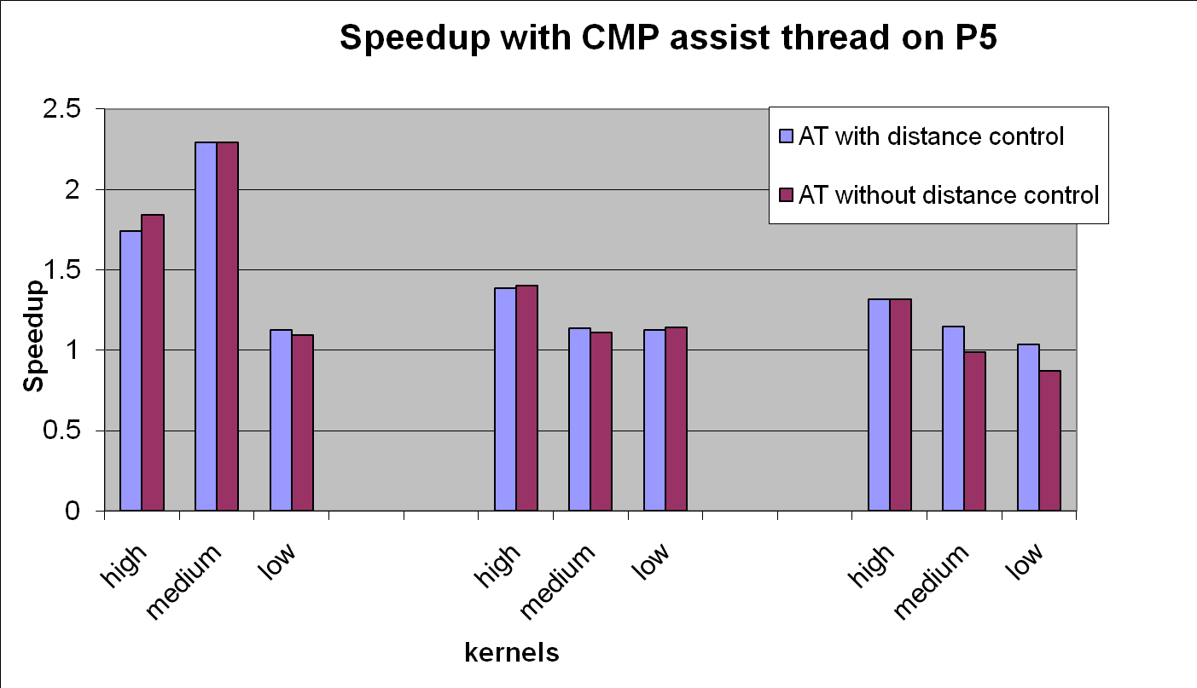
CMP Assist Thread Performance on Power5
at-comp
at-comp
at-bal
at-bal
at-addr
at-addr
CASCON 2009, CDP09

Slide 17
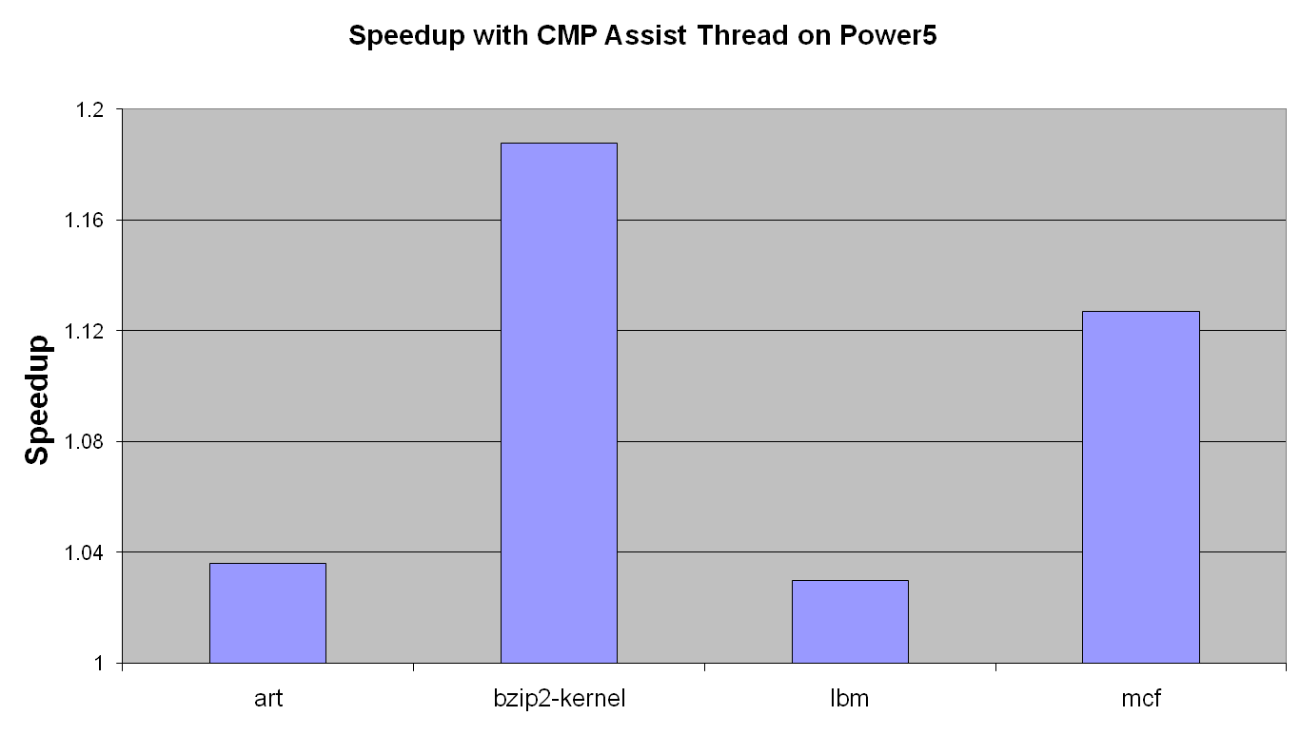
Speedup of Benchmarks
CASCON 2009, CDP09

Slide 18
Summary
The Compiler infrastructure has been designed and implemented
    Delinquent load infrastructure integration
    Profitability analysis for code region selection
    Outlining and backward slicing
    Assist thread optimizations: distance control, loop blocking
    Speculation handling
Performance gains have been demonstrated on a set of kernels
    Small kernels with different types of workloads
    Several SPEC2000/2006 benchmarks
CASCON 2009, CDP09

Slide 19
Future Plans
    Heuristic to choose the proper “delinquent” targets, based on
      Profile information
      Cache miss rates
      Loop structure
    SMT priority control for assisted thread
    Automatic binding based on the current architecture and topology
CASCON 2009, CDP09

Slide 20
Acknowledgements
IBM Toronto compiler development team:
  Gennady Pekhimenko, Yaoqing Gao, Khaled Mohammed, Raul Silvera,
  Roch Archambault, Sandra McLaughlin
IBM Watson compiler research team:
  Kevin K O'Brien,Tong Chen, Zehra Sura, Kathryn O'Brien
CASCON 2009, CDP09

