Slide 1
Reducing Trace Selection Footprint for Large-scale Java Applications without Performance Loss
Peng Wu, Hiroshige Hayashizaki, Hiroshi Inoue, and Toshio Nakatani
IBM Research
Peng Wu
11/08/26

Slide 2
Trace-based Compilation in a Nut-shell
Stems from a simple idea of building compilation scopes dynamically out of execution paths
Code-gen:
handle to handle
trace exits
Optimization: scope-mismatch problem
Trace selection: how to form good compilation scope
method f
method entry
Common traps to misunderstand trace selection:
Do not think about path profiling
Think about trace recording
Do not think about program structures
Think about graph, path, split or join
Do not think about global decisions
Think about local decisions
if (x != 0)
rarely
executed
frequently
executed
while (!end)
do something
trace exit
return

Slide 3
Trace Compilation in a Decade
Increasing selection footprint
DaCapo-9.12, WebSphere
1300~27000 traces
DaCapo-9.12
12000 traces, 1600 trees
linear
cyclic
tree
Testarossa
Trace-JIT
(Java)
Hotspot
Trace-JIT
(Java)
All regions
spec
<200 traces
dynamo
(binary)
A
A
A
<200 traces
<100 trees
<600 traces
PyPy
(Python)
SPUR
(javascript)
Coarse
grained
Loops
B
B
B
C
stub
exit
SpecJVM
<100 traces
<70 trees
Java Grande
<10 trees
exit
YETI
(Java)
D
D
stub
stub
TraceMonkey
(javascript)
Loops
LuaJIT
(Lua)
HotpathVM
(Java)
Delvik
(Java)
exit
exit
One-pass trace selection
(linear/cyclic traces)
Multi-pass trace selection
(trace trees)

Slide 4
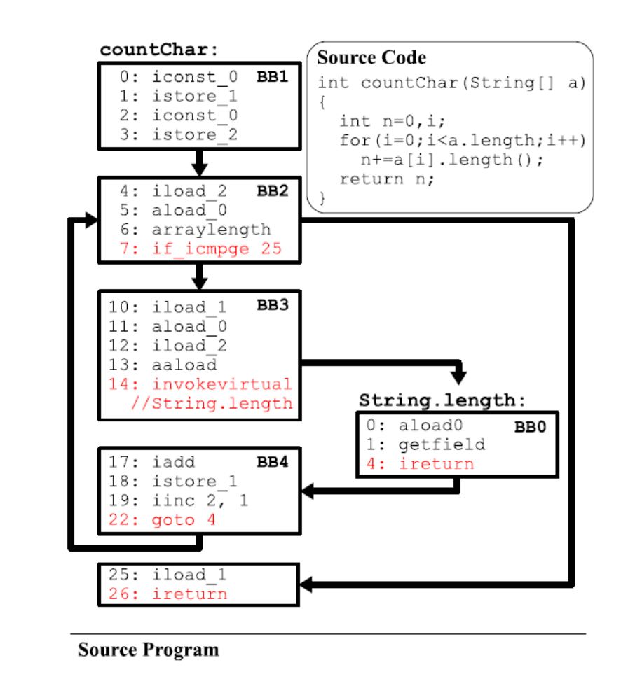
An Example of Trace Duplication Problem
Trace A
Trace B
Trace C
Trace D
In total, 4 traces (17BBs) are selected for a simple loop of 4BB+1BB
Average BB duplication factor on DaCapo is 13

Slide 5
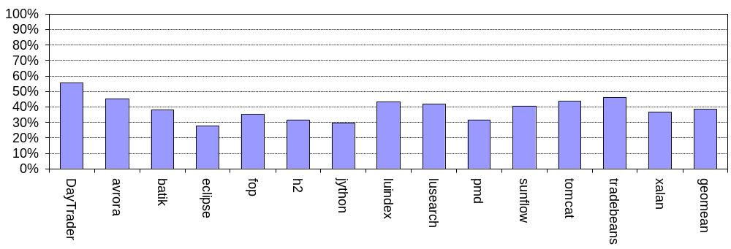
Understanding the Causes (I): Short-Lived Traces
SYMPTON
2
trace B
Trace A is formed first
Trace B is formed later
Afterwards, A is no longer entered
1
trace A
ROOT CAUSE
Trace A is formed before trace B, but node B dominates node A
Node A is part of trace B
On average, 40% traces of DaCapo 9-12 are short lived
% traces selected by baseline algorithm with <500 execution frequency

Slide 6
Understanding the Causes (II): Excessive Duplication Problem
Block duplication is inherent to any trace selection algorithm
  e.g., most blocks following any join-node are duplicated on traces
All trace selection algorithms have mechanisms to detect repetition
  so that cyclic paths are not unrolled (excessively)
But there are still many unnecessary duplications that do not help performance

Slide 7
Examples of Excessive Duplication Problem
Example 1
Example 2
Key: this is a very biased join-node
n
trace buffer
Q: breaking up a cyclic trace at inner-join point?
Q: truncate trace at buffer length (n)?
Hint: efficient to peel 1st iteration of a loop?
Hint: what’s the convergence of tracing large loop body of size m (m>n)?

Slide 8
Our Solution
Reduce short-lived traces
  Constructing precise BB
    address a common pathological duplication in trace termination conditions
  Change how trace head selection is done (most effective)
    address out-of-order trace head selection
  Clearing counters along recorded trace
    favors the 1st born
B
ROOT CAUSE
Trace A and B are selected out of sync wrt topological order
Node A is part of trace B
A
  Trace path profiling
    limit the negative effect of trace duplication
Reduce excessive trace duplication
  Structure-based truncation
    Truncate at biased join-node (e.g., target of back-edge), etc
  Profile-based truncation
    Truncated tail of traces with low utilization based on trace profiling

Slide 9
Technique Example (I): Trace Path Profiling
basic block
Original trace selection algorithm
1. Select promising BBs to monitor exec. count
2. Selected a trace head, start recording a trace
3. Recorded a trace, then submit to compilation
With trace path profiling
3.a. Keep on interpreting the (nursery) trace
  monitor counts of trace entry and exits
  do not update yellow counters on trace
3.b. When trace entry count exceeds threshold, graduate trace from nursery and compile
NOTE: Traces that never graduate from nursery are short-lived by definition
Using nursery to select the topologically early one (i.e., favors “strongest”)

Slide 10
Evaluation Setup
Benchmark
  DaCapo benchmark suite 9.12
  DayTrader 2.0 running on WebSphere 7 (3-tier setup, DB2 and client on a separate machine)
Our Trace-JIT
  Extended IBM J9 JIT/VM to support trace compilation
    based on JDK for Java 6 (32-bit)
    support a subset of warm level optimizations in original J9 JIT
    512 MB Java heap with large page enabled, generational GC
  Steady-state performance of the baseline
    DaCapo: 4% slower than J9 JIT at full opt level
    DayTrader: 20% slower than J9 JIT at full opt level
Hardware: IBM BladeCenter JS22
  4 cores (8 SMT threads) of POWER6 4.0GHz
  16 GB system memory

Slide 11
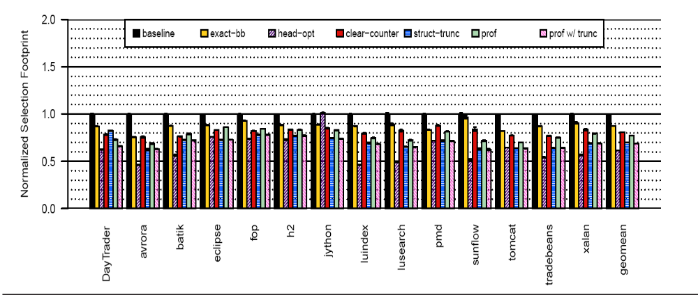
Trace Selection Footprint after Applying Individual Techniques
(normalized to baseline trace-JIT w/o any optimizations)
Trace selection footprint: sum of bytecode sizes among all trace selected
Lower is better
Observation: each individual technique reduces selection footprint between 10%~40%.

Slide 12
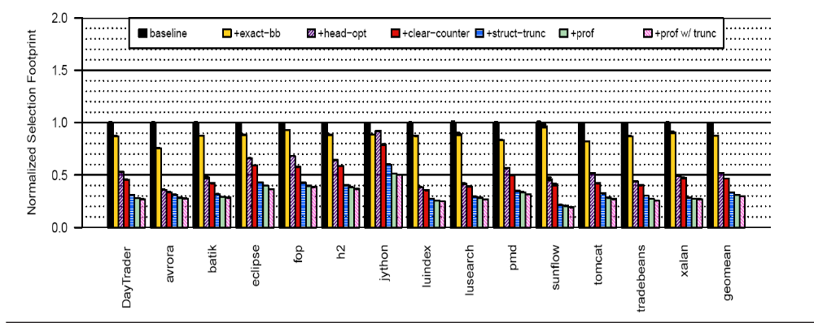
Cumulative Effect of Individual Techniques on Trace Selection Footprint (Normalized to Baseline)
Lower is better
Observations: 1) each technique further improves selection footprint over previous techniques; 2) Cumulatively they reduce selection footprint to 30% of the baseline.
steady-state time: unchanged, from 4% slowdown (luindex) to 10% speedup (WebSphere)
start-up time: 57% baseline
compilation time: 31% baseline
binary size: 31% baseline

Slide 13
Comparison with Other Size-control Heuristics
We are the first to explicitly study selection footprint as a problem
However, size control heuristics were used in other selection algorithms
  Stop-at-loop-header (3% slower, 150% larger than ours)
  Stop-at-return-from-method-of-trace-head (6% slower, 60% larger than ours)
  Stop-at-existing-head (30% slower, 20% smaller than ours)
Why is stop-at-existing-head so footprint efficient?
It does not form short-lived traces because a trace head cannot appear in another trace
It includes stop-at-loop-header because most loop headers become trace head
B
A

Slide 14
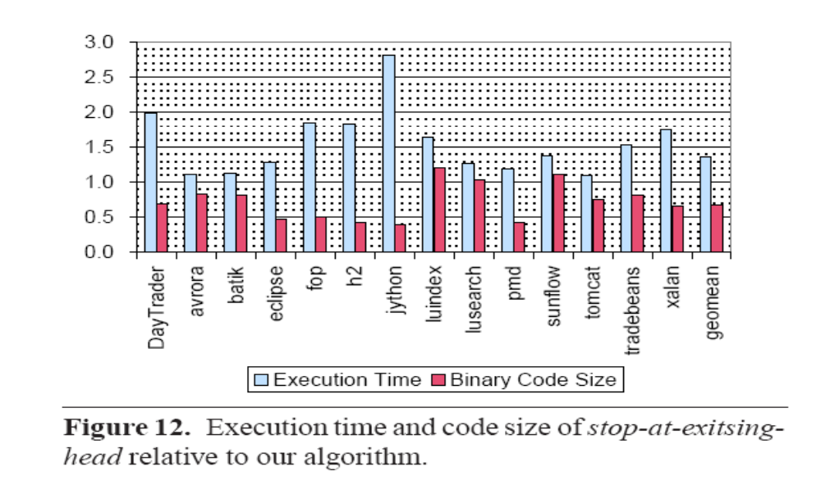
Comparing Against Simpler Solutions

Slide 15
Summary
Common beliefs
Our Grain of Salt
1. Selection footprint is a non-issue as trace JITs target hot codes only
Scope of trace JIT evolved rapidly, incl. running large-scale apps
2. Trace selection is more footprint efficient as only live codes are selected
Duplication can lead to serious selection footprint explosion
3. Tail duplication is the major source of trace duplication
There are other sources of unnecessary duplication: short-lived traces and poor selection convergence
4. Shortening individual traces is the main weapon for footprint efficiency
Many trace shortening heuristics hurt performance
Proposed other means to curb footprint at no cost of performance

Slide 16
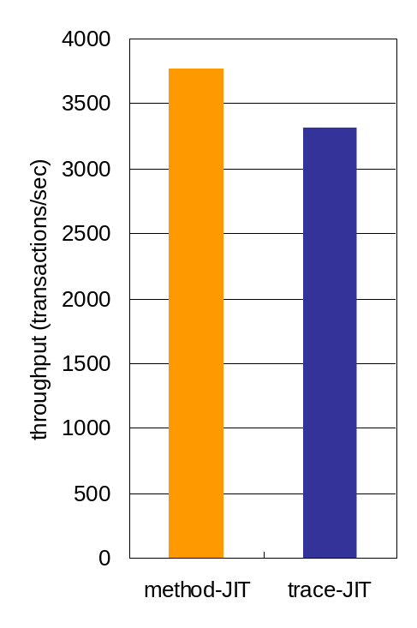
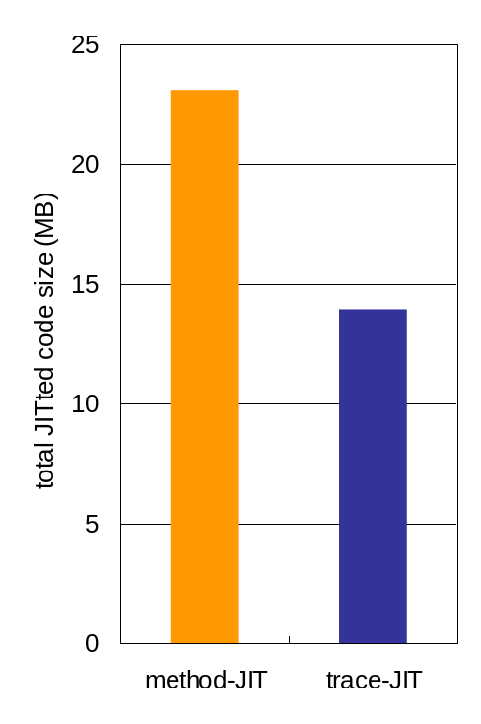
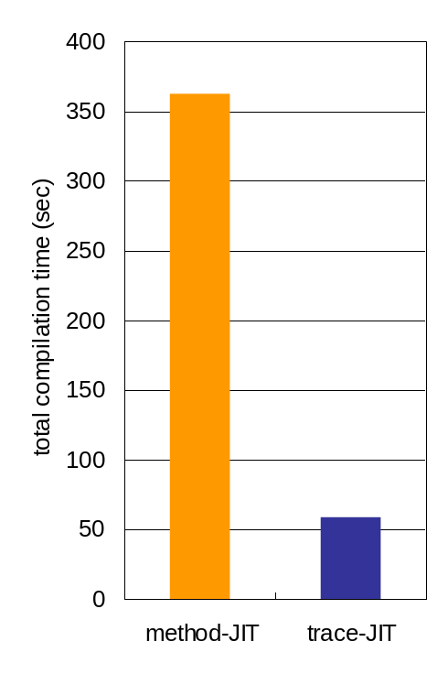
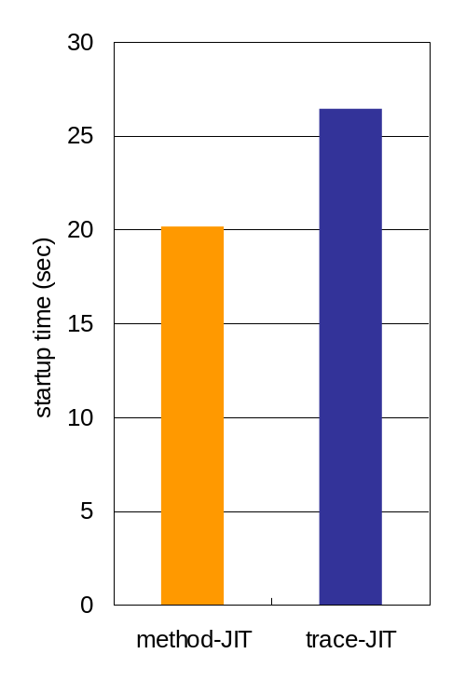
WAS/DayTrader performance
Peak performance
JITted code size
Compilation time
Startup time
higher is better
shorter is better
shorter is better
shorter is better
Base line method-JIT version: pap3260_26sr1-20110509_01(SR1))
Blade Center JS22, POWER6 4.0 GHz, 4 cores (8 threads), AIX 6.1
☹ Trace-JIT is about 10% slower than method-JIT in peak throughput
☺ Trace-JIT generates smaller code size with much shorter compilation time

Slide 17
Concluding Remarks & Future Directions
Significant advances are made in building real trace systems, but much less was understood about them
This work offers insights on how to identify common pitfalls of a class of trace selection algorithms and solutions to remedy them
Trace compilation vs. method compilation remains an over-arching open question

Slide 18
BACK UP

Slide 19
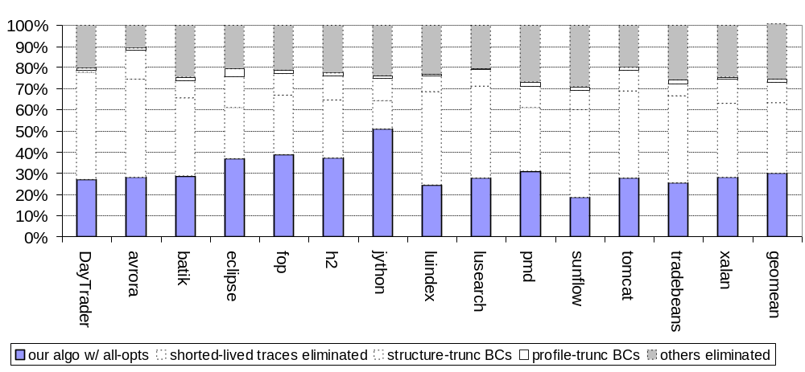
Breakdown of Source of Selection Footprint Reduction
Other reduction may come from better convergence of trace selection
Most footprint reduction comes from eliminating short-lived traces

Slide 20
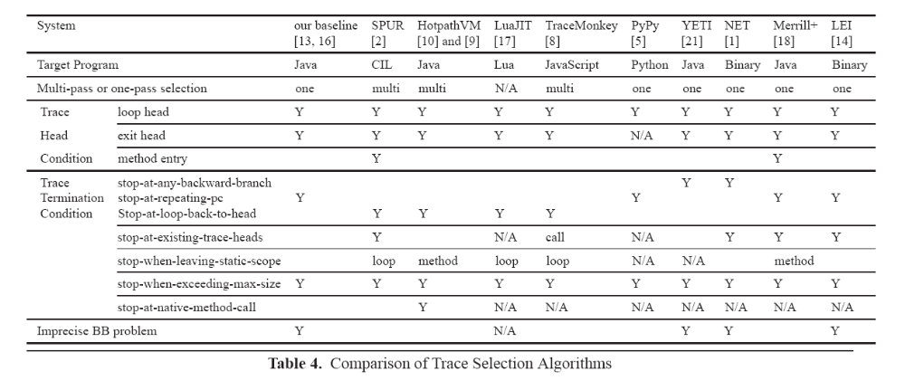
Our Related Work

