Slide 1
Improving Productivity With Fine-grain Compiler-based Checkpointing
Chuck (Chengyan) Zhao
Prof. Greg Steffan
Prof. Cristiana Amza
Allan Kielstra*
Dept. of Electrical and Computer Engineering
University of Toronto
IBM Toronto Lab*
Nov. 10, 2011

Slide 2


Productivity and Compilers
Programmer’s Productivity: important
  computers: fast, cheap
  programmers: slow (relatively), expensive
new way for compiler to help?
  automatic fine-grain checkpointing (CKPT)
  optimizations to reduce checkpoint overhead
applications of checkpointing
  accelerate bug-finding process
  automated support for backtracking algorithms
a compiler can improve programmer’s productivity via automatic CKPT
Notes:
Programmer is busy all the time thus can’t focus 8 *5 on finishing programming tasks. Even in the time spend in programming, debugging is a time consuming task, especially during the process of identifying the root cause of a bug. System may be busy and system conditions are not always predictable. This makes it difficult to repeat/reproduce a bug. Even more, it can take a long time from the beginning of the application till the bug-trigger location in the program, assuming everything else works fine.
Programmer’s time is previous, but computers are fast and relatively less expensive. Can we offload programmer’s burden to a fast computer to automate as much work as possible, and free the programmer from tedious details and thus better focus on figuring out the bug?
Our answer is yes, and the solution we are proposing is called: Compiler-based Software-only checkpointing.

Slide 3
Compiler Checkpointing (CKPT) Framework
C/C++
LLVM IR
Annotated
source
Enable
Checkpointing
Optimize
Checkpointing
Backend
Process
Source code
1. CKPT Inlining
LLVM frontend
2. Pre Optimize
x86
3. Redundancy Eliminations
Callsite Analysis
x64
4. Hoisting
Inter-procedural Transformations
…
5. Aggregation
6. Non Rollback Exposed Store Elimination
POWER
Intra-procedural Transformations
7. Heap Optimize
C/C++
8. Array Optimize
Special Cases Handling
9. Post Optimize
Notes:
Overview of Enable Checkpointing

Slide 4
compiler-based checkpointing basics
a:
b:
main memory
0
5
…
a = 5;
b = 7;
…
0
failure
recovery
7
(&a, 0)
(&b, 0)
checkpoint buffer
main program
Notes:
Mention this is undo checkpointing scheme where the contents in main memory will be modified directly

Slide 5
Transformations to Enable Checkpointing
start_ckpt(); …
backup(&a, sizeof(a));
a = …;
handleMemcpy(…);
memcpy(d, s, len);
foo_ckpt();
foo();
…
stop_ckpt(cond);
3 Steps:
Callsite analysis
Intra-procedural transformation
Inter-procedural transformation
foo(…){ /* body of foo() */}
foo_ckpt(…){
/* body of foo_ckpt() */ }…
Notes:
Say what the special conditional code (c) is !

Slide 6
Checkpointing Optimization Framework
1. CKPT Inlining
2. Pre Optimization
✓
3. Redundancy Eliminations (3 REs)
4. Hoisting
Optimize
Checkpointing
5. Aggregation
✓
6. Non Rollback Exposed Store Elimination
7. DynMem (Heap) Optimization
8. Array Optimization
9. Post Optimization

Slide 7

Redundancy Elimination Optimization
start_ckpt();
…
if (C){
backup(&a, sizeof(a));
a = …;
}
…
backup(&a, sizeof(a));
a = …;
…
backup(&a, sizeof(a));
a = …;
…
…
stop_ckpt(cond);
Algorithm
establish dominating relationship
  stop_ckpt() marker
promote leading backup call
re-establish dominating relationship
  among backup calls
eliminate all non-leading backup call(s)
dom
dom
RE1: remove all non-leading backup call(s)
Notes:
Redundancy Elimination-1

Slide 8
Definition: Rollback Exposed Store
int a, b;
…
start_ckpt();
…
b = … a op …;
…
backup(&a, sizeof(a));
a = …;
…
…
stop_ckpt(cond);
Rollback Exposed Store:
a store to a location with a possible previous load of that location
must backup 'a' because the prior load of 'a' must access the
"old" value on rollback---i.e., 'a' is "rollback exposed"
Rollback Exposed Store needs backup
Notes:
NRESE Optimization

Slide 9
Non-Rollback Exposed Store Elimination (NRESE)
int a, b;
…
start_ckpt();
…
…
backup(&a, sizeof(a));
a = …;
…
…
stop_ckpt(cond);
Algorithm Description
no use of the address (&a) on any path
the backup address (&a) isn’t aliased to anything
  empty points-to set
no prior use of 'a', hence it is non-rollback-exposed
we can eliminate the backup of 'a'
NRESE is a new, checkpoint-specific optimization
Notes:
NRESE Optimization

Slide 10
Applications
Notes:
Just a separator

Slide 11
App1: CKPT enabled debugging
T: safe point, literally earlier than P, the program can reach through checkpoint recovery
Key benefits
  execution rewinding
  arbitrarily large region
  unlimited # of retries
  no restart from beginning
CKPT Region
P: root cause of a bug
Q: place where the bug manifests
(a user or programmer notices the bug at this point)
Notes:
CKPT-Support for Debugging

Slide 12

App2: CKPT enabled backtracking
T: pick a pair of blocks to swap
Key benefits
  automate support for backtracking
    backup actions
    abort
    commit
  cover arbitrarily complex algorithm
  cleaner code, simplify programming
    programmer focus on algorithm
CKPT Region
Proceed with VPR’s random/simulated-annealing based algorithm
Q: keep swap if improvement, discard otherwise
Notes:
CKPT-Support for VPR: say something about VPR
Versatile Placement and Routing algorithm: randomly generated simulated annealing
It randomly selects 2 blocks and swap them, then evaluate the result of the swap. If it ends up with improvement, it keeps the swap, otherwise, discard it.
The process continues until a pre-defined precision or error rate is reached.

Slide 13
Evaluation

Slide 14

Platform and Benchmarks
Evaluation Platform
  Core i7 920, 12GB DDR3, 200GB SATA
  Debian6-i386, gcc/g+-4.4.5
  LLVM-2.9
Benchmarks
  BugBench: 1.2.0
    5 programs with buffer-overflow bugs
    3 CKPT regions per program: Small . Medium . Large
  VPR: 5.0.2
    FPGA CAD tool, 1 CKPT region
CKPT Comparison
  libCKPT: U. Tennessee
  ICCSTM: Intel ICC based STM

Slide 15
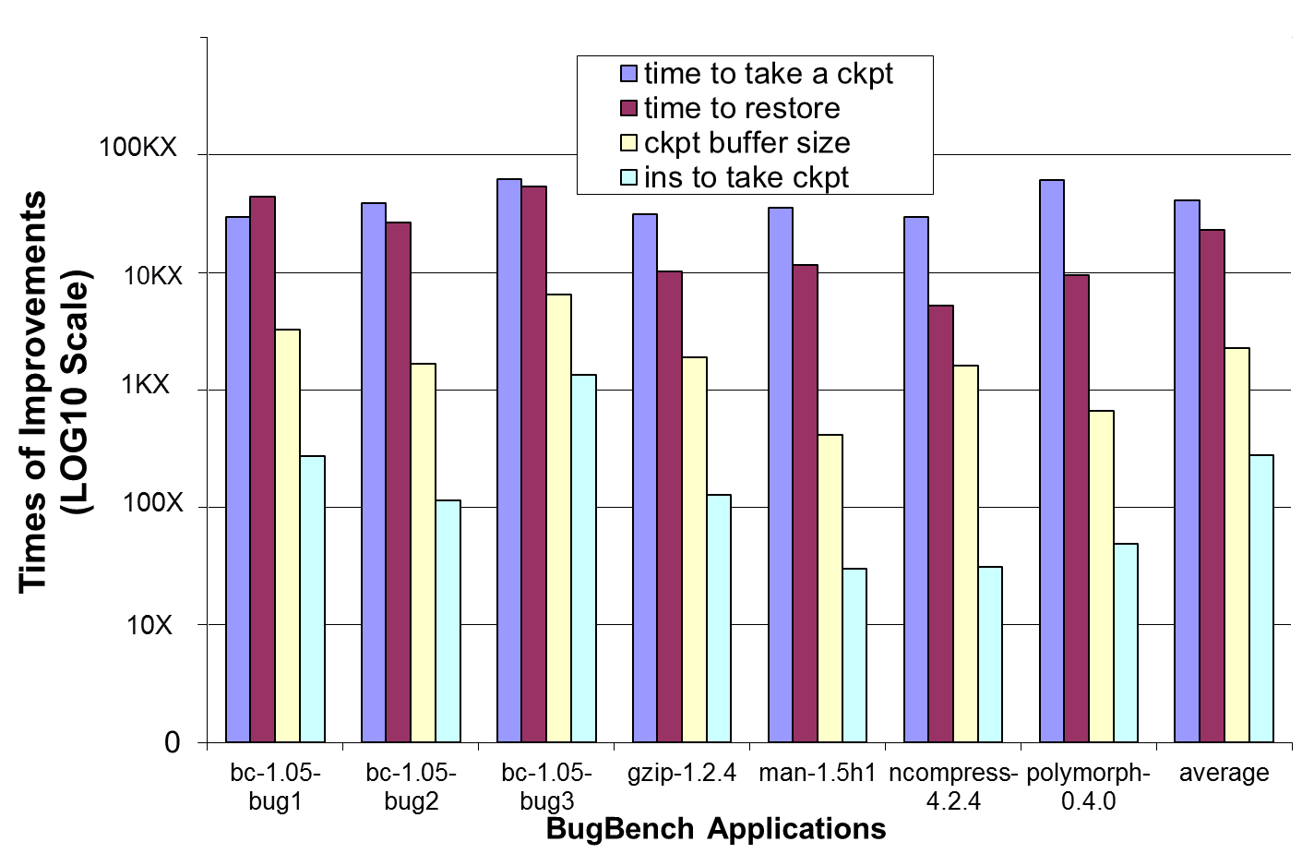
Compare with Coarse-gain Scheme: libCKPT
HUGE gain over coarse-grain libCKPT

Slide 16
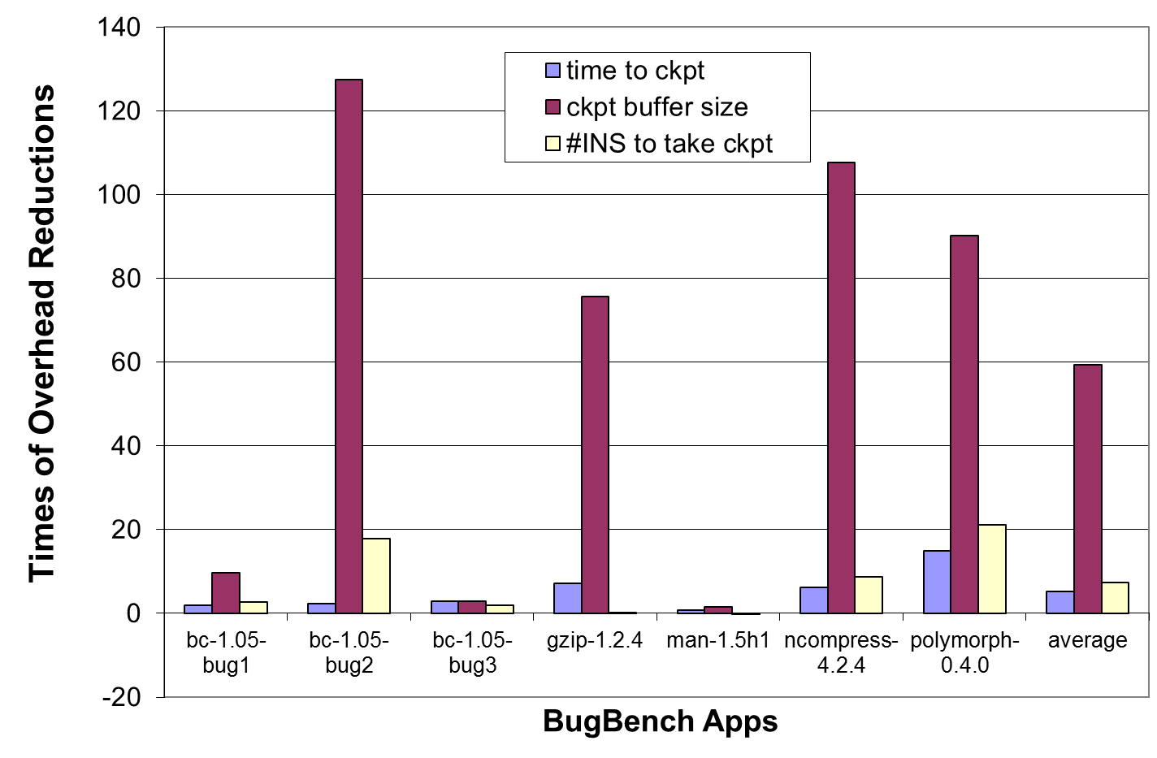
Compare with Fine-gain Scheme: ICCSTM
better than best-known fine-grain ICCSTM

Slide 17
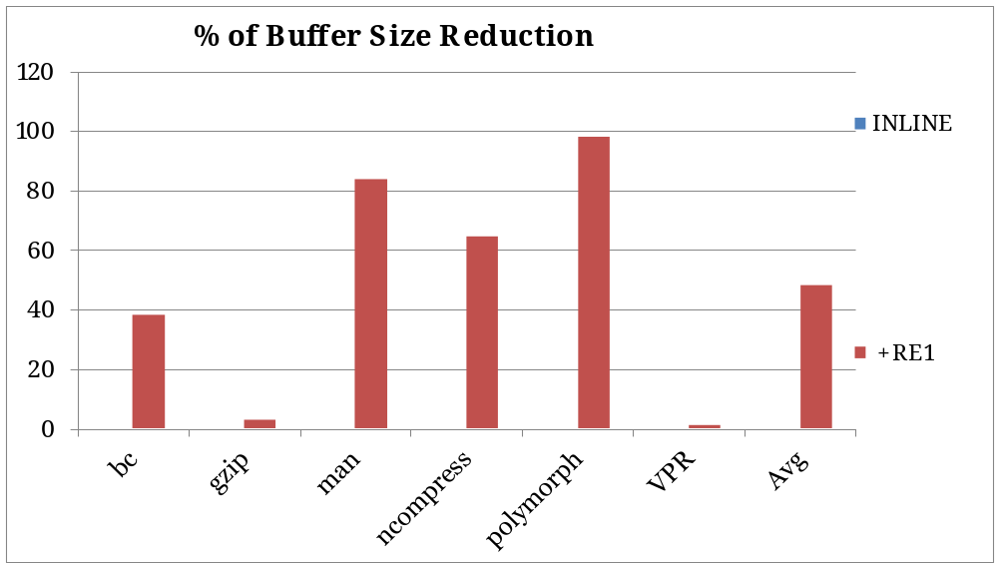
RE1 Optimization: buffer size reduction
%
%
%
%
%
RE1 is the single most-effective optimization
Notes:
% of Buffer Size Reduction: L region, Inline + RE1 only
L Region separated optimization effects: Inline + RE1 only

Slide 18
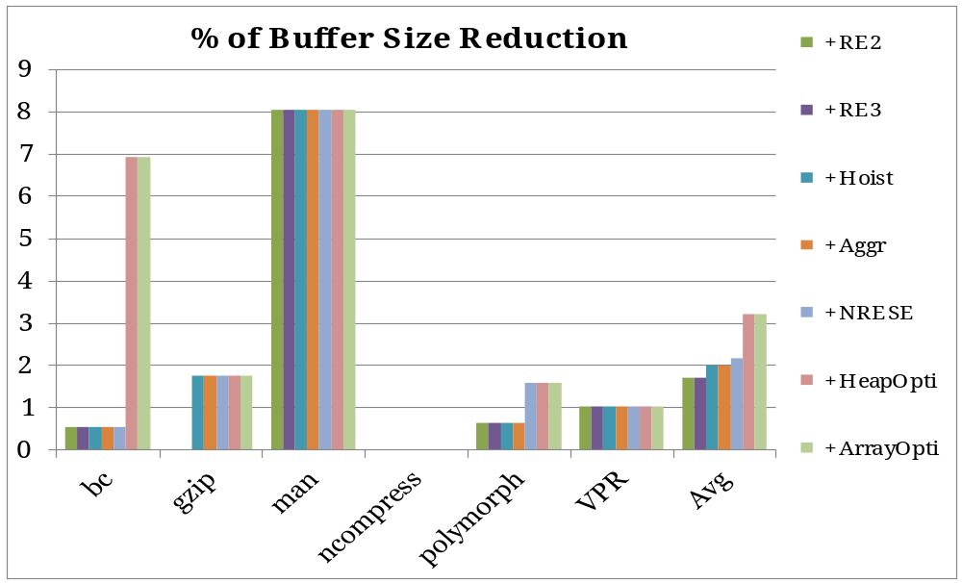
Post RE1 Optimization: buffer size reduction
%
%
%
%
%
%
%
%
%
Other optimizations also contribute
Notes:
% of Buffer Size Reduction: L region, all optimizations other than Inline + RE1 only
L Region separated optimization effects: all optimizations other than Inline + RE1 only

Slide 19


Conclusion
CKPT Optimization Framework
  compiler-driven
  automatic
  software-only
  compiler analysis and optimizations
  100-1000X less overhead: over coarse-grain scheme
  4-50X improvement: over fine-grain scheme
CKPT-supported Apps
  debugger: execution rewind in time
    up to: 98% of CKPT buffer size reduction
    up to: 95% of backup call reduction
  VPR: automatic software backtracking
    only 15% CKPT overhead

Slide 20
Questions and Answers
?

Slide 21
Algorithm: Redundancy Elimination 1
Build dominating relationship (DOM) among backup calls
Identify leading backup call
Promote suitable leading backup call
Remove non-leading backup call(s)

Slide 22
Algorithm: NRESE
Backup address is NOT aliased to anything
  points-to set is empty
AND
On any path from begin of CKPT to the respective write, there is no use of the backup address
  the value can be independently re-generated without the need of it self

Slide 23
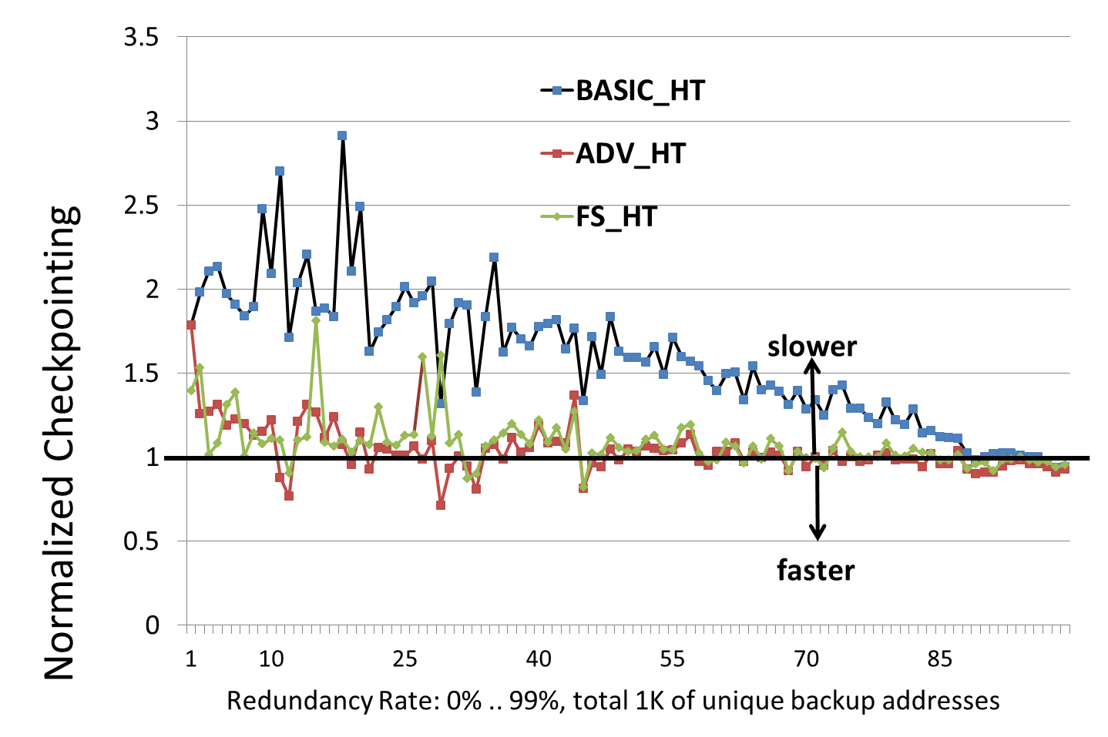
1D array vs. Hash Tables Buffer Schemes

Slide 24
Compare with Coarse-gain Scheme: libCKPT
100KX
10KX
1KX
100X
10X
HUGE gain over coarse-grain libCKPT
Notes:
CKPT Overhead Reduction: libCKPT vs. Our CKPT

Slide 25
Compiler Checkpointing (CKPT) Framework
C/C++
LLVM IR
Annotated
source
Enable
Checkpointing
Optimize
Checkpointing
Backend
Process
Source code
1. CKPT Inlining
2. Pre Optimize
x86
3. Redundancy Eliminations
x64
4. Hoisting
…
5. Aggregation
6. Non Rollback Exposed Store Elimination
Power
7. Heap Optimize
C/C++
8. Array Optimize
9. Post Optimize
Notes:
Overview of the checkpointing framework
Figure out: how to make the same group appear and then disappear (must be doable in PPT 2010).

Slide 26
CKPT Enabled Debugging
Key benefits
  execution rewinding
  arbitrarily large region
  unlimited # of retries
  no restart

Slide 27
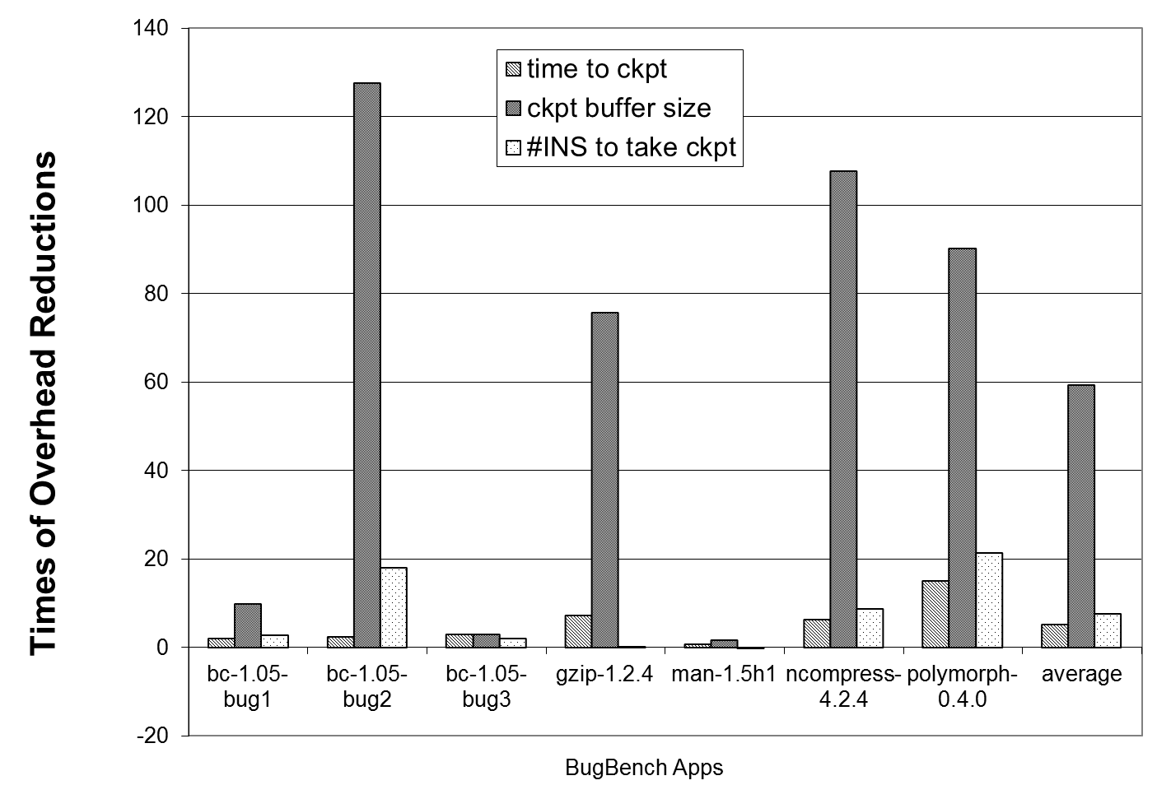
Compare with Fine-gain Scheme: ICCSTM
better than best-known fine-grain solution

Slide 28
Redundancy Elimination Optimization 1
start_ckpt();
…
backup(&a, sizeof(a));
a = …;
…
backup(&a, sizeof(a));
a = …;
…
if (C){
backup(&a, sizeof(a));
a = …; …
}
…
…
stop_ckpt(c);
Algorithm
establish dominating relationship
  among backup calls
promote leading backup call
eliminate all non-leading backup call(s)
D
RE1: keep only dominating backup call
Notes:
Redundancy Elimination-1

Slide 29
CKPT Support for Automatic Backtracking (VPR)
initial guess
✓
obtain a new result (manual CKPT)
check result
good
bad
✓
commit and continue
abort and try next
✓
…
CKPT automates the process, regardless of backtracking complexity

Slide 30
✗
✓

Slide 31
Key benefits
  automate support for backtracking
    backup actions
    abort
    commit
  cover arbitrarily complex algorithm
  cleaner code, simplify programming
    programmer focus on algorithm

Slide 32
App2: CKPT enabled backtracking
Key benefits
  automate support for backtracking
    backup actions
    abort
    commit
  cover arbitrarily complex algorithm
  cleaner code, simplify programming
    programmer focus on algorithm
Initial Guess
Evaluate (manual CKPT)
bad
good
Commit Data
Reset Data
✓
✓
✓
stop condition reached
Finish

Slide 33
Key benefits
  automate CKPT process
    backup actions
    abort
    commit
  cover arbitrarily complex algorithm
  simplify programming
    programmer focus on algorithm

Slide 34
1. CKPT Inlining
2. Pre Optimize
3. Redundancy Eliminations
4. Hoisting
5. Aggregation
6. Non Rollback Exposed Store Elimination
7. Heap Optimize
8. Array Optimize
9. Post Optimize
Notes:
CKPT Optimization Pipeline

Slide 35
How Can A Compiler Help Checkpointing?
Enable CKPT
  compiler transformations
Optimize CKPT
  do standard optimizations apply?
  support CKPT-specific optimizations?
CKPT Uses
  debugging
  backtracking
Notes:
Say we will follow this as the guideline for the rest of the talk

Slide 36
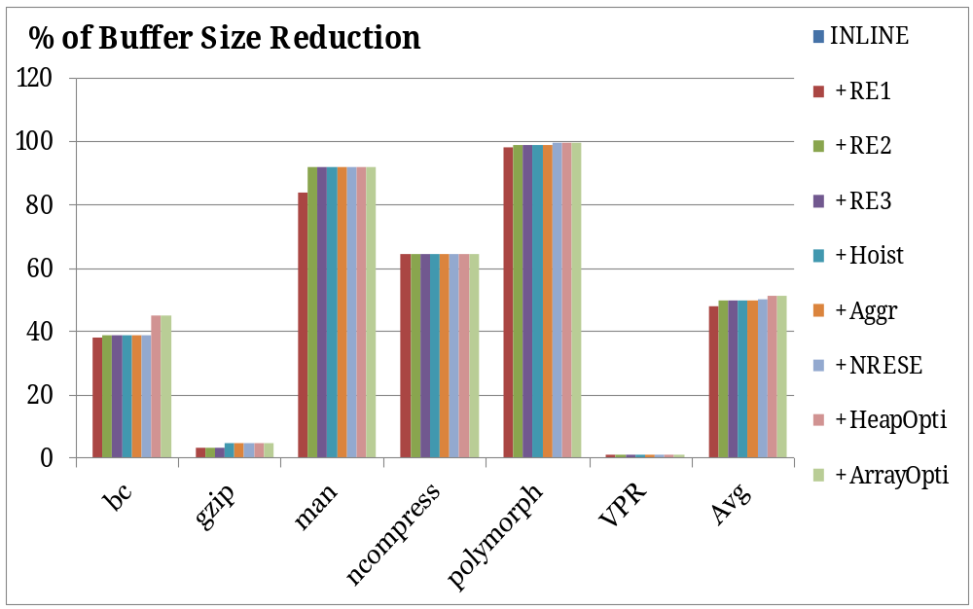
Optimization: buffer size reduction
%
%
%
%
%
up to 98% of CKPT buffer size reduction
Notes:
Say: it is the optimization results on L(arge) Region (Partition) of our application suites
Inline is an enablement optimization, but it doesn’t have an impact on the optimization result
RE1 is the most effective (removing most of the redundancy)
There is never any negative effect from the optimizations (bar graph never goes downwards)

