Slide 1
Exceptions:
Not so rare as you'd think
--Handling Exception Faster
Chao Chen, Nikola Grcevski
(IBM Canada)

Slide 2
Table of Contents
Exception Handling
Performance weight
Exception Thrown Pattern
Caching
Results
Extend the Idea
Notes:
First I am going to talk about exception handling, how it is usually written by java developer and how it is handled by JVM, we than talk about the performance weight of exception handling in the execution of JVM. We will also talk about some execution pattern of the exception in Java code, which leads to our exploit of adding caches to it. Then, we will show some result improvements and Finally, we will talk about how we could extend the idea and make it applicable to other part of the JVM

Slide 3
Exception Handling
Benefit
Elegant error handling
Efficient control flow
Problem
Increase the complexity of JVM runtime
Consume processing resources
Notes:
Java provides an exception handling mechanism for elegant error handling
It is also some time used for control flow purpose
The problem is also very obvious, the complexity of JIT compiler is increased
Also, servicing the handling mechanism can consume nontrivial amount of processing power

Slide 4
Exception Handling – How it is written
foo {
try{
boo()
}
catch(userDefinedException e){
//do something else
}
try{
bar()
}
catch(userDefinedException e){
//do something
}
}
bar throws userDefinedException {
try{
baz()
}
catch(IOException e){
//do something else
}
}
baz throws userDefinedException{
throw new userDefinedException()
}
Notes:
We first have a foo method, who call bar, than baz, who through an exception
There are three handlers here,
one in bar that has the correct handling range, but doesn’t handle the correct type
Another one up in foo who handles correct exception, but the range does not cover our exception
So only this final handler can handle the userDefinedException we throw

Slide 5
Use exception handling for control flow
A {
//try something
try{
B1()
}
catch(goBackToA e){
return
}
//try something else
try{
C1()
}
catch(goBackToA e){
return
}
}
B1 throws goBackToA {
try{
B2()
}
catch(IOException e){
//do something else
}
}
B100 throws goBackToA{
throw new goBackToA()
}
……

Slide 6
Exception Handling – How it is done
Each frame has a list for all exception handler in this frame
Each element on the list contain two key information
  Exception type being handled
  The exception handling range

Slide 7
Exception Handling – How it is done cont.
When exception is being thrown, the current frame’s exception handler table is walked
The PC of throwing point will be checked against the handling range, if match, the handler type is checked
If both matched, the handler will be called
If none in the list match, we go up one frame and do the same
Notes:
When exception is being thrown, the current frame’s exception handler is walked
The PC of throwing point will be checked against the handling range, if match, the handler type is checked
If both matched, the handler will be called
If none in the list match, we go up one frame and do the same
Finally, of course, if no handler is found, we got to top and the exception is handled by the JVM which will print out a message

Slide 8
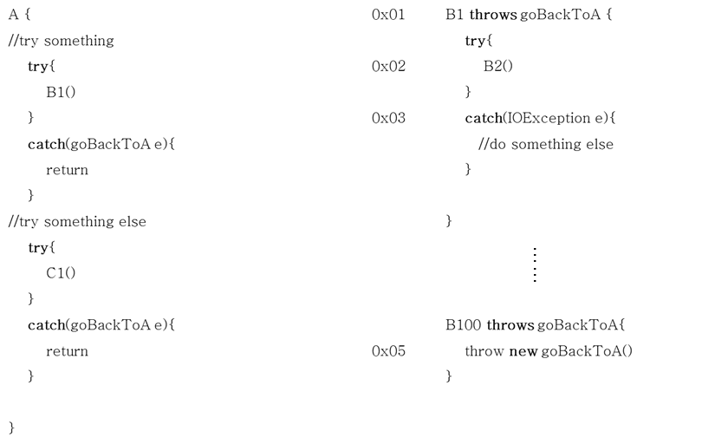
Exception Handling – How it is done cont.
Notes:
Walk through the current frame’s exception handler table

Slide 9
Exception truly exceptional?
Weight of CPU ticks used for exception handling:
Takes about 2% of Running time in SPECJVM98 jack
Takes up to 45% in real life programing scenario if program uses exception handling to control program execution flow
Notes:
The user case is to read from an input stream and then throw an exception when a sought pattern occurs
A Java parser generator that is based on the Purdue Compiler Construction Tool Set (PCCTS). This is an early version of what is now called JavaCC
workload consists a file named jack.jack
contains instructions for the generation of jack itself.
fed to jack so that the parser generates itself multiple times.

Slide 10
Performance penalty
Finding the handler table is not easy!
  Each frame can have a lot of handlers
  Handlers table don’t have an order
Notes:
No matter what structure we use, it is utimilty going to be slow since we can’t do any binary search

Slide 11
Exception Thrown Pattern
Evidence has shown that an exception in a thread is usually either not thrown, or thrown often
If it is thrown often, it is usually handled by the same handler
How to exploit this pattern?
Notes:
Evidence has shown that an exception in a thread is usually either not thrown, or thrown often
If it is thrown often, it is usually handled by the same handler
When ever we have patterns in code, we can exploit it.

Slide 12
Speed up with cache
Exploit temporary locality
A cache to help speed up frame walk
Implement in hash table
If an exception handler is not found in a frame, it will be cached
Cache is first queried before exception table is searched
If an entry is found, than the frame is skipped in search

Slide 13
Negative cache
The cache stores which frame has no handler for the exception
Why?
  Handling exception require a lot of data structure
  Cache footprint might be big
  Fast to go through frames

Slide 14
Speed Up with Cache – First Pass
Hash Table
key | PC | Exception
0
1 | 0x5 | goBackToA
2 | 0x2 | goBackToA
3
key | PC | Exception
key | PC | Exception
0
1 | 0x5 | goBackToA
2
3
Hash function:
key=PC%4

Slide 15
Speed Up with Cache – Second Pass
Hash Table
key | PC | Exception
0
1 | 0x5 | goBackToA
2 | 0x2 | goBackToA
3
Hash function:
key=PC%4

Slide 16
Single or multiple cache?
Single cache for all threads
  Pros: Smaller cache footprint
  Cons: irrelevant behavior from different threads destroy cache
One cache per thread
  Pros: One thread is usually dedicated for a single task, yield better exception handling prediction through cache.
  Cons: bigger struct sizes, footprint
Notes:
Single Thread:
Pros: no synchronization issue, easy to modify and clear cache
Cons: irrelevant behavior from different threads destroy cache
Multi Thread:
Pros: One thread is usually dedicated for a single task, yield better exception handling prediction through cache.
Cons: synchronization issue, require lock at clean up
Multi thread is chosen since clean up doesn’t matter

Slide 17
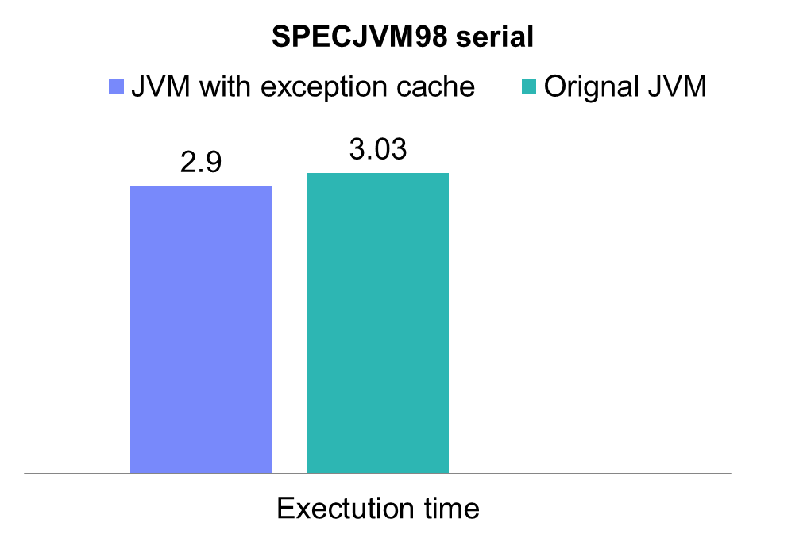
Results
The SPECjvm 98
lower is better
SPECjvm98 is a trademark of Standard Performance Evaluation Corporation.
All tests conducted on a Intel(R) Xeon(R) CPU X5660 @ 2.80GHz machine running RHEL 2.6.27.54 with 24 GB memory
Notes:
Higher is better

Slide 18
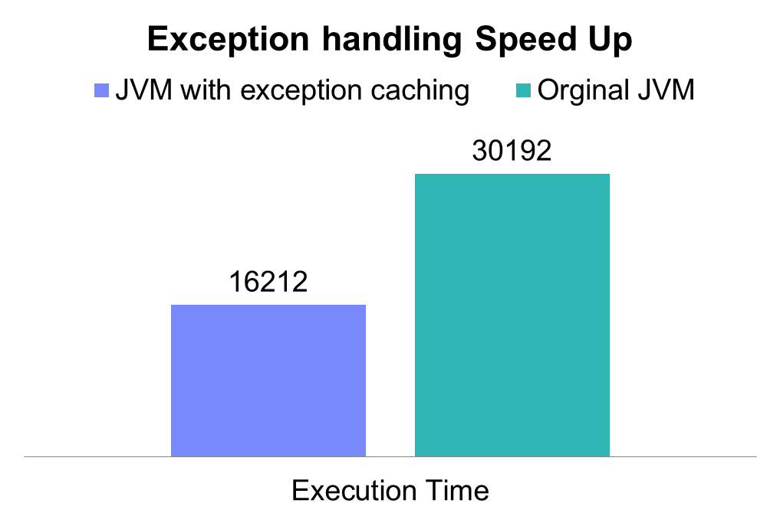
Results
Scenario when program uses exception handling to control program execution flow
lower is better
All tests conducted on a Intel(R) Xeon(R) CPU X5660 @ 2.80GHz machine running RHEL 2.6.27.54 with 24 GB memory

Slide 19
Conclusion
Our presentation have described how exception can be speed up within a production runtime system by adding a small hash table that caches the result of recent queries
Extend the Idea
  Exception handling is only one example of many large data structures allocated and used by Java runtime

Slide 20
Questions

