Slide 1
Compiler Scheduling for a Wide-Issue Multithreaded FPGA-Based Compute Engine
Ilian Tili
Kalin Ovtcharov, J. Gregory Steffan (University of Toronto)

Slide 2
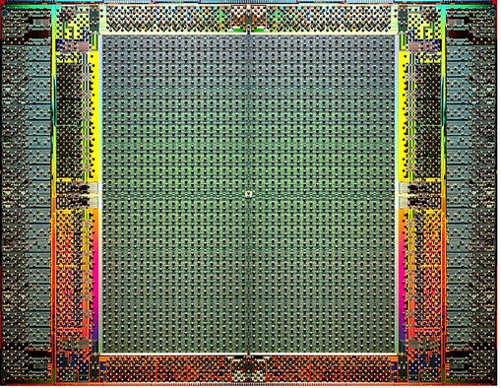
What is an FPGA?
FPGA = Field Programmable Gate Array
Eg., a large Altera Stratix IV: 40nm, 2.5B transistors
820K logic elements (LEs), 3.1Mb block-RAMs, 1.2K multipliers
High-speed I/Os
Can be programmed to implement any circuit

Slide 3

IBM and FPGAs
DataPower
FPGA-accelerated XML processing
Netezza
Data warehouse appliance; FPGAs accelerate DBMS
Algorithmics
Acceleration of financial algorithms
Lime (Liquid Metal)
Java synthesized to heterogeneous (CPUs, FPGAs)
HAL (Hardware Acceleration Lab)
IBM Toronto; FPGA-based acceleration
New: IBM Canada Research & Development Centre
One (of 5) thrust on “agile computing”
SURGE IN FPGA-BASED COMPUTING!

Slide 4
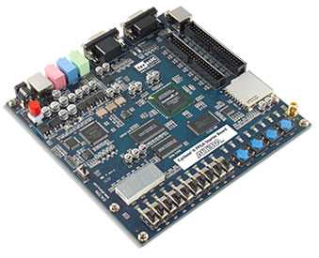
FPGA Programming
Requires expert hardware designer
Long compile times
up to a day for a large design
-> Options for programming with high-level languages?

Slide 5
Option 1: Behavioural Synthesis
Hardware
OpenCL
Mapping high-level languages to hardware
Eg., liquid metal, ImpulseC, LegUp
OpenCL: increasingly popular acceleration language

Slide 6

Option 2: Overlay Processing Engines
ENGINE
OpenCL
Quickly reprogrammed (vs regenerating hardware)
Versatile (multiple software functions per area)
Ideally high throughput-per-area (area efficient)

Slide 7
Option 2: Overlay Processing Engines
ENGINE
ENGINE
ENGINE
OpenCL
ENGINE
ENGINE
ENGINE
Quickly reprogrammed (vs regenerating hardware)
Versatile (multiple software functions per area)
Ideally high throughput-per-area (area efficient)
-> Opportunity to architect novel processor designs

Slide 8
Option 3: Option 1 + Option 2
ENGINE
Synthesis
OpenCL
ENGINE
HARDWARE
Engines and custom circuit can be used in concert

Slide 9
This talk: wide-issue multithreaded overlay engines
Pipeline
Functional Units

Slide 10
This talk: wide-issue multithreaded overlay engines
Variable latency FUs
add/subtract, multiply, divide, exponent (7,5,6,17 cycles)
Deeply-pipelined
Multiple threads
Pipeline
Functional Units

Slide 11
This talk: wide-issue multithreaded overlay engines
Storage & Crossbar
?
Variable latency FUs
add/subtract, multiply, divide, exponent (7,5,6,17 cycles)
Deeply-pipelined
Multiple threads
Pipeline
Functional Units

Slide 12
This talk: wide-issue multithreaded overlay engines
Storage & Crossbar
?
Variable latency FUs
add/subtract, multiply, divide, exponent (7,5,6,17 cycles)
Deeply-pipelined
Multiple threads
Pipeline
Functional Units
-> Architecture and control of storage+interconnect to allow full utilization

Slide 13
Our Approach
?
Avoid hardware complexity
Compiler controlled/scheduled
Explore large, real design space
We measure 490 designs
Future features:
Coherence protocol
Access to external memory (DRAM)

Slide 14
Our Objective
Find Best Design
Fully utilizes datapath
Multiple ALUs of significant and varying pipeline depth.
Reduces FPGA area usage
Thread data storage
Connections between components
Exploring a very large design space

Slide 15
Hardware Architecture Possibilities

Slide 16
Single-Threaded Single-Issue
Multiported Banked Memory
T0
T0
T0
X
Pipeline
X
X
Stalls
X
X
T0
-> Simple system but utilization is low

Slide 17
Single-Threaded Multiple-Issue
Multiported Banked Memory
T0
T0
T0
T0
T0
X
X
X
X
X
X
X
X
Pipeline
X
X
T0
T0
T0
X
T0
X
X
T0
-> ILP within a thread improves utilization but stalls remain

Slide 18
Multi-Threaded Single-Issue
Multiported Banked Memory
T0
T1
T2
T3
T4
T0
T1
T2
Pipeline
T3
T4
T0
T1
T2
-> Multi threading easily improves utilization
Notes:
No stalls

Slide 19
Our Base Hardware Architecture
Multiported Banked Memory
T0
T1
T2
T3
T4
Pipeline
-> Supports ILP and TLP
Notes:
The hardware architecture consists of deeply pipelined Arithmetic Logic Units (ALUs), interconnect fabric for sharing data
between ALUs, memory banks used to store independent thread data, as well as instruction memory, decode and control blocks as seen in Figure 1. All aspects of the hardware architecture are parameterizable to allow the creation of a variety of architectures that can be used to evaluate hardware efficiency. The number of ALUs to instantiate will ultimately be guided by the compiler after static analysis of the application code and knowledge of hardware area cost drives the creation of an efficient architecture for that particular application.
what's the best combination of ILP and TLP to use? Here the challenge is that on an FPGA having a large multiported memory is a challenge to build.

Slide 20
TLP Increase
Memory
T0
T1
T2
T3
T4
T5
Adding TLP
-> Utilization is improved but more storage banks required

Slide 21
ILP Increase
Memory
T5
T0
T1
T2
T3
T4
T5
Adding ILP
-> Increased storage multiporting required

Slide 22
Design space exploration
Vary parameters
ILP
TLP
Functional Unit Instances
Measure/Calculate
Throughput
Utilization
FPGA Area Usage
Compute Density

Slide 23
Compiler Scheduling
(Implemented in LLVM)

Slide 24
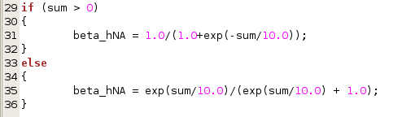
Compiler Flow
C code

Slide 25
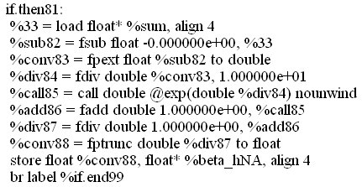
Compiler Flow
C code
LLVM
1
IR code

Slide 26
Compiler Flow
C code
LLVM
1
Data Flow Graph
IR code
LLVM Pass
2

Slide 27
Data Flow Graph
7
5
5
6
7
6
Each node represents an arithmetic operation (+,-, * , /)
Edges represent dependencies
Weights on edges – delay between operations

Slide 28
Initial Algorithm: List Scheduling
Cycle | + , - | * | /
1
2
3
4
Find nodes in DFG that have no predecessors or whose predecessors are already scheduled.
Schedule them in the earliest possible slot.
[M. Lam, ACM SIGPLAN, 1988]

Slide 29
Initial Algorithm: List Scheduling
Cycle | + , - | * | /
1 | A | B | G
2 |  | F | C
3
4
Find nodes in DFG that have no predecessors or whose predecessors are already scheduled.
Schedule them in the earliest possible slot.
[M. Lam, ACM SIGPLAN, 1988]

Slide 30
Initial Algorithm: List Scheduling
Cycle | + , - | * | /
1 | A | B | G
2 |  | F | C
3
4
Find nodes in DFG that have no predecessors or whose predecessors are already scheduled.
Schedule them in the earliest possible slot.
[M. Lam, ACM SIGPLAN, 1988]

Slide 31
Initial Algorithm: List Scheduling
Cycle | + , - | * | /
1 | A | B | G
2 | D | F | C
3 |  |  | H
4
Find nodes in DFG that have no predecessors or whose predecessors are already scheduled.
Schedule them in the earliest possible slot.
[M. Lam, ACM SIGPLAN, 1988]

Slide 32
Operation Priorities
 | Add | Sub
1 | Op1 | Op3
2
3 | Op2
4
5 | Op4
6
7 |  | Op5
ASAP

Slide 33
Operation Priorities
 | Add | Sub
1 | Op1 | Op3
2
3 | Op2
4
5 | Op4
6
7 |  | Op5
 | Add | Sub
1 | Op1
2
3 | Op2
4
5 | Op4 | Op3
6
7 |  | Op5
ASAP
ALAP

Slide 34
Operation Priorities
 | Add | Sub
1 | Op1 | Op3
2
3 | Op2
4
5 | Op4
6
7 |  | Op5
 | Add | Sub
1 | Op1 | Op3
2
3 | Op2
4
5 | Op4 | Op3
6
7 |  | Op5
Mobility
ASAP
ALAP
Mobility = ALAP(op) – ASAP(op)
Lower mobility indicates higher priority
[C.-T. Hwang, et al, IEEE Transactions, 1991]

Slide 35
Scheduling Variations
Greedy
Greedy Mix
Greedy with Variable Groups
Longest Path

Slide 36
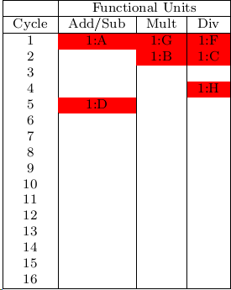
Greedy
Schedule each thread fully
Schedule next thread in remaining spots

Slide 37
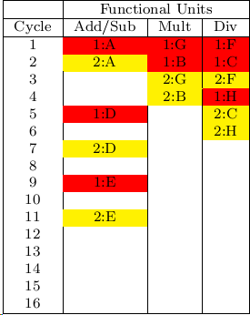
Greedy
Schedule each thread fully
Schedule next thread in remaining spots

Slide 38
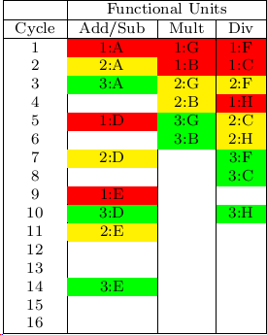
Greedy
Schedule each thread fully
Schedule next thread in remaining spots

Slide 39
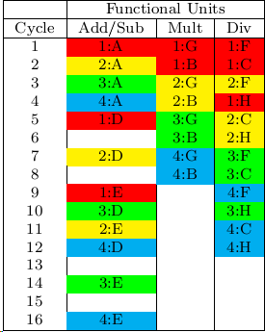
Greedy
Schedule each thread fully
Schedule next thread in remaining spots

Slide 40
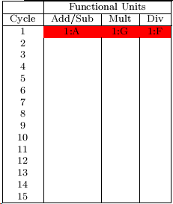
Greedy Mix
Round-robin scheduling across threads

Slide 41
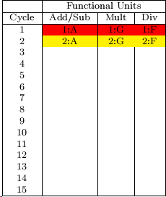
Greedy Mix
Round-robin scheduling across threads

Slide 42
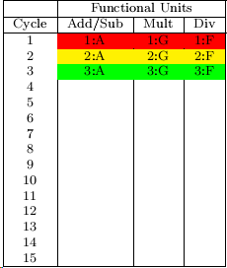
Greedy Mix
Round-robin scheduling across threads

Slide 43
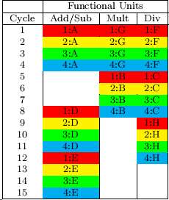
Greedy Mix
Round-robin scheduling across threads

Slide 44
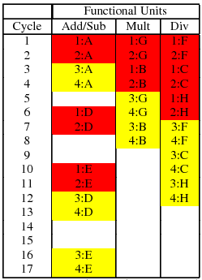
Greedy with Variable Groups
Group = number of threads that are fully scheduled before scheduling the next group

Slide 45
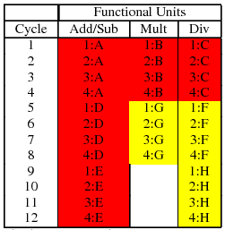
Longest Path
Longest Path Nodes
Rest of Nodes
First schedule the nodes in the longest path
Use Prioritized Greedy Mix or Variable Groups
[Xu et al, IEEE Conf. on CSAE, 2011]

Slide 46
All Scheduling Algorithms
Greedy
Greedy Mix
Variable Groups
Longest Path
Longest path scheduling can produce a shorter schedule than other methods

Slide 47
Compilation Results

Slide 48
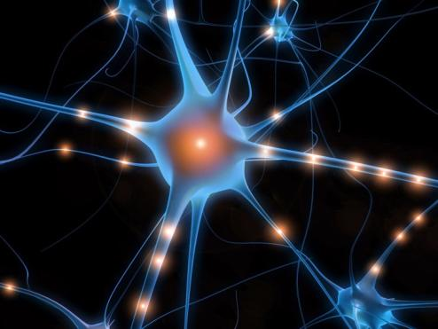
Sample App: Neuron Simulation
Hodgkin-Huxley
Differential equations
Computationally intensive
Floating point operations:
Add, Subtract, Divide, Multiply, Exponent

Slide 49
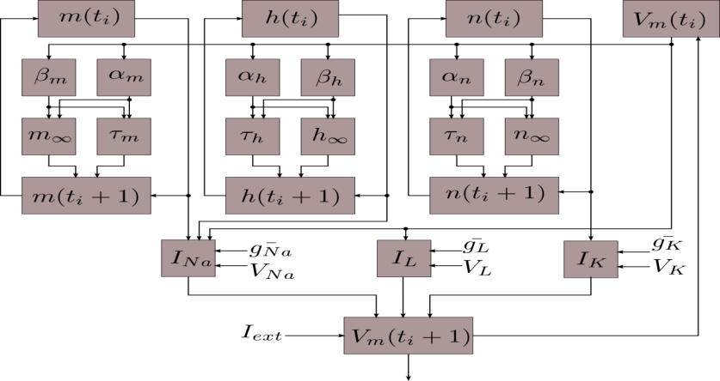
Hodgkin-Huxley
High level overview of data flow

Slide 50
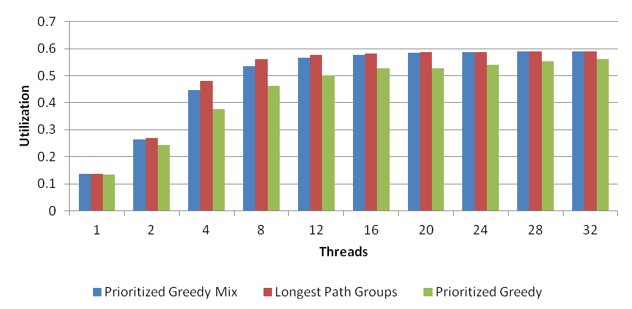
Schedule Utilization
-> No significant benefit going beyond 16 threads -> Best algorithm varies by case

Slide 51
Design Space Considered
T0
Add/Sub
Mult
Div
Exp
Varying number of threads
Varying FU instance counts
Using Longest Path Groups Algorithm

Slide 52
Design Space Considered
T0
T1
T2
T3
Add/Sub
Mult
Div
Exp
Add/Sub
Varying number of threads
Varying FU instance counts
Using Longest Path Groups Algorithm

Slide 53
Design Space Considered
T0
T1
T2
T3
T4
Add/Sub
Mult
Div
Exp
Add/Sub
Mult
Varying number of threads
Varying FU instance counts
Using Longest Path Groups Algorithm

Slide 54
Design Space Considered
T0
T1
T2
T3
T4
T5
T6
Add/Sub
Mult
Div
Exp
Add/Sub
Mult
Div
Add/Sub
Maximum 8 FUs in total
Varying number of threads
Varying FU instance counts
Using Longest Path Groups Algorithm
-> 490 designs considered

Slide 55
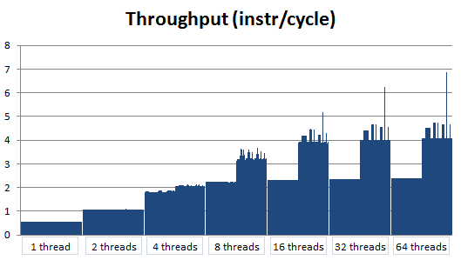
Throughput vs num threads
Throughput depends on configuration of FU mix and number of threads
IPC

Slide 56
Throughput vs num threads
Throughput depends on configuration of FU mix and number of threads
3-add/2-mul/2-div/1-exp
IPC

Slide 57
Real Hardware Results

Slide 58
Methodology
Design built on FPGA
Altera Stratix IV (EP4SGX530)
Quartus 12.0
Area = equivalent ALMs
Takes into account BRAM (memory) requirement
IEEE-754 compliant floating point units
Clock Frequency at least 200MHz

Slide 59
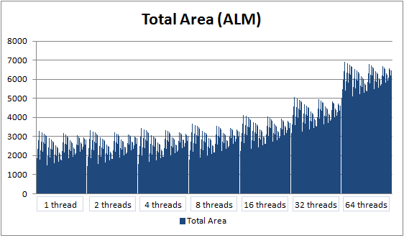
Area vs threads
(eALM)
Area depends on instances of FU and num threads
eALM

Slide 60
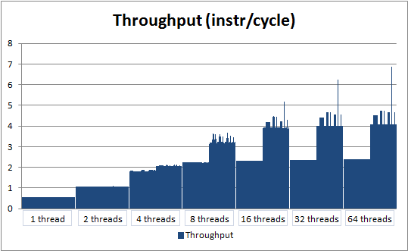
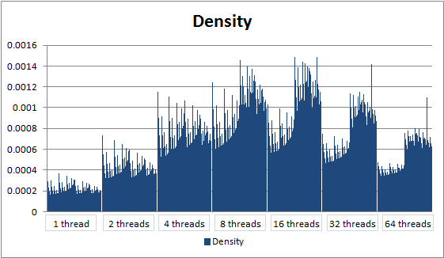
Compute Density
Compute Density =
(instr/cycle/area)
=

Slide 61
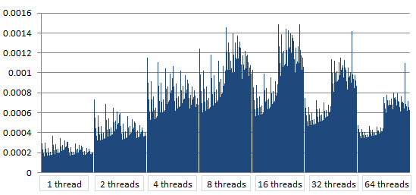
Compute Density
Balance of throughput and area consumption

Slide 62
Compute Density
2-add/1-mul/1-div/1-exp
3-add/2-mul/2-div/1-exp
Balance of throughput and area consumption

Slide 63
Compute Density
2-add/1-mul/1-div/1-exp
3-add/2-mul/2-div/1-exp
Best configuration at 8 or 16 threads.

Slide 64
Compute Density
2-add/1-mul/1-div/1-exp
3-add/2-mul/2-div/1-exp
Less than 8 – not enough parallelism

Slide 65
Compute Density
2-add/1-mul/1-div/1-exp
3-add/2-mul/2-div/1-exp
More than 16 – too expensive

Slide 66
Compute Density
2-add/1-mul/1-div/1-exp
3-add/2-mul/2-div/1-exp
FU mix is crucial to getting the best density

Slide 67
Compute Density
2-add/1-mul/1-div/1-exp
3-add/2-mul/2-div/1-exp
Normalized FU Usage in DFG = [3.2,1.6,1.87,1]
(3,2,2,1)

Slide 68
Conclusions
Longest Path Scheduling seems best
Highest utilization on average
Best compute density found through simulation
8 and 16 threads give best compute densities
Best FU mix proportional to FU usage in DFG
Compiler finds best hardware configuration

Slide 69
Related Work
VESPA : FPGA-Based Vector Processors
CUSTARD : A customisable Threaded FPGA Soft Processor and Tools
NetTM: soft multithreaded multicores for packets
Octavo: towards soft app-specific GPU
LegUp : High level synthesis tool, C to Verilog

Slide 70



Hodgkin-Huxley Equations

