Slide 1
MiX10 Compiling MATLAB for High Peformance Computing
Vineet Kumar and Laurie Hendren
McGill University
Notes:
This presentation demonstrates the new capabilities of PowerPoint and it is best viewed in Slide Show. These slides are designed to give you great ideas for the presentations you’ll create in PowerPoint 2010!
For more sample templates, click the File tab, and then on the New tab, click Sample Templates.

Slide 2
Why? Why not !
1
motivation and challenges

Slide 3


Why MATLAB to X10?
I wish I could make better use of that super computer !
I wish my program could run faster !
What do I do about all the programs that are already written ?
I wish I had time to learn that cool new language I read about!

Slide 4

Captain MiX10 comes to rescue
Keep programming in MATLAB and translate your MATLAB programs to X10
Run your programs faster
No need to learn X10
Make good use of your supercomputing resources

Slide 5


Why do we care about MATLAB?
Over 1 million MATLAB users in 2004 and numbers doubling every 1.5 to 2 years.
Even more MATLAB users who use free systems Octave or SciLab.
11.1 million monthly google searches for “MATLAB”.
Users from disciplines in science, engineering and economics in academia as well as industry.

Slide 6


Why X10 as target?
Award-winning next generation parallel programming language by IBM.
Designed for “Performance and Productivity at scale”.
Provides C++ and Java backends.
MiX10

Slide 7
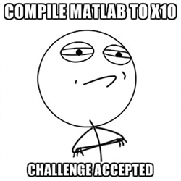
The job’s not easy
MATLAB
no formal language specification
dynamically typed
flexible syntax
unconventional semantics
everything is a matrix
huge builtin library
X10
Object-oriented
Statically typed
Parallel programming
MiX10

Slide 8

What? Under the hood
2
Technical challenges and solutions

Slide 9

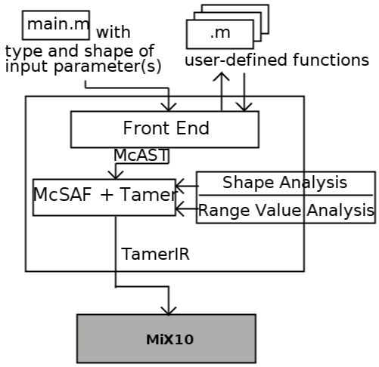

The McLab project overview (recap)

Slide 10
builtins.xml
MiX10 IR generator
Code transformations
Code printer
Builtin handler
Mix10.x10
<Program>.x10
Tamer IR
Callgraph
Analyses
Mix10 IR
Transformed IR
MiX10

Slide 11
Compiling for High Performance
Major Challenges

Slide 12

Key technical challenges
Efficient compilation of arrays
Handling existing MATLAB concurrency controls and introducing new concurrency controls
Efficient framework for handling builtin methods

Slide 13
X10 Arrays
Rail
Intrinsic fixed-size one dimensional array.
Indexed by a Long type value starting at 0.
Similar to a C/C++ array
Abstractions for multi-dimensional arrays
Region arrays
Dynamic and flexible but slow.
Simple arrays
Static and restricted but fast.

Slide 14
X10 Arrays – Simple arrays
Dense rectangular arrays with zero-based indexing.
Support for only up to three dimensions.
Require shape to be defined at compile-time.
Internally elements are backed on a rail in a row-major fashion.
These restrictions allow for efficient optimizations for array indexing.

Slide 15
X10 Arrays – Simple arrays
Default:
Row-major order
Our enhancement:
Column-major order
2D Array
2D Array
(0,0):1 | (0,1):7 | (0,2):8 | (0,3):4
(1,0):-3 | (1,1):6 | (1,2):9 | (1,3):5
(2,0):0 | (2,1):-4 | (2,2):-2 | (2,3):-3
(0,0):1 | (0,1):7 | (0,2):8 | (0,3):4
(1,0):-3 | (1,1):6 | (1,2):9 | (1,3):5
(2,0):0 | (2,1):-4 | (2,2):-2 | (2,3):-3
Rail
…
Rail
…
1 | 7 | 8 | 4 | -3 | 6
1 | -3 | 0 | 7 | 6 | -4

Slide 16
X10 Arrays – Region arrays
Collection of data elements mapped to a collection (region) of indices (points).
A point is an indexing unit of the array, represented by a tuple of integers.
A region is a collection of points of same rank.
A collection of points: Region
Values mapped to region: Array
(3,1) | (2,2) | (-3,1) | (4,0)
(2,5) | (3,2) | (4,7) | (-5,2)
(3,0) | (4,3) | (5,1) | (6,3)
(3,1):1 | (2,2):7 | (-3,1):8 | (4,0):4
(2,5):-3 | (3,2):6 | (4,7):9 | (-5,2):5
(3,0):0 | (4,3):-4 | (5,1):-2 | (6,3):-3

Slide 17
X10 Arrays – Region arrays
Flexibility of shape and indexing.
A rich set of API methods.
No need to declare shape statically.
Flexibility comes at a cost of performance.

Slide 18
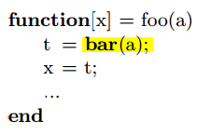
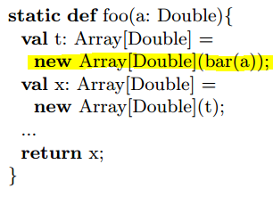
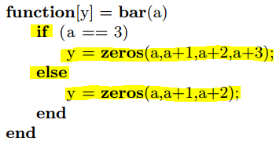
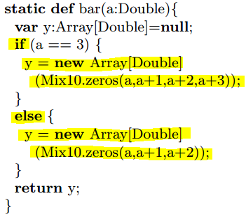
An example
4-D
3-D

Slide 19
Our Strategy
Gather as much static information as possible.
Use simple arrays if shapes of all arrays
Are known statically.
Remain same at all points in the program.
Are supported by X10 simple arrays
Else, use region arrays.
If using region arrays, statically specify arrays’ ranks, if known.
Extend the X10 compiler to provide helper methods for easy sub-array access (use of ‘:’ operator).

Slide 20
X10 Concurrency constructs
Fine-grained concurrency
async S – Create asynchronous concurrent activities.
Sequencing
finish S – Wait for all transitively created concurrent activities by S.
Place-shifting operations
at (P) S – execute S at processing unit P.
Atomicity
atomic S, when (cond) S – Execute S atomically with respect to other atomic statements.

Slide 21
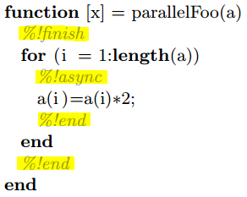
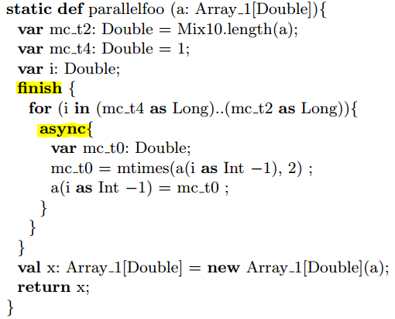
Introducing Concurrency constructs in MATLAB

Slide 22
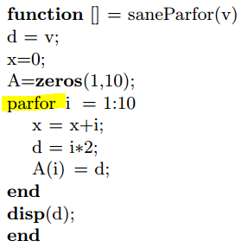
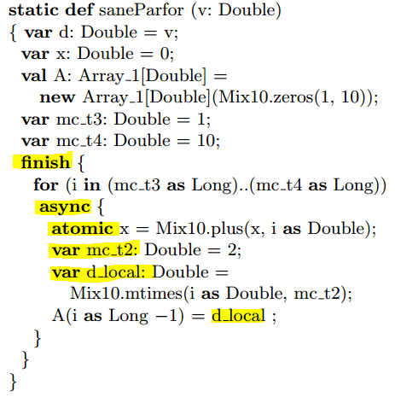
MATLAB parfor
All reduction statements are made atomic.
For any variable that is defined outside the loop and is not a reduction variable, a local copy is made for each concurrent iteration.
Any variable, not defined outside the for loop is declared local to the async block.
Introduce finish and async constructs to control the concurrent flow of execution.

Slide 23
Parallelizing vector instructions
Loop vectorization is a suggested optimization technique in MATLAB to replace loop-based scalar-oriented code by a vector operation.
Depending on the type of operation and size of the vector, we can benefit by breaking down the operation into a set of concurrent operations on parts of the vector.
Operation
Operation

Slide 24
Parallelizing vector instructions
We implement concurrent versions of relevant operations by extending our builtin framework.
Users can use –vec_par_length switch to specify a threshold size of the input vector for all or specific builtins beyond which the concurrent version of the builtin will be invoked.
Example: -vec_par_length all=500 sin=1000 cos=1000 will invoke concurrent version of sin and cos only if size of input vector is >1000. For all other builtins, concurrent version will be invoked for input vector size >500.

Slide 25
Builtin framework – design goals
Provide an easy way to extend for specialized implementations of builtin methods.
Specialization for concurrency.
Specialization for column vector operations .
Provide an easy way for programmers to make custom modifications to builtin implementations.
Keep readability in mind.

Slide 26
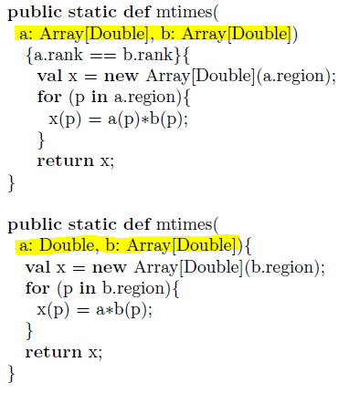
Builtin methods overloading
4 overloaded methods only for real values for region arrays.
Another 4 for complex numbers.

Slide 27
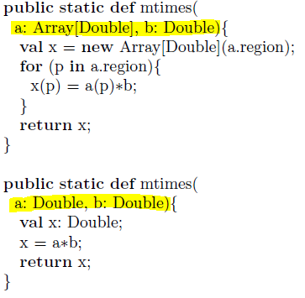
Builtin methods overloading
Different implementations for simple arrays.
Even more implementations for specialized versions.

Slide 28

Should we have all the possible overloaded methods for every builtin used in the generated code ?

Slide 29
That’s what Builtin handler solves!
Template based specialization framework.
Easily extensible for specializations.
Generates only required overloaded versions based on the kind of arrays, specialization used and type of input arguments.
Creates a separate class (Mix10.x10).
Improves readability.
Allows custom modifications.

Slide 30
Wow! Some preliminary results
3

Slide 31
Compilation flow
MiX10
X10c
javac
x10c++
g++
MATLAB
X10
Java, C++
-O, -NO_CHECKS
Managed backend
-O, -NO_CHECKS
Native backend

Slide 32
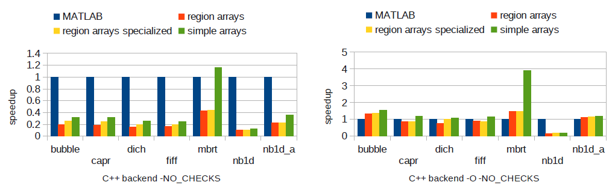
We achieved over 20% performance improvement with X10 sequential code compared to MATLAB.
Builtin specialization is important (nb1d_a).
Complex number operations are really efficient with C++ backend (mbrt).
Native backend(C++)

Slide 33
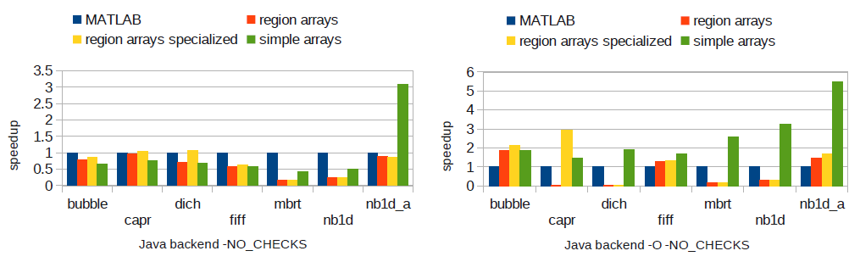
Simple arrays perform much better compared to region arrays for
2-D arrays not involving stencil operations.
Providing static information with region arrays improves performance by around 30%.
(again)Builtin specialization is important to improve performance.
Note capr and dich with –O flag turned on …
Managed backend(Java)

Slide 34


Slide 35
“The JIT is very unhappy”
Optimizer triggered code inlining.
Resultant code too big for JIT compiler to compile and it switched to interpreter.
Static rank declaration eliminated runtime rank checks.
Reduced code size for capr enough for JIT compiler to compile but dich was still too large.
(again) Static rank declaration gave significant performance improvements for other benchmarks (upto 30% depending on number of array accesses)

Slide 36
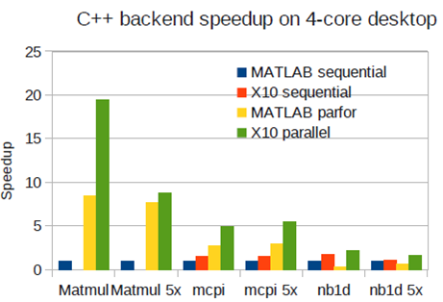
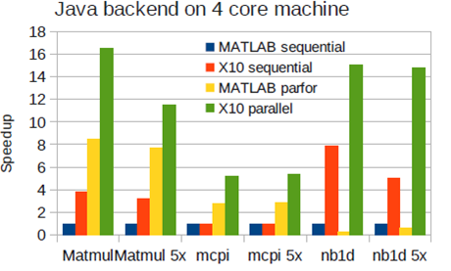
Over 2 to 20 times speedup for C++ and 5 to 16 times speedup for Java compared to sequential MATLAB and around 2 times compared to parallel MATLAB.
Concurrency performance results

Slide 37
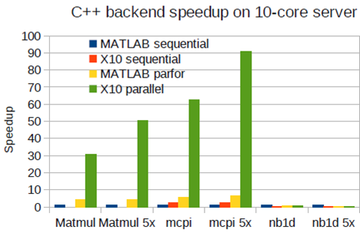
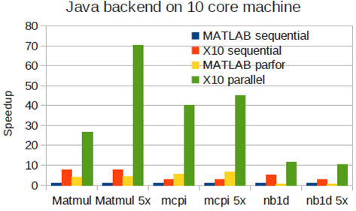
Over 30 to 90 times speedup for C++ and 10 to 70 times speedup for Java compared to sequential MATLAB and compared to parallel MATLAB, around 10 times for C++ and 6 times for Java.
Slowdowns for large number of parallel activities, each with small computation.
Concurrency performance results

Slide 38
Thank You
http://www.sable.mcgill.ca/mclab/mix10.html

Slide 39
Acknowledgements
NSERC for supporting this research, in part
David Grove for helping us validate and understand some results
Anton Dubrau for his help in using Tamer
Xu Li for providing valuable suggestions

Slide 40
McSAF Static Analysis Framework
function[x,y] = rgbFilter(h,w,c,p,g)
% h : height of the image
% w : width of the image
% c : colour of the filter
% p : pixel matrix of the image
% g : gradient factor
filter=ones(h,w);
filter=filter*c;
%applyFilter=filter;
%x = i;
for i=1:w
x = p(:,i);
x = x+gradient(w,g);
end
x = p;
y = applyFilter(p,filter);
end
McSAF
function[x,y] = rgbFilter(h,w,c,p,g)
% h : height of the image
% w : width of the image
% c : colour of the filter
% p : pixel matrix of the image
% g : gradient factor
filter=ones(h,w);
filter=filter*c;
%applyFilter=filter;
x = i;
% for i=1:w
%x = p(:,i);
%x = x+gradient(w,g);
%end
x = p;
y = applyFilter(p,filter);
end
What happens if we uncomment
%applyFilter=filter; ?
A low-level IR
Kind analysis
Is this an error ?
No, it’s a call to the builtin i();
y = applyFilter(p,filter); becomes an array access

Slide 41
Tamer
Tamer
function[x,y] = rgbFilter(h,w,c,p,g)
% h : height of the image
% w : width of the image
% c : colour of the filter
% p : pixel matrix of the image
% g : gradient factor
filter=ones(h,w);
filter=filter*c;
%applyFilter=filter;
%x = i;
for i=1:w
x = p(:,i);
x = x+gradient(w,g);
end
x = p;
y = applyFilter(p,filter);
end
Very low-level IR
Callgraph
Type analysis
Shape analysis
IsComplex analysis

Slide 42
X10 as a target language
Nice X10 features

Slide 43
The type ‘Any’
function[x,y] = rgbFilter(h,w,c,p,g)
% h : height of the image
% w : width of the image
% c : colour of the filter
% p : pixel matrix of the image
% g : gradient factor
filter=ones(h,w);
filter=filter .* c;
%applyFilter=filter;
%x = i;
for i=1:w
x = p(:,i);
x = x+gradient(w,g);
end
x = p;
y = applyFilter(p,filter);
end
return [x as Any, y as Any];
Same idea also used for Cell Arrays

Slide 44
Point and Region API
function[x,y] = rgbFilter(h,w,c,p,g)
% h : height of the image
% w : width of the image
% c : colour of the filter
% p : pixel matrix of the image
% g : gradient factor
filter=ones(h,w);
filter=filter .* c;
%applyFilter=filter;
%x = i;
for i=1:w
x = p(:,i);
x = x+gradient(w,g);
end
x = p;
y = applyFilter(p,filter);
end
mix10_pt_p = Point.make(0, 1-(i as Int));
mix10_ptOff_p = p;
x = new Array[Double](
((p.region.min(0))..(p.region.max(0)))*(1..1),
(pt:Point(2))=>
mix10_ptOff_p(pt.operator-(mix10_pt_p)));
mix10_pt_p = Point.make(0, 1-(i as Int));
mix10_ptOff_p = p;
x = new Array[Double](
((p.region.min(0))..(p.region.max(0)))*(1..1),
(p:Point(2))=>
mix10_ptOff_p(p.operator-(mix10_pt_p)));
Works even when shape is unknown at compile time

Slide 45
Native backend

Slide 46
Managed backend

Slide 47
MATLAB
Aspect MATLAB
Frontend
McSAF
Tamer
Fortran backend
Dynamic analysis
McVM
X10 backend
McIR
McSAF IR, Kind analysis
Tame IR, Callgraph, Analyses
The McLab project overview

Slide 48
Source code
function[x,y] = rgbFilter(h,w,c,p,g)
% h : height of the image
% w : width of the image
% c : colour of the filter
% p : pixel matrix of the image
% g : gradient factor
filter=ones(h,w);
filter=filter*c;
%applyFilter=filter;
%x = i;
for i=1:w
x = p(:,i);
x = x+gradient(w,g);
end
x = p;
y = applyFilter(p,filter);
end
Apply gradient and filter to an image
Create a filter
Apply gradient
Apply filter

Slide 49
McSAF Static Analysis Framework
function[x,y] = rgbFilter(h,w,c,p,g)
% h : height of the image
% w : width of the image
% c : colour of the filter
% p : pixel matrix of the image
% g : gradient factor
filter=ones(h,w);
filter=filter*c;
%applyFilter=filter;
%x = i;
for i=1:w
x = p(:,i);
x = x+gradient(w,g);
end
x = p;
y = applyFilter(p,filter);
end
McSAF
function[x,y] = rgbFilter(h,w,c,p,g)
% h : height of the image
% w : width of the image
% c : colour of the filter
% p : pixel matrix of the image
% g : gradient factor
filter=ones(h,w);
filter=filter*c;
%applyFilter=filter;
x = i;
% for i=1:w
%x = p(:,i);
%x = x+gradient(w,g);
%end
x = p;
y = applyFilter(p,filter);
end
Low level IR
Kind analysis
Is a parameterized expression array or function call ?

Slide 50
Tamer
Tamer
function[x,y] = rgbFilter(h,w,c,p,g)
% h : height of the image
% w : width of the image
% c : colour of the filter
% p : pixel matrix of the image
% g : gradient factor
filter=ones(h,w);
filter=filter*c;
%applyFilter=filter;
%x = i;
for i=1:w
x = p(:,i);
x = x+gradient(w,g);
end
x = p;
y = applyFilter(p,filter);
end
What are the types of h, w, c, p and g ?
Is ones(h,w) builtin or
user-defined?
What is the shape of filter ?
Is g real or complex ?
What are the types of x and y ?

Slide 51
MATLAB
Aspect MATLAB
Frontend
McSAF
Tamer
Fortran backend
Dynamic analysis
McVM
X10 backend
McIR
McSAF IR, Kind analysis
Tame IR, Callgraph, Analyses
The McLab project overview

Slide 52
X10 Arrays
“Rail” is the intrinsic fixed-size one dimensional array, indexed by a Long type value starting at 0.
Simple arrays
Dense rectangular arrays with zero-based indexing.
Support only upto three dimensions.
Internally elements are backed on a rail in a row-major fashion.
These restrictions allow for efficient optimizations for array indexing.
Region arrays
A region is a collection of points of same rank.
A point is an indexing unit of the array.
A region array is a set of elements mapped to points in the underlying region.
Flexibility of shape and indexing.
Flexibility comes at a cost of performance.

Slide 53
Benchmarks
bubble - bubble sort
capr - computes the capacitance per unit length of a coaxial pair of rectangles
dich - ﬁnds the Dirichlet solution to Laplace’s equation
fiff - a ﬁnite diﬀerence solution to a wave equation
mbrt - computes a mandelbrot set
nb1d - simulates the gravitational movement of a set of objects in 1 dimension

Slide 54
In this talk
1
2
3
WHY?
WHAT?
WOW!

