Slide 1
Experiences with implementing lightweight synchronization in Java by using the new Intel Haswell Transactional Memory features
Yi Zhang, Nikola Grcevski
(IBM Canada)

Slide 2
Motivation
HLE & Implementation in JIT
RTM & Implementation In JIT
Performance Results
Summary & Future Work

Slide 3
Motivation
Coarse-grained VS Fine-grained Lock

Slide 4
Motivation
Coarse-grained VS Fine-grained Lock
Lock

Slide 5
Motivation
Coarse-grained VS Fine-grained Lock
  Coarse-grained: not efficient, hard to scale
Lock

Slide 6
Motivation
Coarse-grained VS Fine-grained Lock
  Coarse-grained: not efficient, hard to scale
Lock
Lock
Lock
Lock
Lock

Slide 7
Motivation
Coarse-grained VS Fine-grained Lock
  Coarse-grained: not efficient, hard to scale
  Fine-grained: efficient, more complicated->deadlock
Lock
Lock
Lock
Lock
Lock

Slide 8
Motivation
Coarse-grained VS Fine-grained Lock
  Coarse-grained: not efficient, hard to scale
  Fine-grained: efficient, more complicated->deadlock

Slide 9
Motivation
Coarse-grained VS Fine-grained Lock
  Coarse-grained: not efficient, hard to scale
  Fine-grained: efficient, more complicated->deadlock
Overhead of Java Monitor
  Most are not real conflicts

Slide 10
Motivation
Coarse-grained VS Fine-grained Lock
  Coarse-grained: not efficient, hard to scale
  Fine-grained: efficient, more complicated->deadlock
Overhead of Java Monitor
  Most are not real conflicts
Read vs Read
synchronized (a) {
c = a.b;
}

Slide 11
Motivation
Coarse-grained VS Fine-grained Lock
  Coarse-grained: not efficient, hard to scale
  Fine-grained: efficient, more complicated->deadlock
Overhead of Java Monitor
  Most are not real conflicts
Write vs Write
synchronized (a) {
a.b2 = 20
}
synchronized (a) {
a.b1 = 10;
}

Slide 12
Motivation
Lock-based

Slide 13


Motivation
Lock-based

Slide 14
Motivation
Lock-based
transactional memory

Slide 15
Motivation
Lock-based
transactional memory

Slide 16

Motivation
Lock-based
What about
correctness?
transactional memory

Slide 17
Motivation
Transactional Memory (with Intel's extension)
T1
T2
T3
Transactional region

Slide 18

Motivation
Transactional Memory (with Intel's extension)
T1
T2
T3
Transactional region

Slide 19

Motivation
Transactional Memory (with Intel's extension)
T1
T2
T3
Transactional region

Slide 20
Motivation
Transactional Memory (with Intel's extension)
T1
T2
T3
Transactional region

Slide 21
Motivation
Transactional Memory (with Intel's extension)
  More efficient than coarse-grained lock
Transactional region

Slide 22
Motivation
Transactional Memory (with Intel's extension)
  More efficient than coarse-grained lock
  No deadlock as in fine-grained lock, and even more accurate
Transactional region

Slide 23
Motivation
HLE & Implementation in JIT
RTM & Implementation In JIT
Performance Results
Summary & Future Work

Slide 24
--- HLE (Hardware Lock Elision)
Intel Transactional Synchronization Extensions
Instruction prefix XAQUIRE/XRELEASE

Slide 25
--- HLE (Hardware Lock Elision)
Intel Transactional Synchronization Extensions
Instruction prefix XAQUIRE/XRELEASE
monEnter
monExit
…
cmpxchg lockword, currentThreadId
...
…
cmpxchg lockword, 0, currentThreadId
…
mov lockword, 0
...

Slide 26
Intel Transactional Synchronization Extensions
--- HLE (Hardware Lock Elision)
Instruction prefix XAQUIRE/XRELEASE
monEnter
monExit
…
cmpxchg lockword, currentThreadId
...
…
cmpxchg lockword, 0, currentThreadId
...
xacquire
…
mov lockword, 0
...

Slide 27
Intel Transactional Synchronization Extensions
--- HLE (Hardware Lock Elision)
Instruction prefix XAQUIRE/XRELEASE
monEnter
monExit
…
cmpxchg lockword, currentThreadId
...
…
cmpxchg lockword, 0, currentThreadId
...
xacquire
…
mov lockword, 0
...
xrelease

Slide 28
Intel Transactional Synchronization Extensions
--- HLE (Hardware Lock Elision)
Instruction prefix XAQUIRE/XRELEASE
monEnter
monExit
…
cmpxchg lockword, currentThreadId
...
…
cmpxchg lockword, 0, currentThreadId
...
xacquire
…
mov lockword, 0
...
xrelease

Slide 29
Intel Transactional Synchronization Extensions
--- HLE (Hardware Lock Elision)
Instruction prefix XAQUIRE/XRELEASE
monEnter
monExit
…
cmpxchg lockword, currentThreadId
...
…
cmpxchg lockword, 0, currentThreadId
...
…
mov lockword, 0
...

Slide 30
Intel Transactional Synchronization Extensions
--- HLE (Hardware Lock Elision)
Instruction prefix XAQUIRE/XRELEASE
Lockword not zero
…
cmpxchg lockword, currentThreadId
...
…
cmpxchg lockword, 0, currentThreadId
...
xacquire

Slide 31
Intel Transactional Synchronization Extensions
--- HLE (Hardware Lock Elision)
Instruction prefix XAQUIRE/XRELEASE
Lockword not zero
…
cmpxchg lockword, currentThreadId
...
…
cmpxchg lockword, 0, currentThreadId
...
xacquire
Lockword != 0

Slide 32
Intel Transactional Synchronization Extensions
--- HLE (Hardware Lock Elision)
Instruction prefix XAQUIRE/XRELEASE
Lockword not zero ---> Cascade failure

Slide 33
Intel Transactional Synchronization Extensions
--- HLE (Hardware Lock Elision)
Instruction prefix XAQUIRE/XRELEASE
Lockword not zero ---> Cascade failure

Slide 34
Intel Transactional Synchronization Extensions
--- HLE (Hardware Lock Elision)
Instruction prefix XAQUIRE/XRELEASE
monEnter
monExit
…
cmpxchg lockword, currentThreadId
...
…
cmpxchg lockword, 0, currentThreadId
...
…
mov lockword, 0
...

Slide 35
Intel Transactional Synchronization Extensions
--- HLE (Hardware Lock Elision)
Instruction prefix XAQUIRE/XRELEASE
monEnter
monExit
…
cmpxchg lockword, currentThreadId
...
…
cmpxchg lockword, 0, currentThreadId
...
…
mov lockword, 0
...

Slide 36
Intel Transactional Synchronization Extensions
--- HLE (Hardware Lock Elision)
Instruction prefix XAQUIRE/XRELEASE
SpinLabel:
pause
cmp lockword, 0
jne spinLabel
monEnter
monExit
…
cmpxchg lockword, currentThreadId
...
…
cmpxchg lockword, 0, currentThreadId
...
xacquire
…
mov lockword, 0
...
xrelease

Slide 37
Intel Transactional Synchronization Extensions
--- HLE (Hardware Lock Elision)
Instruction prefix XAQUIRE/XRELEASE
Pros: easy implementation, backward compatible

Slide 38
Intel Transactional Synchronization Extensions
--- HLE (Hardware Lock Elision)
Instruction prefix XAQUIRE/XRELEASE
Pros: easy implementation, backward compatible
Cons: Switch to non-transactional execution, no retry

Slide 39
Motivation
HLE & Implementation in JIT
RTM & Implementation In JIT
Performance Results
Summary & Future Work

Slide 40
--- RTM (Restricted Transactional Memory)

Slide 41
New instructions: xbegin, xend
--- RTM (Restricted Transactional Memory)
monEnter
monExit

Slide 42
New instructions: xbegin, xend
--- RTM (Restricted Transactional Memory)
xbegin fallbackLabel
monEnter
monExit
xend

Slide 43
New instructions: xbegin, xend
--- RTM (Restricted Transactional Memory)
xbegin fallbackLabel
monEnter
monExit
FallbackLabel:
Handle different failures base on eax
xend

Slide 44
New instructions: xbegin, xend
Handle transient and persistent failure
  Check eax value
--- RTM (Restricted Transactional Memory)

Slide 45
New instructions: xbegin, xend
Handle transient and persistent failure
  Check eax value
  Persistent Failure: ( no write back cacheable)
    Instruction: CPUID, PAUSE, etc.
    IO access
--- RTM (Restricted Transactional Memory)

Slide 46
New instructions: xbegin, xend
Handle transient and persistent failure
  Check eax value
  Persistent Failure: ( no write back cacheable)
    Instruction: CPUID, PAUSE, etc.
    IO access
  Transient Failure:
    Conflicts
    Context switch
    Transactional cache overflow
--- RTM (Restricted Transactional Memory)

Slide 47
--- RTM (Restricted Transactional Memory)
# core: 4
# thread: 16
array accesses: write(%5), read(95%)
synchronized (a) {
a.[i] = M;
}
synchronized (a) {
M = a.[i];
}

Slide 48
--- RTM (Restricted Transactional Memory)
# core: 4
# thread: 16
array accesses: write(%5), read(95%)
Lower is better

Slide 49

New instructions: xbegin, xend
Handle transient and persistent failure
  Check eax value
--- RTM (Restricted Transactional Memory)
retry count

Slide 50
New instructions: xbegin, xend
Handle transient and persistent failure
  Check eax value
--- RTM (Restricted Transactional Memory)
Slow path length
retry count

Slide 51
New instructions: xbegin, xend
Handle transient and persistent failure
  Check eax value
--- RTM (Restricted Transactional Memory)
Slow path length
retry count
failure rate

Slide 52
Motivation
HLE & Implementation in JIT
RTM & Implementation In JIT
Performance Results
Summary & Future Work

Slide 53
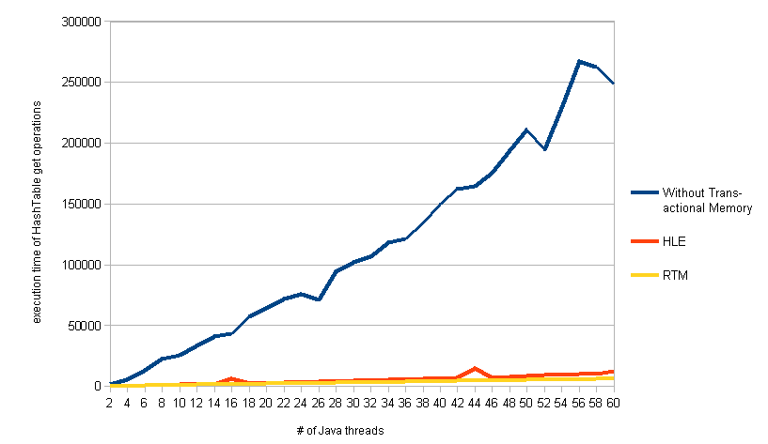
Performance Results
Micro-benchmark with java/util/Hashtable.get
Lower is better

Slide 54
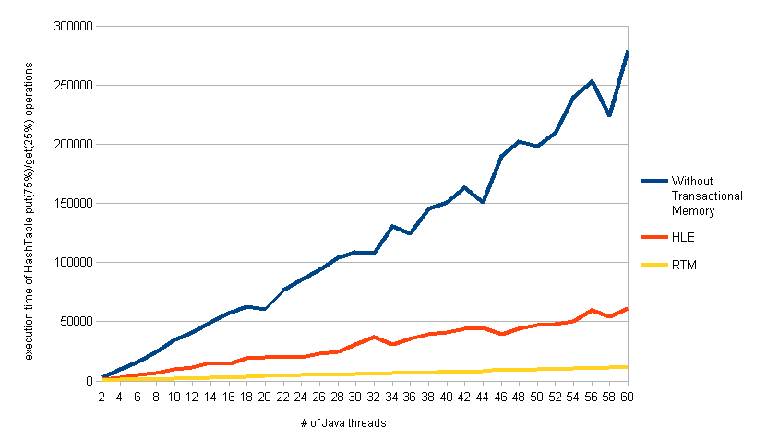
Performance Results
Micro-benchmark with java/util/Hashtable.get(25%) and java/util/Hashtable.put(75%)
Lower is better

Slide 55
Motivation
HLE & Implementation in JIT
RTM & Implementation In JIT
Performance Results
Summary & Future Work

Slide 56
Summary
Intel's Transactional Memory Extension
how to implement transactional execution in Just-in-Time java compiler.
Transactional memory can be more effective than lock based synchronization and has good scalability
Penalty of transaction aborts

Slide 57


Summary
Intel's Transactional Memory Extension
how to implement transactional execution in Just-in-Time java compiler.
Transactional memory can be more effective than lock based synchronization and has good scalability
Penalty of transaction aborts
Lock-based
Transactional memory

Slide 58
Future Work
Implement transactional memory version of some special java method
Speculative execution optimization

Slide 59
"Transactional Synchronization in Haswell". http://software.intel.com/en-us/blogs/2012/02/07/transactional-synchronization-in-haswell
"Intel(r) Transactional Synchronization Extensions (Intel(r) TSX) profiling with Linux". perfhttp://software.intel.com/en-us/blogs/2013/05/03/intelr-transactional-synchronization-extensions-intelr-tsx-profiling-with-linux-0
Intel® Architecture Instruction Set Extensions Programming Reference

Slide 60

"Transactional Synchronization in Haswell". http://software.intel.com/en-us/blogs/2012/02/07/transactional-synchronization-in-haswell
"Intel(r) Transactional Synchronization Extensions (Intel(r) TSX) profiling with Linux". perfhttp://software.intel.com/en-us/blogs/2013/05/03/intelr-transactional-synchronization-extensions-intelr-tsx-profiling-with-linux-0
Intel® Architecture Instruction Set Extensions Programming Reference

