Slide 1
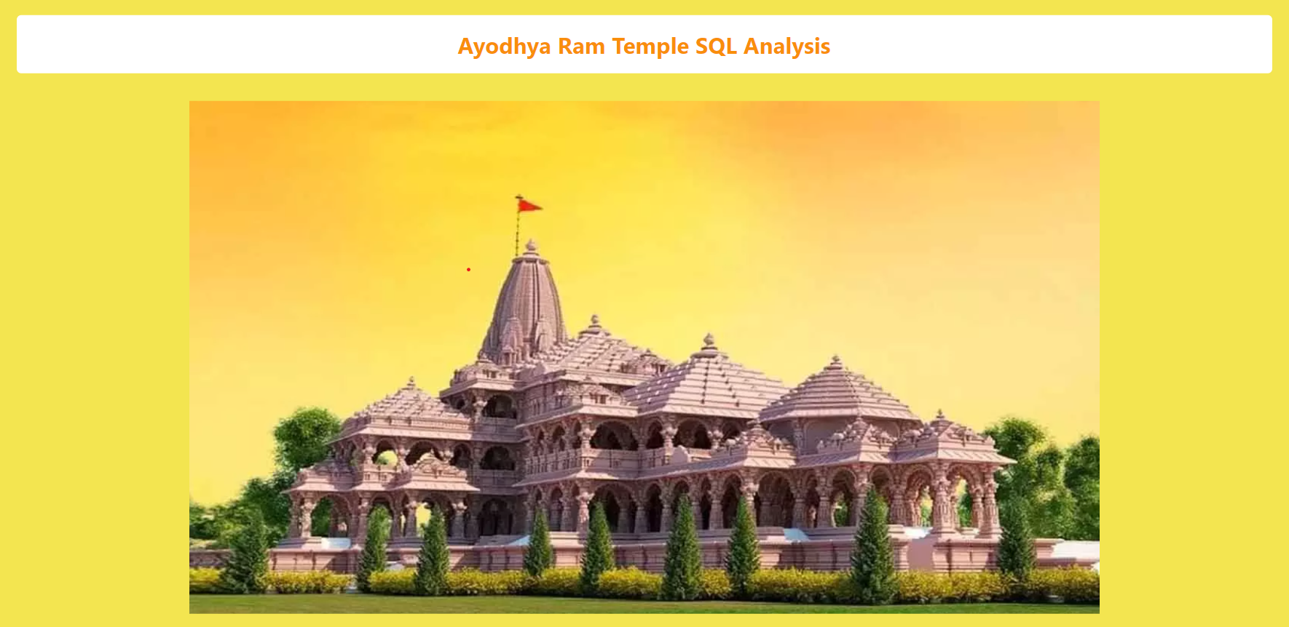
Designed & Developed By:-
Jnanaranjan Pradhan

Slide 2
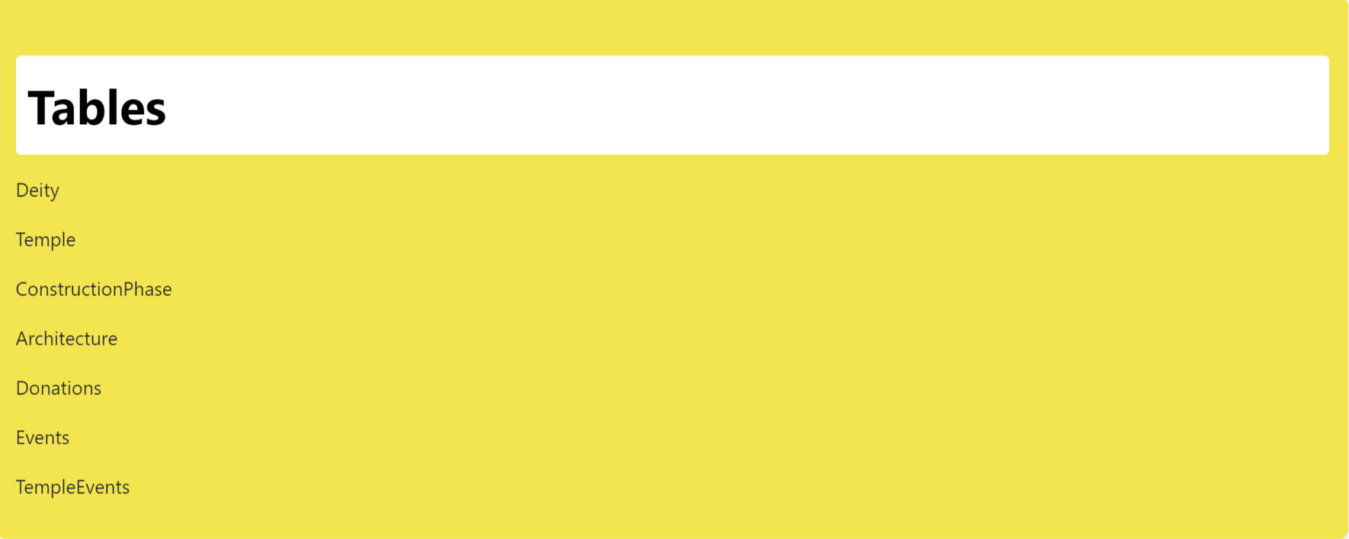

Slide 3
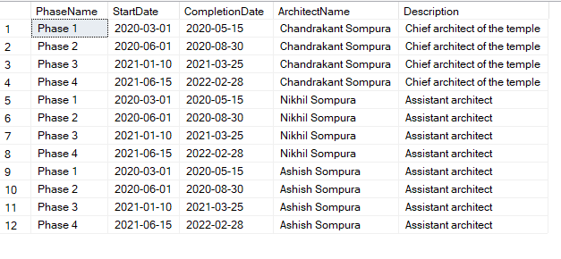
1)Retrieve information about the Ram Mandir?
select * from Temple
2)List all construction phases for the Ram Mandir?
select c.PhaseName,c.StartDate,c.CompletionDate,a.ArchitectName,a.Description
from ConstructionPhase as c inner join Architecture as a on c.TempleID=a.TempleID

Slide 4

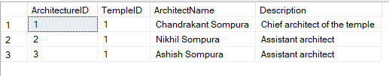
3)Find the total amount of donations received for the Ram Mandir?
select sum(Amount) as Total_donation from Donations
4)Get details about the architecture of the Ram Mandir?
select * from Architecture

Slide 5

5)Retrieve events associated with the Ram Mandir?
select tv.*,e.* from TempleEvents as tv inner join Events as e on tv.EventID=e.EventID
6)Find donors who contributed more than 50000 towards the Ram Mandir?
select * from Donations where Amount>50000

Slide 6
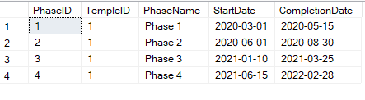
7)Retrieve details about a specific deity (e.g., Rama) ?
select * from Deity where Name='rama'
8)Find the start and end dates of the construction phases for the Ram Mandir?
select * from ConstructionPhase

Slide 7

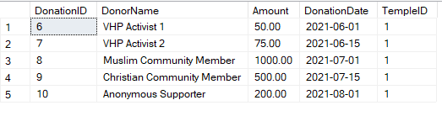
9)Count the number of events associated with each temple?
select count(EventID) as number_of_events from Events
10)Find the donors who made contributions on or after 2021-06-01'?
select * from Donations where DonationDate>='2021-06-01'

Slide 8

